Slide 1
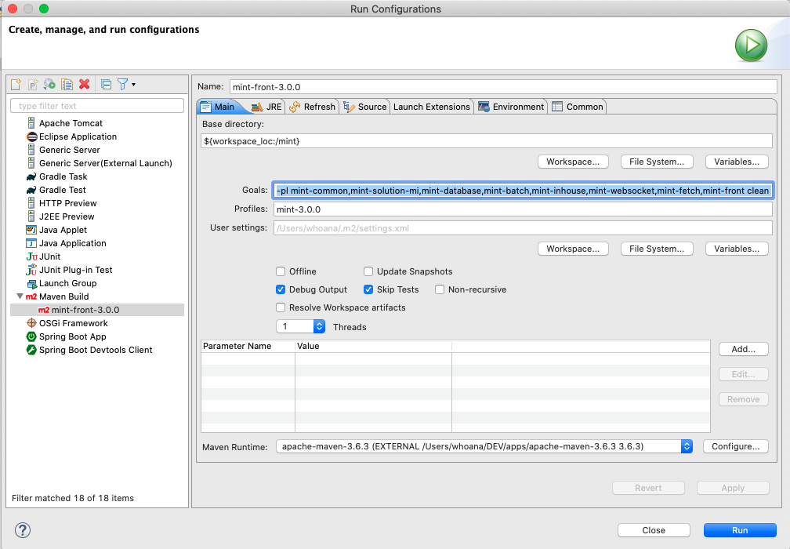
How to Run Maven build mint
Goals: -pl mint-common,mint-solution-mi,mint-database,mint-batch,mint-inhouse,mint-websocket,mint-fetch,mint-front clean package
Profiles:mint-3.0.0

