Slide 1
Force Gaming
Web and Cloud Application
By Mark O’Connor, John Nash and Cathal Peelo

Slide 2
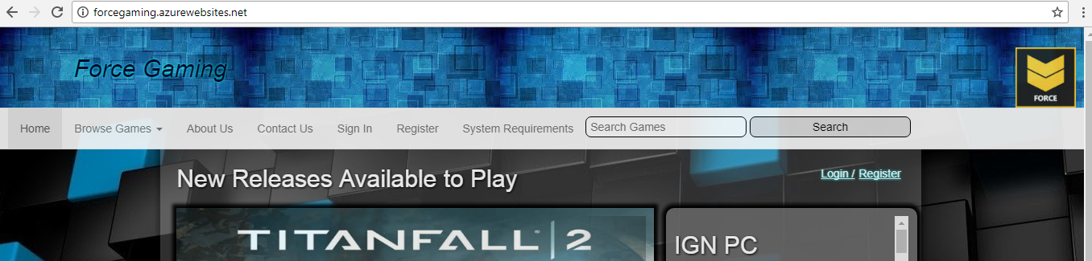
Viewable on: forcegaming.azurewebsites.net
Business Case and Objectives
Target Audience
Design Strategy

Slide 3
Business Case and Objectives
Third party video game library subscription service
Individual titles are not purchased
Simple business model -members pay flat monthly fee for unlimited access

Slide 4
Target Audience
Subscription model has become popular
Gamers (typically between 14-40, need decent quality PC)
No sunk cost if game does not live up to expectations

Slide 5
Design Strategy
Users can browse games – by search, genre or scrolling through library
If users wish to add a game to their list, it is placed in their account for easy access
RSS feed encourages users to return – future plans could include message board for user feedback/interaction

Slide 6
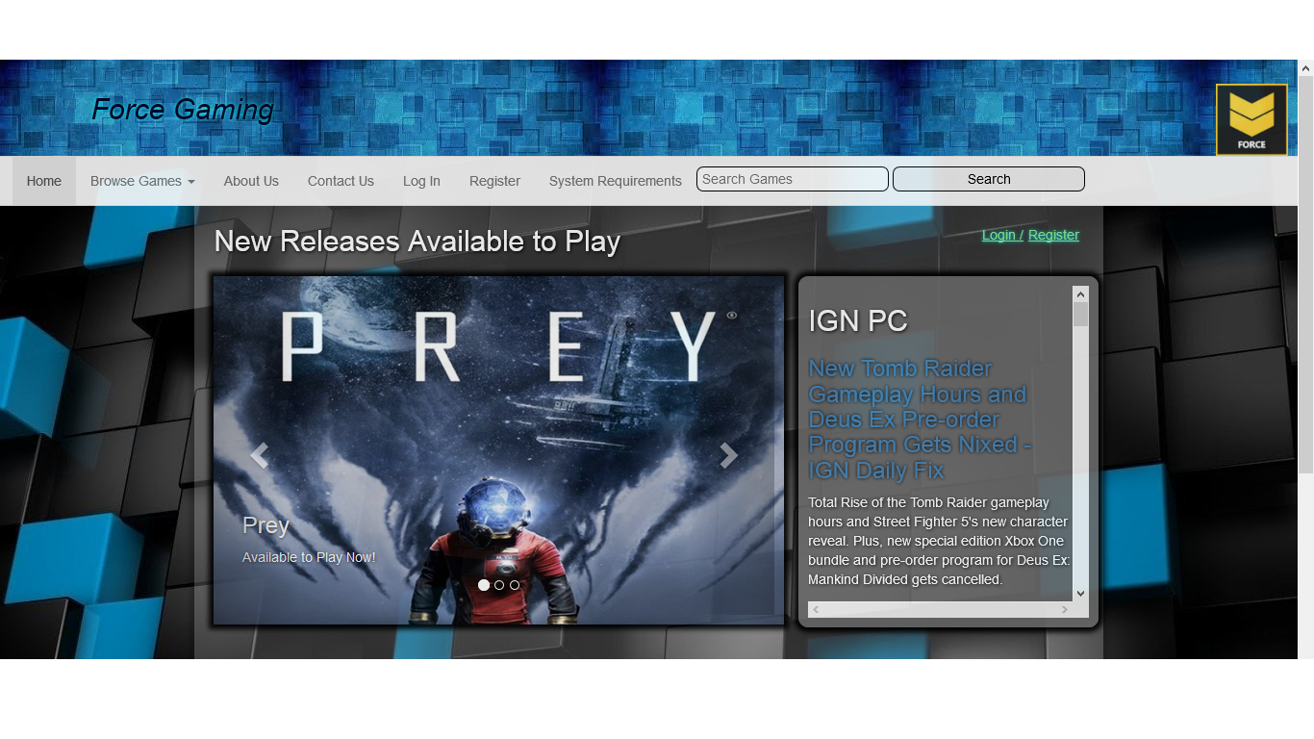

Slide 7
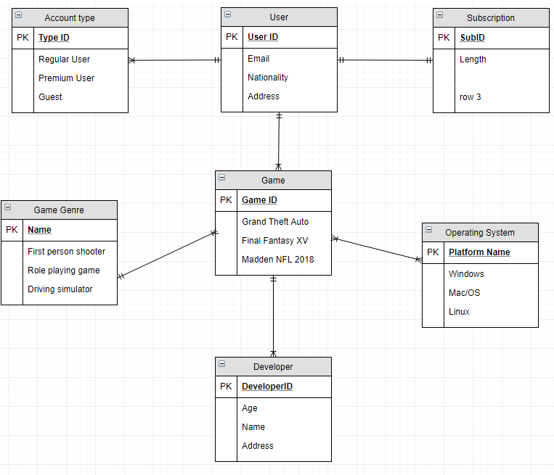
Database Design: First Steps

Slide 8
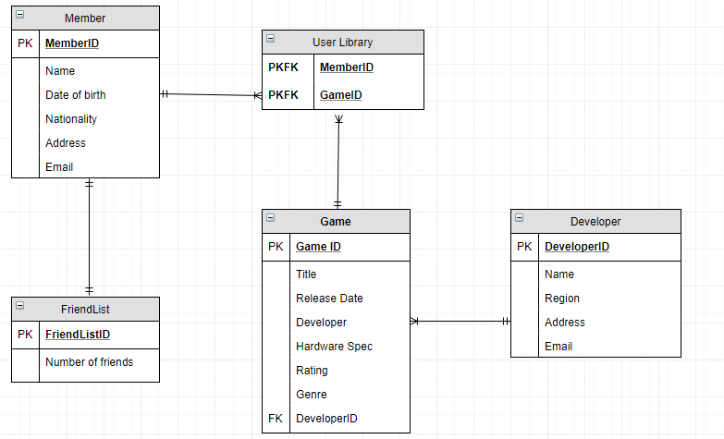
Database Design: Final Structure

Slide 9
Search Engine Optimisation
Unique titles
Description meta tag
Intelligible alt tags
Simple URLs
Semantically significant anchor text

Slide 10
Technologies
Azure cloud hosting
ASP.NET
Bootstrap
JQuery

Slide 11
Strengths
Relatively horizontal structure
User-friendly

Slide 12
Room for Improvement
Maintenance - a dev team will be needed
Possible integration of XML and SQL databases
Connecting Contact Us section with the databases

Slide 13
Thank you for watching!
Any questions?

