Slide 1
Chapter 9 | Oceans and Marine Resources

Slide 2
Ch. 9 | Oceans and Marine Resources
9
Key Message #1
Ocean Ecosystems
The Nation’s valuable ocean ecosystems are being disrupted by increasing global temperatures through the loss of iconic and highly valued habitats and changes in species composition and food web structure. Ecosystem disruption will intensify as ocean warming, acidification, deoxygenation, and other aspects of climate change increase. In the absence of significant reductions in carbon emissions, transformative impacts on ocean ecosystems cannot be avoided.

Slide 3
Ch. 9 | Oceans and Marine Resources
9
Key Message #2
Marine Fisheries
Marine fisheries and fishing communities are at high risk from climate-driven changes in the distribution, timing, and productivity of fishery-related species. Ocean warming, acidification, and deoxygenation are projected to increase these changes in fishery-related species, reduce catches in some areas, and challenge effective management of marine fisheries and protected species. Fisheries management that incorporates climate knowledge can help reduce impacts, promote resilience, and increase the value of marine resources in the face of changing ocean conditions.

Slide 4
Ch. 9 | Oceans and Marine Resources
9
Key Message #3
Extreme Events
Marine ecosystems and the coastal communities that depend on them are at risk of significant impacts from extreme events with combinations of very high temperatures, very low oxygen levels, or very acidified conditions. These unusual events are projected to become more common and more severe in the future, and they expose vulnerabilities that can motivate change, including technological innovations to detect, forecast, and mitigate adverse conditions.

Slide 5
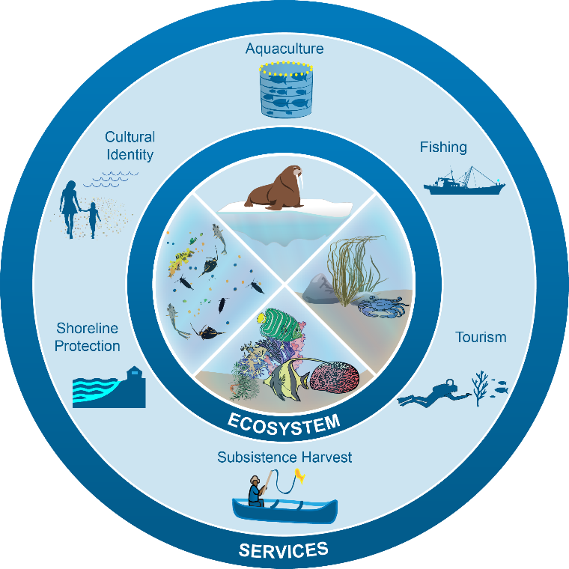
Fig. 9.1: Marine Ecosystem Services
Ch. 9 | Oceans and Marine Resources
The diagram shows some marine ecosystems (center) and the services they provide to human communities (outer ring). Marine ecosystems in the United States range from tropical coral reefs (center bottom) to sea ice ecosystems in the Arctic (center top). They also include ecosystems with freely drifting plankton (center left) and with animals and seaweed that live on the ocean bottom (center right). Climate change is disrupting the structure and function of marine ecosystems in the United States and altering the services they provide to people. These services include food from fishing (commercial, recreational, and subsistence harvest) and aquaculture, economic benefits from tourism, protection of coastal property from storms, and nonmarket goods such as the cultural identity of coastal communities. Source: NOAA.

Slide 6
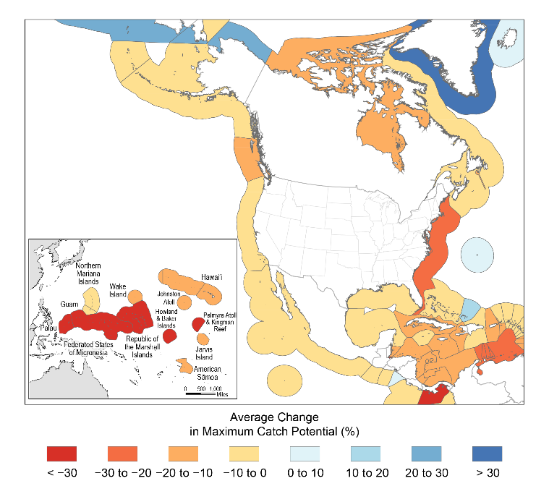
Fig. 9.2: Projected Changes in Maximum Fish Catch Potential
Ch. 9 | Oceans and Marine Resources
The figure shows average projected changes in fishery catches within large marine ecosystems for 2041–2060 relative to 1991–2010 under a higher scenario (RCP8.5). All U.S. large marine ecosystems, with the exception of the Alaska Arctic, are expected to see declining fishery catches. Source: adapted from Lam et al. 2016.⁹⁶
Notes:
96: Lam, V.W.Y., W.W.L. Cheung, G. Reygondeau, and U.R. Sumaila, 2016: Projected change in global fisheries revenues under climate change. Scientific Reports, 6, Art. 32607. http://dx.doi.org/10.1038/srep32607

Slide 7
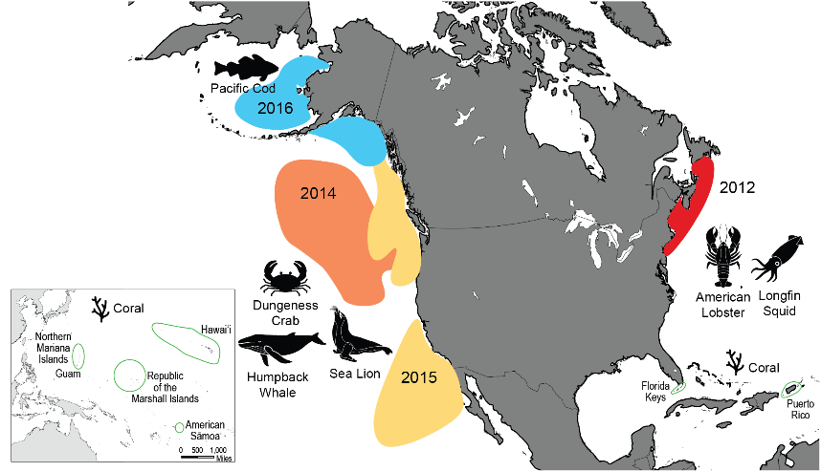
Fig. 9.3: Extreme Events in U.S. Waters Since 2012
Ch. 9 | Oceans and Marine Resources
The 2012 North Atlantic heat wave was concentrated in the Gulf of Maine; however, shorter periods with very warm temperatures extended from Cape Hatteras to Iceland during the summer of 2012. American lobster and longfin squid and their associated fisheries were impacted by the event.¹ The North Pacific event began in 2014² and extended into shore in 2015^{3,4} and into the Gulf of Alaska in 2016,^{5,6} leading to a large bloom of toxic algae that impacted the Dungeness crab fishery and contributed directly and indirectly to deaths of sea lions and humpback whales. U.S. coral reefs that experienced moderate to severe bleaching during the 2015–2016 global mass bleaching event⁷ are indicated by coral icons. Source: Gulf of Maine Research Institute.
Notes:
1. Mills, K.E., A.J. Pershing, C.J. Brown, Y. Chen, F.-S. Chiang, D.S. Holland, S. Lehuta, J.A. Nye, J.C. Sun, A.C. Thomas, and R.A. Wahle, 2013: Fisheries management in a changing climate: Lessons from the 2012 ocean heat wave in the northwest Atlantic. Oceanography, 26 (2), 191–195. http://dx.doi.org/10.5670/oceanog.2013.27
2. Bond, N.A., M.F. Cronin, H. Freeland, and N. Mantua, 2015: Causes and impacts of the 2014 warm anomaly in the NE Pacific. Geophysical Research Letters, 42 (9), 3414-3420. http://dx.doi.org/10.1002/2015GL063306
3. Di Lorenzo, E. and N. Mantua, 2016: Multi-year persistence of the 2014/15 North Pacific marine heatwave. Nature Climate Change, 6, 1042-1047. http://dx.doi.org/10.1038/nclimate3082
4. McCabe, R.M., B.M. Hickey, R.M. Kudela, K.A. Lefebvre, N.G. Adams, B.D. Bill, F.M.D. Gulland, R.E. Thomson, W.P. Cochlan, and V.L. Trainer, 2016: An unprecedented coastwide toxic algal bloom linked to anomalous ocean conditions. Geophysical Research Letters, 43 (19), 10,366-10,376. http://dx.doi.org/10.1002/2016GL070023
5. Walsh, J.E., R.L. Thoman, U.S. Bhatt, P.A. Bieniek, B. Brettschneider, M. Brubaker, S. Danielson, R. Lader, F. Fetterer, K. Holderied, K. Iken, A. Mahoney, M. McCammon, and J. Partain, 2018: The high latitude marine heat wave of 2016 and its impacts on Alaska. Bulletin of the American Meteorological Society, 99 (1), S39-S43. http://dx.doi.org/10.1175/BAMS-D-17-0105.1
6. Oliver, E.C.J., S.E. Perkins-Kirkpatrick, N.J. Holbrook, and N.L. Bindoff, 2018: Anthropogenic and natural influences on record 2016 marine heat waves. Bulletin of the American Meteorological Society, 99 (1), S44-S48. http://dx.doi.org/10.1175/bams-d-17-0093.1
7. Hughes, T.P., K.D. Anderson, S.R. Connolly, S.F. Heron, J.T. Kerry, J.M. Lough, A.H. Baird, J.K. Baum, M.L. Berumen, T.C. Bridge, DC Claar, C.M. Eakin, J.P. Gilmour, N.A.J. Graham, H. Harrison, J.-P.A. Hobbs, A.S. Hoey, M. Hoogenboom, R.J. Lowe, M.T. McCulloch, J.M. Pandolfi, M. Pratchett, V. Schoepf, G. Torda, and S.K. Wilson, 2018: Spatial and temporal patterns of mass bleaching of corals in the Anthropocene. Science, 359 (6371), 80-83. http://dx.doi.org/10.1126/science.aan8048

Slide 8
Ch. 9 | Oceans and Marine Resources
9
Chapter Author Team
Federal Coordinating Lead Authors
Roger B. Griffis, National Oceanic and Atmospheric Administration
Elizabeth B. Jewett, National Oceanic and Atmospheric Administration
Chapter Lead
Andrew J. Pershing, Gulf of Maine Research Institute
Chapter Authors
C. Taylor Armstrong, National Oceanic and Atmospheric Administration
John F. Bruno, University of North Carolina at Chapel Hill
D. Shallin Busch, National Oceanic and Atmospheric Administration
Alan C. Haynie, National Oceanic and Atmospheric Administration
Samantha A. Siedlecki, University of Washington (now at University of Connecticut)
Desiree Tommasi, University of California, Santa Cruz
Review Editor
Sarah R. Cooley, Ocean Conservancy

Slide 9
Ch. 9 | Oceans and Marine Resources
9
Acknowledgments
Technical Contributor
Vicky W. Y. Lam, University of British Columbia
USGCRP Coordinators
Fredric Lipschultz, Senior Scientist and Regional Coordinator
Apurva Dave, International Coordinator and Senior Analyst

Slide 10
Pershing, A.J., R.B. Griffis, E.B. Jewett, C.T. Armstrong, J.F. Bruno, D.S. Busch, A.C. Haynie, S.A. Siedlecki, and D. Tommasi, 2018: Oceans and Marine Resources. In Impacts, Risks, and Adaptation in the United States: Fourth National Climate Assessment, Volume II [Reidmiller, D.R., C.W. Avery, D.R. Easterling, K.E. Kunkel, K.L.M. Lewis, T.K. Maycock, and B.C. Stewart (eds.)]. U.S. Global Change Research Program, Washington, DC, USA. doi: 10.7930/NCA4.2018.CH9
https://nca2018.globalchange.gov/chapter/oceans

