Slide 1
Thermal Energy Consumption of Heating and Cooling an Ice Rink
Mathematical Modelling – Semester 2 – 16/10/2026 – Group 8
21975066 Jake Pedersen
20937120 Bui Duc Minh Cao
20448350 Adam Zaltsman

Slide 2
Acknowledgement of Country
We would like to acknowledge the traditional custodians of the land on which we are meeting, the Whadjuk people of the Nyungar nation, and pay our respects to elders past, present and emerging.

Slide 3
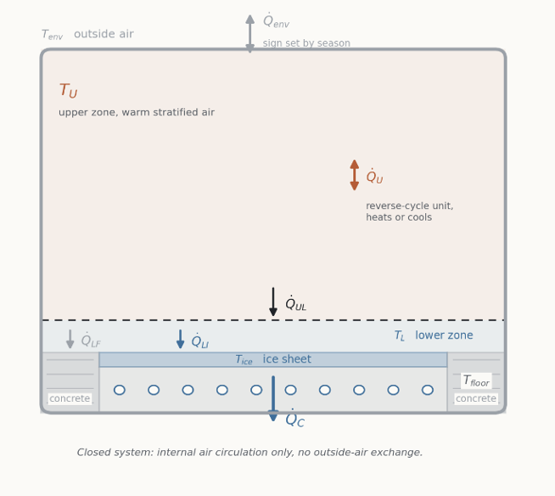
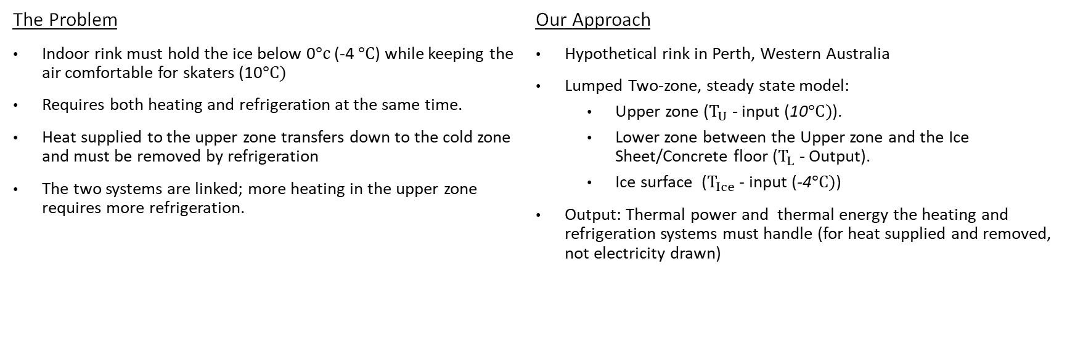
Introduction
The Problem
Indoor rink must hold the ice below 0$°c$ (-4 $°C$) while keeping the air comfortable for skaters (10$°C)$
Requires both heating and refrigeration at the same time.
Heat supplied to the upper zone transfers down to the cold zone and must be removed by refrigeration
The two systems are linked; more heating in the upper zone requires more refrigeration.
Our Approach
Hypothetical rink in Perth, Western Australia
Lumped Two-zone, steady state model:
  Upper zone ($T_{U}$ - input (10$°C)$).
  Lower zone between the Upper zone and the Ice Sheet/Concrete floor ($T_{L}$ - Output).
  Ice surface ($T_{Ice}$ - input (-4$°C)$)
Output: Thermal power and thermal energy the heating and refrigeration systems must handle (for heat supplied and removed, not electricity drawn)
Why it Matters
Rinks are energy-intensive buildings
A simple model gives estimates for sizing equipment (heating/refrigeration plant) and comparing design choices (building size/shape)
It shows which parameters drive the load.
Notes:
Indoor ice rinks are an unusual engineering problem: the ice must be kept below freezing, while the air above it must be comfortable enough for skaters. The building is effectively being heated and refrigerated at the same time. Any heat applied to the upper zone of the rink doesn’t stay there; it transfers down towards the cold zone, and the refrigeration system has to remove it. So, the refrigeration and heating systems are linked; the more heat we apply to the upper zone, the harder the refrigeration in the lower zone has to work.
For our project, we modelled the thermal energy consumption of a hypothetical ice rink in Perth. For our scope, we’re looking at the heating/cooling thermal energy that needs to be applied/removed, not the electricity the plant equipment draws.
We used a lumped, two-zone, steady—state model with an Upper comfort zone (input of 10 degrees Celsius), a lower zone that is in-between the upper zone and ice surface (output calculated from model) the the Ice surface itself (input of-4 degree’s Celsius ), From this we can calculate the thermal power and thermal energy that the heating and refrigeration systems need to handle.
Rinks are energy-intensive buildings; a simple model is useful for estimating thermal load requirements for plant equipment and for comparing designs to assess efficiency and identify which parameters matter most.

Slide 4
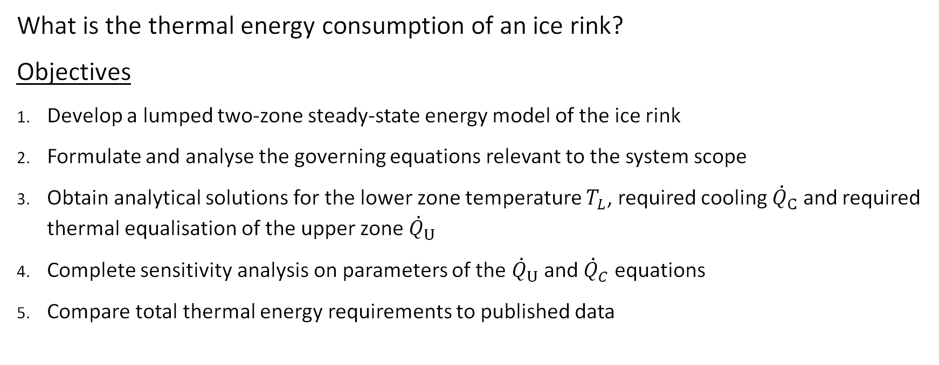
Problem Statement and Objectives
What is the thermal energy consumption of an ice rink?
Objectives
Develop a lumped two-zone steady-state energy model of the ice rink
Formulate and analyse the governing equations relevant to the system scope
Obtain analytical solutions for the lower zone temperature $T_{L}$, required cooling ${\dot{Q}}_{C}$ and required thermal equalisation of the upper zone ${\dot{Q}}_{U}$
Complete sensitivity analysis on parameters of the ${\dot{Q}}_{U}$ and ${\dot{Q}}_{C}$ equations
Compare total thermal energy requirements to published data

Slide 5
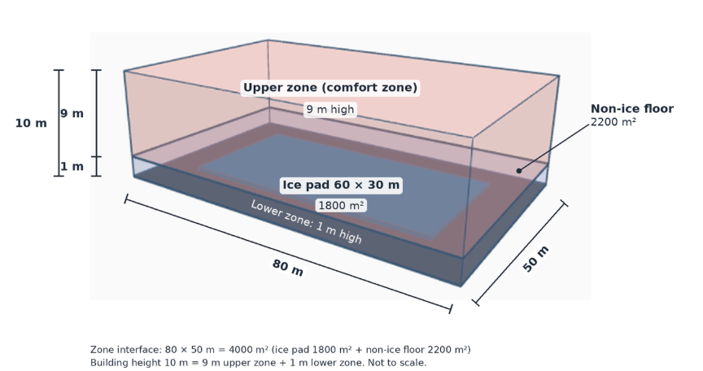
Physical System and Assumptions
Assumptions
Uniform air and surface temperatures
Steady state
No occupant, humidity or radiation effects
Closed system
Lower zone/environment is negligible
Upper zone reverse-cycle air conditioner
Notes:
Air temperature is uniform within each zone; the ice temperature is also uniform. This is the standard lumped simplification, splitting the zones into two zones captures the main difference between the cold air and the ice and the upper comfort zone above and ignores variations of temperatures within those zones.
System is steady state, each zone’s temperature doesn’t change with time. The thermal plants hold these temperatures as set points, and once reached, the temperature stops changing. This ignores the startup required to bring the building to the ideal temperature before opening to the public and the daily variation in operating hours.
There are no occupants, humidity effects or radiative exchange and no heat sources other than the upper zones reverse cycle unit and the outdoor environment through the building envelope; these are left out to keep the model manageable for this project. Because this was neglected, we would assume it adds load, which means our results are a lower bound on what they would be in reality.
The building is a closed system. Air circulates between the two zones but is not influenced by outside air. A real ice rink would bring in outside air, which would need to be cooled or heated and would also add to the additional load.
The lower zone we have assumed to have no direct connection to the outdoors, as its walls are roughly 4% of the total envelope area and are neglected, which changed the loads by about 1kW or less.
The upper zone thermal plant is a reverse-cycle air conditioner that can heat or cool; its power can be positive(heats) and negative (cools). This allows the reverse-cycle unit to maintain the comfort set point in both hot and cool weather. Both the reverse-cycle and the refrigeration unit are described in terms of thermal power only, so no thermal plant efficiency is introduced, and the results are thermal loads rather than electrical consumption.

Slide 6
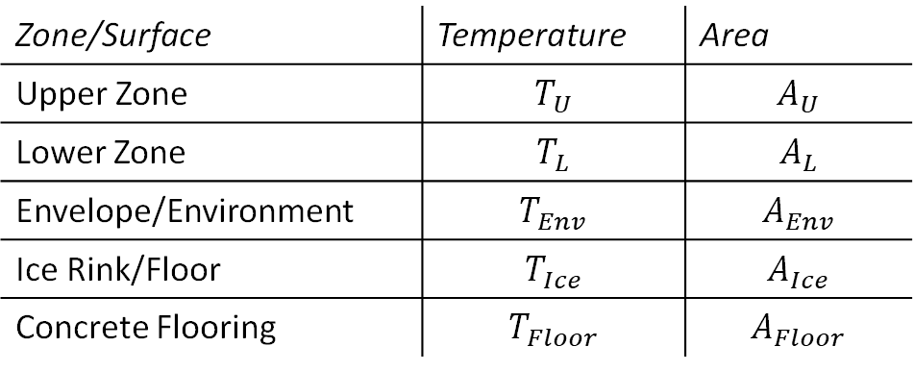
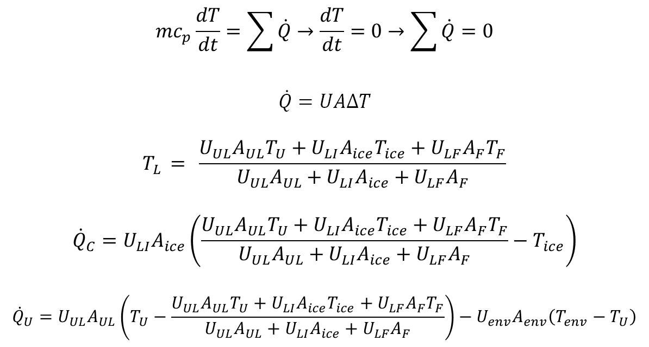
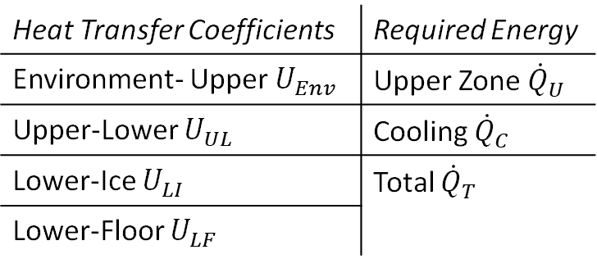
Mathematical Model
Zone/Surface | Temperature | Area
Upper Zone | $$T_{U}$$ | $$A_{U}$$
Lower Zone | $$T_{L}$$ | $$A_{L}$$
Envelope/Environment | $$T_{Env}$$ | $$A_{Env}$$
Ice Rink/Floor | $$T_{Ice}$$ | $$A_{Ice}$$
Concrete Flooring | $$T_{Floor}$$ | $$A_{Floor}$$
$$mc_{p}\frac{dT}{dt}=\sum{\dot{Q}}→\frac{dT}{dt}=0→\sum{\dot{Q}}=0$$
$$\dot{Q}=UAΔT$$
$$T_{L }= \frac{U_{UL}A_{UL}T_{U}+U_{LI}A_{ice}T_{ice}+U_{LF}A_{F}T_{F}}{U_{UL}A_{UL}+U_{LI}A_{ice}+U_{LF}A_{F}}$$
$${\dot{Q}}_{C}=U_{LI}A_{ice}\left(\frac{U_{UL}A_{UL}T_{U}+U_{LI}A_{ice}T_{ice}+U_{LF}A_{F}T_{F}}{U_{UL}A_{UL}+U_{LI}A_{ice}+U_{LF}A_{F}}−T_{ice}\right)$$
$${\dot{Q}}_{U}=U_{UL}A_{UL}\left(T_{U}−\frac{U_{UL}A_{UL}T_{U}+U_{LI}A_{ice}T_{ice}+U_{LF}A_{F}T_{F}}{U_{UL}A_{UL}+U_{LI}A_{ice}+U_{LF}A_{F}}\right)−U_{env}A_{env}\left(T_{env}−T_{U}\right)$$
Heat Transfer Coefficients | Required Energy
Environment- Upper $U_{Env}$ | Upper Zone ${\dot{Q}}_{U}$
Upper-Lower $U_{UL}$ | Cooling ${\dot{Q}}_{C}$
Lower-Ice $U_{LI}$ | Total ${\dot{Q}}_{T}$
Lower-Floor $U_{LF}$
Notes:
In developing our model, we considered the temperature and area of each zone/surface in our system: Upper Zone, Lower Zone, Envelope/Environment, Ice Floor, and Concrete Flooring.
We also defined the heat transfer coefficients between each neighbouring zone/surface, the required heating of the upper thermal plant, the cooling thermal plant below the ice and the total thermal requirement of both.
Our main governing equations are $mc_{p}\frac{dT}{dt}=\sum{\dot{Q}}$ and $\dot{Q}=UAΔT.$ As we assume our model to be at steady state $\frac{dT}{dt}=0$ therefore the accumulation of all our thermal energy elements must be 0.
The following equations here are applications of this to determine T_L, Q_C and Q_U, with the two Q values using the T_L value calculated first

Slide 7
Solution Methodology: Model Input
We evaluate the closed form solution with these input: The geometry, Set points, and Published coefficients
Symbol | Meaning | Baseline (range)
Areas (m²)
A_{ice} | Ice surface | 1800
A_{F} | Non-ice floor | 2200
A_{UL} | Zone interface | 4000
A_{env} | Roof + upper walls | 6340
Temperatures (°C)
T_{U} | Upper-zone air | 10 (8.7–15)
T_{ice} | Ice surface | −4 (−5 to −3)
T_{F} | Non-ice floor | 10 (8–18), assumed
T_{env} | Outdoor air | 32.1 / 18.0 / 8.1
Symbol | Meaning | Baseline (range)
Coefficients (W m⁻² K⁻¹)
U_{UL} | Upper ↔ lower air | 4 (2–8)
U_{LI} | Lower air ↔ ice | 5 (4–6)
U_{LF} | Lower air ↔ floor | 6.4 (5–8)
U_{env} | Building envelope | 0.45 (0.27–0.91)
Unknowns, solved by the model
T_{L} | Lower-zone air | output (°C)
Q̇_{U} | Upper-unit power | output (kW)
Q̇_{C} | Ice cooling power | output (kW)
Table 3. Model inputs, with the ranges used in the sensitivity analysis, and the three unknowns.
Sources: IIHF (2025); Lin et al. (2022, 2023); Ferrantelli et al. (2021); Bureau of Meteorology (2026); Karampour and Rogstam (2012); Zeng et al. (2022); ABCB (2022).
Notes:
Thank you. You have seen the model; I will now show how we solved it and what it predicts, starting with the inputs. On the left is the geometry: 1800 square metres of ice, 2200 of concrete floor around it, a 4000 square metre interface between the two zones, and 6340 square metres of envelope. That is the roof plus the upper-zone walls only, which is the correction we made after the proposal. Then the temperatures: the upper-zone air at 10 degrees, the ice at minus 4, the floor at 10, which is assumed, and three outdoor conditions from the Bureau of Meteorology. On the right are the four heat-transfer coefficients with their sources and the ranges we use later. The interzone coefficient U-UL is an effective coefficient for air exchange across the boundary between the zones, not a property of a wall. Finally, the three unknowns: the lower-zone air temperature, the power of the upper-zone unit, and the ice cooling power.

Slide 8
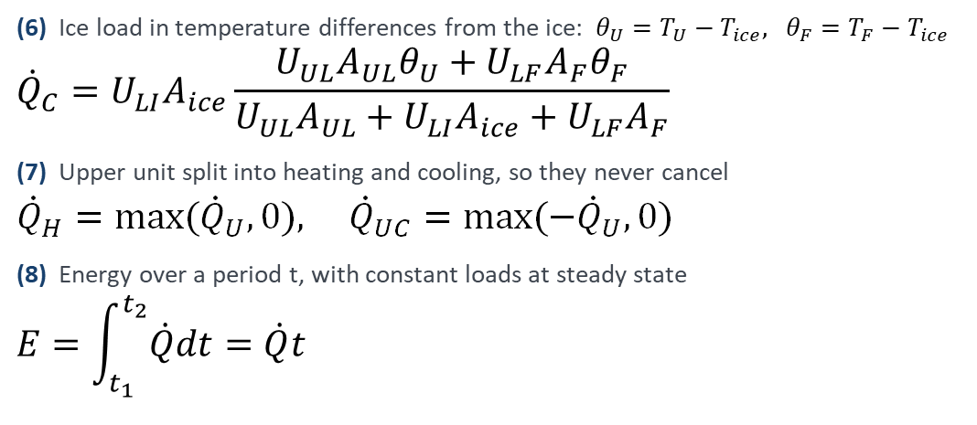
Solution Methodology (cont.)
1 Formulate
Three linear balances at steady state
2 Solve
One balance at a time, in closed form
3 Implement
Python sens.py runs every case
4 Verify
Hand and Excel checks agrees
5 Analyse
Sensitivity and combined sectors
(6) Ice load in temperature differences from the ice: $θ_{U}=T_{U}−T_{ice}, θ_{F}=T_{F}−T_{ice}$
$${\dot{Q}}_{C}=U_{LI}A_{ice}\frac{U_{UL}A_{UL}θ_{U}+U_{LF}A_{F}θ_{F}}{U_{UL}A_{UL}+U_{LI}A_{ice}+U_{LF}A_{F}}$$
(7) Upper unit split into heating and cooling, so they never cancel
$${\dot{Q}}_{H}=max({\dot{Q}}_{U},0), {\dot{Q}}_{UC}=max(−{\dot{Q}}_{U},0)$$
(8) Energy over a period t, with constant loads at steady state
$$E=\int_{t_{1}}^{t_{2}}{\dot{Q}dt}=\dot{Q}t$$
The lower zone air is a weighted average, so it must lie between −4 °C and 10 °C.
In (6), the ice load depends only on temperature differences from the ice, so the outdoor condition never reach it.
Notes:
Here is how we solved the model, in five steps. Step 1: at steady state the energy balances become three linear equations. Step 2: because the upper-zone temperature is a fixed set point, we can solve them one at a time. The lower-zone balance gives the lower-zone temperature, the ice balance gives the ice load, and the upper-zone balance gives the unit’s power. Written with temperature differences from the ice, equation 6 shows that the ice load depends only on theta-U and theta-F, so the outdoor temperature never reaches it. Equation 7 splits the unit’s power into heating and cooling, so they cannot cancel when we add up energy, and equation 8 turns power into energy. Step 3: we coded the closed form in a Python script, sens.py. Step 4: we verified it, because the Python results match independent hand and Excel calculations. Step 5: we used the code for the sensitivity analysis, which I will show next.

Slide 9
Results: Baseline loads
Condition | Outdoor (°C) | Upper unit (kW)
Summer day | 32.1 | −11.5 (cooling)
Winter day | 18.0 | +28.8 (heating)
Winter night | 8.1 | +57.0 (heating)
Table 4. Baseline results.
Implication: a heating only could not hold 10 °C on hot Perth days.
Figure 2. Thermal power against outdoor temperature, baseline inputs.
Notes:
Here are the baseline results. The blue line is the ice cooling power: 97 kilowatts at every outdoor temperature, exactly as the closed form predicts, with the lower-zone air at 6.78 degrees in all three conditions. The orange line is the upper-zone unit. On a winter night it heats with 57 kilowatts and on a winter day with 28.8, and its power falls in a straight line as the outside warms, by 2.85 kilowatts per degree. It crosses zero at 28.1 degrees. Above that the unit has to cool, so on a 32-degree summer day it removes 11.5 kilowatts. Over one day the ice needs 97 kilowatts times 24 hours, which is 2328 kilowatt-hours. This answers Objective 3, and the daily energy feeds Objective 5. The practical point: a heating-only unit could not hold 10 degrees on a hot Perth day, so this rink needs a reverse-cycle unit.

Slide 10
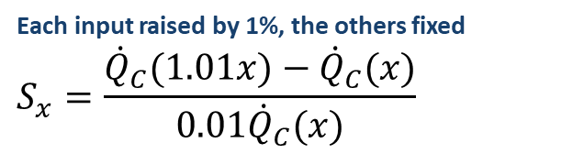
Result: Normalized sensitivity
Each input raised by 1%, the others fixed
$$S_{x}=\frac{{\dot{Q}}_{C}(1.01x)−{\dot{Q}}_{C}(x)}{0.01{\dot{Q}}_{C}(x)}$$
One input at a time, in winter day
Floor 8 → 18 °C: ice load 90.5 → 122.9 kW (33%); upper unit +40.3 → −17.4 kW.
Envelope coefficient 0.27 → 0.91: ice load unchanged; upper unit 37.9 → 5.4 kW.
Implication: better data for the air ice coefficient and the floor matter the most
Figure 3. Normalized sensitivity S of the ice cooling power.
Notes:
To compare inputs with different units, we use a normalised sensitivity, the formula on the right: the percentage change in the ice load for a 1 percent change in one input. Temperatures enter as their difference from the ice, because the zero of the Celsius scale is arbitrary. The air–ice coefficient dominates: a 1 percent rise raises the ice load by 0.77 percent. The upper-air and floor temperature differences follow at 0.53 and 0.47. The interzone and floor coefficients matter little, and the envelope has no effect on the ice load at all. One input at a time, the floor temperature stands out: from 8 to 18 degrees, the ice load rises by a third and the upper unit switches from heating to cooling, even on a winter day. So, for Objective 4, better data for the air–ice coefficient and the floor temperature would improve our prediction the most.

Slide 11
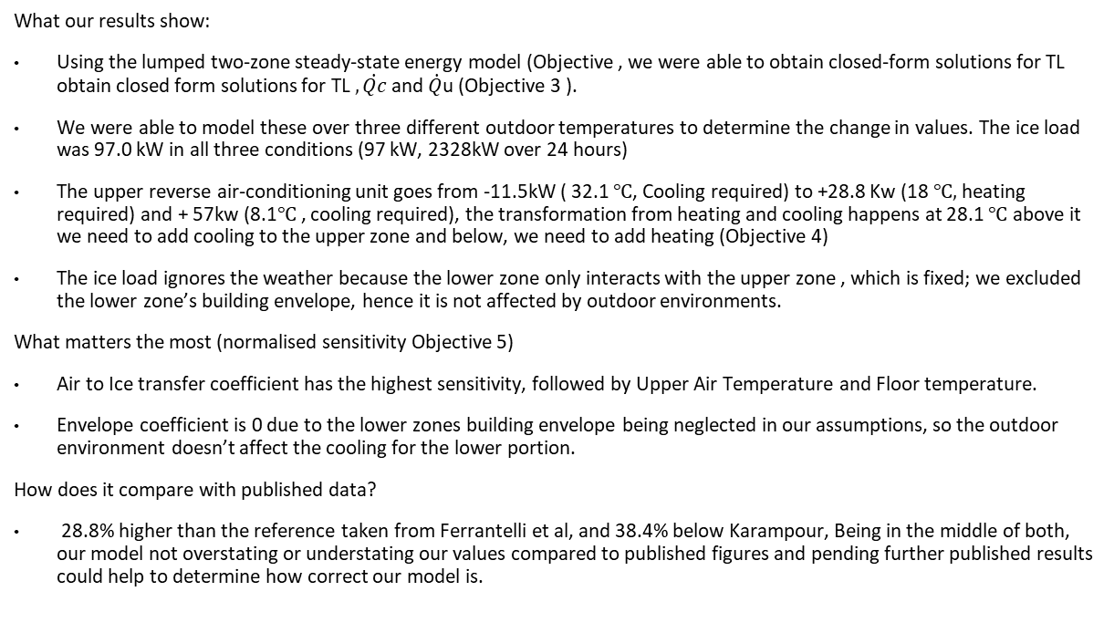
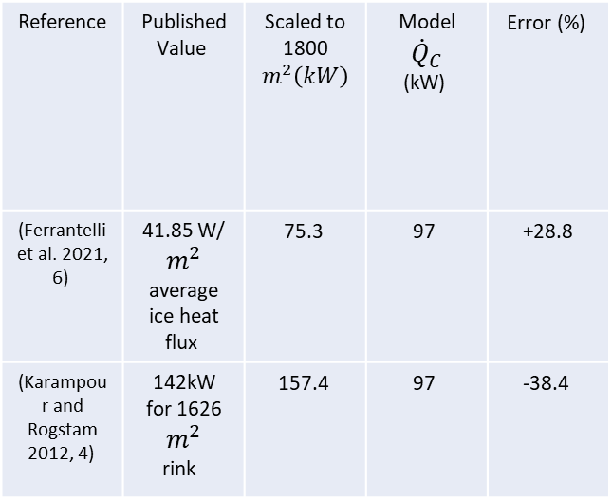
Discussion
What our results show:
Using the lumped two-zone steady-state energy model (Objective , we were able to obtain closed-form solutions for TL obtain closed form solutions for TL $, \dot{Qc}$and $\dot{Q}$u (Objective 3 ).
We were able to model these over three different outdoor temperatures to determine the change in values. The ice load was 97.0 kW in all three conditions (97 kW, 2328kW over 24 hours)
The upper reverse air-conditioning unit goes from -11.5kW ( 32.1 $℃$, Cooling required) to +28.8 Kw (18 $℃,$ heating required) and + 57kw (8.1$℃$, cooling required), the transformation from heating and cooling happens at 28.1 $℃$ above it we need to add cooling to the upper zone and below, we need to add heating (Objective 4)
The ice load ignores the weather because the lower zone only interacts with the upper zone , which is fixed; we excluded the lower zone’s building envelope, hence it is not affected by outdoor environments.
What matters the most (normalised sensitivity Objective 5)
Air to Ice transfer coefficient has the highest sensitivity, followed by Upper Air Temperature and Floor temperature.
Envelope coefficient is 0 due to the lower zones building envelope being neglected in our assumptions, so the outdoor environment doesn’t affect the cooling for the lower portion.
How does it compare with published data?
28.8% higher than the reference taken from Ferrantelli et al, and 38.4% below Karampour, Being in the middle of both, our model not overstating or understating our values compared to published figures and pending further published results could help to determine how correct our model is.
Reference | Published Value | Scaled to 1800 $$m^{2}\left(kW\right)$$ | Model $${\dot{Q}}_{C}$$ (kW) | Error (%)
(Ferrantelli et al. 2021, 6) | 41.85 W/ $$m^{2}$$ average ice heat flux | 75.3 | 97 | +28.8
(Karampour and Rogstam 2012, 4) | 142kW for 1626 $$m^{2}$$ rink | 157.4 | 97 | -38.4
Notes:
Ferrantelli, Andrea, Klaus Viljanen, and Jarek Kurnitski. 2021. "Energy Analysis in Ice Hockey Arenas and Analytical Formula for the Temperature Profile in the Ice Pad with Transient Boundary Conditions." Advances in Building Energy Research 15 (4): 499–522.
https://doi.org/10.1080/17512549.2019.1615549.
Karampour, Mazyar, and Jörgen Rogstam. 2012. “Measurement and Modelling of Ice Rink Heat Loads.” https://www.diva-portal.org/smash/get/diva2:542333/FULLTEXT01.pdf.

Slide 12
Conclusions
Limitations
Well-mixed lower zone overstates convection.
Radiation, occupants, humidity and ventilation are neglected. These would add additional load.
Closed system assumption: The ice load is independent in our model of outdoor conditions, which wouldn’t be true in practice.
The floor temperature is assumed; when varied, it adds additional load.
Key Findings
Air-ice thermal coefficient value is most important.
In the given model, the refrigeration is constant while the heating varies.
The combined thermal energy consumption of an Ice rink
in Perth, Australia, is approximately between 97 kW and
154 kW per hour.
Achieved Project Objectives
Preliminary model of a two-zone steady-state ice rink
Practised the process of mathematical modelling in real-life applications
  Using governing heat equations to model different situations
Future Improvements
Considering the thermal to electrical energy conversions
Reducing simplifying assumptions
  Humidity, human interaction, uniform temperature zones
Analysis of the heat equalisation of the upper zone (compare to published data)

Slide 13
Questions?

