Slide 1
quantum speedups For search AND OPTIMIZATION
Andris Ambainis
University of Latvia

Slide 2
Quantum search (Grover)
?
?
?
?
?
...
N objects;
Find an object with a certain property.
Grover, 1996: O(√N) quantum steps.
Speeds up naive search for a solution.

Slide 3

Search
Amplitude amplification
Quantum divide and conquer
Quantum counting
Dynamic programming
Search by quantum walk
Backtracking
Simulated annealing
Branch-and-bound

Slide 4
DIRECTION 1: search by quantum walk

Slide 5
Proximity search
Finite search space.
Some elements might be marked.
Find a marked element!
1
2
3
4
5
6
After checking A, it may be easier to check B than C.

Slide 6
Example: search on grids
√N • √N grid.
In one step, we can:
check if vertex marked;
move 1 step;
Naive quantum search step: checks √N objects,
distance √N between them.
Complexity: √N • √N = N.

Slide 7
Search by random walk
Random walk, following the locality constraints.
Stop after finding a marked vertex.

Slide 8
Szegedy’2004
Random walk: T steps
Quantum walk: O(√T) steps

Slide 9
APPLIcation: Element distinctness
31 40 75 71 93 32 47 11 70 37 78 79 36 63 40 48 98 23 41 16 66 75 38 27 42 55 77 19 45 15 53 22 91 37 90 58 13 10 25 29 25 56 68 12 11 51 23 77 15 17 24 88 56 42
Are there 2 equal numbers?
Classical: N steps.
Quantum: O(N^{2/3}).
[A, FOCS’2004]

Slide 10
Szegedy’2004
Random walk: T steps
Quantum walk: O(√T) steps
Quantum walk solves a decision problem!

Slide 11
|Ψ_{start}⟩ - starting state;
No marked element - |Ψ_{start}⟩ unchanged;
Marked elements - |Ψ_{start}⟩ diverges to an almost orthogonal state |Ψ⟩.
|Ψ⟩ not concentrated on marked element
Quantum walk detects if
marked element exists:
O(√T) steps

Slide 12

New result
Theorem Assume that a marked state is reached in expected time at most T.
A quantum algorithm can find a marked state in
time $\tilde{O}\left(\sqrt{T}\right)$.
[A, Gilyen, Jeffery, Kokainis, STOC’2020]

Slide 13

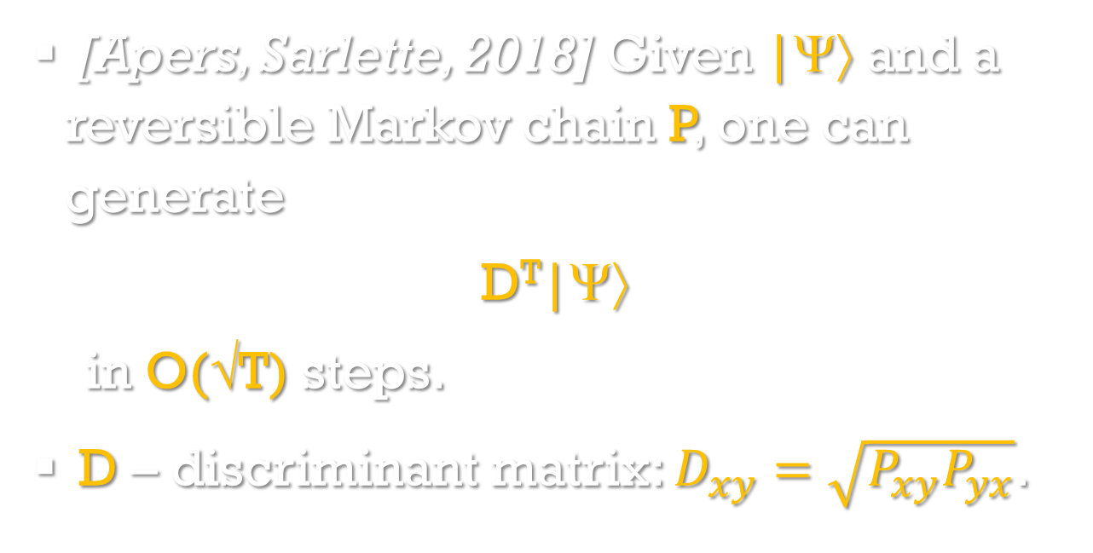
Quantum fast-forwarding
[Apers, Sarlette, 2018] Given |Ψ⟩ and a reversible Markov chain P, one can generate
D^{T}|Ψ⟩
in O(√T) steps.
D – discriminant matrix: $D_{xy}=\sqrt{P_{xy}P_{yx}}$.

Slide 14
Open problem
When can we speed up walks that do not start from the stationary distribution?

Slide 15
direction 2: quantum speedups for np-complete problems?

Slide 16


Slide 17

Travelling Salesman Problem
4
A
B
N cities, find the best route visiting all cities;
N! candidate routes;
Quantum search:
2
4
3
5
C
D
3
Classically, O(2^{N}) time!
$$O\left(\sqrt{N!}\right)$$

Slide 18
Best classical algorithm
4
Find the shortest route through every subset of cities S.
Order: from smaller S to larger S.
Time ≈ 2^{N}.
A
B
2
4
3
5
C
D
3
[Held, Karp, Journal of SIAM, 1962]

Slide 19
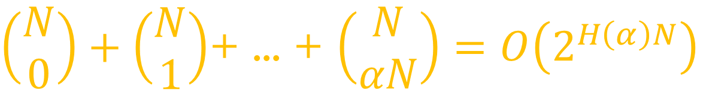
classical part
Find the shortest route through every S, |S|≤ α N.
Time:
$\left(\begin{matrix}N \\ 0\end{matrix}\right)+\left(\begin{matrix}N \\ 1\end{matrix}\right)$+ ... + $\left(\begin{matrix}N \\ αN\end{matrix}\right)=O\left(2^{H\left(α\right)N}\right)$
For α=0.24...,
$$O(1.73…N)$$

Slide 20
Divide and conquer

Slide 21
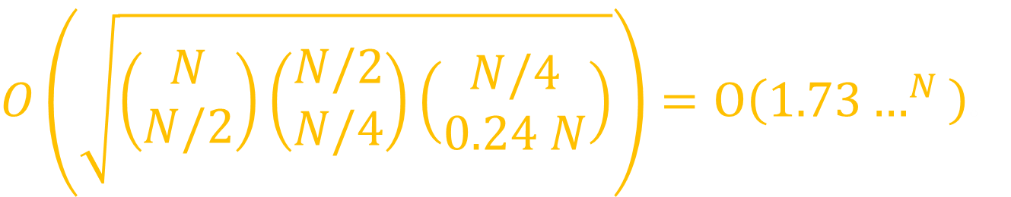
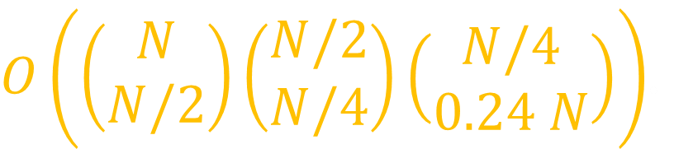
Divide and conquer
Classical search for the best split:
$O\left(\left(\begin{matrix}N \\ N/2\end{matrix}\right)\left(\begin{matrix}N/2 \\ N/4\end{matrix}\right)\left(\begin{matrix}N/4 \\ 0.24 N\end{matrix}\right)\right)$.
Quantum search:
$O\left(\sqrt{\left(\begin{matrix}N \\ N/2\end{matrix}\right)\left(\begin{matrix}N/2 \\ N/4\end{matrix}\right)\left(\begin{matrix}N/4 \\ 0.24 N\end{matrix}\right)}\right)=O\left({1.73…}^{N}\right)$.

Slide 22
MORE Quantum algorithms
Dynamic programming on subsets of {1, ..., n}:
Compute F({1, ..., n});
F(S) - minimum over F(S-{k})+some extra cost,
O(1.817...^{n}) quantum time,
[A, Balodis, Iraids, Kokainis, Prūsis, Vihrovs, SODA’2019]

Slide 23
More quantum algorithms
Treewidth (Kļevickis, Prūsis, Vihrovs, TQC’2022):
O(1.755...^{n}) classically;
O(1.538...^{n}) quantumly.
Speeding up other methods for solving NP-complete problems?

Slide 24
direction 3: variable time search

Slide 25
Variable time search
?
?
?
...
Objects – subroutines.
Some objects can be faster to check.
Example: divide-and-conquer with subproblems
of different size.

Slide 26
Standard quantum search
Each query Q = one “quantum black box”, runs checking procedure on superposition of inputs.
Q
D
Q
D
D
Q
D
...
...
...
...
...
...
...
...
...
...
Running time:

Slide 27
Quantum vs classical
Quantum:
Classical T₁+...+T_{N} = N T_{avg}.
Quantum gap decreases/disappears if T_{avg}<<T_{max}.

Slide 28
Two models
Known times: checking time T_{i} for object i known in advance, can be used to design algorithm.
Unknown times: T_{i} discovered by running the checking algorithm.

Slide 29
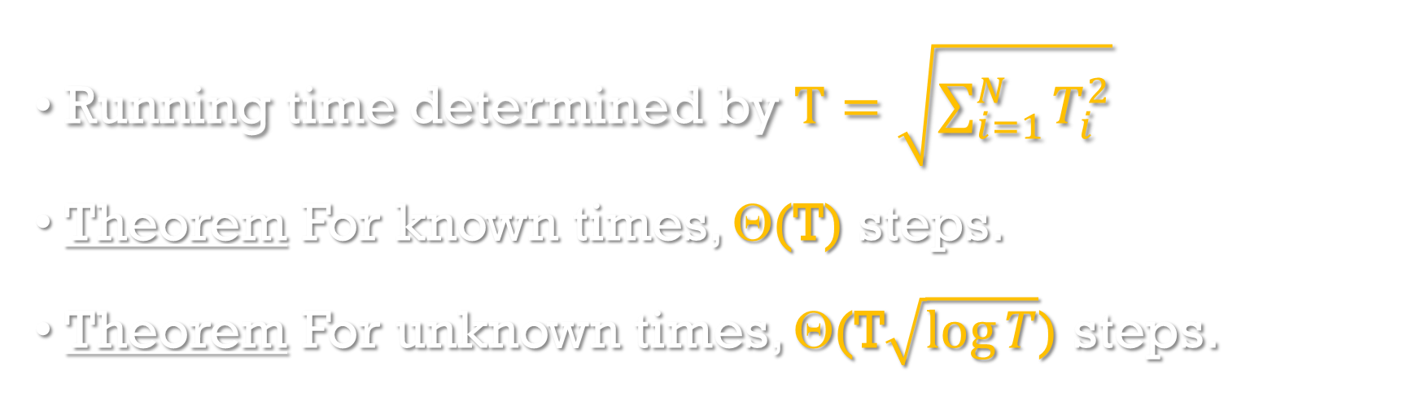
results
Running time determined by $T=\sqrt{\sum_{i=1}^{N}{T_{i}^{2}}}$
Theorem For known times, Θ(T) steps.
Theorem For unknown times, Θ(T$\sqrt{\log{T}}$) steps.
[A, STACS’2007, A, Kokainis, Vihrovs, TQC’ 2023, Vihrovs, arXiv:2505.22405]

Slide 30
Basic idea
3 outcomes: “true”, “false”, “did not stop”
Search for “true” or “did not stop”.
Amplified version C’_{t}.
C_{t}
...
...

Slide 31
Basic idea (2)
3 outcomes: “true”, “false”, “did not stop”
Search for “true” or “did not stop”.
Amplified version C’_{3t}.
C’_{t}
C_{3t}
...
...
...

Slide 32
Geometry application
3 -LINES:
N lines in a plane;
Are there 3 lines that intersect in one point?
Best classical algorithm: O(N²).
Quantum algorithm: O(N log^{c} N).

Slide 33
3-LINES problem
Entire plane
Region 1
Region 2
…
Region m
Subregion 1
Subregion 2
…
[A, Larka, TQC’2020, Vihrovs, arXiv:2505.22405]

Slide 34
Hopcroft’s problem
N lines, N points. Determine if any of the points is on any of the lines.
Classical: O(N^{4/3}).
[Vihrovs, MFCS’2024] Quantum: O(N^{5/6}).
Combination of quantum search and classical data structures.

Slide 35
Outlook
Exponential quantum speedups for a few problems (factoring, simulation).
Up-to-quadratic speedups for many problems.
Interesting combinations of quantum and classical methods.

Slide 36

Questions?

