Slide 1
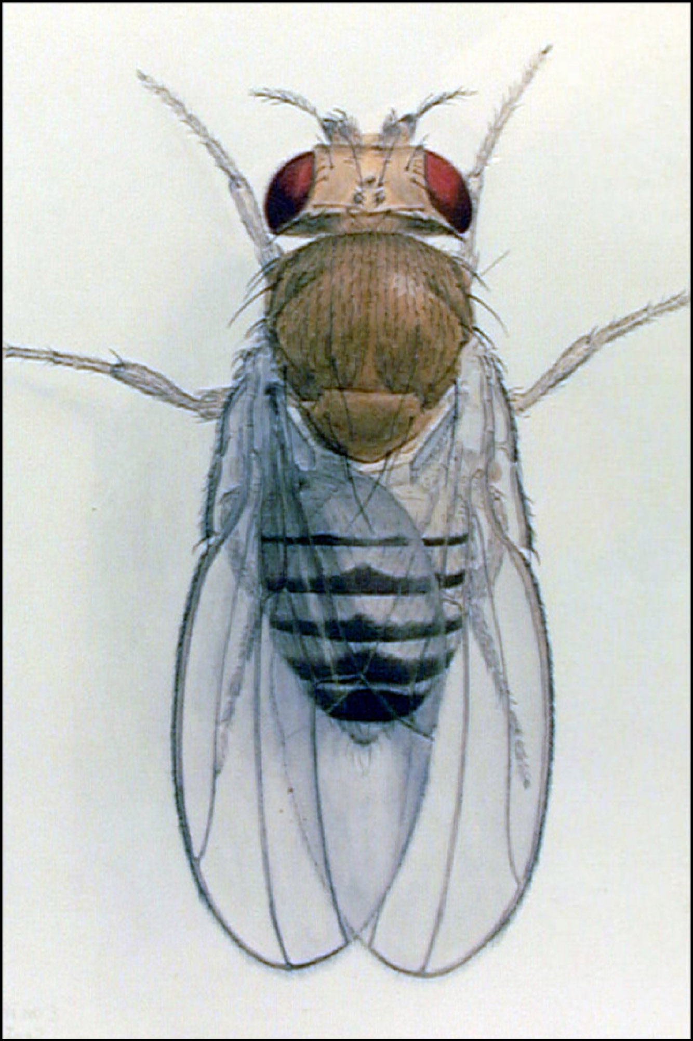
Comprehensive Characterization of the
Drosophila Transcriptome
49th Annual Drosophila Research Conference: modENCODE workshop
Susan Celniker
Lawrence Berkeley National Laboratory

Slide 2
ModENCODE Project Goals
SPECIFIC AIM 1: Identify protein coding and non-protein coding transcribed sequences
  1.1 Prepare RNA samples from representative developmental, tissue and cell types
  1.2 Produce 38 bp resolution expression profiles of the transcriptome for all RNA samples
  1.3 Produce 7 bp expression profiles for a carefully selected subset of samples
1.4 Identify composite exon sets with pooled gene specific targets
Co-PIs - Peter Cherbas (IU) and Tom Gingeras (Affymetrix)
SPECIFIC AIM 2: Map transcript structures
2.1 Synthesize data to produce and refine transcript models
2.2 Map TSS, exon/intron junctions and polyA sites by RLM-RACE, RT-PCR and cDNA _x0010__x0010__x0010__x0010__x0010__x0010__x0010__x0010__x0010__x0010_sequencing
2.3 Characterize and validate ncRNAs by 454 Life Science pyrosequencing
2.4 Map cis-elements required for RNA splicing by RNAi of RNA-binding proteins
Co-PIs - Michael Brent (WU),Roger Hoskins (LBNL) and Brenton Graveley (UCHC)
SPECIFIC AIM 3: Functionally validate ncRNAs
3.1 RNAi using cell-based assays
3.2 Overexpression using cell-based assays
Co-PI - Norbert Perrimon (Harvard)

Slide 3
How many genes in Drosophila?
Current estimates
FlyBase

Slide 4
Aim 1:Expression
~300 RNA samples in biological triplicate
~300 samples on 38-bp genome tiling arrays
24 samples on 7-bp genome tiling array sets
160 RACE-fragment pools (16,000 prod’s)
Comprehensive identification of transcribed sequences by microarray hybridization and next generation sequencing.

Slide 5
RNA Samples

Slide 6
Cell Lines represent specific lineages
expressed at high level
not detectable
D16-c3
fng
tsh
Antp
ci
elB
pnr
fz3
CI.8
A
Antp
D
V
tsh
ci
fng
fz3
P
pnr
Lucy Cherbas

Slide 7
Expression Analysis of 15 Drosophila cell lines
Base-pair coverage
for individual cell lines
Base-pair coverage
for the union of expression
Unique transcription
per cell line
all transfrags created with bandwidth 50, min-run 90, max-gap 90
interrogated genomic space is calculated using “blanket transfrags” which are created assuming all probes are above threshold
https://dgrc.cgb.indiana.edu/cells/store/catalog.html

Slide 8
Improved exon discrimination
using 7bp arrays
sample 1
😐
7bp

signal g
r
aph
t
r
ansf
r
ags
sample 1
😐
35bp

signal g
r
aph
t
r
ansf
r
ags
sample 2
☹
7bp

signal g
r
aph
t
r
ansf
r
ags
sample 2
35bp
signal g
r
aph
t
r
ansf
r
ags
r
e
f
seq (+)
c
o
o
r
din
a
t
es
CG10353-RA
r
e
f
seq (-)
CG10353-RB
Notes:
Improved exon discrimination by transfrags from 7bp arrays

Slide 9
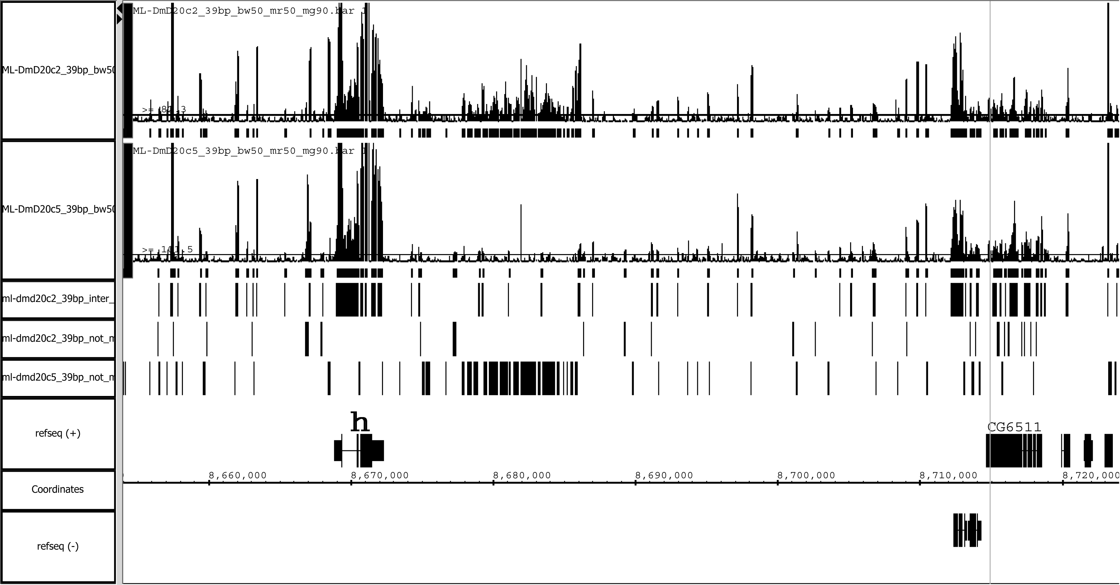
Comparison of ML-DmD20 cell lines
clone2 versus clone5
clone2
RNA
clone5
RNA
2 and 5
5 not 2
2 not 5
Intergenic transcription downstream of hairy (h)

Slide 10
Specific Aim 2: Synthesis and Validation
Synthesis of RNA expression data, comparative data and gene predictions.
20,000 short RT-PCRs
20,000 RACE experiments
Small RNA sequencing on 454: 16 runs
6,000 cDNA screens & 3,000 long RT-PCRs
RNAi of 120 RNA binding proteins on arrays
Identify cis-reg. elements in control of splicing

Slide 11
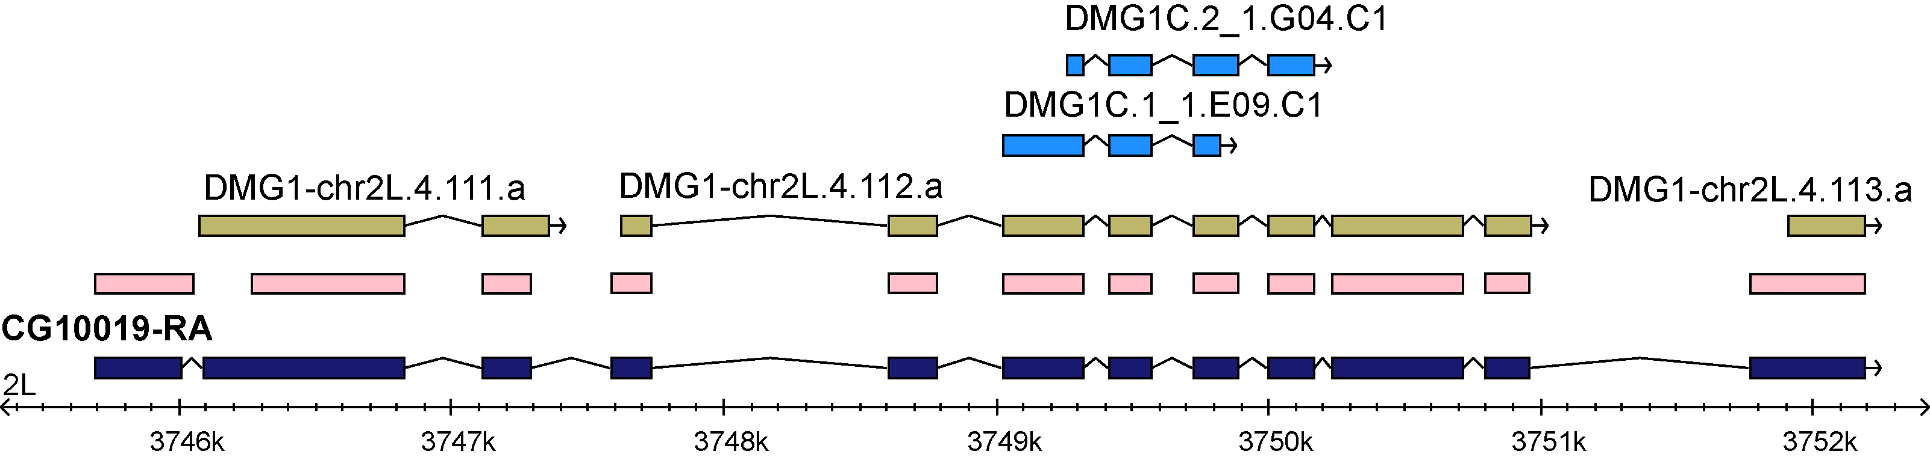
Modeling and Validation
Conserved exons MIT
GenBank Accession #s 49077286 - 49077870
Michael Brent, Charlie Comstock, Laura Langton and Jeltje van Baren

Slide 12
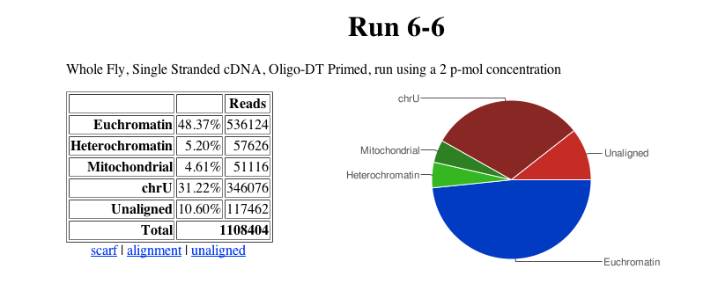

Solexa sequencing to verify splice sites
Intron Statistics
DMG2
DMG3

Slide 13
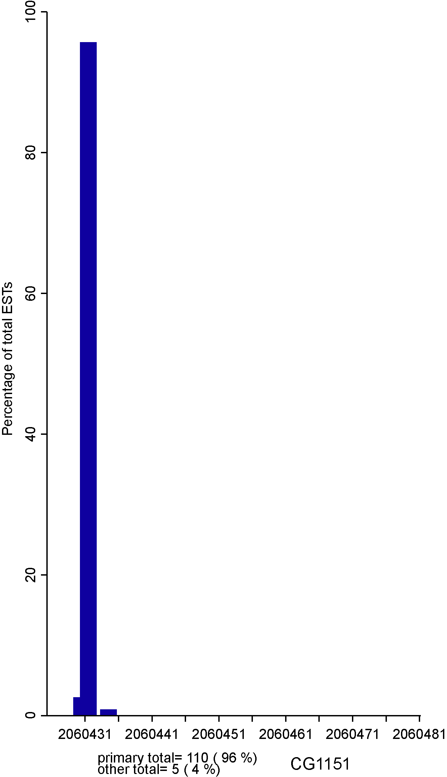
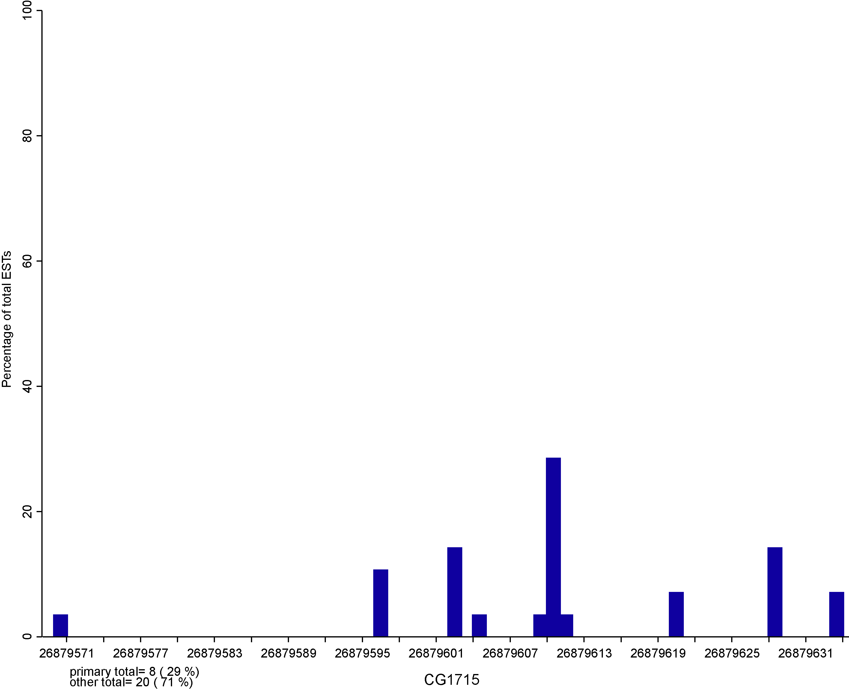
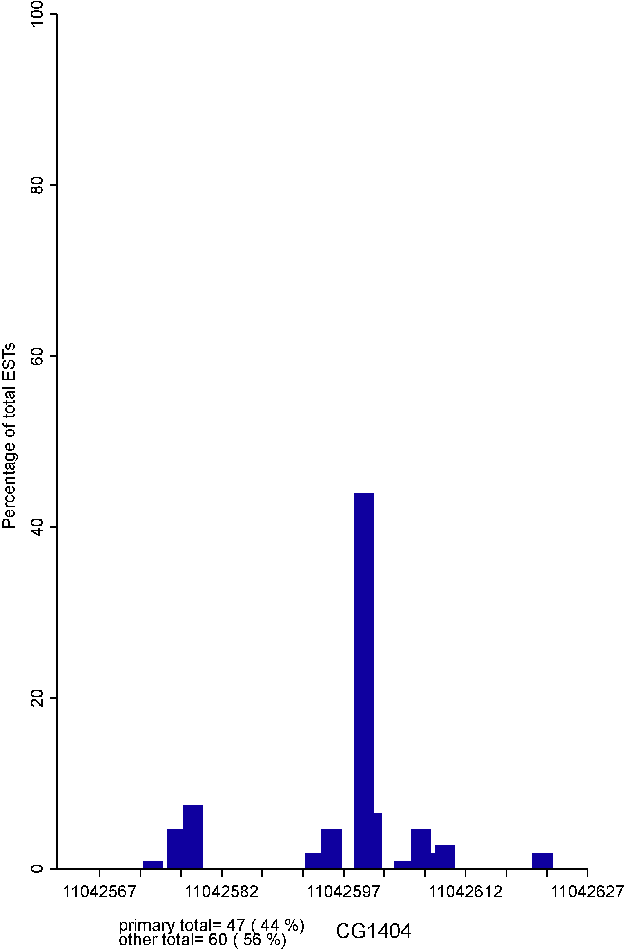
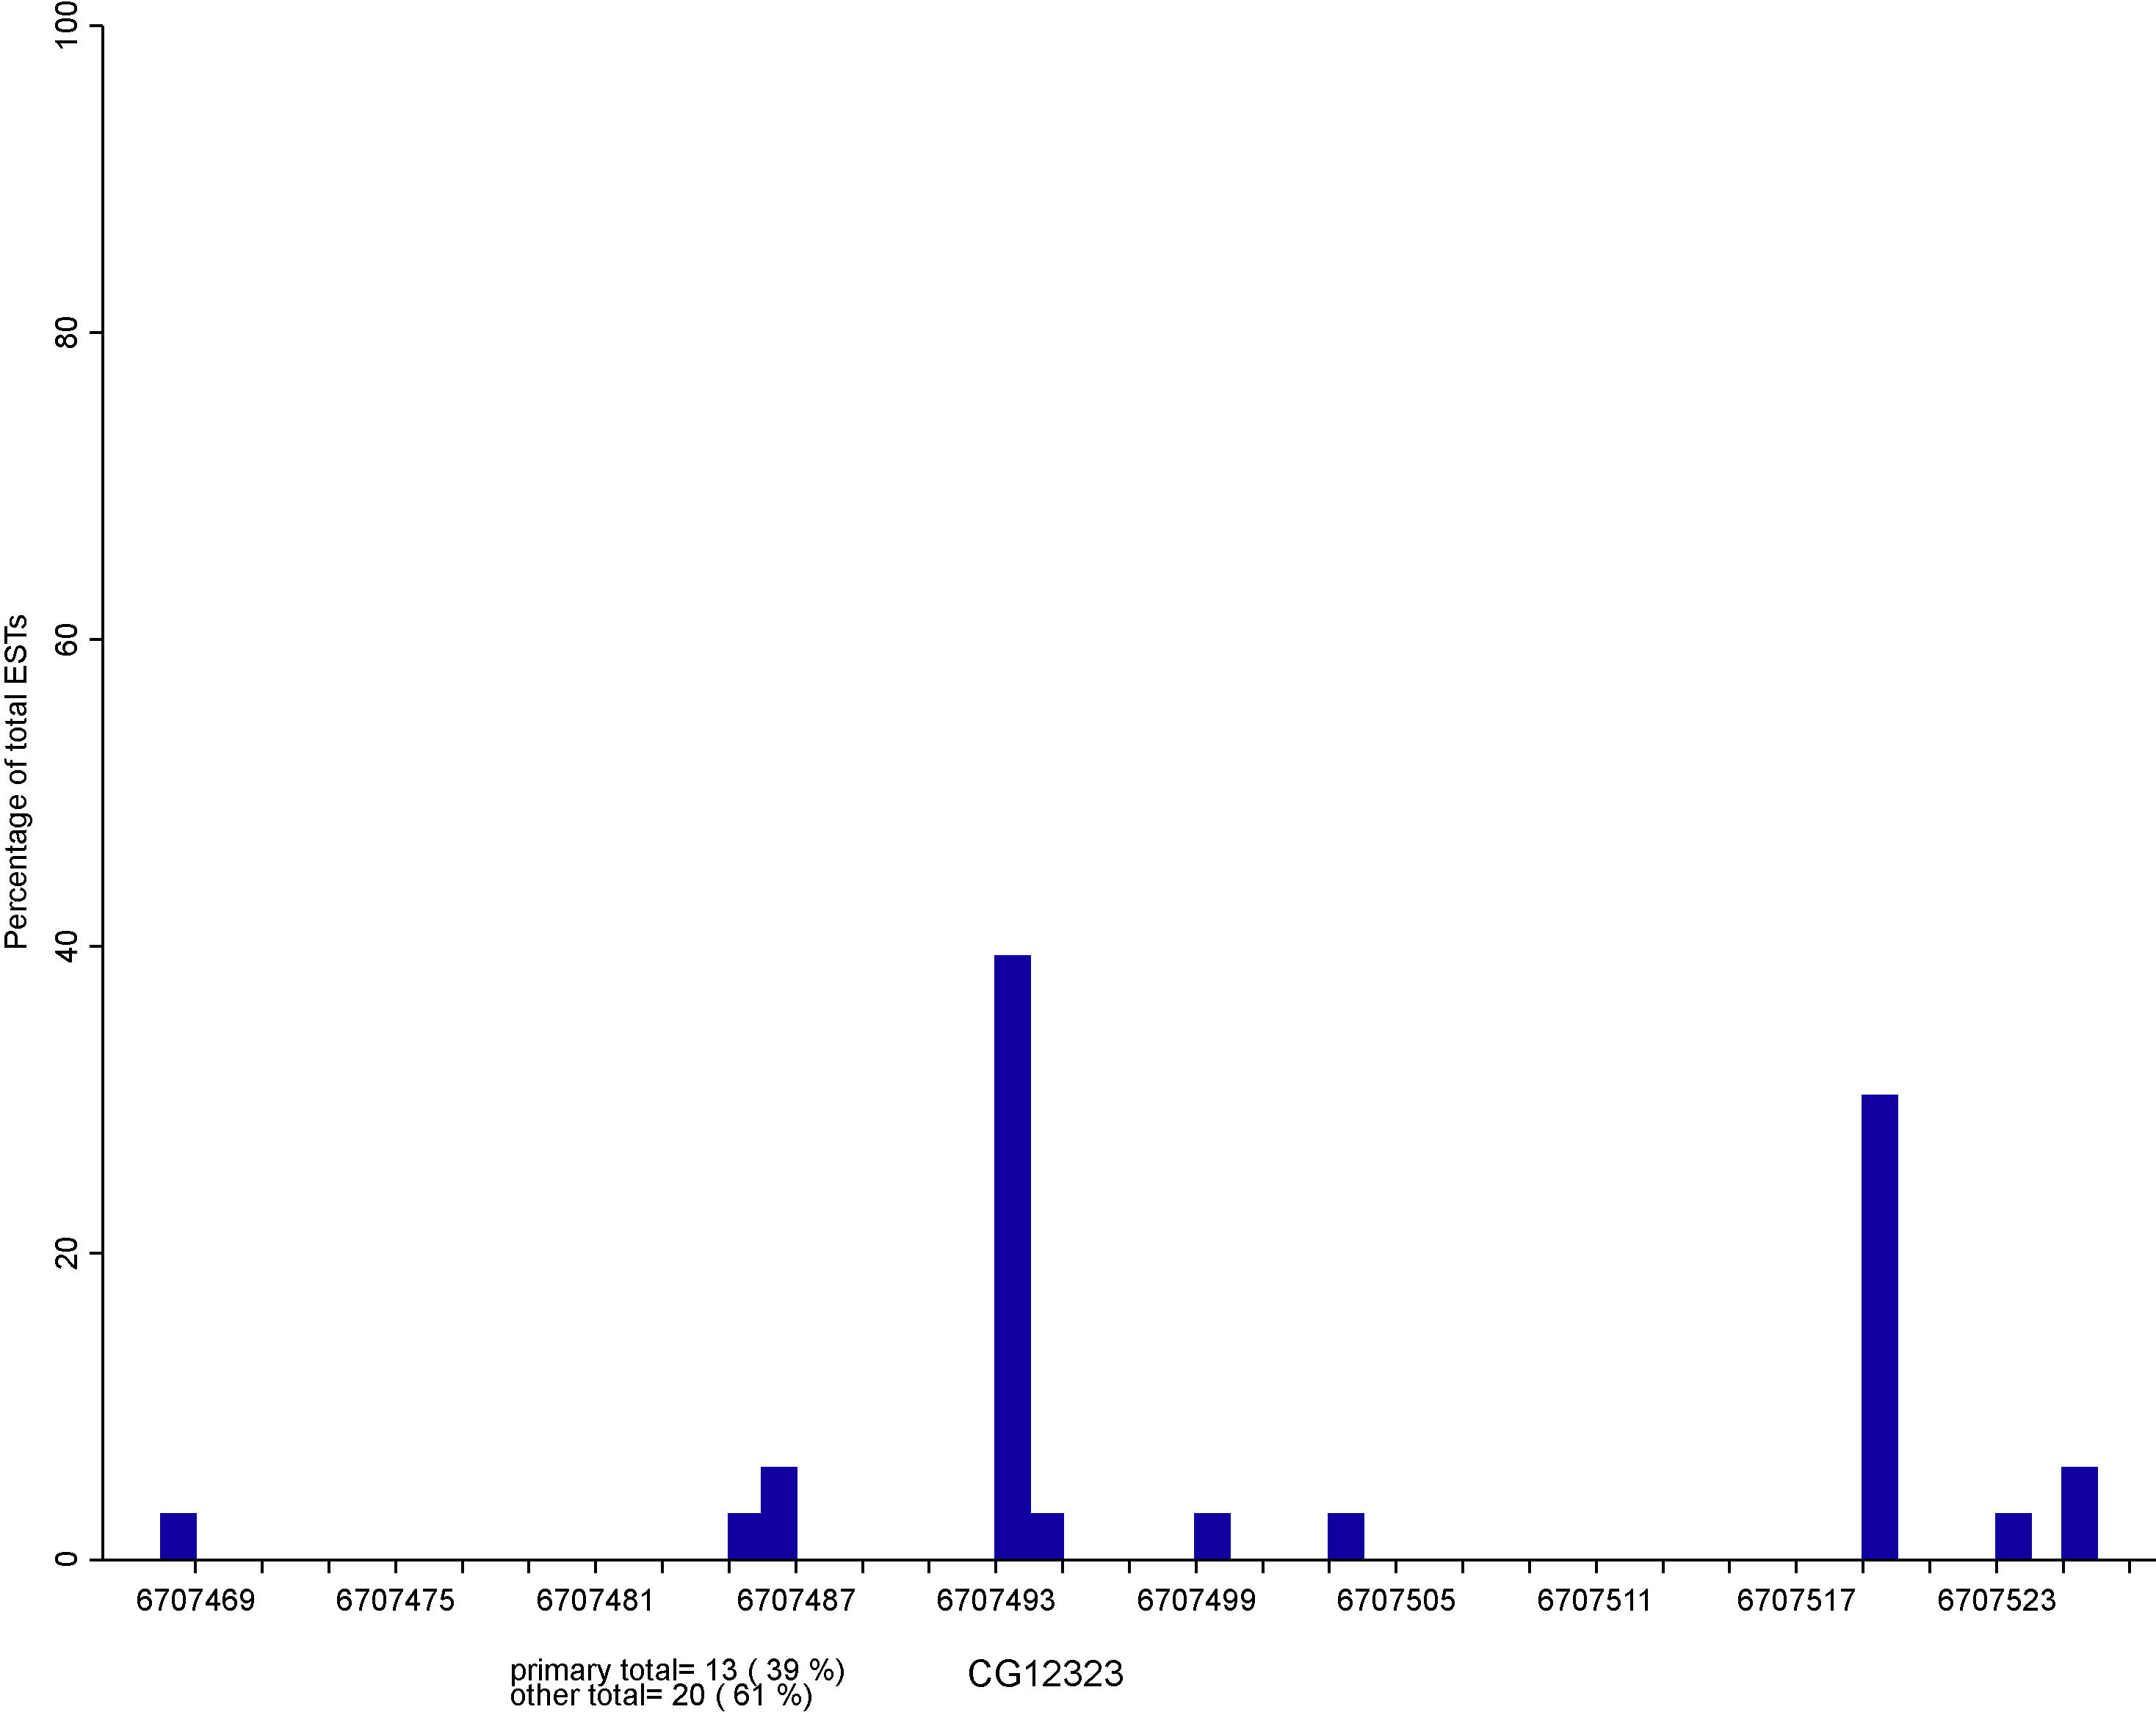
Analysis of transcription start sites
RE, RH
Single dominant Peak
1,002/2,738
Broad
63/2,738
Broad with dominant Peak
981/2,738
Multimodal Peak
692/2,738
Ben Booth and Joseph Carlson, LBNL; Classification Carninci et al., ‘06

Slide 14
Motif Abundance

Slide 15
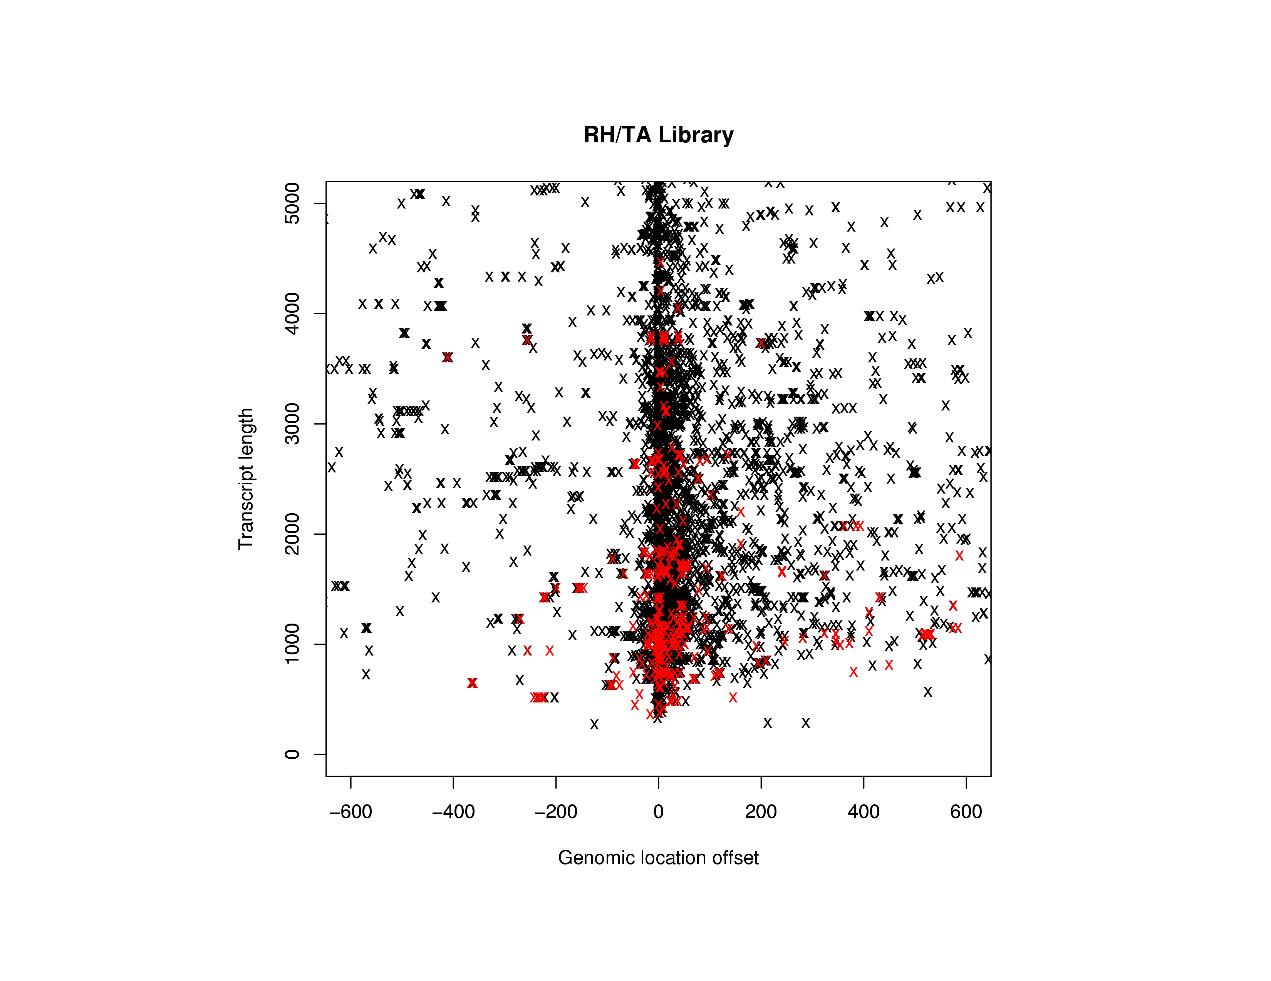
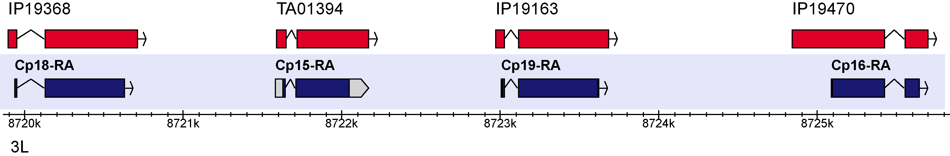
RLM cDNA Library
Charles Yu, Roger Hoskins and Joseph Carlson, LBNL

Slide 16
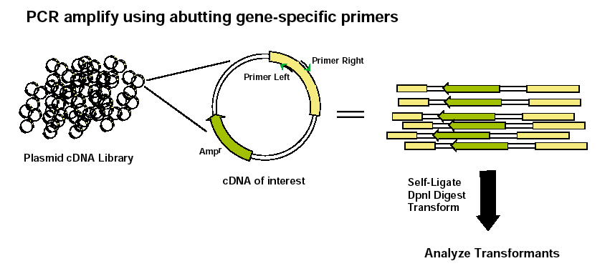
cDNA Library Screening Using iPCR
Advantages over RT PCR
Captures 5’ and 3’ UTRs
Captures splice variants
Extends predictions
Summary
Attempts 3,829
Recovered 2,047
Success rate 53%
Hoskins et al., (2005) NAR 33(21):e185
Wan et al., (2006) Nat Proto 1:624

Slide 17
cDNA Sequencing Corrects Gene Models

Slide 18
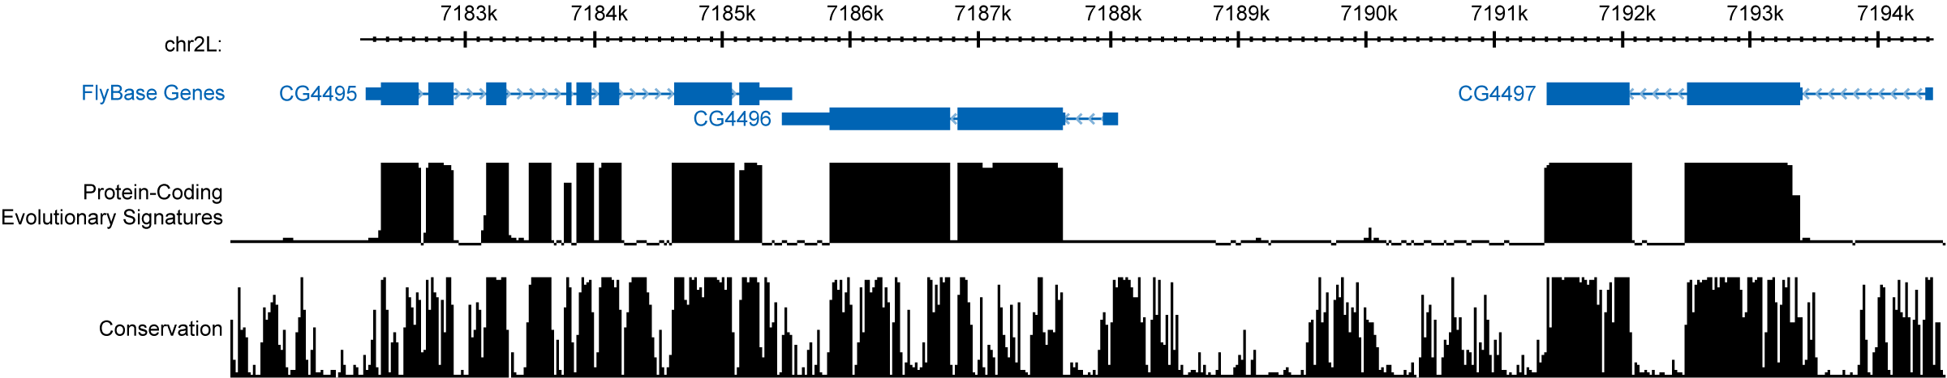
Power of Evolutionary Signatures for Exon Identification
High protein-coding signal, low conservation
  Ability to recognize fast-evolving exons
High conservation, but not protein-coding Evolutionary signatures specific to function
Collaboration with Manolis Kellis
Stark et al, Nature 2007 450:219: Lin et al., Genome Res. 2007 17:1823

Slide 19
Validation of the Transcriptome
* Comparison of FlyBase Release 5.2, 5.5 Annotations
and BDGP and Exelixis ESTs, BDGP cDNA
and modENCODE RT-PCR data

Slide 20
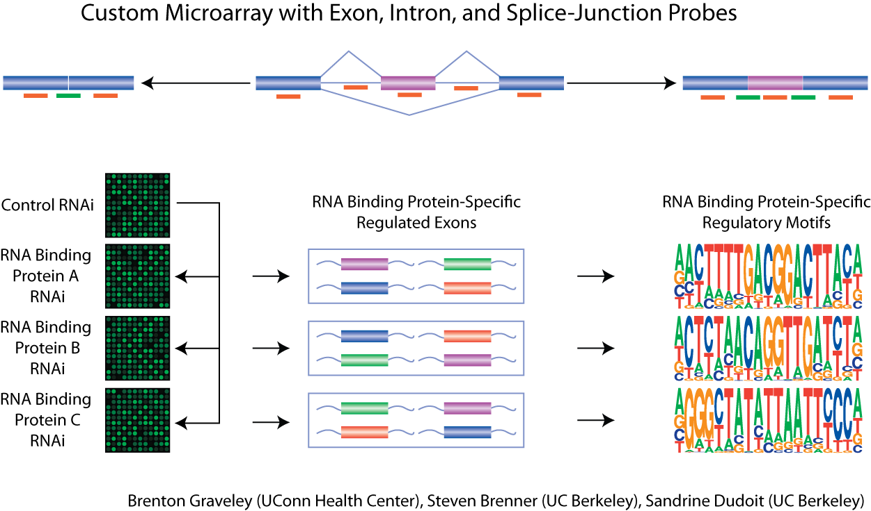

Slide 21

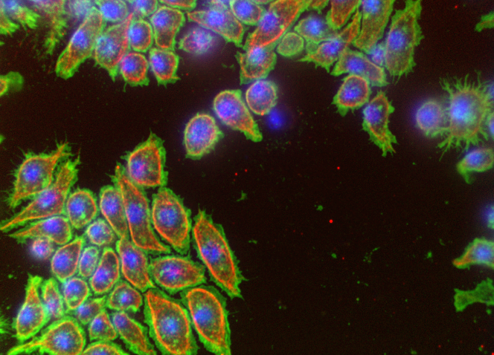
Plans for demonstrating biological relevance of ncRNAs
RNAi screens
DRSC dsRNAs arrayed in 384-well plates
Plate reader-based
assays
Microscopy-base
assays
Transcriptional-Luciferase
Reporter Assays
Protein modification
(phospho-specific antibodies)
GFP or antibodies
(Aerius)
Z-scores
Cell number
P-Akt level
700 nm
800 nm
P
DRSC: Drosophila RNAi Screening Center, Harvard Medical School
http://flyrnai.org/ - Mathey-Prevot and Perrimon

Slide 22
Acknowledgements
modENCODE Drosophila Transcriptome Project
UCB: Angela N. Brooks, Kasper D. Hansen, Sandrine Dudoit and Steven E. Brenner
LBNL: Roger Hoskins, Ann S. Hammonds, Joseph W. Carlson, Kenneth H. Wan, Charles Yu and Benjamin Booth
IU: Peter Cherbas, Justen Andrews, Lucy Cherbas, Dayu Zhang, David Miller, Andreas Rechsteiner, Thomas C. Kaufman and Justin P. Kumar
WashU: Laura Langton, Marijke J. van Baren, Aaron E. Tenney, Charles L. G. Comstock and Michael Brent
Affymetrix and CSH: Aarron T. Willingham, Philipp Kapranov, Srinka Ghosh and Thomas R.Gingeras
UCHC: Michael O. Duff, Li Yang, and Brenton R. Graveley
Harvard: Norbert Perrimon, Stephanie Mohr and Bernard Mathey-Prevot
Funding: modENCODE NHGRI, expression NHGMS

