Slide 1
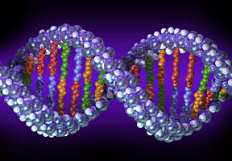
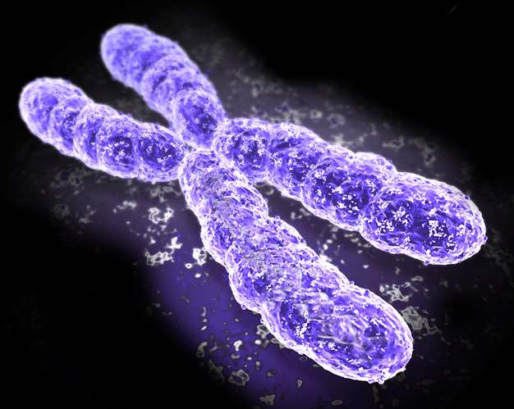
Genome-wide Mapping
of Chromosomal Proteins in Drosophila
Genome Sequence & Gene Expression
Chromosome Inheritance
& Genome Stability
Chromatin states &
Nuclear Organization
Notes:
Drosophila uniquely suited to making these functional correlations

Slide 2
The Players
Antibodies, Chromatin Preps, ChIP-Mapping, Validation
Gary Karpen - LBNL and UC Berkeley
Sarah Elgin - Washington University
Mitzi Kuroda - Harvard Medical School
Vince Pirrotta - Rutgers University
Bioinformatics / Computational Analysis
Peter Park - Harvard Medical School
Peter Kharchenko

Slide 3
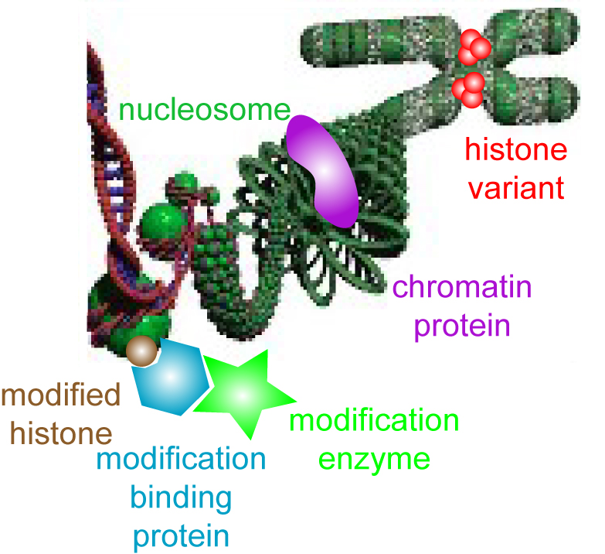
Which Proteins ?
~100 total
Histone modifications and variants (~50)
‘heterochromatin’, silenced genes
H3K9me,me2,me3
H3K27me,me2,me3
H2Av
‘euchromatin’, active genes
H3K4me,me2,me3
H3 and H4 K acetylations (limited)
H2Av
Histone modifying enzymes (~25)
Su(var)3-9, G9a, dSET DB1 (H3K9me)
TRX, TRR, ASH1 (H3K4me)
E(z) (H3K27me)
LSD1 demethylase (H3K4me)
JMJD2A, UTX demethylases (H3K9me, H3K27me)

Slide 4
Which Proteins ?
Chromosomal proteins (~25)
Histone modification binding
Pc (H3K27me)
HP1 (H3K9me)
H2Av
Chromatin remodeling
SWI/SNF
NURF
ACF
Insulators
Su(Hw)
Mod(mdg)4
‘Epigenetic Sets’
CTCF
3D architecture
H3K9me, me2, me3: modifications
Nuclear lamina and pores
Su(var)3-9, G9a, dSET DB1: methylases
Lamin C
JMJD2A: demethylase
Lamin B receptor
Nup 153
HP1: binds H3K9me2 and 3, Su(var)3-9

Slide 5
More details
Poster # 767B

Slide 6
General Approach: ChIP

Slide 7
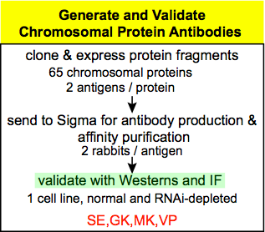
Antibodies
purchase histone modification/
variant-specific antibodies
~30
Validate these (mass spectrometry)
antibody production &
obtain existing antibodies for
other chromosomal proteins (~20)
make antibodies for other ~30 chromosomal proteins
two Abs: against two protein fragments per protein

Slide 8
Donate good antibodies

Slide 9
Chromatin Preparation
3 cell lines (MK, VP)
S2 ( embryonic)
Cl.8+ (larval wing disc)
MLDmBG3-c2 (neuronal)
2 embryo stages (SE)
2-4 hrs (blastoderm, relatively uniform)
14-16 hrs (highly determined/differentiated)
Target: map 100 proteins in these 5 sources
150 proteins/modifications on lists
initially will just use 2 cell lines (S2 & Cl.8)
to identify which proteins show interesting patterns,
which redundant/less interesting (e.g. histone acetylations)

Slide 10
Differentiayed tissues
1) salivary glands-direct correlation with protein mapping on polytenes
2) third instar wing discs-undifferentiated and diploid, show specific patterns of gene silencing and activation, and of interest for comparisons with Cl.8+ cells
3) adult heads-terminally-differentiated diploid cells
4) germ-line cells- likely to be the most undifferentiated cells in the organism, could identify a baseline state for chromatin

Slide 11
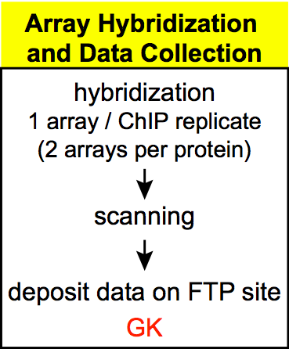
Data Collection
Affymetrix Genome Tiling Arrays
Direct sequencing
Solexa ?? ABI??
better coverage (e.g. satellites)
more quantitative?
cheaper?
availability?
Rutgers Facility
VP

Slide 12
ChIP/seq
may offer very significant advantages in resolution and dynamic range
Kuroda & Park

Slide 13
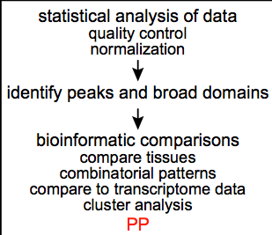
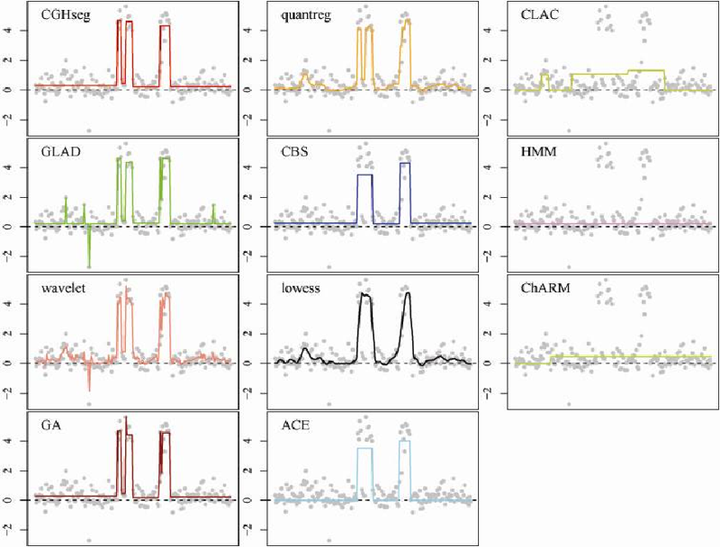
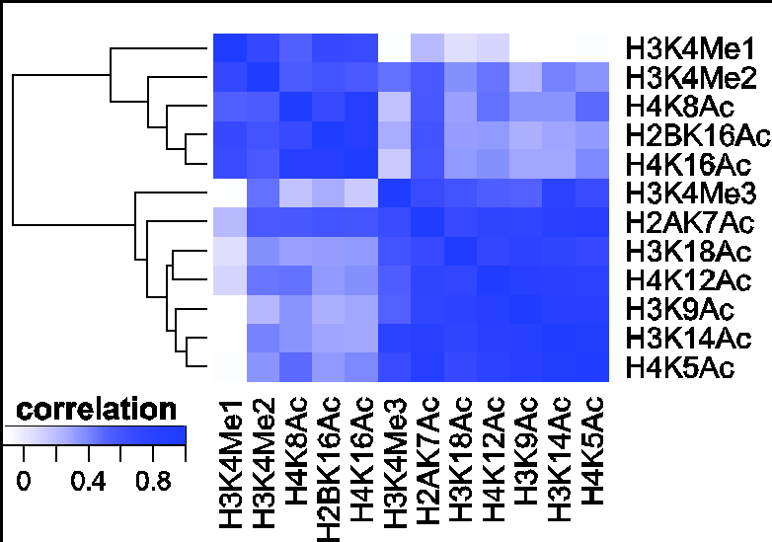
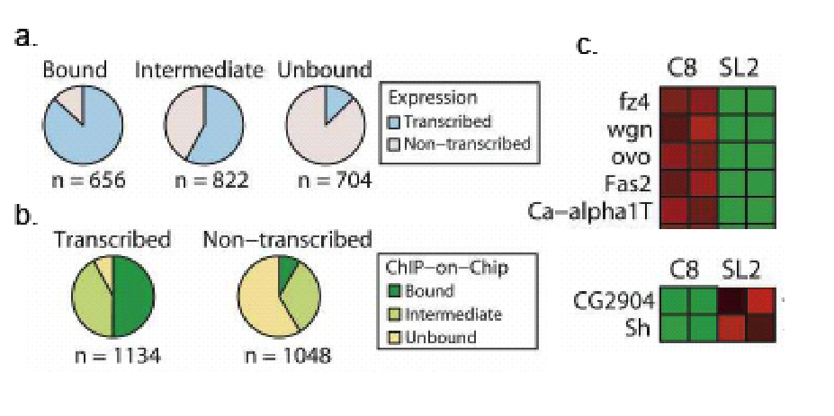
Data Analysis

Slide 14
Data Submission
submit all data to DCC once verified, update after validation
all antibodies will be made available to the ‘public’

Slide 15
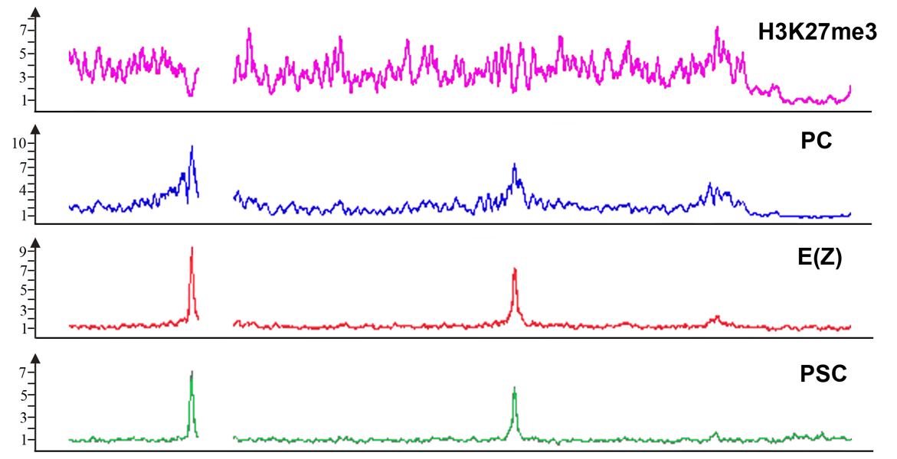
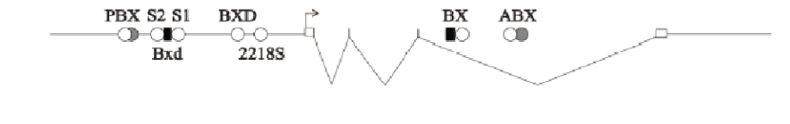
PcG proteins and histone modifications
at the Ubx gene

Slide 16
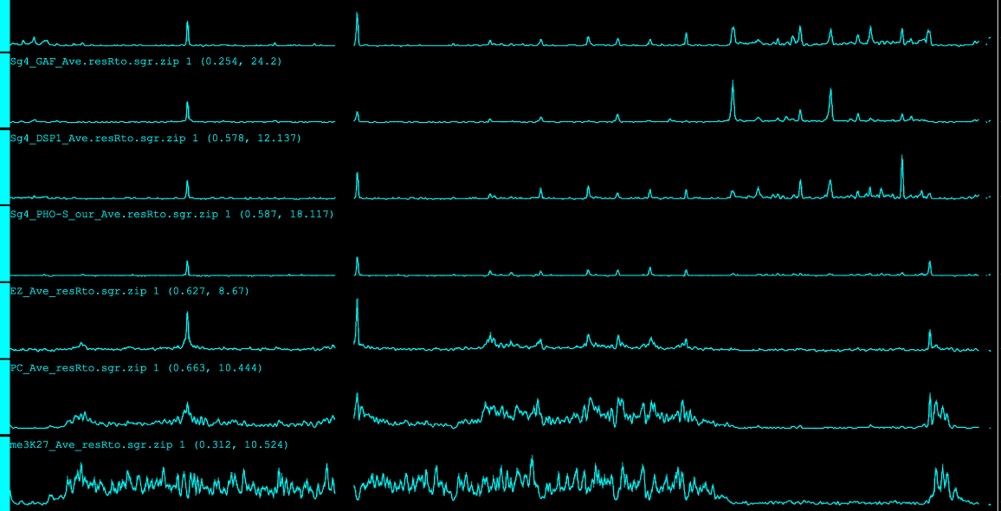
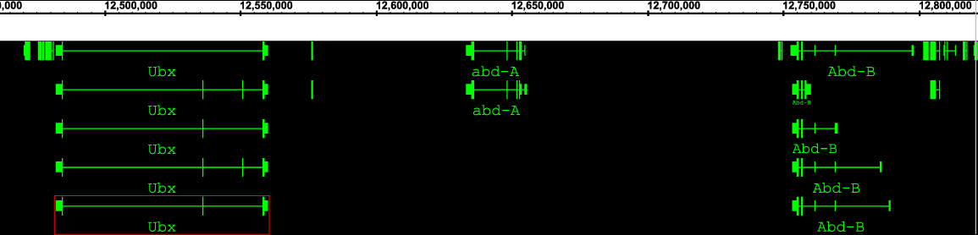
TRX-C
GAF
DSP1
PHO
E(z)
PC
K27me3
bx
bxd
iab2
Mcp
Fab7
Fab8
Yuri Schwartz & Tanya Kahn

Slide 17
Binding sites
for DNA binding proteins with
known connection to PcG function
protein | “traditional” binding consensus | Microarray-based binding consensus
GAF | GAGAG | pair of GAGAG spaced from 1 to 150bp
PHO | GCCAT | GCNGCCATttt
DSP1 | GAAAA | GTTGTT, GTGCGT
PSQ | GAGAG | gtgGTGACCG, CGATA

Slide 18
TRX-C
GAF
DSP1
PHO
E(z)
PC
K27me3
bx
bxd
iab2
Mcp
Fab7
Fab8
Yuri Schwartz & Tanya Kahn

Slide 19
91%
computationally defined PREs in Sg4
show prominent binding of TRX-C

Slide 20
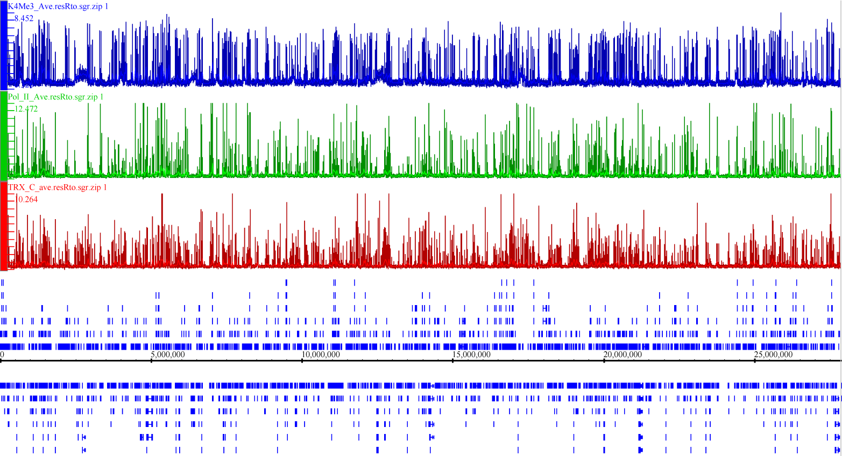
TRX-C binds to thousands of active genes
(3R chromosome in Sg4 cells)
H3K4me3
Pol II
TRX-C
Yuri Schwartz & Tanya Kahn

Slide 21
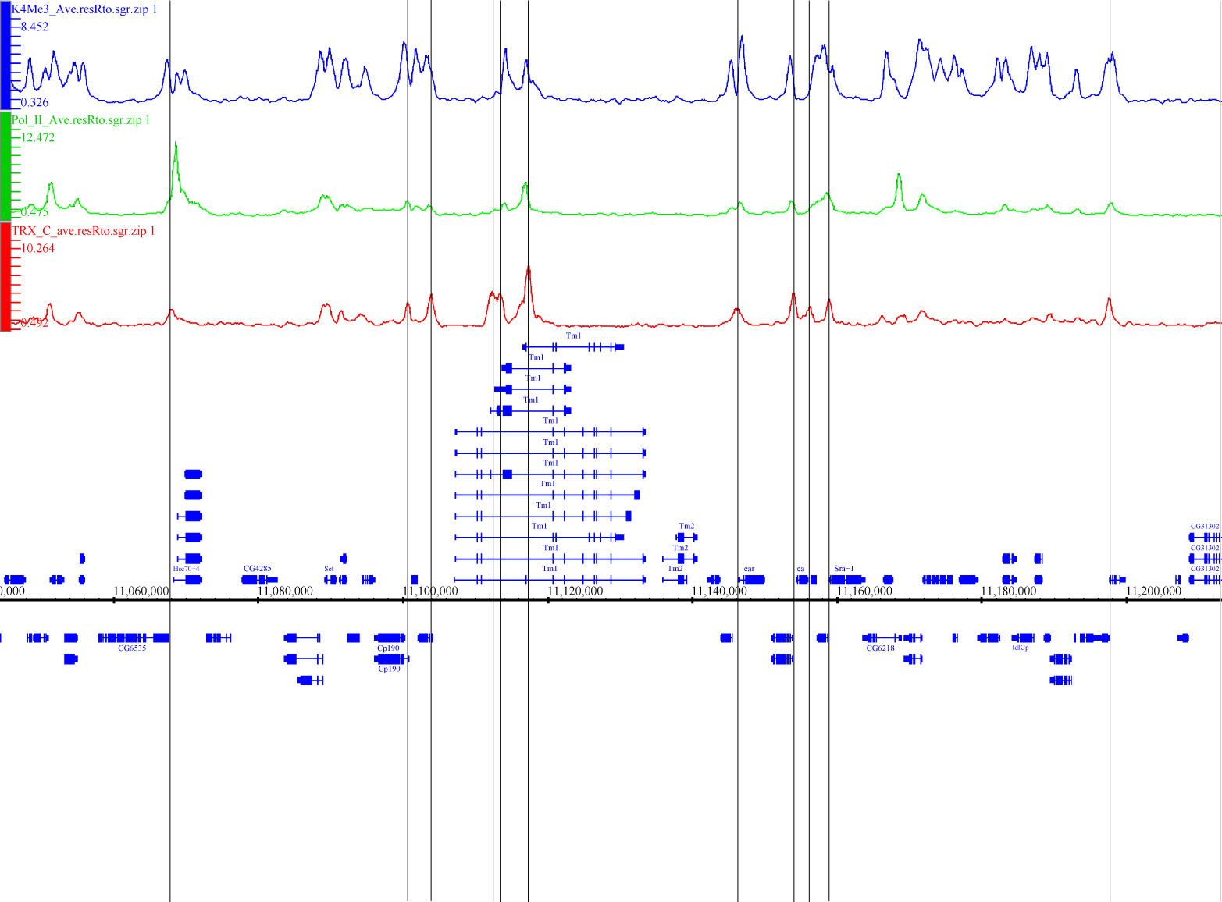
TRX-C binds to thousands of active genes
(fragment of 3R chromosome)
H3K4me3
Pol II
TRX-C
Yuri Schwartz & Tanya Kahn

Slide 22
TRX at TSS

Slide 23
Alternative chromatin states of PcG target genes
Cell lines: Sg4 – embryonic origin
BG3c2 – neural origin
D23 – wing imaginal disc
Proteins: Pc, Ez, (Psc for Sg4 only), H3K27me3
Trx-C, Trx-N, Ash1, PolII,
H3K4me3, H3K27Ac

Slide 24
Overlapping between semicomplete PcG sites
Found in BG3
84(85%)
Lost E(z) binding
in BG3
7(47%)
Sg4 (Pc, Ez, K27me3)
99
Absent in BG3
15(15%)
Lost Pc, Ez, K27me3
in BG3
8 (53%)
Active in BG3
(Ash1 and K27Ac domain)
3
Mute in BG3
(No Ash1, Pc, K27me3, K27Ac)
5
Yuri Schwartz & Tanya Kahn

Slide 26
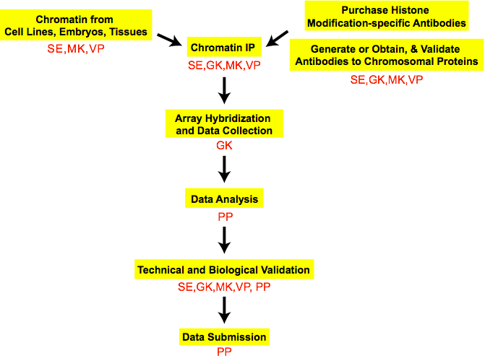
General Plan and Expectations
validated ‘landscape’ of histone modifications/variants & other chromosomal proteins
epigenetic interactions,
cell- and tissue-specific differences
correlations with each other, transcripts, functional elements

Slide 27
General Approach: ChIP-array, ChIP-chip
VP

