Slide 1
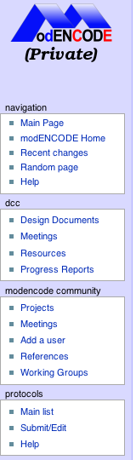
How to create a new protocol
Click on the “Submit/Edit” link under protocols

Slide 2
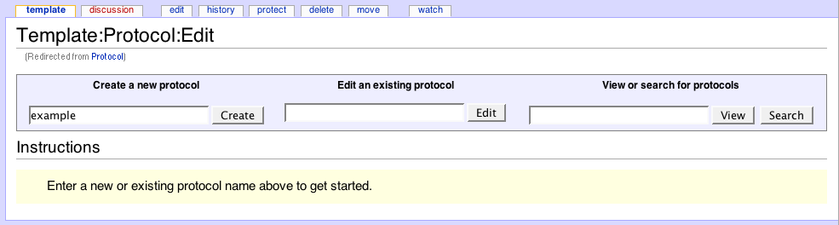
Choose a name for the protocol, then click ‘Create’

Slide 3
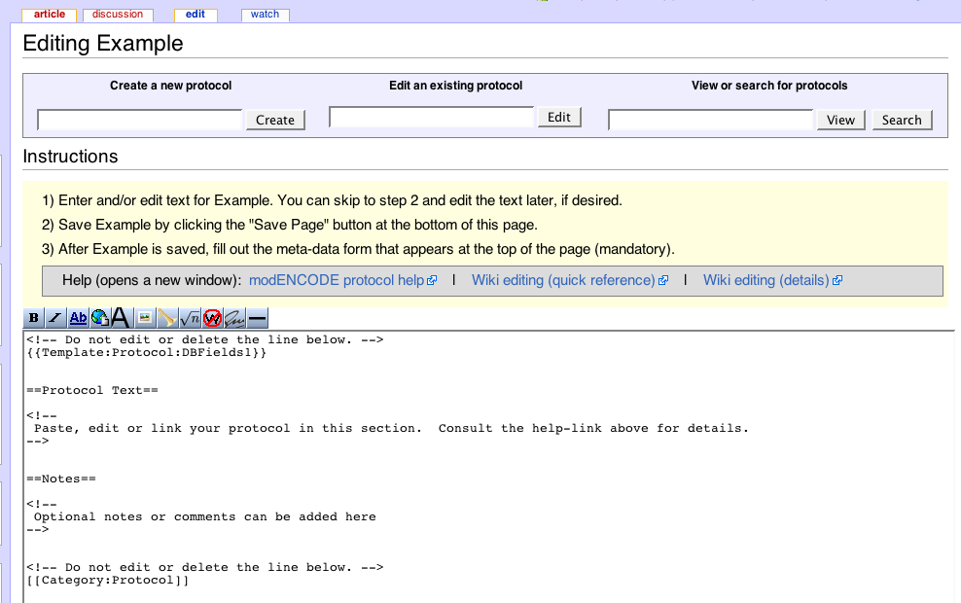
Help links (each will open a new window/tab)
Page template
This will take you to a new page in Edit mode. There are several help links and a page template is preloaded.

Slide 4
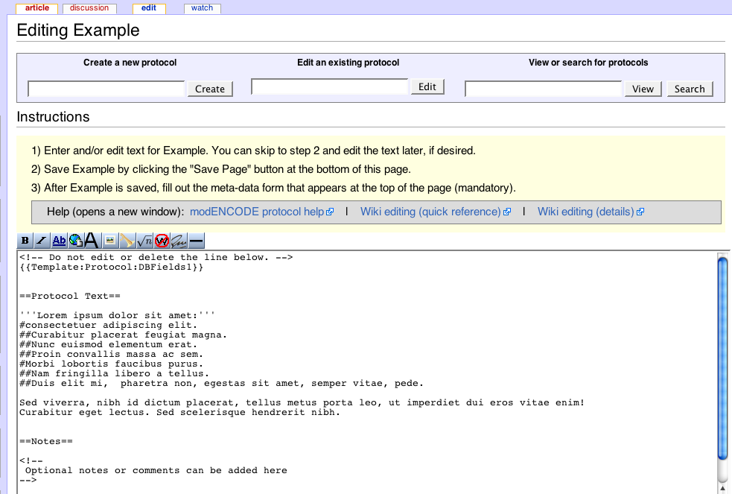
Paste and/or enter the protocol text and save the page. See “modENCODE protocol help” for other ways to import protocol text.

Slide 5
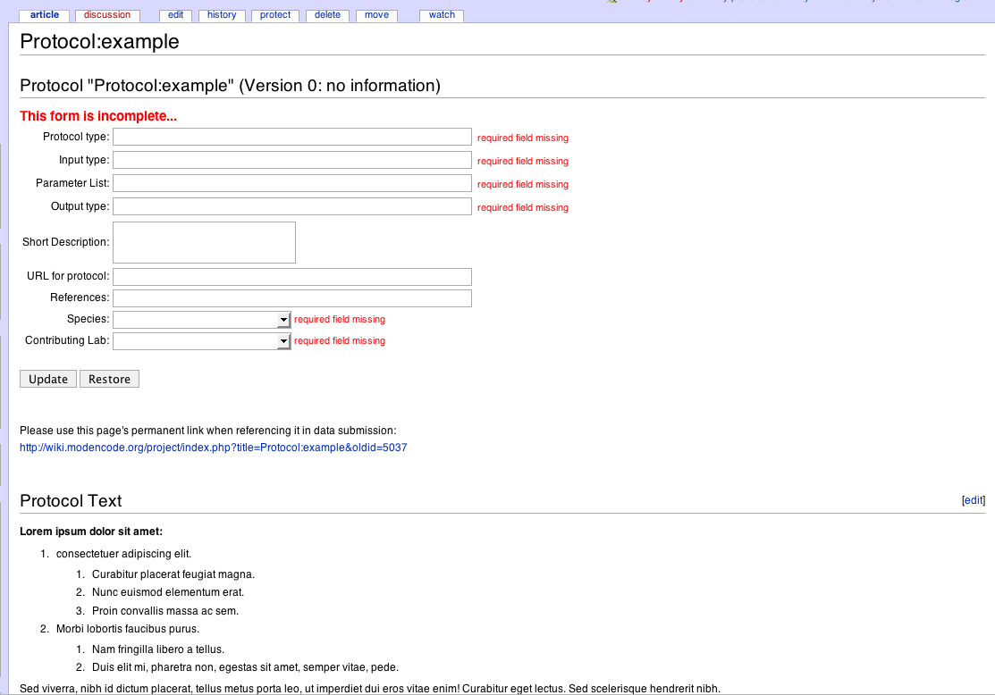
Once the new protocol is saved, fill out the form at the top of the page

Slide 6
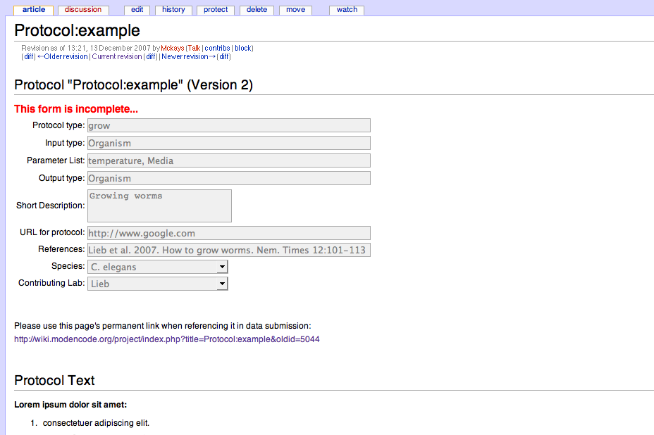
Permanent Link
Once the form is completed, the version will be saved and closed to further input.
Use the permanent link to cite this version of the protocol
Subsequent edits to the protocol text will become new versions, which will allow edits to the meta-data and will create a new permanent link

