Slide 1
WELCOME

Slide 2
HTML
HTML STANDS FOR HYPER TEXT MARKUP LANGUAGE

Slide 3
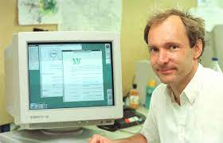
HTML WAS DEVELOPED BY TIM BERNES LEE

Slide 4



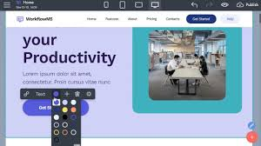
It is used to create webpages

Slide 5
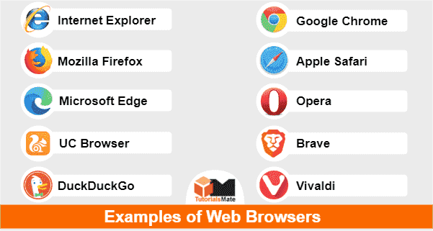
The output is displayed in browser

Slide 6
Html editors
Notepad
Notepad++
Sublime
Brackets
Atom
Visual Studio

Slide 7
Html basic structure
<!DOCTYPE html> <html> <head> <title>Trylogic</title> </head> <body> <p>Hello</p> </body> </html>

Slide 8
<!DOCTYPE html>
It Defines the version of html

Slide 9
<html> . . </html>
It is the root of html

Slide 10
<head> . . </head>
It is used for information purpose

Slide 11
<title> . </title>
It is to set title of webpage

Slide 12
<body> . . </body>
It is visible part

Slide 13
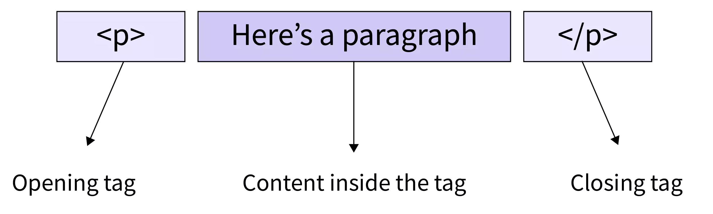
Tag
A tag is something written in angular brackets

Slide 14
Types in tags
There are three types of tags
Paired tags
Unpaired tags
Self closing tags

Slide 15
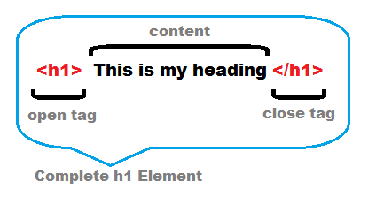
Paired tags
Tags that have opening and closing tags it is paired tags.

