Slide 1
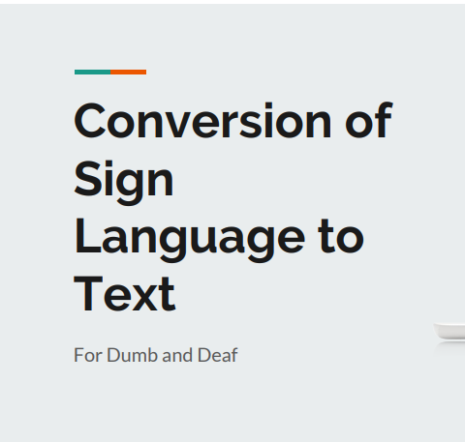
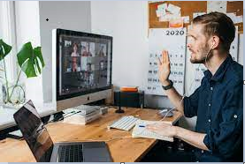

Slide 2
Faculty associated
Students
associated
Prof. Amit Manjhwar
Prof. Jamvant S. Kumare
Karishma Parashar
0901CS181053
Khushbu Modani
0901CS181054

Slide 3
Introduction
Communication with the hearing impaired (deaf/mute) people is a great challenge in our society today; this can be attributed to the fact that their means of communication (Sign Language or hand gestures at a local level) requires an interpreter at every instance. Conversion of images to text can be of great benefit to the non-hearing impaired and hearing impaired people (the deaf/mute) from circadian interaction with images.

Slide 4
Objective
Our project aims to create a
computer application and train
a model which when shown a
real time video of hand gestures
of American Sign Language
shows the output for that
particular sign in text format on
the screen.

Slide 5
Software Requirements
Python 3.8.4
TensorFlow 2.3.0
OpenCV 4.5.1.48
Keras 2.4.3
PIL
OS
Tkinter 8.6.10

Slide 6
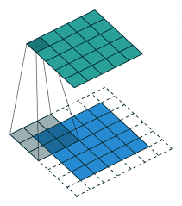
Convolutional Neural Networks
CNNs consist of multiple convolutional layers each layer containing numerous “filters” which perform feature extraction.
Initially these “filters” are random and by training, the feature extraction gets better by better.
It’s primarily used for image classification

Slide 7
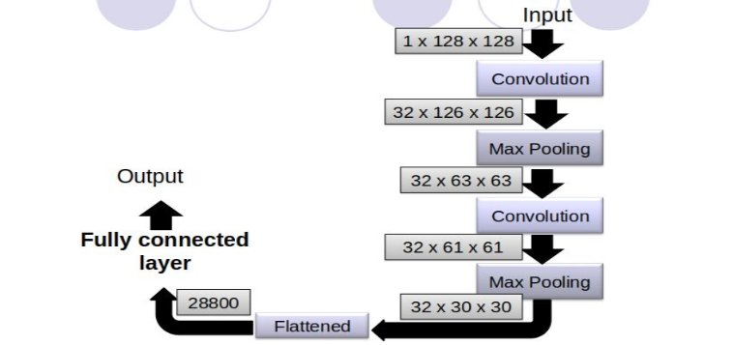
CNN Classifier Model

Slide 8
Implementation
DATA ACQUISTION
To achieve a high accuracy for sign recognition in sign language recognition system, 100 images will be taken for each signs. These images are included in training and testing database. The captured image at a distance is adjusted by the signer to get the required image clarity
PRE-PROCESSING
Pre-processing consist image acquisition, segmentation and morphological filtering methods.

Slide 9
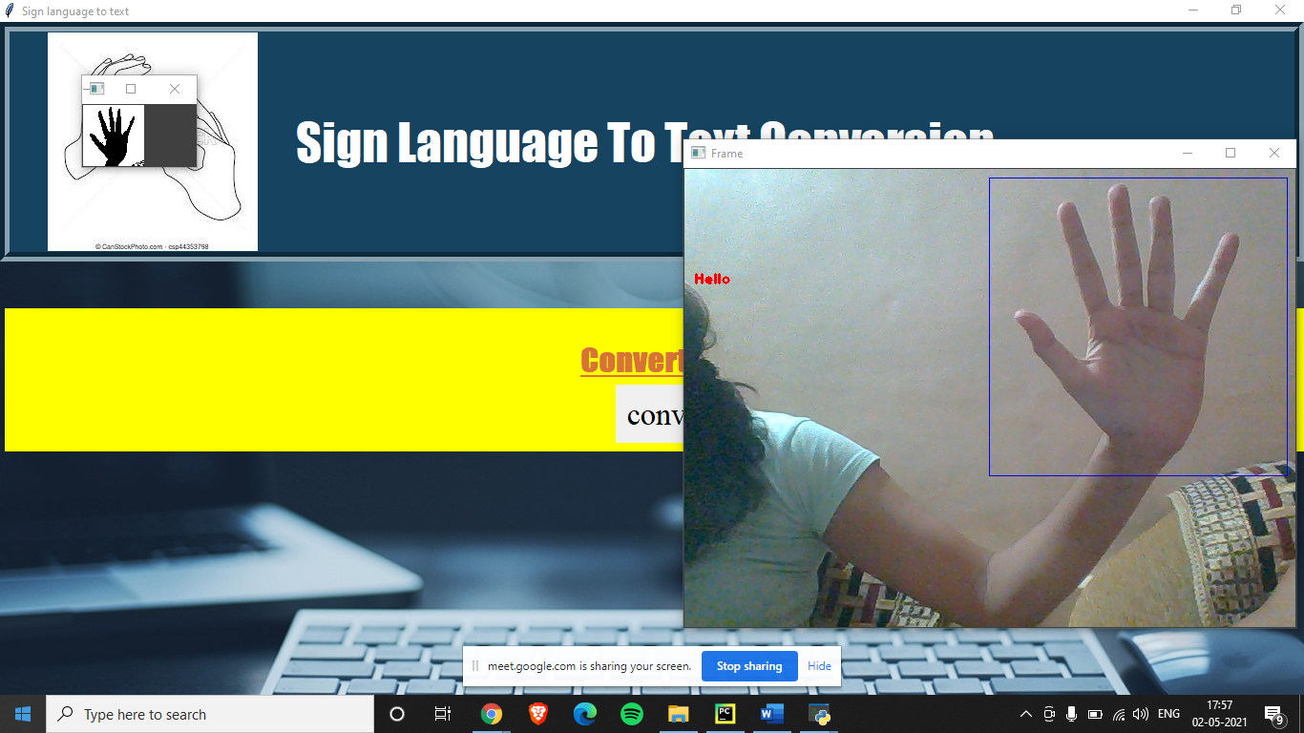

Created our own Dataset
Capturing Raw Image
Image Post Gaussian Blur

Slide 10
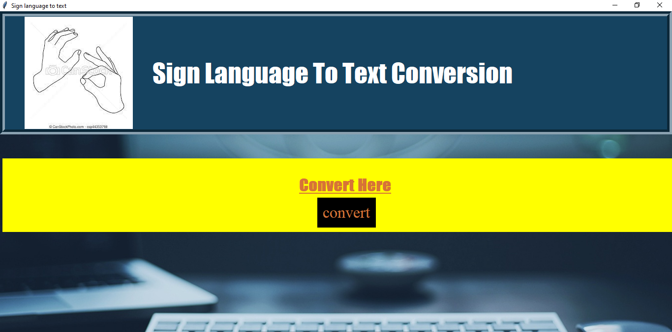
Our GUI Snapshot

Slide 11
Our Application’s Snapshots

Slide 12
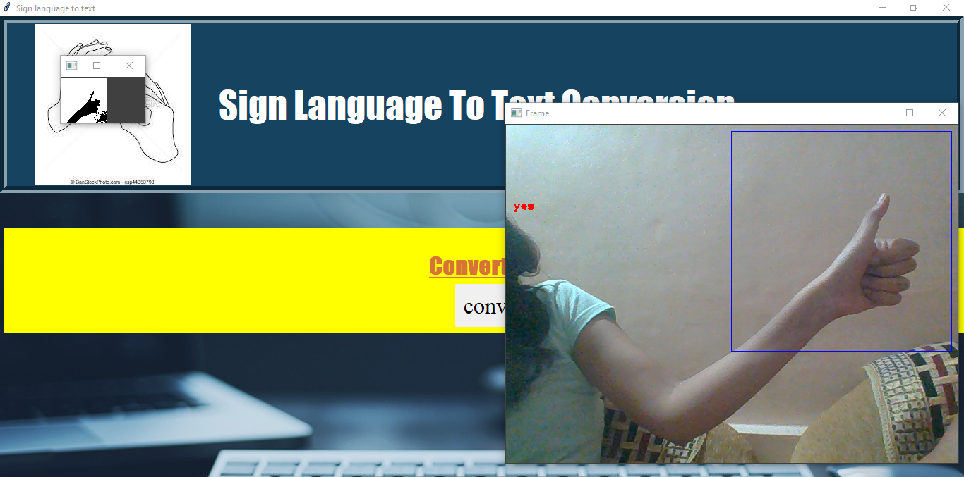
Continue…

Slide 13
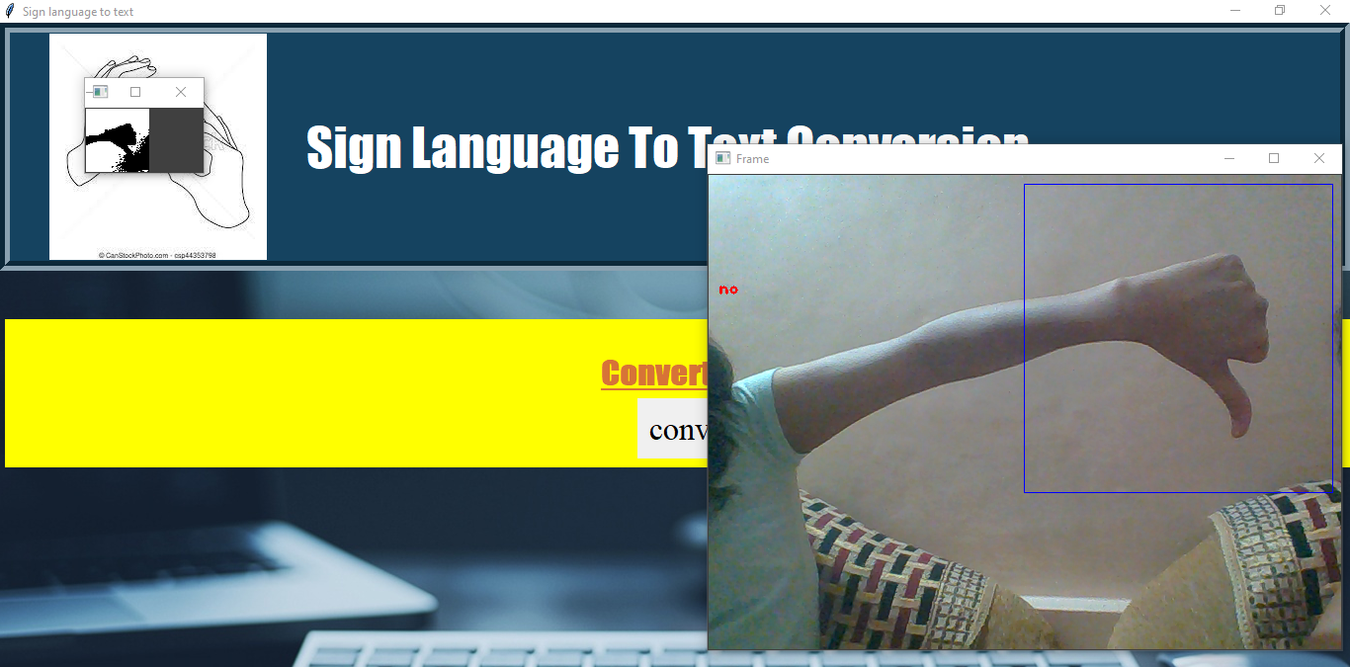
Continue…

Slide 14
Conclusion
Using various concepts of image processing and fundamental properties of image, recognizer of gesture has successfully by developed this system.
Every God creature has an importance in the
society, remembering this fact, let us try to include hearing
impaired people in our day to day life and live together.

Slide 15
Future Work
We are planning to achieve higher accuracy even in case of complex backgrounds by trying out various background subtraction algorithms.
We are also thinking of improving the preprocessing to predict gestures in low light conditions with a higher accuracy.

