Slide 1
MYNTRA SALES DASHBOARD
A simple, visual explanation of the dataset and its charts
30 orders | 43 units sold | ₹62,057 sales value
Prepared from the uploaded myntra_sales_dataset.csv
Easy-language presentation • October 2026

Slide 2
1. Dataset Overview
What this dashboard is built from
Total Orders
Units Sold
Sales Amount
30
43
₹62,057
Average Rating
Products
Cities
4.16 / 5
15
20
The file contains 30 order records from January 2026. It includes product, brand, city, payment method, order status and customer rating. Each chart answers a different business question—for example, what sells best, where orders come from, and how customers rate their experience.
Myntra Sales Dataset • Dashboard explanation
2

Slide 3
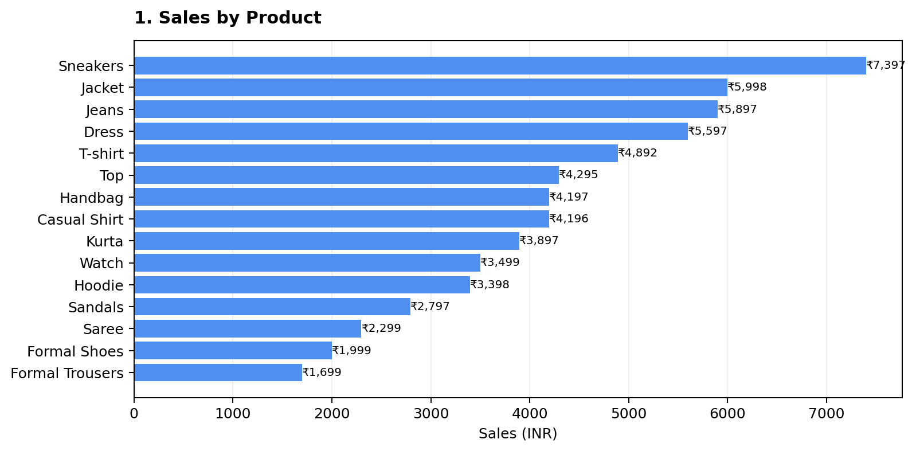
1. Dashboard Chart Explanation
Read the chart first, then use the note below to understand what it means.
IN SIMPLE WORDS
Shows which product categories bring in the most sales. Sneakers lead at ₹7,397, followed by Jackets and Jeans. This helps prioritize stock and promotions.
Tip: Compare totals and context together.
Myntra Sales Dataset • Dashboard explanation
3

Slide 4
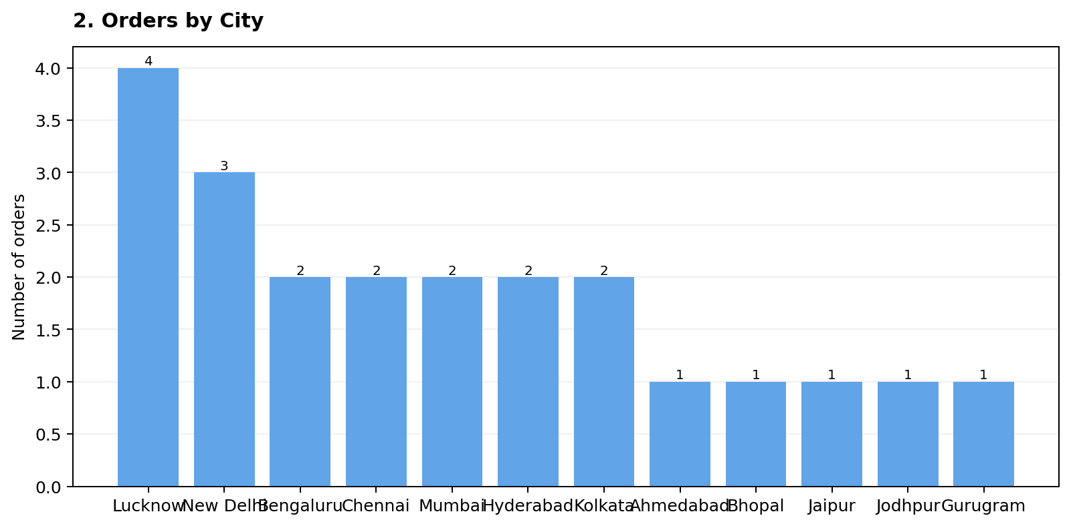
2. Dashboard Chart Explanation
Read the chart first, then use the note below to understand what it means.
IN SIMPLE WORDS
Counts orders placed in each city. Lucknow has the most orders (4), while New Delhi has 3. Many cities have only one order, so comparisons should be treated as early signals.
Tip: Compare totals and context together.
Myntra Sales Dataset • Dashboard explanation
4

Slide 5
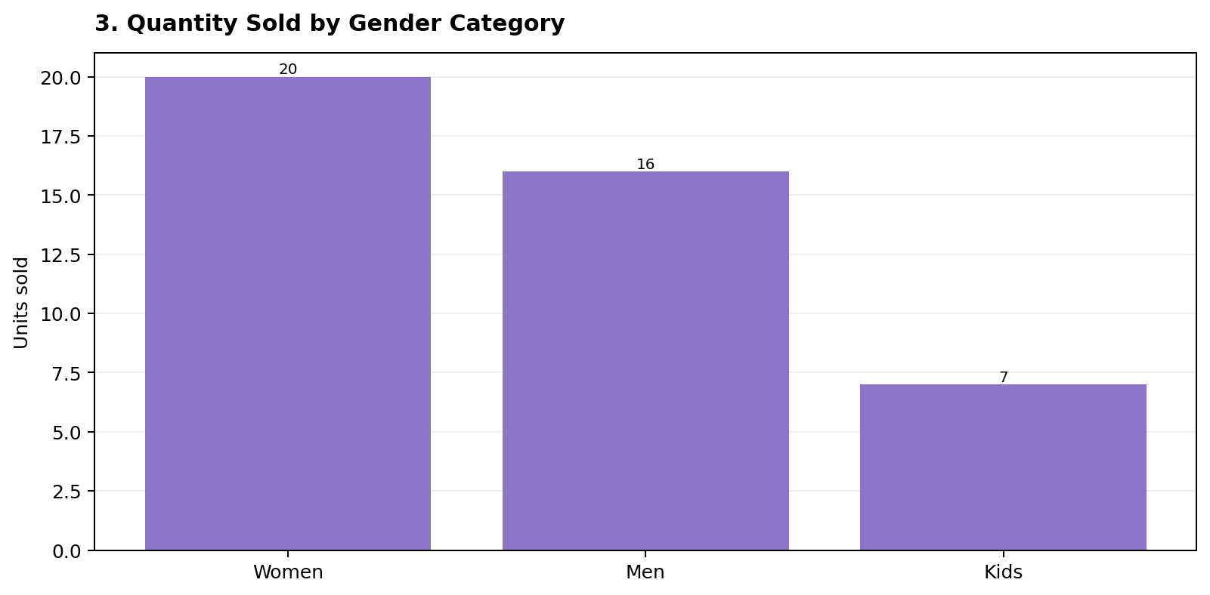
3. Dashboard Chart Explanation
Read the chart first, then use the note below to understand what it means.
IN SIMPLE WORDS
Compares the number of items sold to Women, Men and Kids categories. Women account for 20 units, Men 16 and Kids 7. Women are the largest group in this sample.
Tip: Compare totals and context together.
Myntra Sales Dataset • Dashboard explanation
5

Slide 6
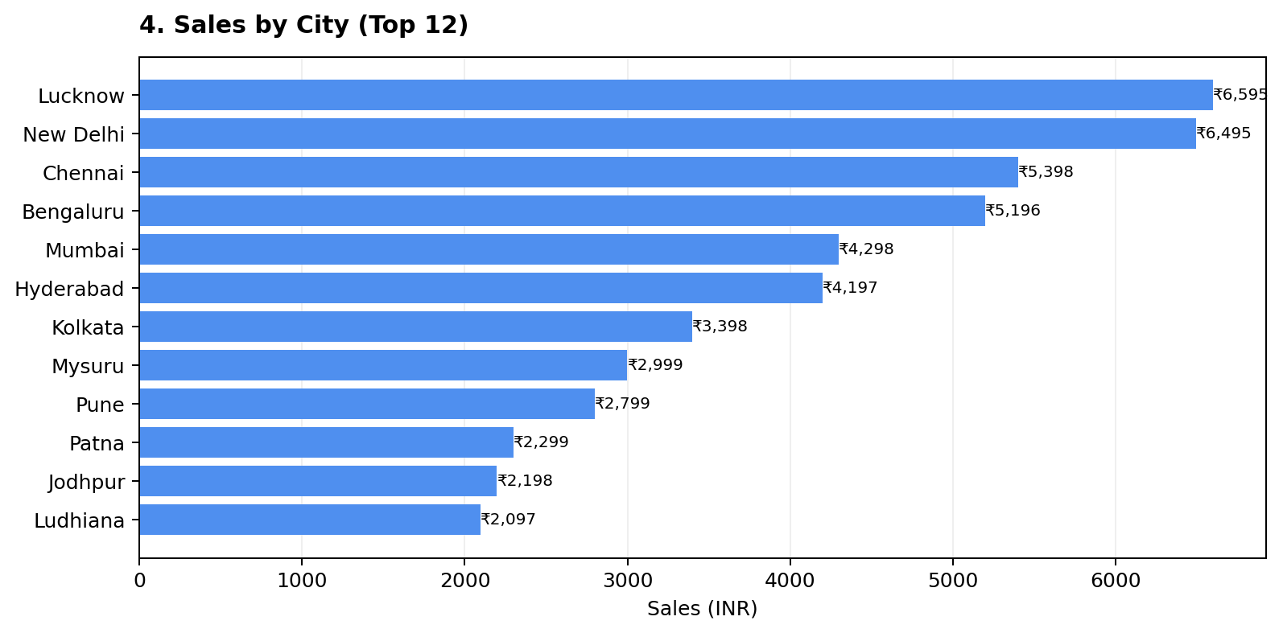
4. Dashboard Chart Explanation
Read the chart first, then use the note below to understand what it means.
IN SIMPLE WORDS
Shows the total sales value from each city. Lucknow (₹6,595) and New Delhi (₹6,495) are the top two. These cities may be useful for targeted campaigns.
Tip: Compare totals and context together.
Myntra Sales Dataset • Dashboard explanation
6

Slide 7
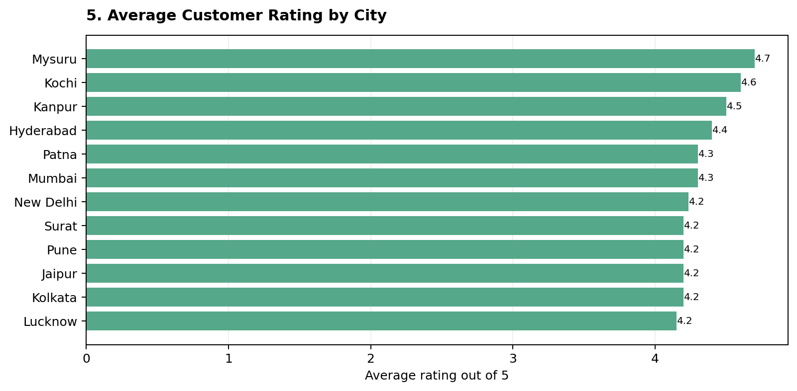
5. Dashboard Chart Explanation
Read the chart first, then use the note below to understand what it means.
IN SIMPLE WORDS
Displays the average customer rating for each city. Mysuru has the highest average (4.7), but it has only one order. Use ratings with order counts for fair comparisons.
Tip: Compare totals and context together.
Myntra Sales Dataset • Dashboard explanation
7

Slide 8
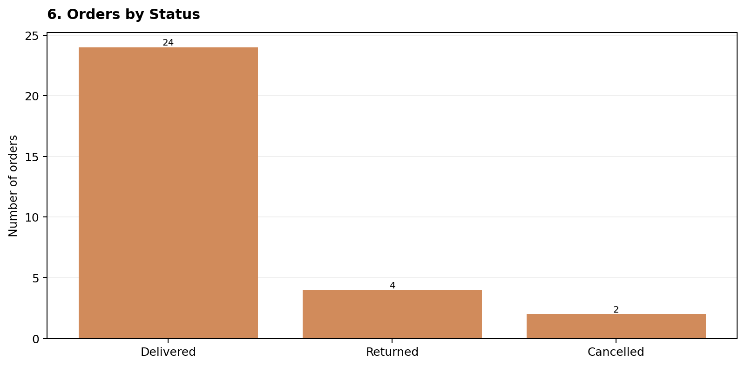
6. Dashboard Chart Explanation
Read the chart first, then use the note below to understand what it means.
IN SIMPLE WORDS
Shows how orders ended: 24 delivered, 4 returned and 2 cancelled. Most orders were delivered, but returns and cancellations should be reviewed to improve customer experience.
Tip: Compare totals and context together.
Myntra Sales Dataset • Dashboard explanation
8

Slide 9
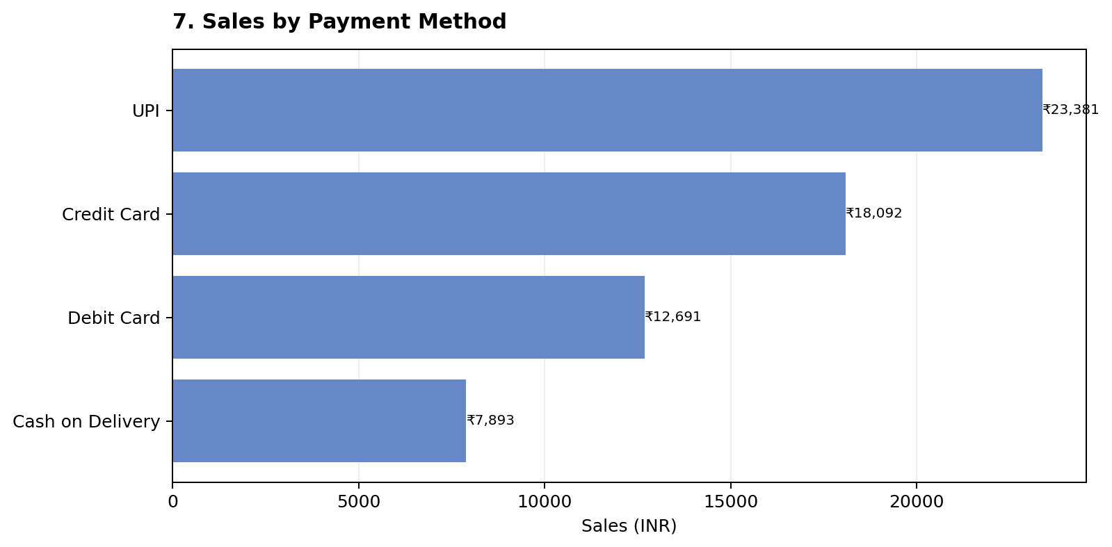
7. Dashboard Chart Explanation
Read the chart first, then use the note below to understand what it means.
IN SIMPLE WORDS
Compares sales value by payment type. UPI contributes the most sales (₹23,381), followed by Credit Card (₹18,092). This can help guide checkout and payment support decisions.
Tip: Compare totals and context together.
Myntra Sales Dataset • Dashboard explanation
9

Slide 10
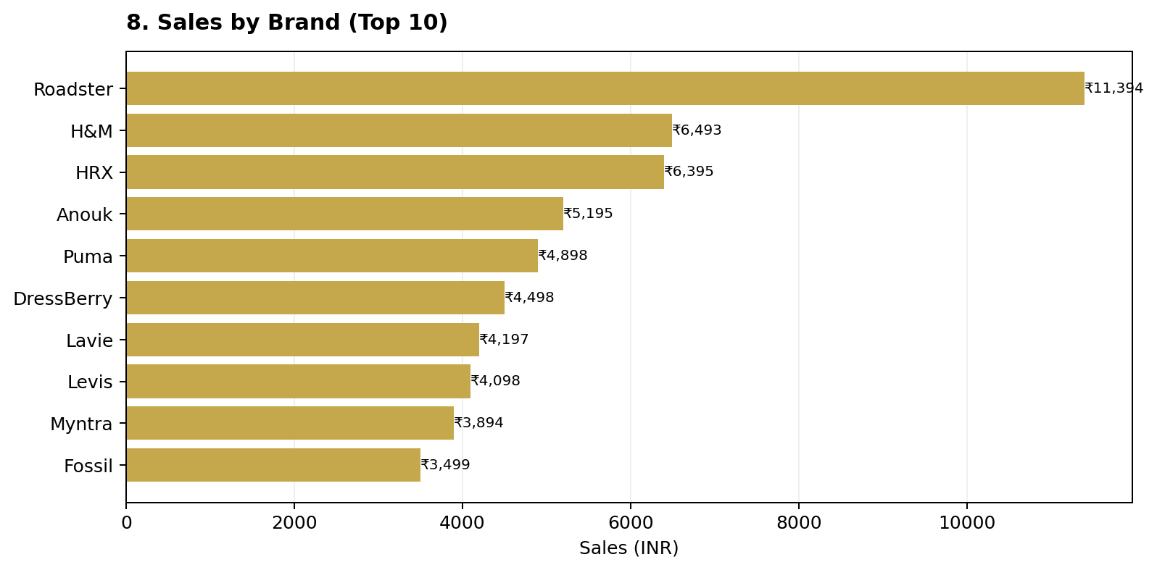
8. Dashboard Chart Explanation
Read the chart first, then use the note below to understand what it means.
IN SIMPLE WORDS
Ranks brands by sales amount. Roadster leads with ₹11,394 in this dataset. Brand sales can guide merchandising, but the sample is small and covers only 30 orders.
Tip: Compare totals and context together.
Myntra Sales Dataset • Dashboard explanation
10

Slide 11
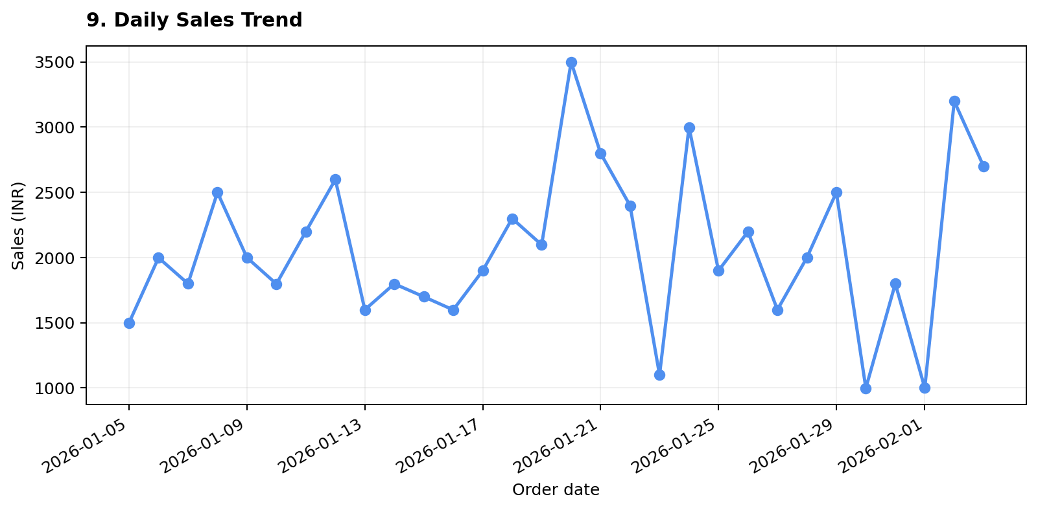
9. Dashboard Chart Explanation
Read the chart first, then use the note below to understand what it means.
IN SIMPLE WORDS
Shows sales recorded on each order date. Since the file has one order per date, this is mainly a view of order-level sales variation—not a reliable long-term trend. More months of data would help identify seasonality.
Tip: Compare totals and context together.
Myntra Sales Dataset • Dashboard explanation
11

Slide 12
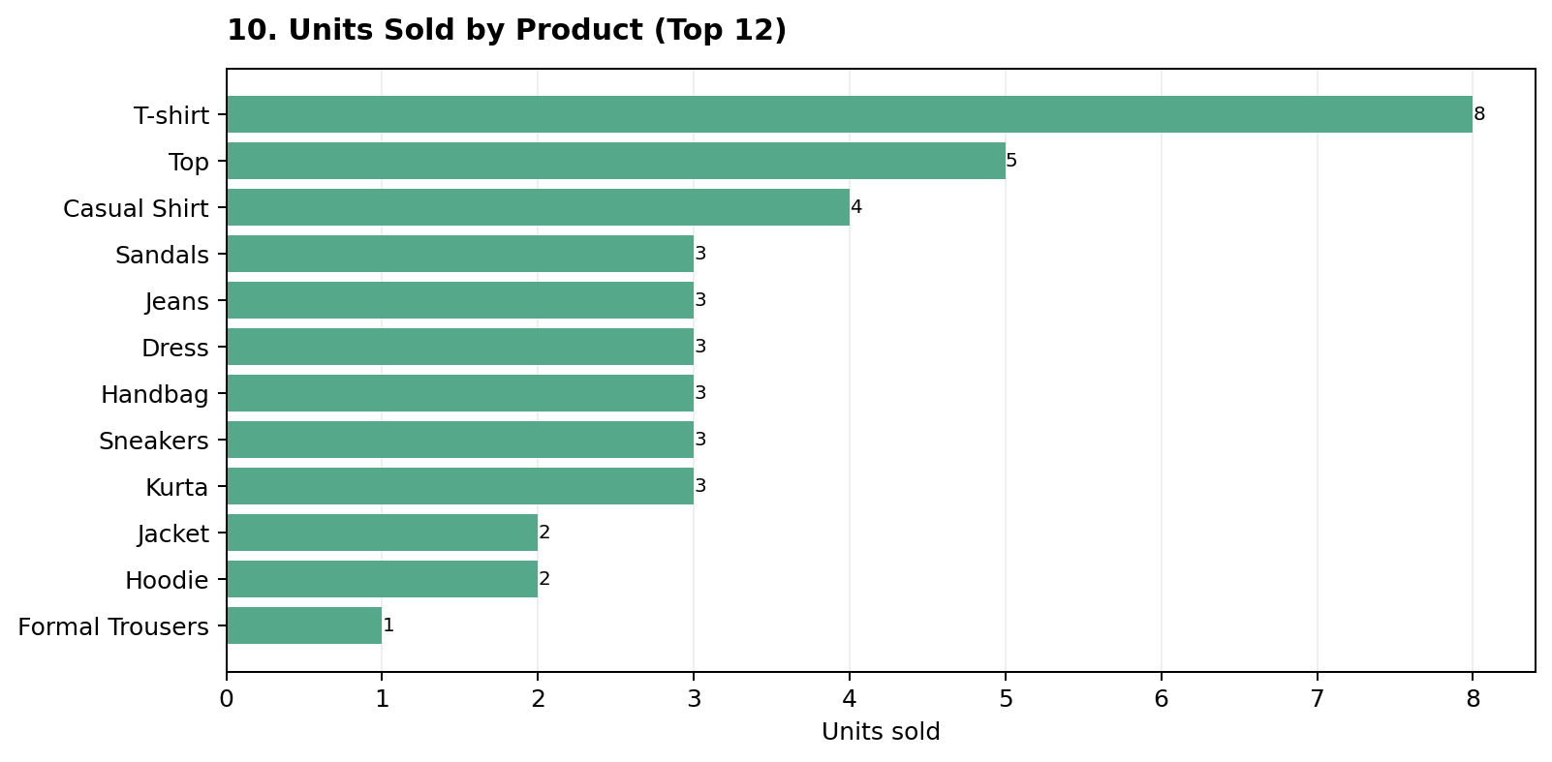
10. Dashboard Chart Explanation
Read the chart first, then use the note below to understand what it means.
IN SIMPLE WORDS
Shows how many individual units were sold in each product category. T-shirts lead with 8 units, followed by Tops with 5. This differs from sales value because some products have multiple units per order.
Tip: Compare totals and context together.
Myntra Sales Dataset • Dashboard explanation
12

Slide 13
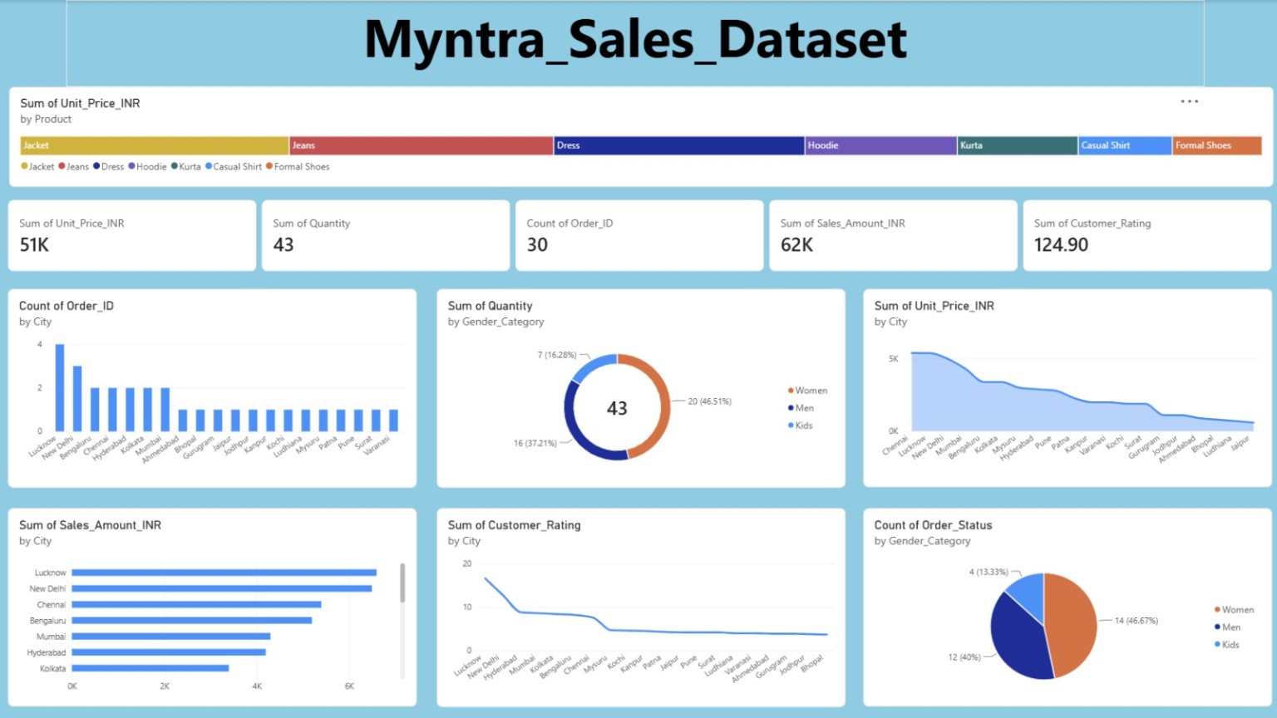
12. How to Read the Original Dashboard
The uploaded screenshot contains KPI cards and several charts.
What each visible element means
Product strip at top
Compares the sum of listed unit prices by product. It is not the same as sales revenue.
KPI cards
Quick totals: unit price sum, quantity, order count, sales amount and rating sum.
Orders by city
Bars show how many orders came from each city. Taller bars mean more orders.
Quantity by gender
Donut chart shows units by Women, Men and Kids categories.
Unit price / sales by city
City charts compare price totals or sales totals. Use the sales amount chart for revenue comparisons.
Rating by city
Shows the sum or average of ratings depending on the visual setup. Average rating is usually easier to interpret.
Order status by gender
A pie chart should show order status counts; if the legend shows gender, the visual fields may be configured incorrectly.
Myntra Sales Dataset • Dashboard explanation
13

Slide 14
13. Key Findings and Recommendations
A quick summary you can present in class or in a project review.
1. Best-selling product by sales value
Recommendations
Sneakers lead with ₹7,397 in sales; Jackets and Jeans follow.
• Keep popular products available and test focused promotions.
• Explore marketing in Lucknow and New Delhi, but collect more data before making large decisions.
• Review returned and cancelled orders to understand possible causes.
• Keep payment options simple, including UPI and cards.
• Track ratings alongside the number of orders for each city.
2. Strongest city in this sample
Lucknow has 4 orders and ₹6,595 sales, just ahead of New Delhi at ₹6,495.
3. Gender category
Women account for 20 units, Men 16 and Kids 7.
4. Payment choice
UPI has the highest sales amount at ₹23,381.
5. Order fulfilment
24 of 30 orders are delivered; 4 returned and 2 cancelled.
6. Customer satisfaction
Average rating is 4.16 out of 5. Returned orders average lower ratings than delivered orders.
Myntra Sales Dataset • Dashboard explanation
14

Slide 15
14. Important Notes Before You Present
A few details help keep the interpretation accurate.
•
The dataset contains only 30 orders, so treat patterns as early indications—not proof of long-term customer behaviour.
•
Total sales amount is ₹62,057. Total unit-price sum is ₹50,870; these are different measures because some orders contain multiple units.
•
The average customer rating is 4.16/5. The sum of ratings is 124.90, which is less useful for judging satisfaction.
•
The screenshot appears to show some charts using sums where averages or counts may be clearer. For example, average rating by city is easier to explain than sum of ratings.
•
For a report-quality dashboard, label every axis, use consistent INR formatting, and ensure the chart legend matches the metric being shown.
Myntra Sales Dataset • Dashboard explanation
15

