Slide 1
Supermarket Data Analysis Using MySQL and Hive
DSO 599: Capstone Project

Slide 2
overview
Goal:
The goal of the supermarket data analysis is to examine the purchasing behaviors of consumers, such as the purchasing patterns and frequently purchasing pairs.
Data:
The data consists of 5 tables: aisle, product, order_product, department, orders. The smaller datasets of order_product contains 1.3M rows, and the larger one contains 32.4M rows
Tools:
The tools for the project are: Mysql Workbench and Hive.

Slide 3
FINDING MOST POPULAR SHOPPING PATH
Why tracking shopping patterns:
Tracking shoppers purchasing patterns can help in optimizing almost all aspects of store design, merchandising and marketing.
Methodology:
Join order_product table and product table to find the combination of order_id and aisle.
Find distinct order_id and aisle_id pairs.
Concatenate aisle_id as path and find the counts of each path.

Slide 4
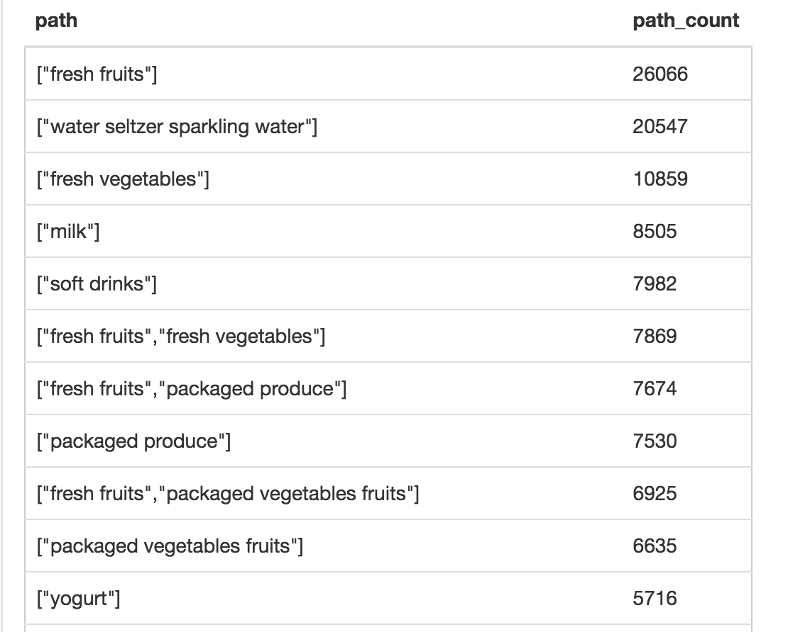
FINDING MOST POPULAR SHOPPING PATH
The table on the right shows the most popular patterns.
Consumers by fresh fruits, water seitzer sparkling water, fresh vegetables, mild and soft drinks indipendently.
Consumers also tend to by vegetables or packaged produce along with fruits.

Slide 5
Frequently PURCHASING pairs
Why tracking frequently purchasing pairs:
Retailers can not only increase their profit but, also decrease cost by proper management of shelf space allocation and products display.
Methodology:
Self join order_product table on the same order_id but different product_id to find the pairs of products consumers purchase together.
Concatenate the pairs together to find the counts of each pair and rank by the total counts.

Slide 6
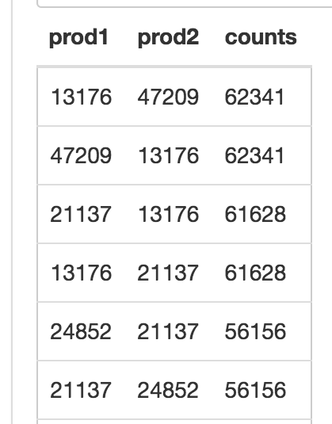
Frequently PURCHASING pairs
Table on the right shows the most frequently purchased pairs of products.
By looking into the products name, we can tell that the people tend to buy bags of organic banana and organic avocado organic strawberry and baby spinach together,

Slide 7

THANKS!

