Slide 1
Basic rules…
At a certain time, in a certain room, only one course should be scheduled
Course
Room slots
Time slots

Slide 2
Basic rules…
Course
1
1.5-unit courses should take up to one slot in the D.V. volume.
Room slots
Time slots
Room slots
Time slots

Slide 3
Basic rules…
Course
1
Room slots
Time slots
For a 3.0-unit course, it should take up to two slot in the D.V. volume.
And what else?
Room slots
1
1
Room slots
Time slots
Time slots

Slide 4
3.0-unit courses should take {0, 2} slots
Also,
- 2 slots should be in the same room
- Paired scheduling (M,W) / (T/Th)
- Consecutive scheduling
Basic rules…
Course
1
1
1
1
1
Room slots
Room slots
Room slots
Time slots
Time slots
Time slots
Room slots
1
1
1
1
1
1
Room slots
Room slots
Room slots
Time slots
Time slots
Time slots

Slide 5
Time & Room availabilities function as filters
Room reserved for non-teaching
Room reserved for certain courses
Room capacity
Room features
Professor time availabilities
Course
Depart-level
Time-Room Filter
Course A
Time-Room Filter
Course B
Time-Room Filter
Course C
Time-Room Filter
Course A
Course B
Course C
Room slots
Time slots

Slide 6
Courses should not be scheduled at the same time
Course A (1)
Course A (1)
Course A (2)
Courses…
taught by the same professor
with high preference correlations
1
1
1
Course
1
Course B (1)
Course B (2)
Course B (2)
1
Room slots
1
1
1
1
Time slots

Slide 7
Balancing the scheduling
BALANCING
Room slots
Room slots
Time slots
Time slots
…
…
Weekday
Room
Weekday
Room

Slide 8
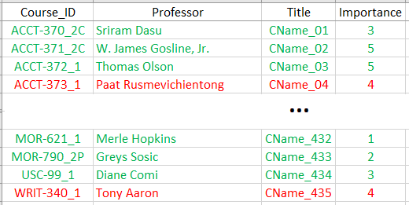
Setting up the weighted objective
1) Scheduling completion – course number (100%)
2) Scheduling completion – course importance (100%)
Early
morning
Morning
Afternoon
Evening
Mon
0
1
2
3
4
5
6
7
8
3) Course: daily time slot preference (100%)
Tue
9
10
11
12
13
14
15
16
17
Wed
18
19
20
21
22
23
24
25
26
Thu
27
28
29
30
31
32
33
34
35
4) Professor: daily time slot preference (100%)
Fri
36
37
38
39
40
41
42
43
44
…
5) Scheduling balance – across weekdays & rooms
Weekday
Room

