Slide 1
COVID-19 Pandemic Effect on Corporate Stocks
Presented by:
Rahma Nabil
Date:
2/7/2026

Slide 2
Project Idea:
The Challenge
The COVID-19 era (2018–2022) reshaped global markets. While some companies struggled, others achieved remarkable growth.
Key Question:
Did all companies respond to this transformation in the same way
Our Solution
An interactive Power BI dashboard analyzing 20 Fortune 500 companies through performance, risk, recovery, and sector comparison
Unique Value
Beyond Returns
Risk & Recovery Analysis
Tech vs Non-Tech Comparison
Actionable Business Insights

Slide 3
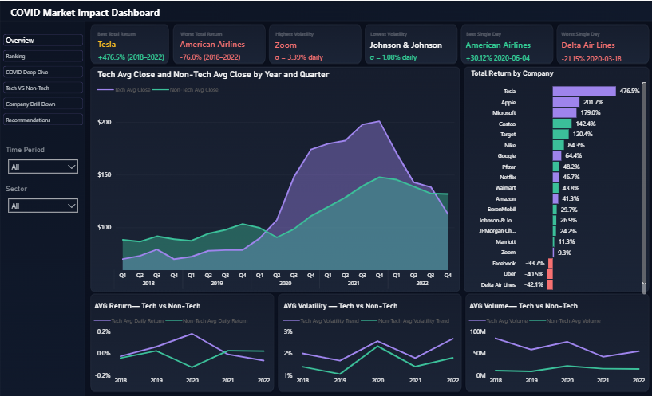
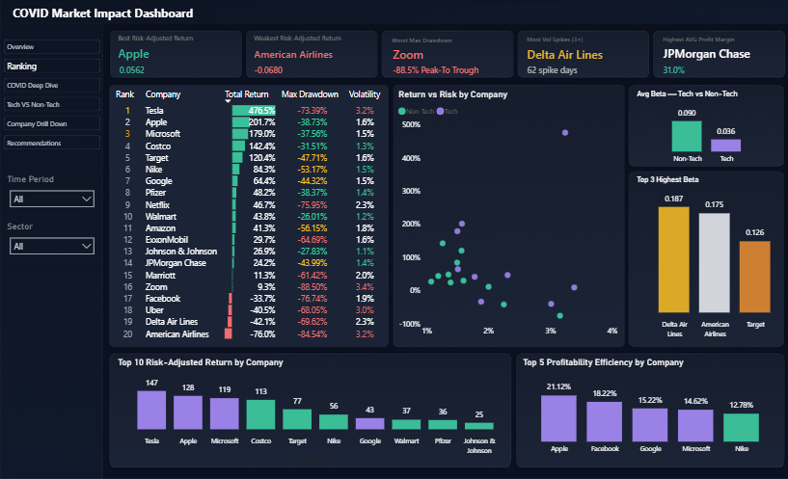
Project Wireframe:
Portfolio Overview
KPI Rankings

Slide 4
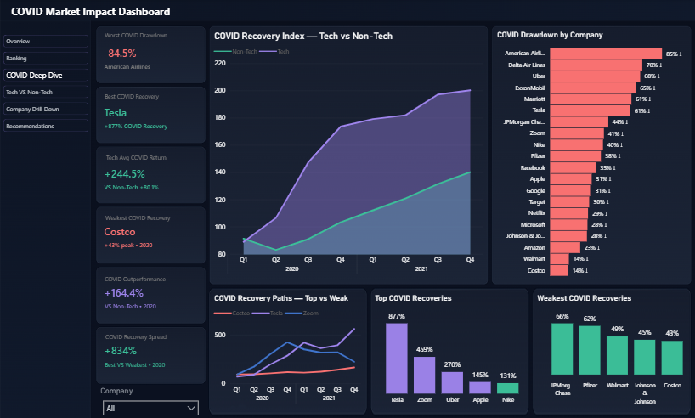
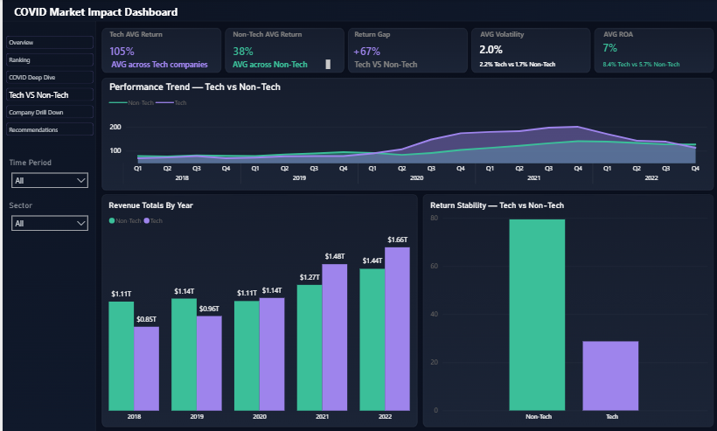
Project Wireframe:
COVID Deep Dive
Tech vs Non-Tech
Comparison

Slide 5
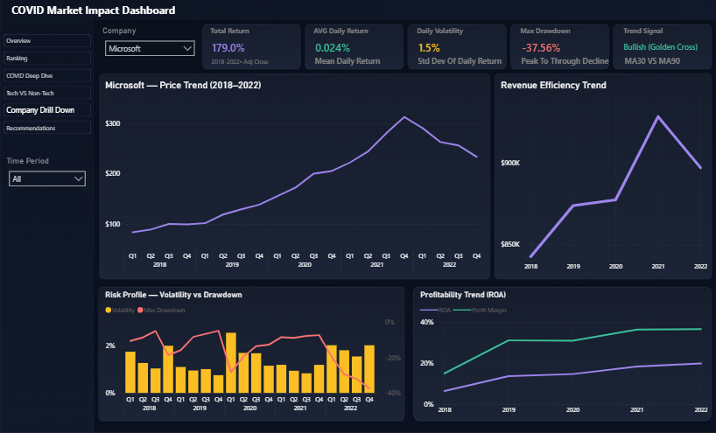
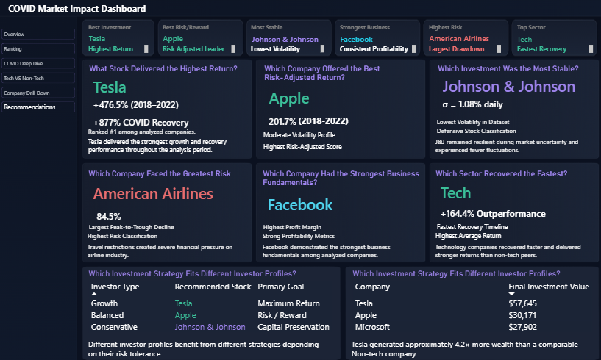
Project Wireframe:
Company Drill Down
Recommendations
Focus:
Provide a smooth analytical journey from global market insights to detailed company-level analysis.

Slide 6
End Users & Features
End User | Need | Feature | How It Helps
Investors | Find profitable investment opportunities | Portfolio Overview, KPI Rankings | Quickly identify the best-performing companies and compare returns.
Financial Analysts | Measure risk and evaluate performance | Volatility, Sharpe Ratio, Max Drawdown | Analyze risk, compare companies, and support financial analysis.
Portfolio Managers | Compare sectors and monitor trends | Tech vs Non-Tech Analysis, Company Drill-Down | Evaluate sector performance and make informed portfolio decisions.

Slide 7
Data Structure
Database Architecture
Star Schema
3 Fact Tables
• Daily Stock Return
• BetaReturns
• 20 Companies
2 Dimension Tables
• dimCompany
• dCalendar
Relationships
dimCompany (1) ─── (*) Daily Stock Return
dimCompany (1) ─── (*) BetaReturns
dimCompany (1) ─── (*) 20 Companies
dCalendar (1) ─── (*) Daily Stock Return
dCalendar (1) ─── (*) BetaReturns
dCalendar (1) ─── (*) 20 Companies

Slide 8
Data Structure
Dataset Characteristics
Companies: 20
Period: 2018–2022
Sectors: Technology, Retail, Finance, Energy, Healthcare, Transportation
Daily Records: Stock Market Trading Data
FinancialRecords: Annual Financial Statements
Risk Metrics: Beta , Market
Return, Drawdown
Analysis Type: Time-Series & Financial Analysis
Data Flow
CSV Files
↓
Power Query Cleaning
↓
Data Modeling
↓
Relationships
↓
DAX Measures
↓
Visualizations
↓
Interactive Dashboard

Slide 9
Programming Languages & Technologies
Programming Languages
Language | Purpose
DAX | KPI Calculations & Business Logic
Power Query (M) | Data Cleaning & Transformation
Tools
Tool | Purpose
Microsoft Power BI | Interactive Dashboard Development
Power Query Editor | Data Preprocessing
Star Schema Data Model | Relationship Management
Supporting Technologies
Technology | Purpose
CSV Files | Historical Stock Data Source
Interactive Visualizations | Present Data Insights
Slicers & Filters | Dynamic Data Filtering
Drill-Through / Drill-Down | Detailed Company Analysis

Slide 10
Live Application
Application Status
Item | Status
Project Status | Completed
Dashboard Version | Final Version
Platform | Microsoft Power BI Desktop
Dashboard Validation
Validation | Purpose
Data Validation | Ensure imported CSV data is accurate
DAX Validation | Verify KPI calculations
Visual Validation | Ensure charts display correct results
Filter Validation | Verify slicers and interactions work correctly
Quality Assurance
All KPIs verified
Dashboard interactions validated
Data consistency confirmed

Slide 11
Deliverables
Deliverables
Item | Status
Power BI Dashboard (.pbix) | ✅ Completed
Project Report | ✅ Completed
Presentation | ✅ Completed
Documentation | ✅ Completed
Project Milestones
Final Products
Phase | Status
Data Preparation | ✅
Data Modeling | ✅
Dashboard Development | ✅
Final Documentation | ✅
Product
Interactive Power BI Dashboard
Final Report
Presentation Slides
Source Dataset (CSV)

Slide 12
Project Team + Roles
Members | Role
Azza Yasser EL Arif | Data Collection
Mohamed Atef Abdel | Data Cleaning & Transformation
Mariam Hany Ibrahim | Data Modeling (Star Schema & Relationships)
Nouran Ezzat Attia | Visualization
Mohamed Basem Khalil | Dashboard Design & DAX Measures & KPI Development
Rahma Nabil Mohamady | Documentation & Presentation
Collaboration
Discord
WhatsApp
ZOOM Meeting
Google Meeting

Slide 13
Thank You
Any Questions??
Contact Information:
mariamhanyai07@hotmail.com
nourranezzat8@gmail.com
mohamedbasem518@gmail.com
azzayasser791@gmail.com
moddeatef123@gmail.com
rn4638975@gmail.com

