Slide 1
Cifar-10 image recognition
0551082 李佳陽
@CCE
Professor:曾建誠

Slide 2
Outline
ResNet
Architecture
Dead ReLu problem
Experimental
Training dataset
Training detail
Result
Resource Required

Slide 3
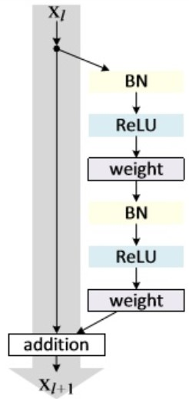
Architecture
Residual block
full pre-activation

Slide 4
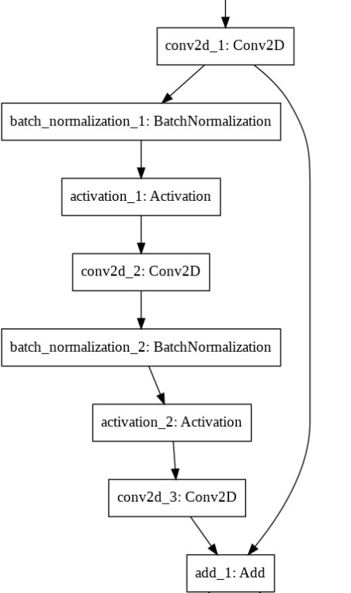
Architecture
32X32X3
Residual block
16XFilter size:1X1, stride:1X1
32X32X16
16XFilter size:3X3, stride:1X1
32X32X16
32X32X16
16XFilter size:3X3, stride:1X1
32X32X16
32X32X16

Slide 5
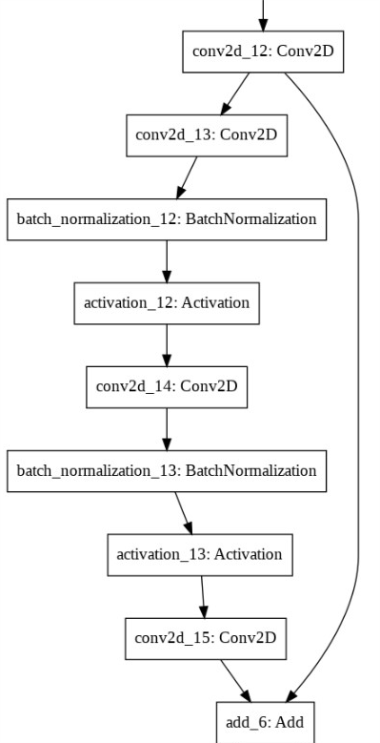
Architecture
Residual block
32X32X16
32XFilter size:3X3, stride:2X2
16X16X32
32XFilter size:3X3, stride:1X1
16X16X32
32XFilter size:3X3, stride:1X1
16X16X32
16X16X32
32XFilter size:3X3, stride:1X1
16X16X32
16X16X32

Slide 6
Architecture
Number of parameters
Total params: 569,514
Trainable params: 567,050
Non-trainable params: 2,464

Slide 7
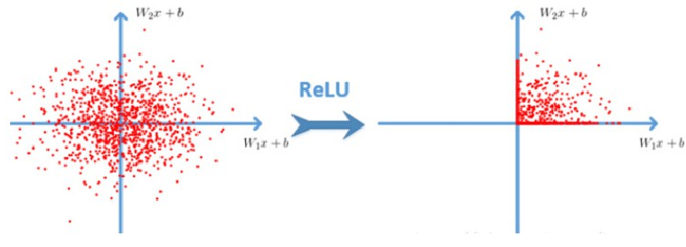
Dead ReLu problem
The neuron will never activate on any datapoint again. If this happens, then the gradient flowing through the unit will forever be zero from that point on.

Slide 8
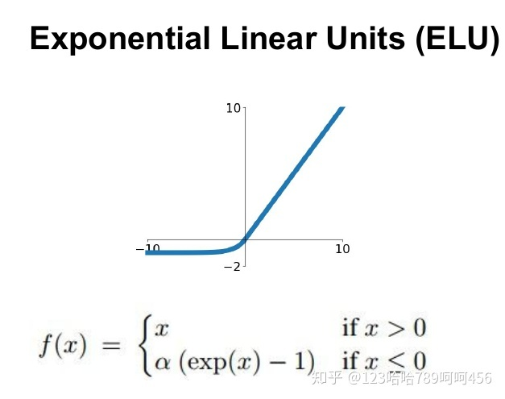
Dead ReLu problem
Use ELU to avoid Dead ReLu problem.

Slide 9
Dead ReLu problem
Replace ReLu with ELU in residual block.
ELU
ELU
full pre-activation

Slide 10
Training dataset
Data augmentation
Including randomly rotate image, shift image and flip image.
Normalize data
mean std normalization

Slide 11
Training detail
Learning rate schedule
Learning rate is scheduled to be reduced after 51, 101, 201 epochs.
Save the best model
Save the highest accuracy of model.
Parameter
Optimizer:SGD
Initial learning rate:0.1

Slide 12
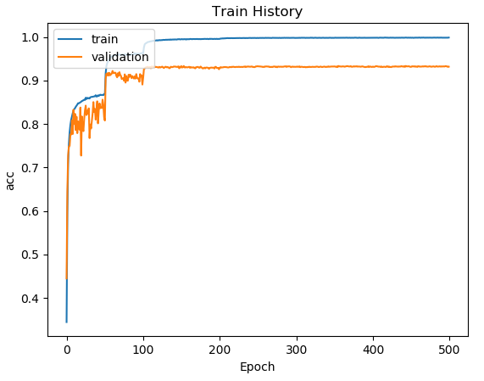
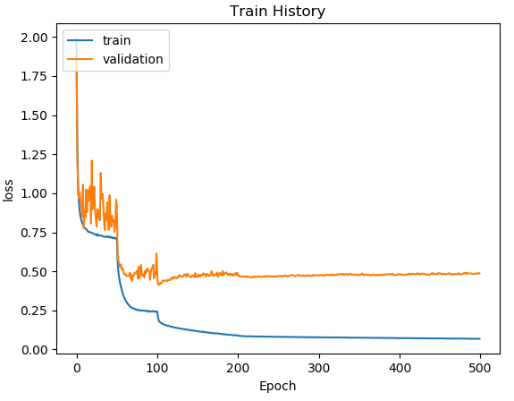
Result
Training

Slide 13
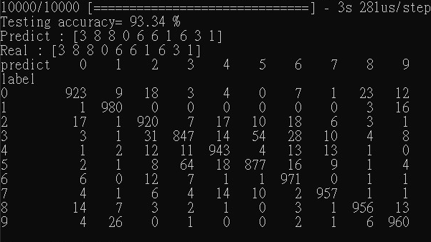
Result
Testing

Slide 14
Resource Required
Device and tools
PC(CPU:i5 6500/GPU:NVDIA GTX 1060 )
IDE: PyCharm

