Slide 1

SAP Cloud Platform Solution Diagrams & Icons Guidelines
Ренат Хамидулин, SAP
Сентябрь, 2020

Slide 2
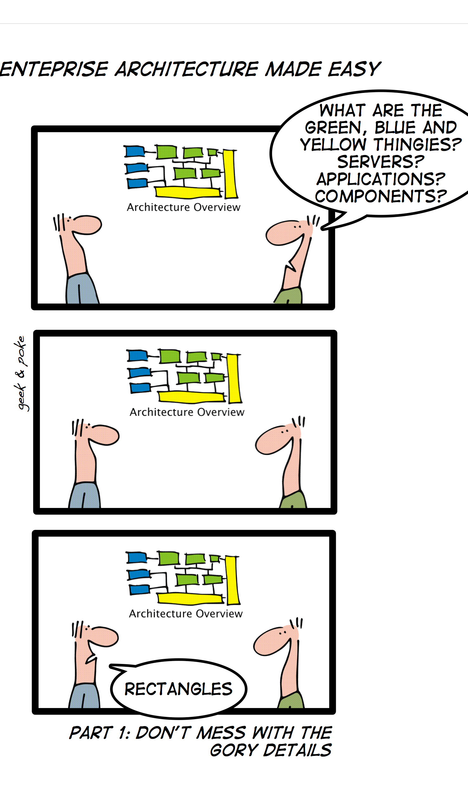
Зачем вообще заморачиваться на тему схем
An Architect spends majority of time not with creating architecture, but with
Acquiring technical information from various sources
Preparing documents and presentations for stakeholders
Discussing with developers and stakeholders
Aligning development efforts with other groups
Communication skills are mandatory!
* Why Does Software Cost So Much?: And Other Puzzles of the Information Age, (1995), p. 218.
Где применяем
Рабочие обсуждения
Документирование
Обучение
Требования
Просто
Понятно
Приятно глазу
Низкая трудоемкость
Credit: Geek&Poke

Slide 3






A2A Integration On Premise to Cloud
ISA-M Template v3.3
Public Cloud Apps I Data I Users | Things
Cloud Application (SAP / Non SAP)
Characteristics | Selection Criteria
Hybrid Traffic
Unaligned APIs
Pre-Packaged Content
Structure Mapping
Value Mapping
Routing
Splitting / Aggregation
Protocol Mediation
Techn. Exception Handling
Quality of Service: Best effort, exactly once
Public Cloud Integration Components
SAP Cloud Platform
Cloud Integration
SAP API Business Hub
Connectivity¹
Secure tunnel
Firewall
On-Premise Integration Components
Cloud Connector¹
DMZ
Firewall
Firewall
On Premise Apps | Data I Users | Things
On Premise Application
(SAP / Non SAP)
Disclaimer: this slide shows an illustrative example that needs to be adapted to the specific customer context and requirements. It serves as a starting point for customers to model their hybrid integration use cases.
¹Or reverse proxy (see decision tree).

Slide 4
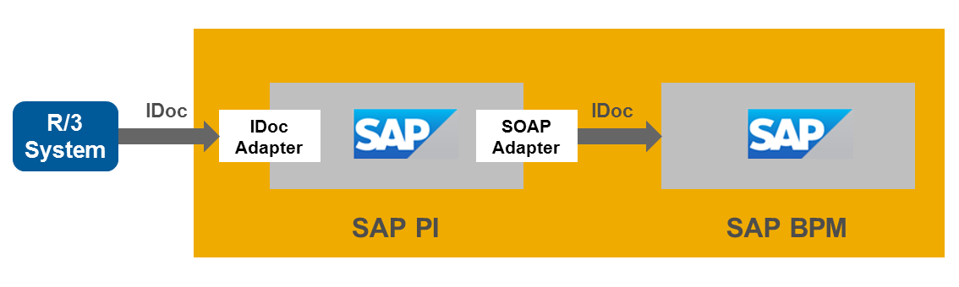
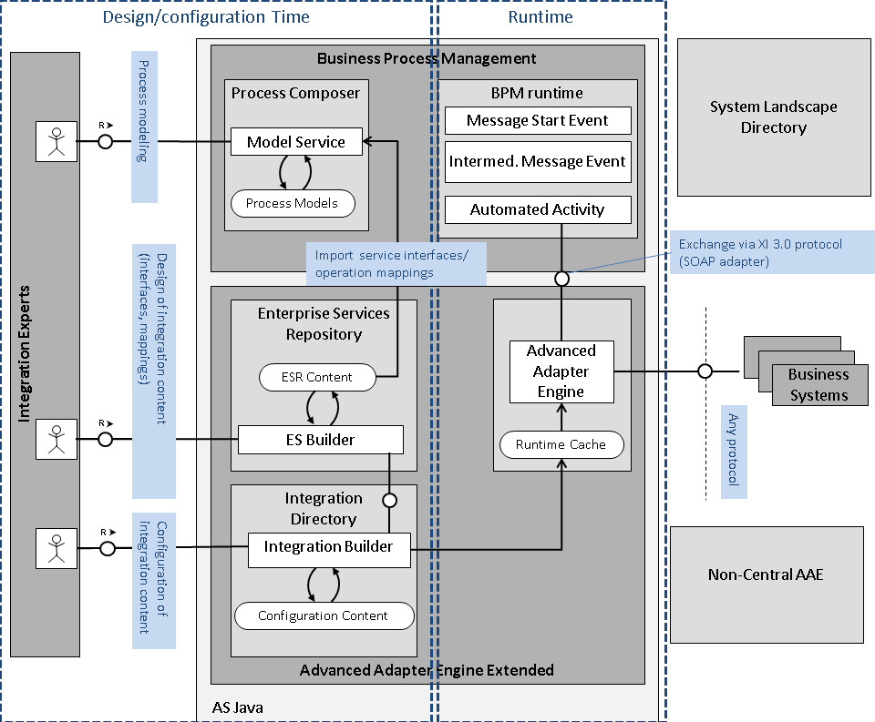
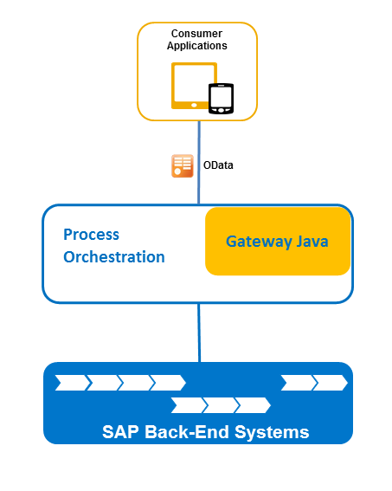
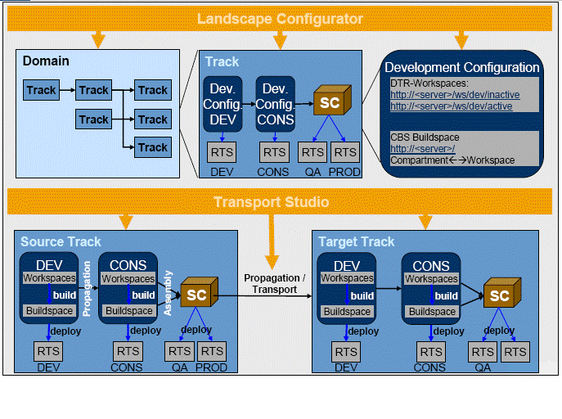
Техники моделирования архитектуры применяемые в материалах SAP
Freestyle
Technical Architecture Modeling
SCP Solution Diagrams

Slide 5
Пару слов про Technical Architecture Modeling (1/3)
It is a company-wide standard for technical architecture models.
It is based on a long experience of modeling at SAP and on the UML Standard
It defines a subset of UML 2.0 which covers most modeling cases needed at SAP
It assigns the diagrams and elements to the conceptual and design level, and gives guidance when to use which diagram or element type.
It extends UML with FMC block diagrams which are successfully used at SAP since 1990 for conceptual architecture models.
TAM is mandatory for development.
FMC: http://www.fmc-modeling.org/fmc-and-tam

Slide 6
Пару слов про Technical Architecture Modeling (2/3)

Slide 7
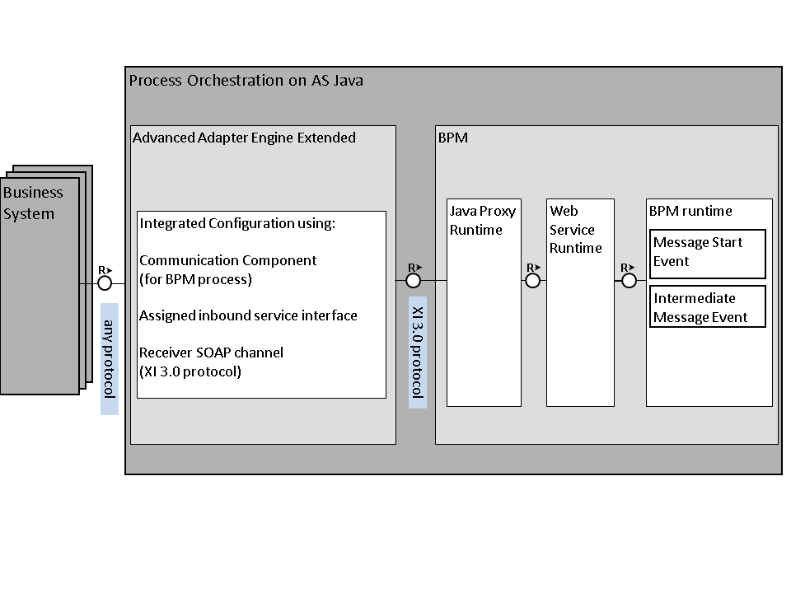
Пару слов про Technical Architecture Modeling (3/3)
Source: https://help.sap.com/viewer/3cbd9bae5d3e45ab99e968e0c879beb4/7.5.19/en-US/012e4d47dceb495994fd54c8eba413c7.html
Source: https://help.sap.com/viewer/3cbd9bae5d3e45ab99e968e0c879beb4/7.5.19/en-US/a0631841412946f4b624ae20faa9d772.html

Slide 8
А теперь, наконец, про SCP Solution Diagrams & Icons

Slide 9
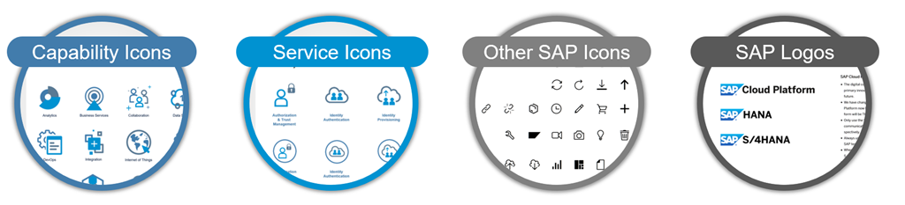
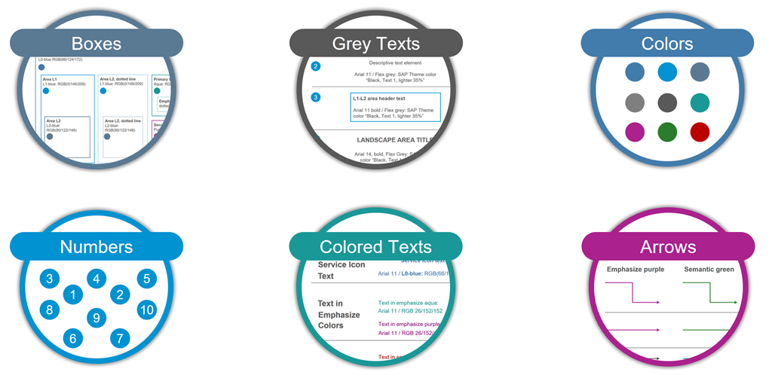
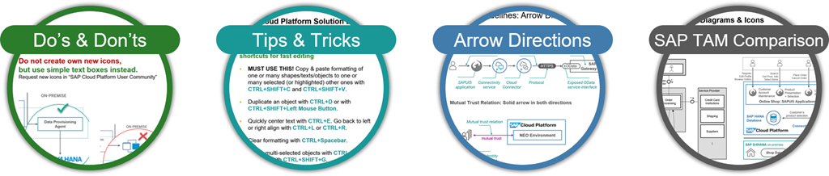
SCP Solution Diagrams & Icons Guidelines
Официальная Wiki страница: https://wiki.scn.sap.com/wiki/pages/viewpage.action?pageId=477829554
Слайды MS PowerPoint: SAP-Cloud-Platform_official-solution-diagrams-and-icons_v09.pptx
Use SAP Icons & Logos
Use Design Elements for MS PowerPoint Slides
Follow Author Guidelines

Slide 10



SAP Cloud Platform Solution Diagrams & Icons – Design Guidelines Comparison with SAP TAM Block Diagrams (1)
SAP TAM Block Diagrams |  | SAP Cloud Platform Solution Diagrams
Purpose: Most important diagram type for describing architecture. Show the static structure of the system, and provide a big picture view. |  | Purpose: Domain-specific diagram type that describe SAP Cloud Platform solution scenarios across IT landscapes. Show SAP Cloud Platform services, environments, systems, and their interdependencies.
Agents process information, communicate via channels, access storage |  | Agents, systems, SAP Cloud Platform services depicted as blue circled icons, gray icons, or colored boxes
Storage elements contain information accessed by agents. |  | Storage visualized either as corresponding SAP Cloud Platform database as a service icon or as rounded box for non-SAP-Cloud-Platform storages (for example, an on-premise database).
Channels transport information between agents Request-response channels show the direction of a request, indicating the triggering agent (=the Client) Modifying Access: “A” can read and write storage content Read-only Access: “A” can only read storage content |  | Arrows express “interdependencies” between services, components, users, or systems. Interdependencies include request/response channels, usage relations, data flows (for example, data replication, using a dashed line), or trust relations. The standard interdependency is a request/response channel that points from client to server (using a solid line arrow). For mutual relations like a mutual trust relation from one system to another, a bidirectional, solid line arrow is used. There is no visual difference between modifying and read-only access types; use text annotation to provide additional details that are not represented visually (for example, a modifying read and write access), or use TAM block diagrams instead. See the previous slide for more details on arrow directions.
Notes: Use class diagrams to show how data is located in storages or exchanged via channels. Use activity or sequence or state diagrams to express the behavior of agents and how they interact. |  | Notes: Use SAP TAM Diagrams for more technically detailed SAP Cloud Platform solution architectures.
Agent
SAP Cloud Platform service
User Persona
Agent
Storage
Storage
SAP HANA Database
A1
A2
Client
R
Server
A
S
A
S

Slide 11






SAP Cloud Platform Solution Diagrams & Icons – Design Guidelines Comparison with SAP TAM Block Diagrams (2)
SAP TAM Block Diagram Example
SAP Cloud Platform Solution Diagram Example
Customers
Customers
...
...
Register Edit Profile Browse Orders
Search Get Prod. Info Select Items
Place Order Cancel Order
Register Edit Profile Browse Orders
Search Get Prod. Info Select Items
Place Order Cancel Order
R
R
R
Service Provider
Online Shop: SAPUI5 Applications
Online Shop Server
Service Provider
Customer Account Maintenance
Product Presentation + Selection
Order Processing
Credit Card Institutions
Customer Account Maintenance
Product Presentation + Selection
Order Processing
R
Credit Card Institutions
Shipping
Shipping
Customer’s product selection
Customer’s product selection
SAP HANA service
REST
...
...
Credit Card Institutions
Suppliers
Connectivity
ERP data
...
SAP S/4HANA on-premise
Firewall
Customer data
Product Information
Product Availability
Orders
Shop Data
OData
Cloud
Connector

Slide 12
Резюме
Используйте TAM, чтобы:
Правильно читать схемы в традиционной документации SAP
Рисовать свои детальные схемы в стиле «как у SAP» с фокусом на внутреннюю архитектуру решения, преимущественно для OnPremise.
Отражать в графике особенности коммуникаций и информационного обмена между компонентами решения.
Используйте SCP Solution Diagrams, чтобы:
Правильно читать схемы в новой документации SAP
Рисовать свои верхоуровневые схемы в стиле «от SAP» с фокусом на архитектуру решения в виде композиции Cloud сервисов и OnPremise сервисов.
Отражать в графике особенности взаимосвязей между используемыми сервисами.

Slide 13
Спасибо!
Контактная информация:
Ренат Хамидулин
Консультант-эксперт
renat.khamidoulin@sap.com
+7 903 969 09 95

