Slide 1
Optimizing E-Commerce Conversion Through Clickstream Funnel Analysis
Capstone case study • Kaggle multi-category store (Nov 2019) • Owner: Jordan
Dashboards: Funnel • Category/Revenue • Timing
Method: descriptive + diagnostic analytics (no ML)

Slide 2
Ask & Scope
• Business task: identify funnel drop-offs and diagnose drivers of conversion and revenue
• Scope: Nov 2019 only; event-level funnel (view → cart → purchase)
• Constraints: no session stitching; conversion rates are event-based proxies
• Deliverables: 3 dashboards + recommendations

Slide 3
Dataset & Key Assumptions
• Source: Kaggle “Ecommerce Behavior Data from Multi-Category Store”
• Fields used: event_type, event_time, category_code, price, user identifiers
• Revenue proxy: sum(price) on purchase events
• Conversion proxy: purchases/views, carts/views, purchases/carts (not session-based)

Slide 4
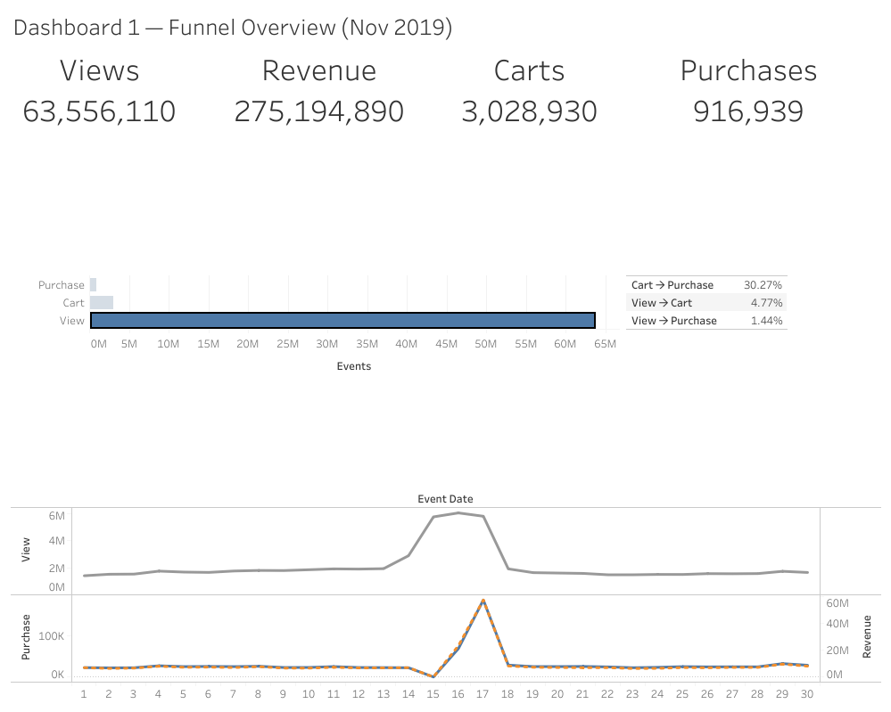
Dashboard 1 — Funnel Overview
What’s happening across the funnel (volume, proxy conversion, daily trend)

Slide 5
Key Funnel Insights
• Primary friction point is View → Cart (largest drop-off)
• Cart → Purchase is relatively strong (high intent once carted)
• Mid-month spike suggests promotion/tracking anomaly worth annotating in reporting
• Recommendation focus: improve add-to-cart drivers (PDP clarity, trust, shipping/returns visibility)

Slide 6
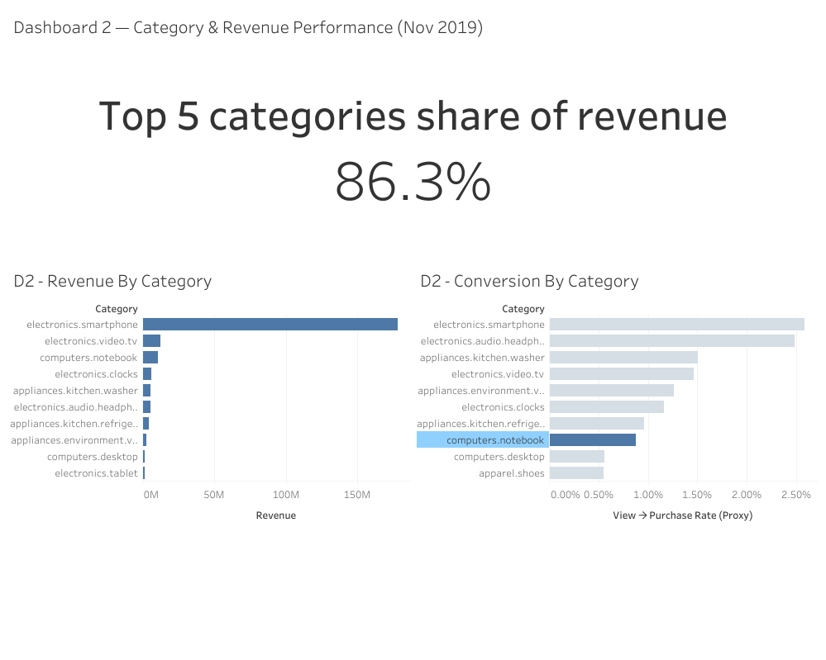
Dashboard 2 — Category & Revenue Performance
Which categories drive revenue and how conversion varies across high-traffic categories

Slide 7
Key Category Insights
• Revenue is highly concentrated in the top categories (Top 5 share is very high)
• Protect and optimize the highest-revenue categories (availability, pricing, merchandising)
• Target high-view / lower-conversion categories for PDP + offer experiments
• Monitor concentration risk and diversify revenue drivers over time

Slide 8
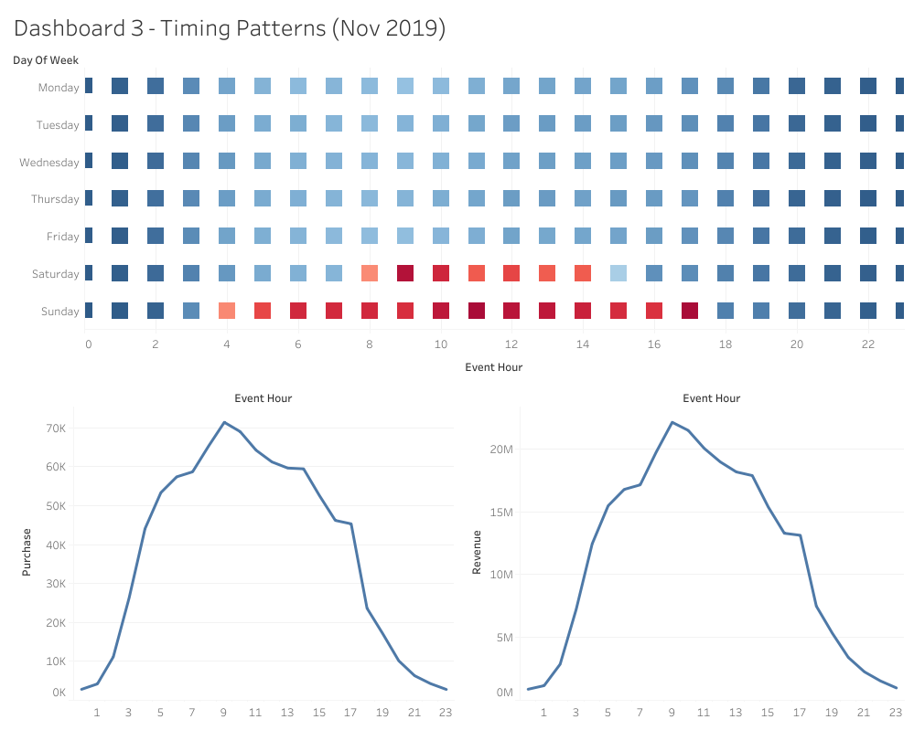
Dashboard 3 — Timing Patterns
When purchases and revenue occur (hour-of-day × day-of-week)

Slide 9
Key Timing Insights
• Purchases and revenue peak in morning-to-midday hours (strongest window around ~9–11)
• Weekends show stronger midday intensity versus weekdays
• Execution: time promos, email, and paid spend to match high-intent windows
• Ops: ensure inventory/service readiness during peak windows

Slide 10
Recommendations & Measurement Plan
• Improve View → Cart: PDP/CTA clarity, trust signals, shipping/returns transparency, better filters/search
• Category focus: scale top revenue categories; optimize high-traffic low-conversion categories
• Timing execution: schedule campaigns around peak hours and weekends
• Track weekly: proxy conversion rates, revenue by category + top-5 share, purchases/revenue by hour/day

