Slide 1
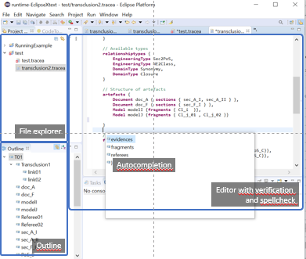
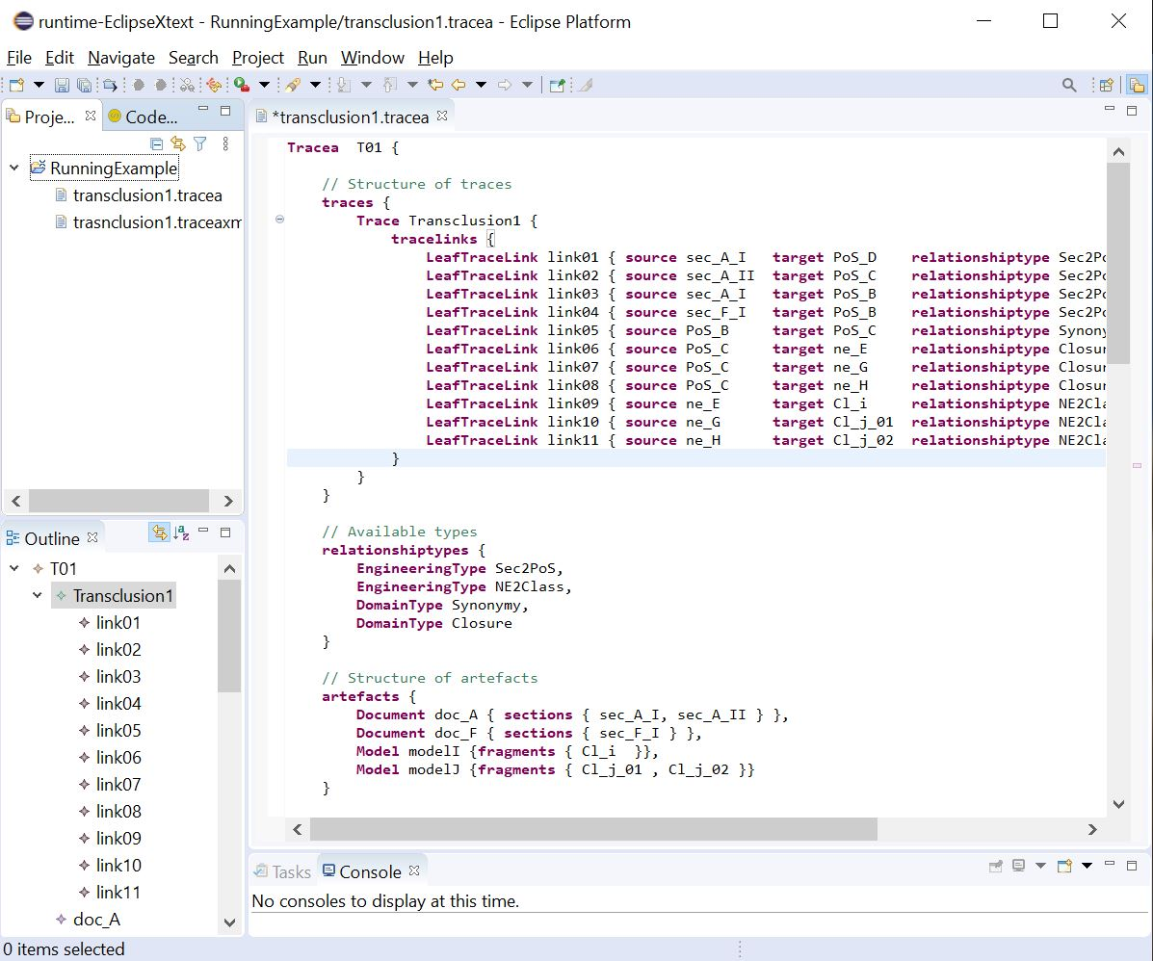
Platform adaptation
Merge grammar
rules
Plugin sources
Grammar
Xtext
src
src
src
.java
Metamodel
Ecore
Eclipse plugin editor
Model sources
GenModel
artefacts
src
src
src
.java
Automated generation
XMI generator
Semi-automated gen.
Helper.java
Manual adaptation
MyDslGenerator.java

Slide 2
Platform adaptation
Merge grammar
rules
Plugin sources
Grammar
Xtext
src
src
src
.java
Metamodel
Ecore
Eclipse plugin editor
Model sources
GenModel
artefacts
src
src
src
.java
Automated generation
XMI generator
Semi-automated gen.
Helper.java
Manual adaptation
MyDslGenerator.java

