Slide 1
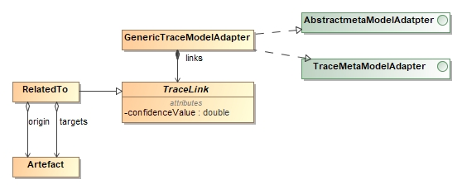
Traceability Information Model
Core

