Slide 1
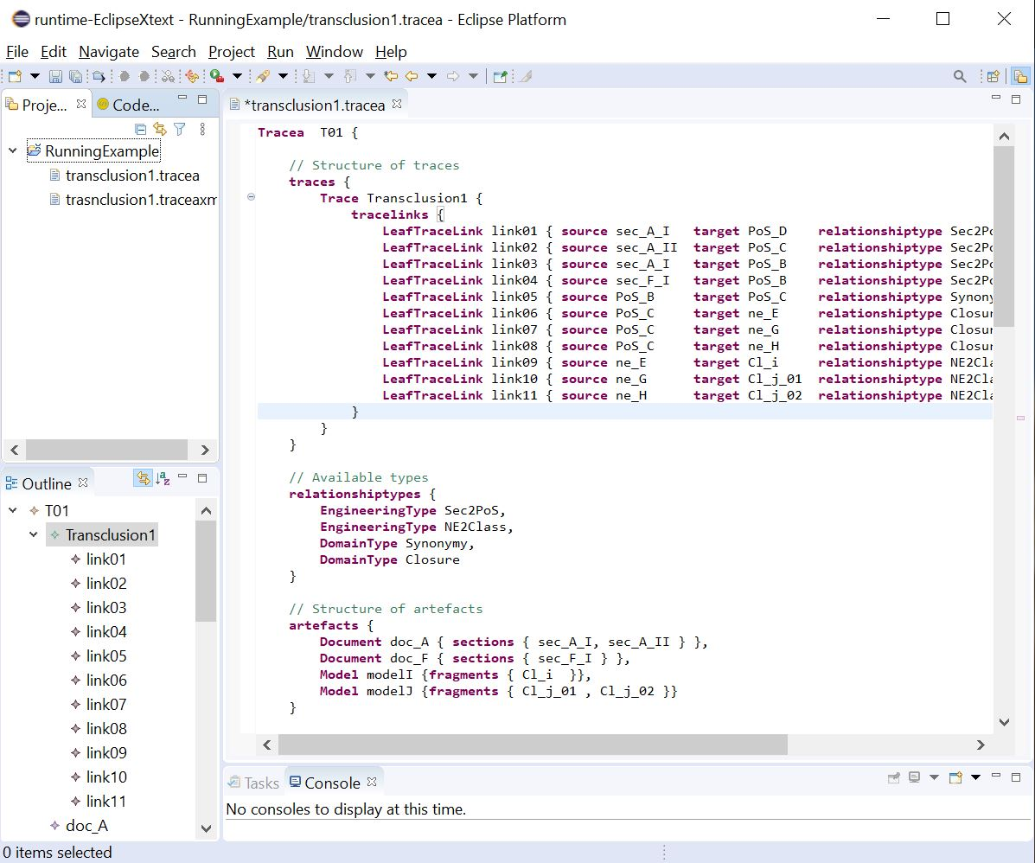
File explorer
Editor with verification
and auto completion
Outline

Slide 2
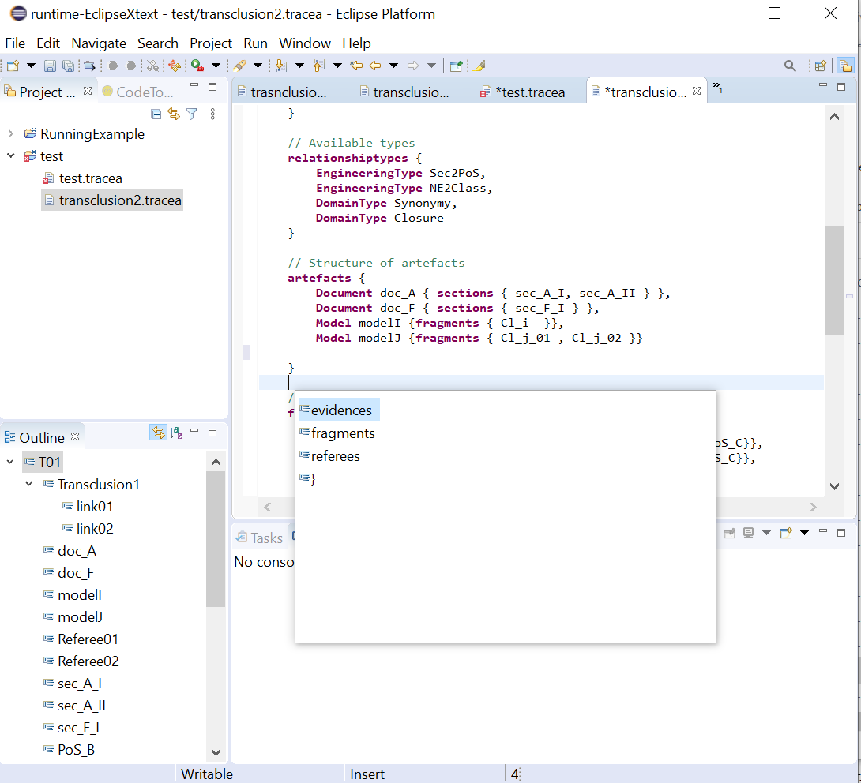
Editor with verification
and content-assist
File explorer
Auto-completion
Outline

