Slide 2
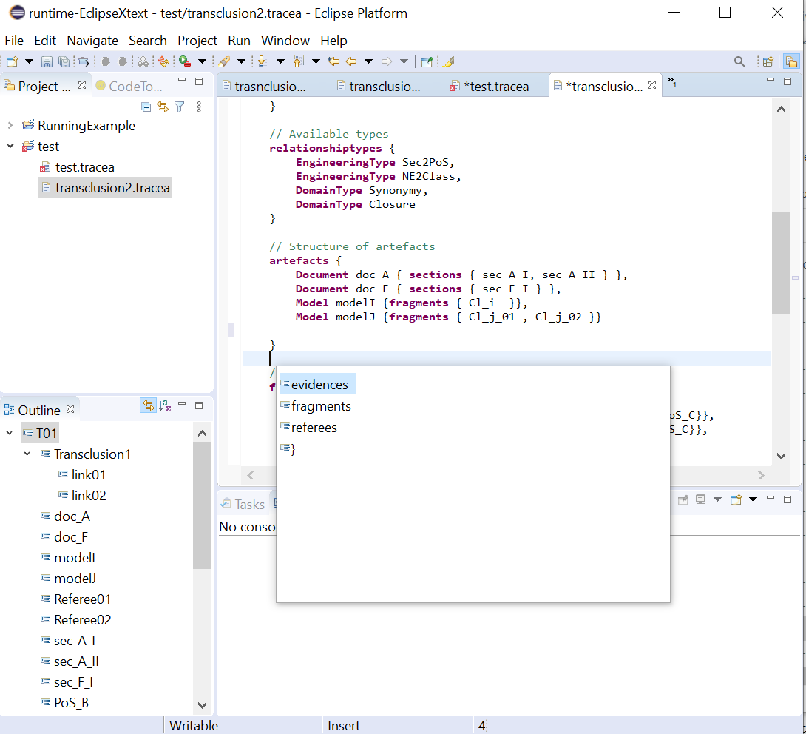

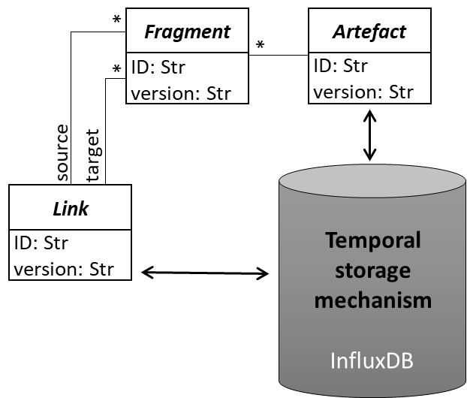
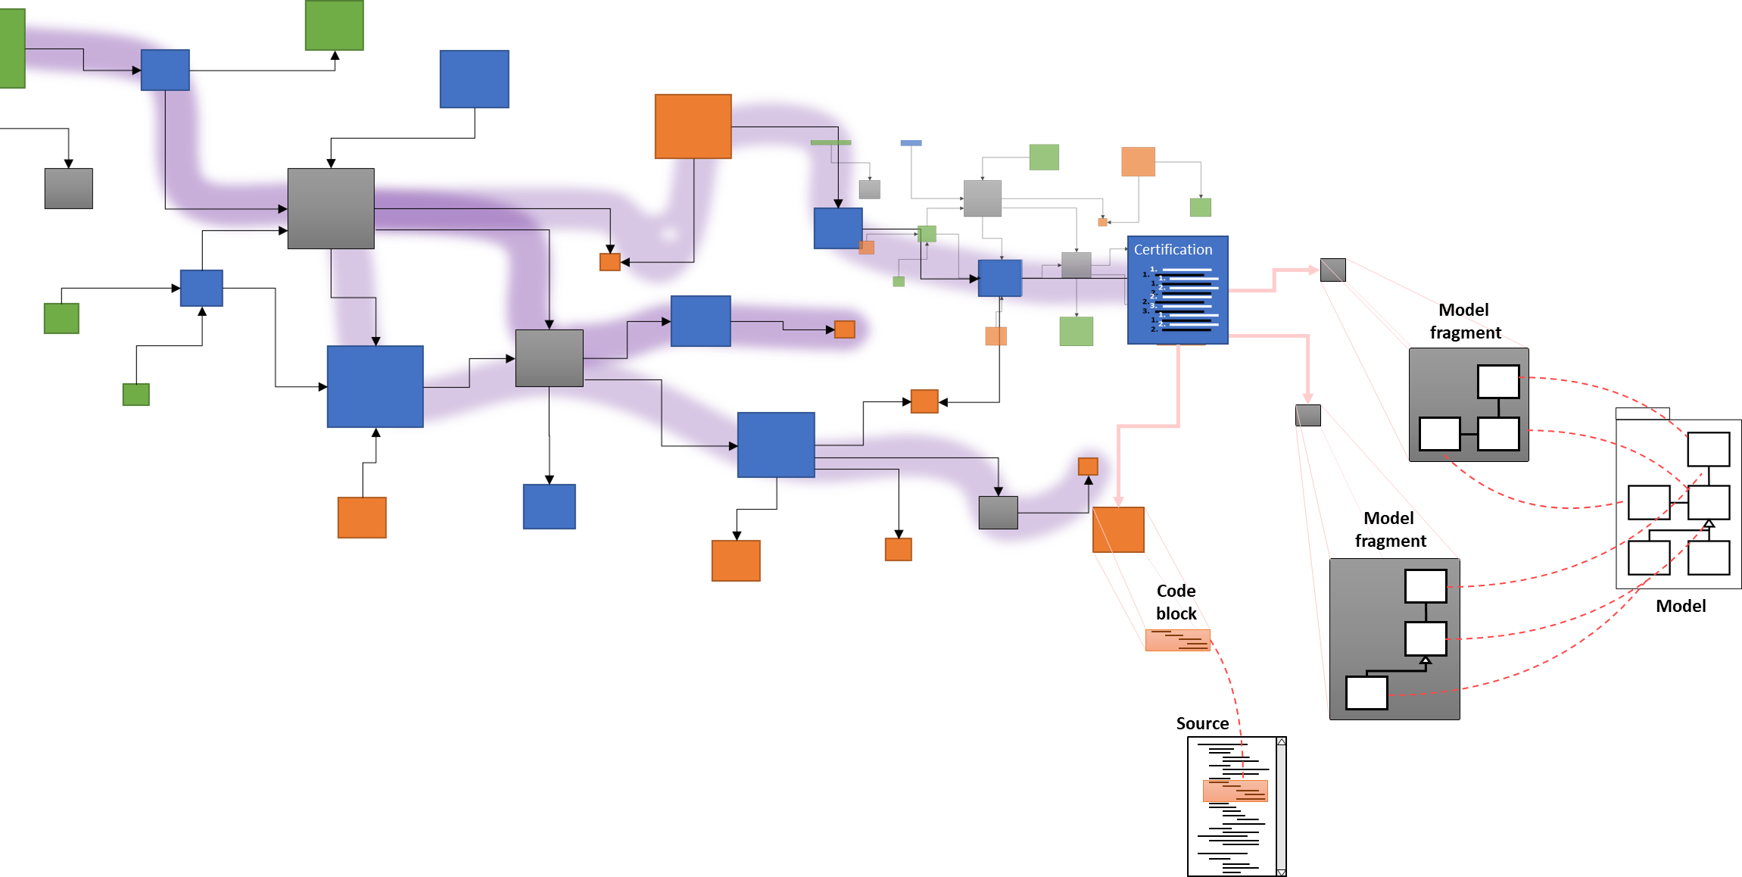

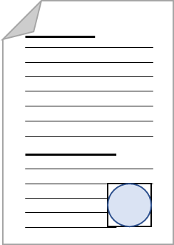
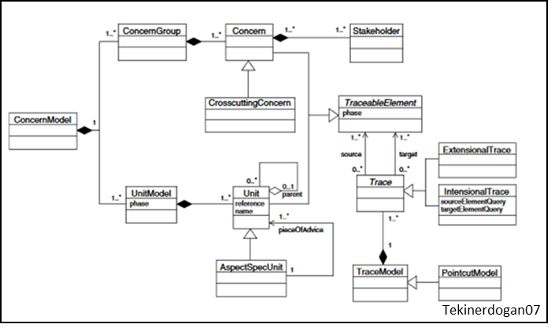
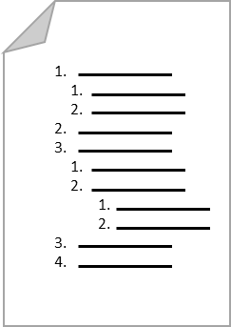

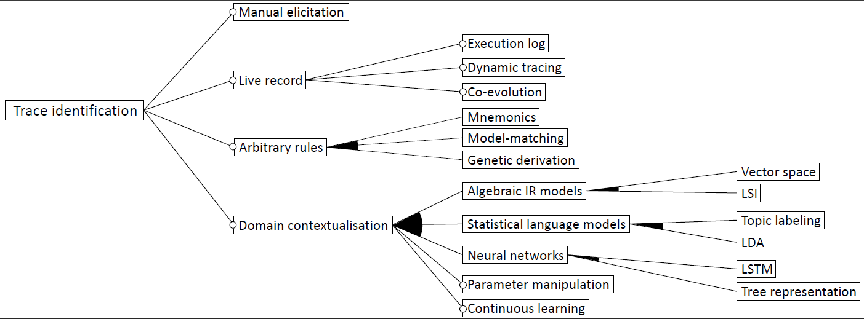
IDE
Storage
Environment
3
4
Traces
Links
Tracing elements
5
2
Documentation
Requirements
Models
Source code
System artefacts
1

Slide 3
IDE
Storage
Environment
3
4
Traces
Links
Tracing elements
5
1
Documentation
Requirements
Models
Source code
System artefacts
2

Slide 4
IDE
Storage
Environment
3
4
Ui-model dependency
XMI portability
Traces
Links
Tracing elements
5
Traces are derived
on-the-fly from links
No quality assessment
Identification
Manual identification
1
UML dependencies visualized
Documentation
Requirements
Models
Source code
System artefacts
2
Expressive customization
Eclipse integration

