Slide 1
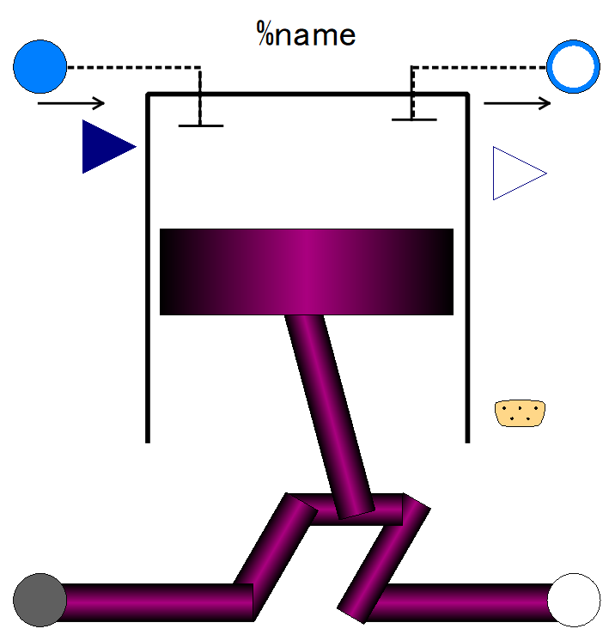

Slide 2
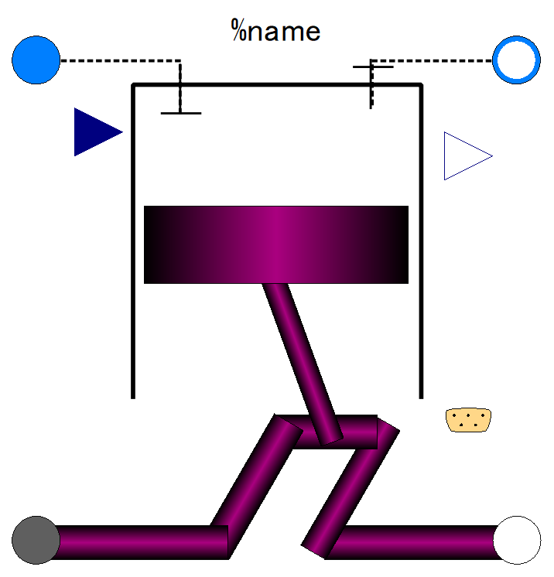
Fluid inlet port, input&output (use “connect” operator)
Fluid outlet port, input&output (use “connect” operator)
Fuel flow rate, output
Fuel fraction in in-taken gas;
input (use “connect” operator),
Expandable connector prepared for communication with internal variables which cannot be accessed by other ports,
input&output (use “connect” operator)
Flange (rotational mechanics port),
input&output (use “connect” operator)
Flange (rotational mechanics port),
input&output (use “connect” operator)

Slide 3
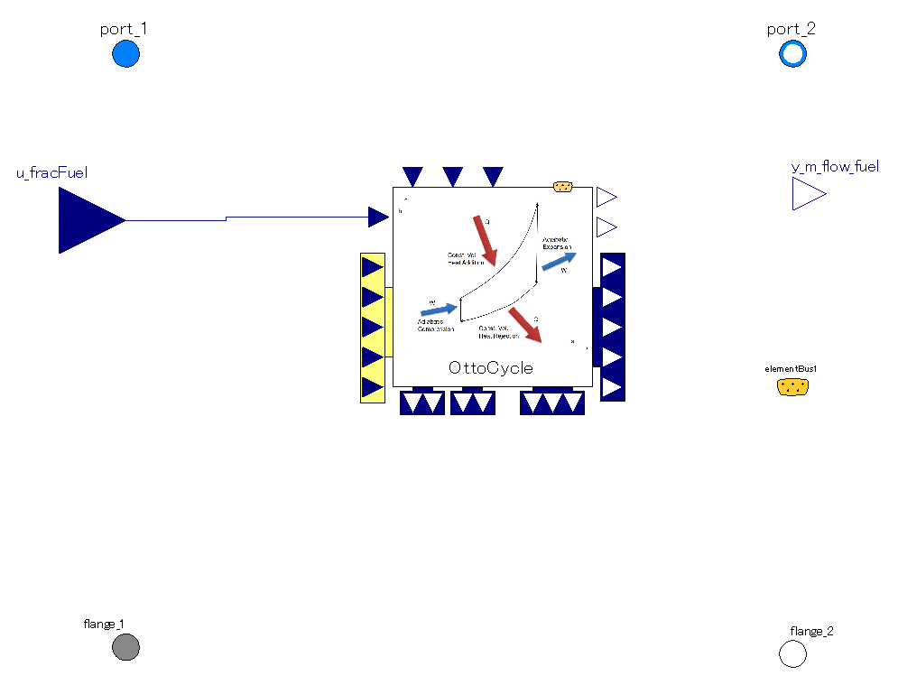
The mass flow rate through the piston is averaged over 2 rotations (=1 cycle).
Thus mass flow rate is steady as long as flange rotation is so.
Pressure and spec. enthalpy of port_1 are referred as fluid state before compression stroke in cycle calculation
Pressure and spec. enthalpy of fluid state after expansion stroke are referred as those of port_2.
It calculates power output, mass of fuel consumed in one Otto cycle and fluid state after expansion stroke.
The power output of Otto cycle is averaged over 2 rotations (=1 cycle).
Thus, torque out is steady as long as flange rotation is so.

Slide 4
P [Pa]
Pexh
Pexh
Pexh
Pintk
Pintk
Pintk
V [m3]
V [m3]
V [m3]
Exhaust stroke; work is done onto fluid.
-> power loss for engine.
Wexh= -1 * Pexh*(V2-V4)
Positive sign : loss for engine
intake stroke; work is extracted from fluid.
-> power gain for engine
Wintk= -1 * Pintk*(V1-V2)
Positive sign: loss for engine
This total work of intake/exhaust strokes is “pumping work” of piston&cylinder.
Loss for engine, enthalpy of exhaust flow increases.
Wpump= Wexh+Wintk
positive sign: loss for engine

Slide 5
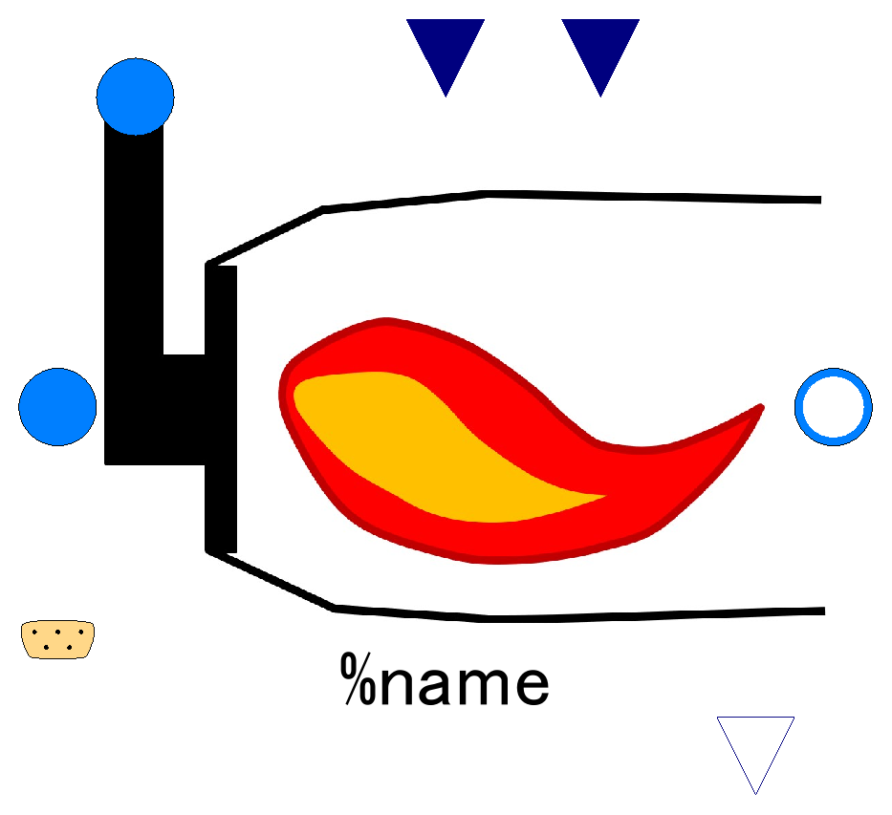

Slide 6
Lower Heating Value of Fuel;
input (use “connect” operator),
valid only when use_u_LHV_fuel==true
Efficiency of combustion;
input (use “connect” operator),
valid only when use_u_effComb==true
Fuel inlet port, input&output (use “connect” operator)
Fluid inlet port, input&output (use “connect” operator)
Fluid outlet port, input&output (use “connect” operator)
Fuel flow, output

Slide 7
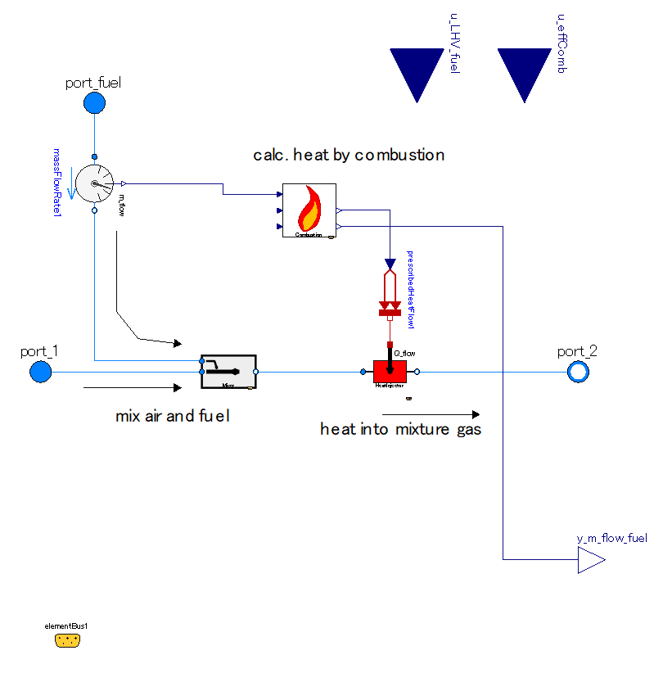

Slide 8
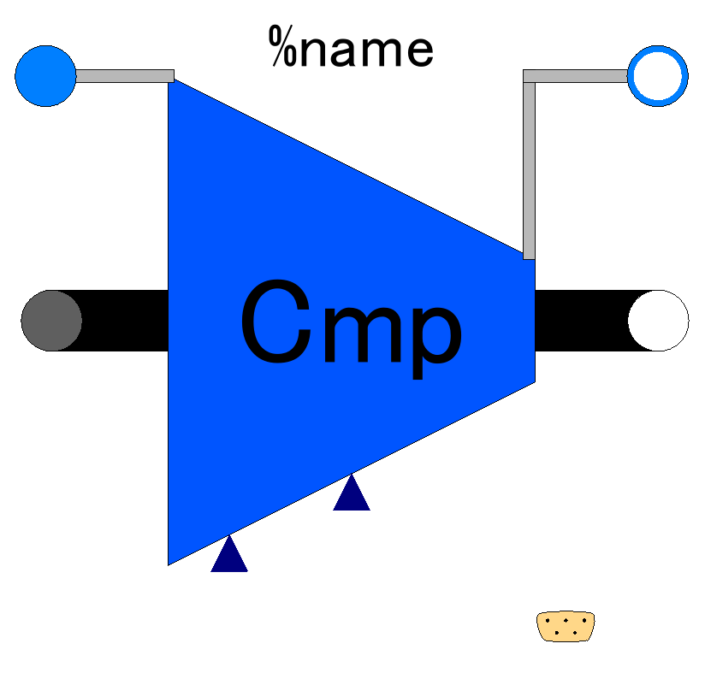

Slide 9
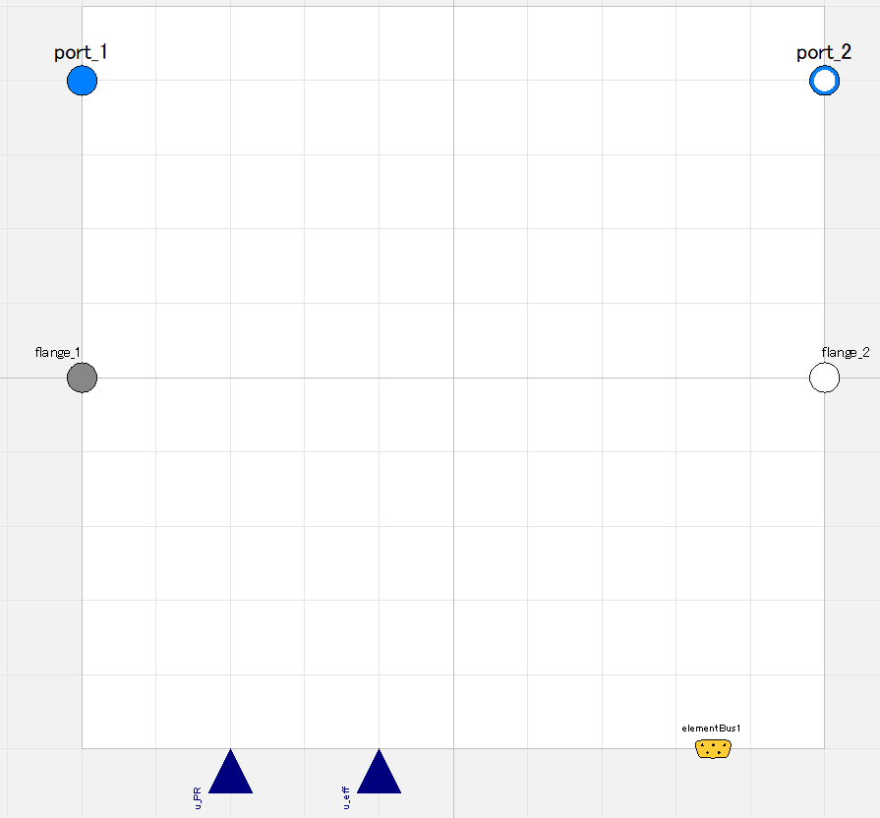

Slide 10
Fluid inlet port, input&output (use “connect” operator)
Fluid outlet port, input&output (use “connect” operator)
Flange (rotational mechanics port),
input&output (use “connect” operator)
Flange (rotational mechanics port),
input&output (use “connect” operator)
Pressure ratio;
input (use “connect” operator),
valid only when switchDetermine_PR==viaRealInput
Efficiency;
input (use “connect” operator),
valid only when switchDetermine_eff==viaRealInput
Expandable connector prepared for communication with internal variables which cannot be accessed by other ports,
input&output (use “connect” operator)

Slide 11
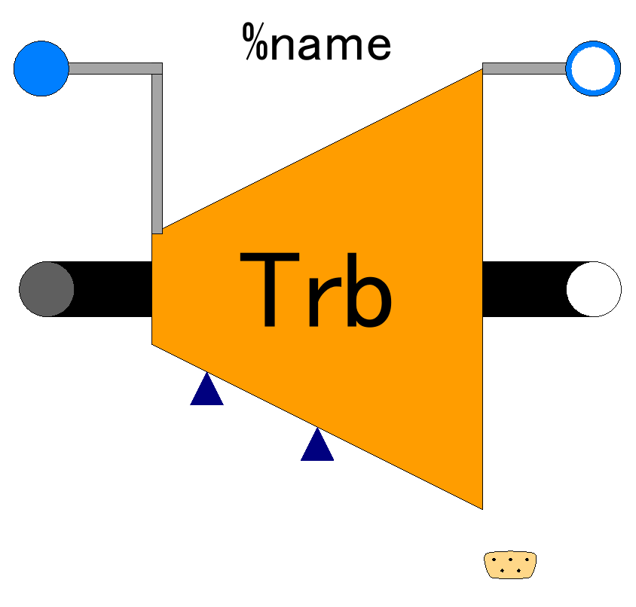

Slide 12
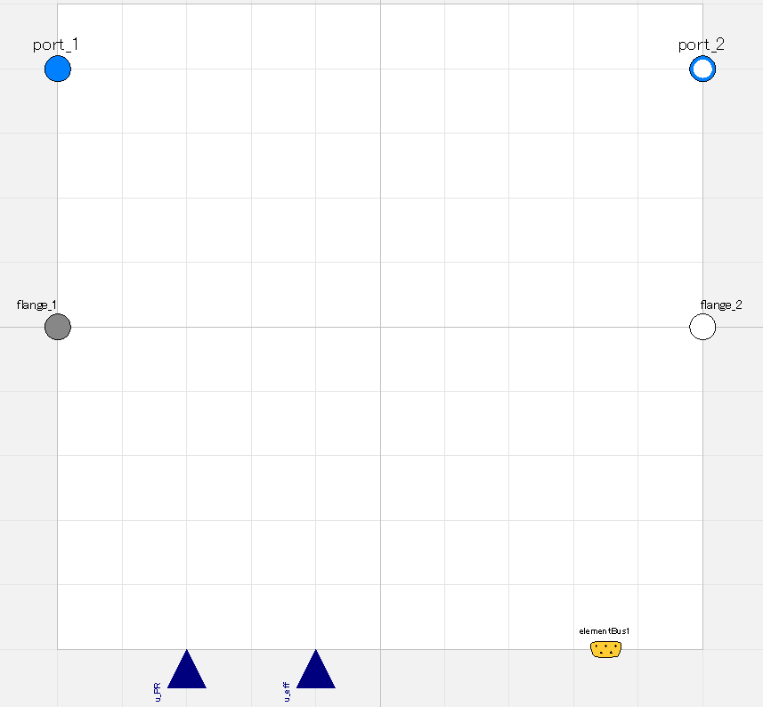

Slide 13
Fluid inlet port, input&output (use “connect” operator)
Fluid outlet port, input&output (use “connect” operator)
Flange (rotational mechanics port),
input&output (use “connect” operator)
Flange (rotational mechanics port),
input&output (use “connect” operator)
Pressure ratio;
input (use “connect” operator),
valid only when switchDetermine_PR==viaRealInput
Efficiency;
input (use “connect” operator),
valid only when switchDetermine_eff==viaRealInput
Expandable connector prepared for communication with internal variables which cannot be accessed by other ports,
input&output (use “connect” operator)

