Slide 1
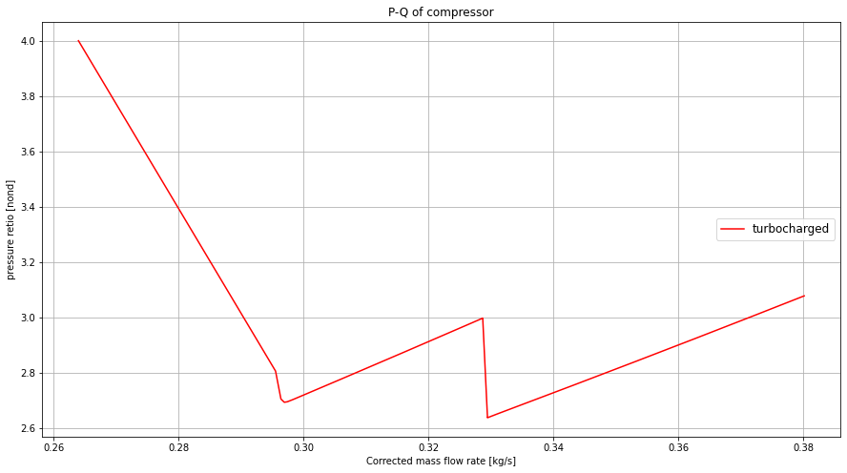
Response to sudden acceleration (throttle opening)
Op. line toward steady state.
Time< 50 [s]
Op. line at initialization and right after.
Acceleration and toward steady state
50 < time <100 [s]

