Slide 1
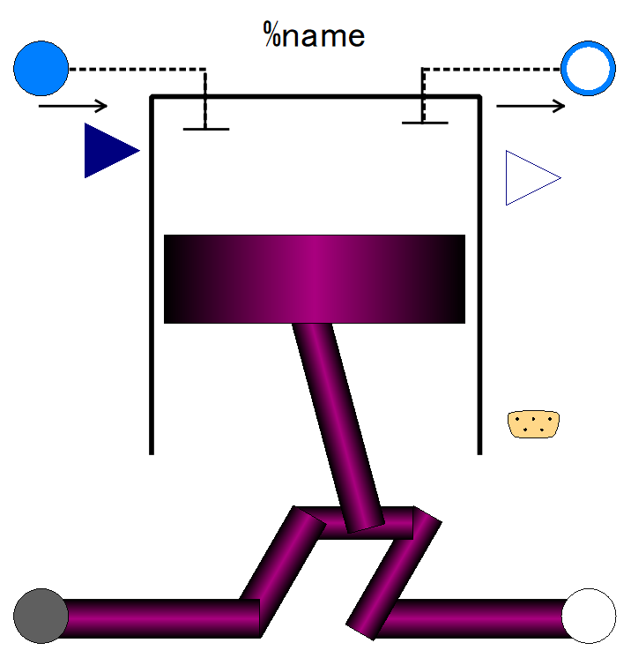

Slide 2
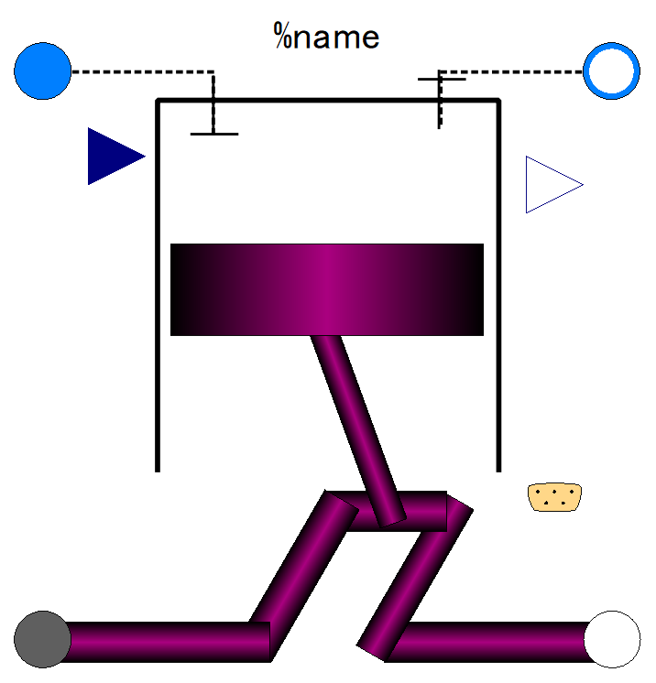
Fluid inlet port, input&output (use “connect” operator)
Fluid outlet port, input&output (use “connect” operator)
Fuel flow rate, output
Fuel fraction in in-taken gas;
input (use “connect” operator),
Expandable connector prepared for communication with internal variables which cannot be accessed by other ports,
input&output (use “connect” operator)
Flange (rotational mechanics port),
input&output (use “connect” operator)
Flange (rotational mechanics port),
input&output (use “connect” operator)

Slide 3
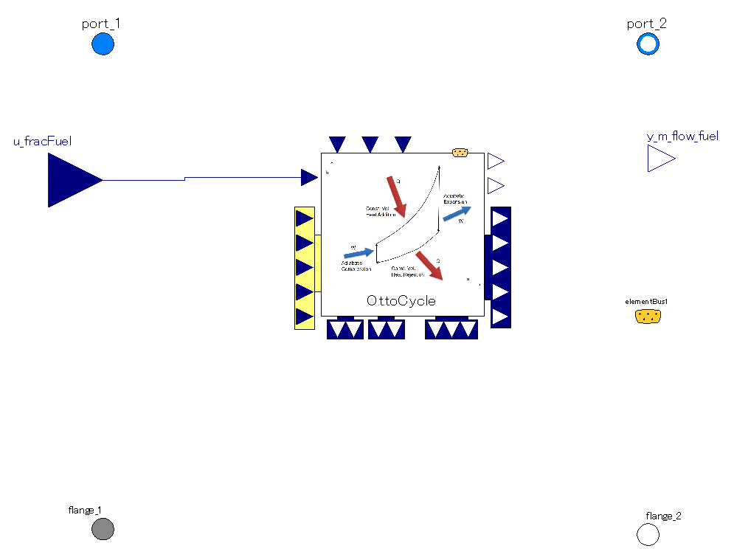
The mass flow rate through the piston is averaged over 2 rotations (=1 cycle).
Thus mass flow rate is steady as long as flange rotation is so.
Pressure and spec. enthalpy of port_1 are referred as fluid state before compression stroke in cycle calculation
Pressure and spec. enthalpy of fluid state after expansion stroke are referred as those of port_2.
It calculates power output, mass of fuel consumed in one Otto cycle and fluid state after expansion stroke.
The power output of Otto cycle is averaged over 2 rotations (=1 cycle).
Thus, torque out is steady as long as flange rotation is so.

Slide 4
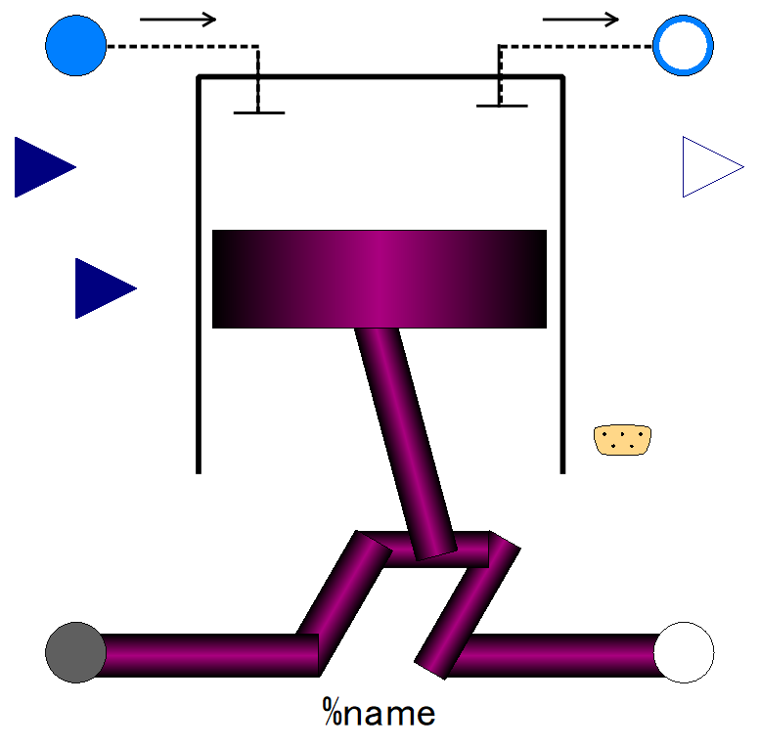

Slide 5
Fluid inlet port, input&output (use “connect” operator)
Fluid outlet port, input&output (use “connect” operator)
Fuel flow rate, output
Air fraction in in-taken gas;
input (use “connect” operator),
Expandable connector prepared for communication with internal variables which cannot be accessed by other ports,
input&output (use “connect” operator)
Fuel fraction in in-taken gas;
input (use “connect” operator),
Flange (rotational mechanics port),
input&output (use “connect” operator)
Flange (rotational mechanics port),
input&output (use “connect” operator)

Slide 6
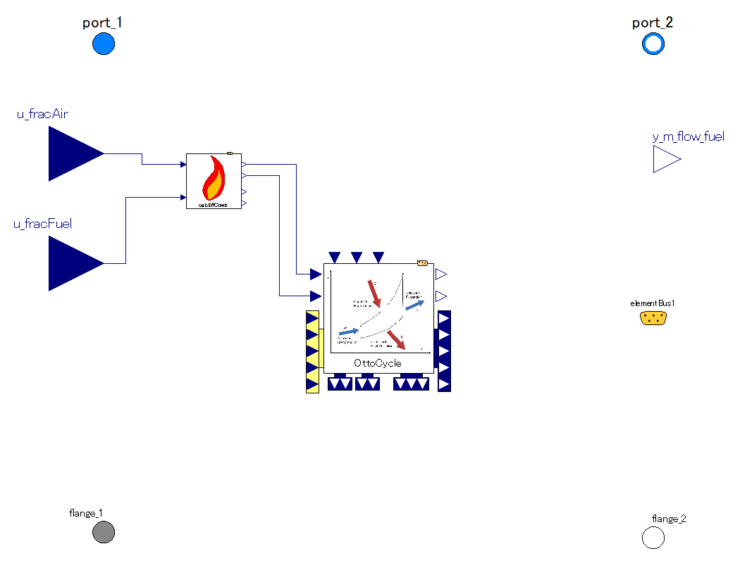
The mass flow rate through the piston is averaged over 2 rotations (=1 cycle).
Thus mass flow rate is steady as long as flange rotation is so.
Combustion efficiency is calculated by mass fraction of air and fuel.
Pressure and spec. enthalpy of fluid state after expansion stroke are referred as those of port_2.
Pressure and spec. enthalpy of port_1 are referred as fluid state before compression stroke in cycle calculation
It calculates power output, mass of fuel consumed in one Otto cycle and fluid state after expansion stroke.
The power output of Otto cycle is averaged over 2 rotations (=1 cycle).
Thus, torque out is steady as long as flange rotation is so.

Slide 7
P [Pa]
Pexh
Pexh
Pexh
Pintk
Pintk
Pintk
V [m3]
V [m3]
V [m3]
Exhaust stroke; work is done onto fluid.
-> power loss for engine.
Wexh= -1 * Pexh*(V2-V4)
Positive sign : loss for engine
intake stroke; work is extracted from fluid.
-> power gain for engine
Wintk= -1 * Pintk*(V1-V2)
Positive sign: loss for engine
This total work of intake/exhaust strokes is “pumping work” of piston&cylinder.
Loss for engine, enthalpy of exhaust flow increases.
Wpump= Wexh+Wintk
positive sign: loss for engine

Slide 8
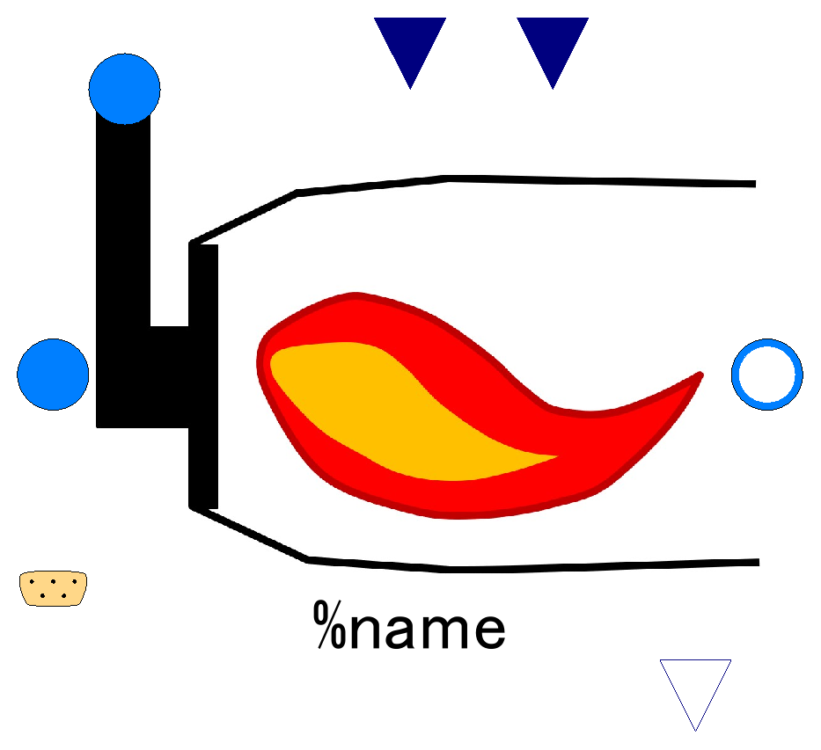

Slide 9
Lower Heating Value of Fuel;
input (use “connect” operator),
valid only when use_u_LHV_fuel==true
Efficiency of combustion;
input (use “connect” operator),
valid only when use_u_effComb==true
Fuel inlet port, input&output (use “connect” operator)
Fluid inlet port, input&output (use “connect” operator)
Fluid outlet port, input&output (use “connect” operator)
Fuel flow, output

Slide 10
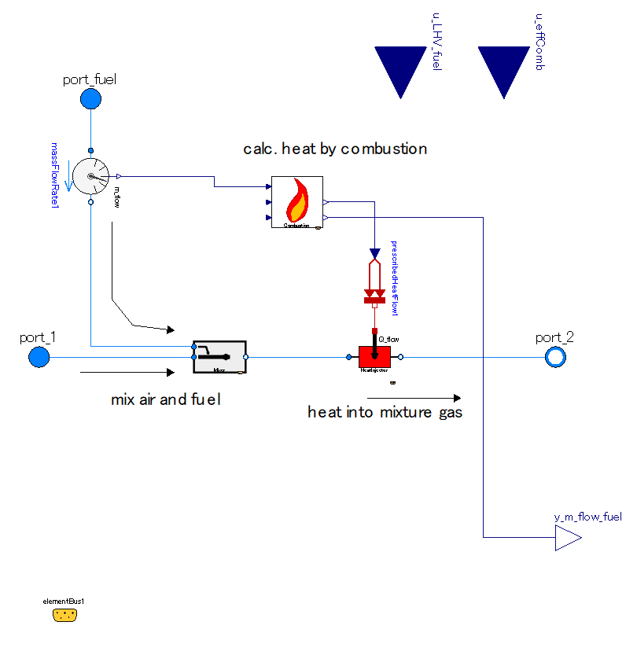

Slide 11
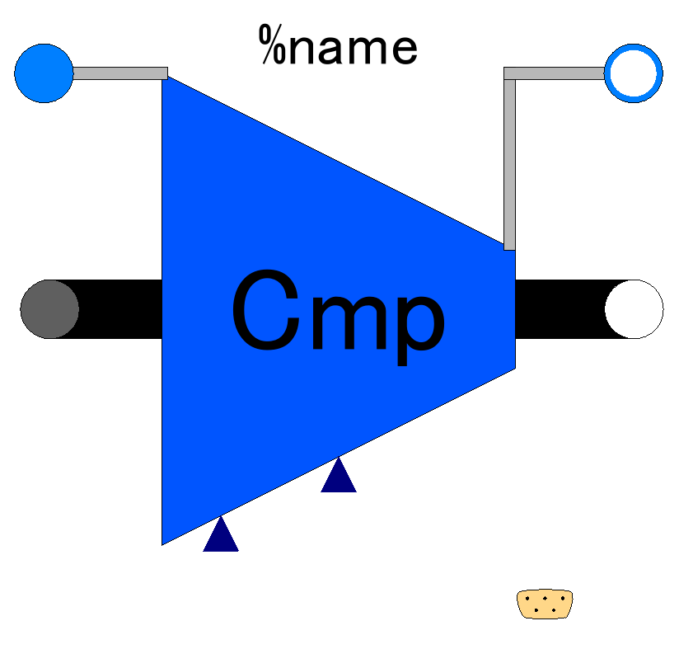

Slide 12
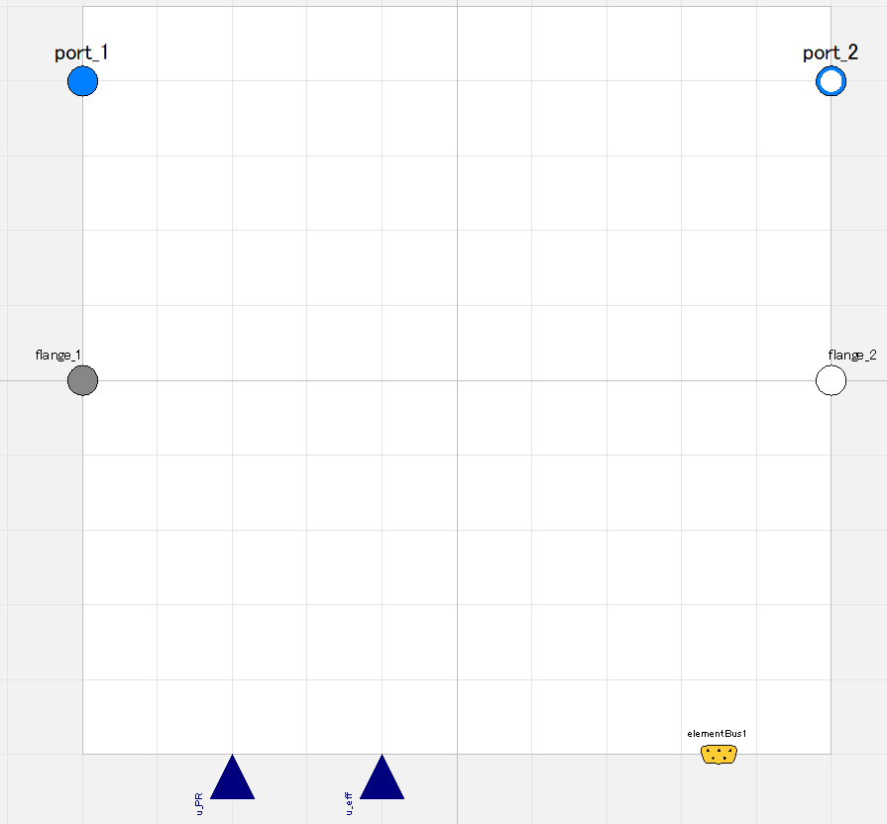

Slide 13
Fluid inlet port, input&output (use “connect” operator)
Fluid outlet port, input&output (use “connect” operator)
Flange (rotational mechanics port),
input&output (use “connect” operator)
Flange (rotational mechanics port),
input&output (use “connect” operator)
Pressure ratio;
input (use “connect” operator),
valid only when switchDetermine_PR==viaRealInput
Efficiency;
input (use “connect” operator),
valid only when switchDetermine_eff==viaRealInput
Expandable connector prepared for communication with internal variables which cannot be accessed by other ports,
input&output (use “connect” operator)

Slide 14
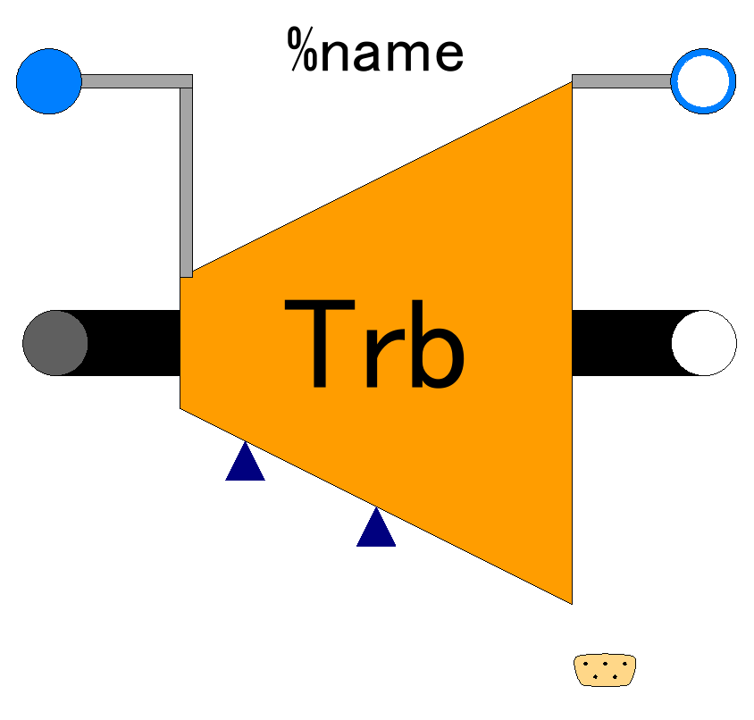

Slide 15
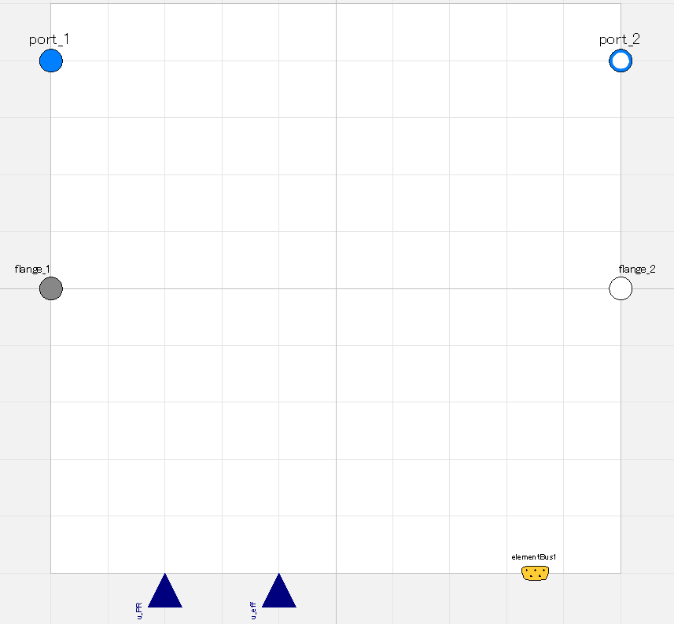

Slide 16
Fluid inlet port, input&output (use “connect” operator)
Fluid outlet port, input&output (use “connect” operator)
Flange (rotational mechanics port),
input&output (use “connect” operator)
Flange (rotational mechanics port),
input&output (use “connect” operator)
Pressure ratio;
input (use “connect” operator),
valid only when switchDetermine_PR==viaRealInput
Efficiency;
input (use “connect” operator),
valid only when switchDetermine_eff==viaRealInput
Expandable connector prepared for communication with internal variables which cannot be accessed by other ports,
input&output (use “connect” operator)

