Slide 1
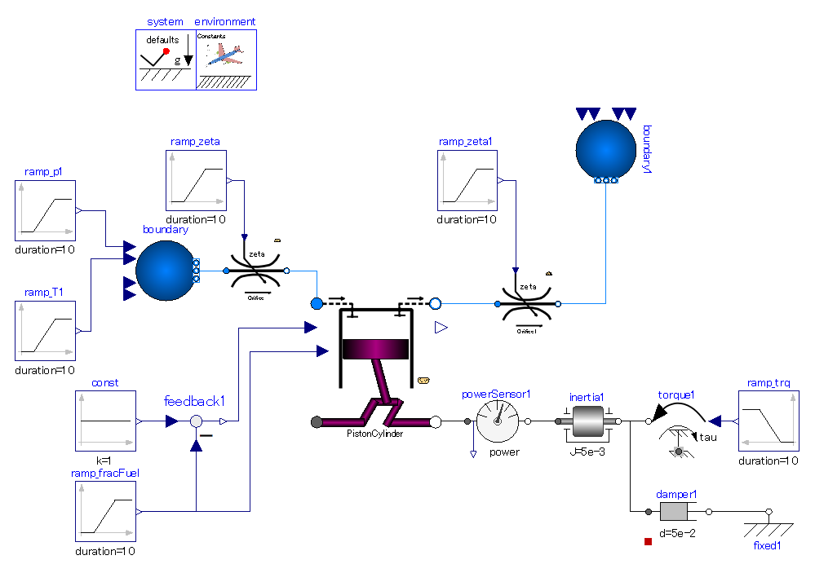

Slide 2
Pressure loss coefficient of orifice.
Pressure loss coefficient of orifice.
Controllable flow restriction.
The pressure loss coefficient can be manipulated by external real signal.
Input inlet fluid states, p and T.
Additional load can be applied.
Input the fraction of air and fuel in in-taken air fuel mixture.
Viscos friction. The friction torque is proportional to the shaft absolute angular velocity (shaft speed relative to fixed surrounding world) of shaft speed.
Shaft rotation gets steady at the angular speed at which the engine torque output is in equilibrium with friction torque.

Slide 3
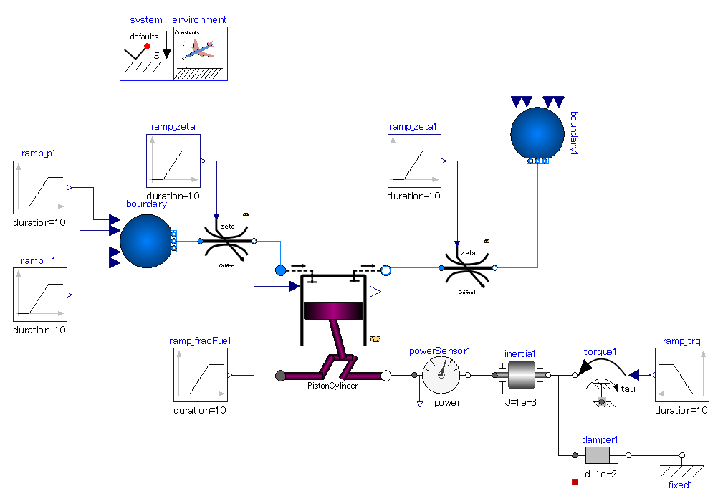

Slide 4
Pressure loss coefficient of orifice.
Pressure loss coefficient of orifice.
Controllable flow restriction.
The pressure loss coefficient can be manipulated by external real signal.
Input inlet fluid states, p and T.
Additional load can be applied.
Input the fraction of fuel in in-taken air fuel mixture.
Viscos friction. The friction torque is proportional to the shaft absolute angular velocity (shaft speed relative to fixed surrounding world) of shaft speed.
Shaft rotation gets steady at the angular speed at which the engine torque output is in equilibrium with friction torque.

Slide 5
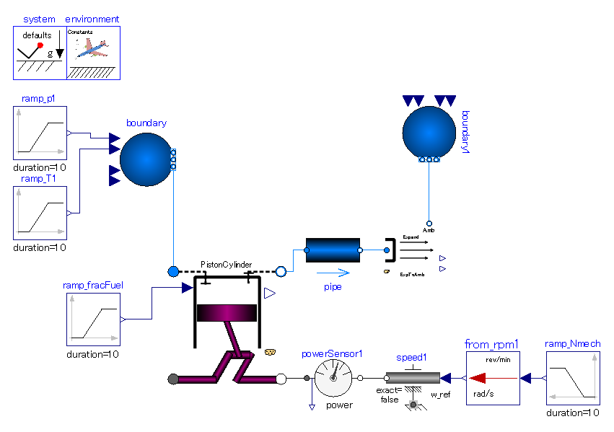

Slide 6
Pressure remaining at the end of exhaust pipe is free-expanded to ambient static pressure, which generates reaction force.
It is assumed that discharge coefficient is 1. Choke-Non-Choke is not considered.
Input inlet fluid states, p and T.
Input the fraction of fuel in in-taken air fuel mixture.
Constrain the shaft speed, then torque is output of PistonCylinder.

Slide 7
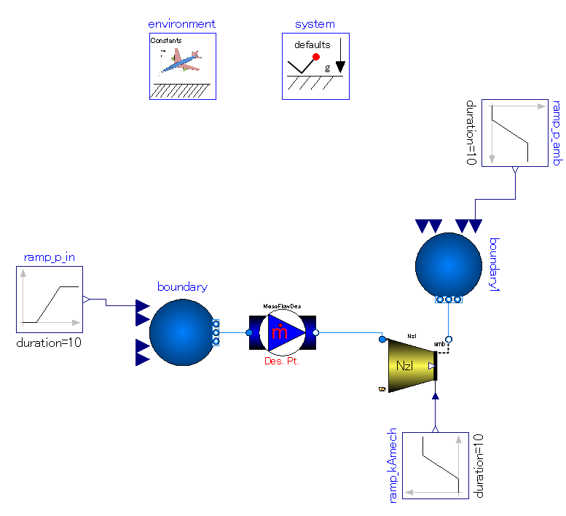
Nozzle throat mechanical cross sectional area is “actuatable” by multiplication factor after constraint period.
The area multiplication factor is changed from 1.0 to 0.9 gradually in this example.

Slide 8
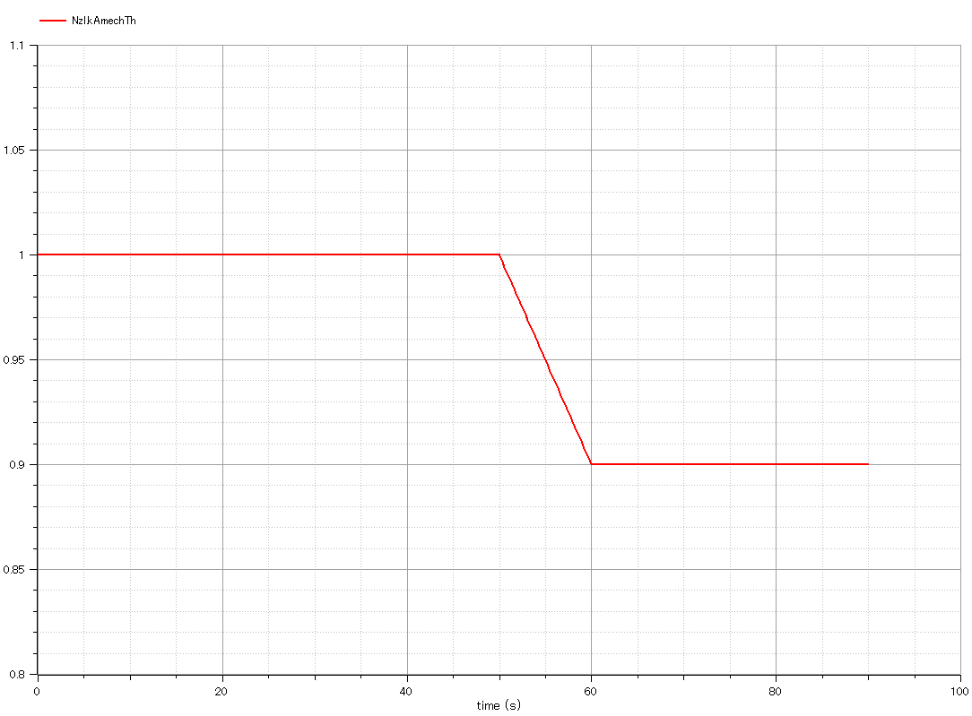
Input:
nozzle pressure ratio is increased

Slide 9
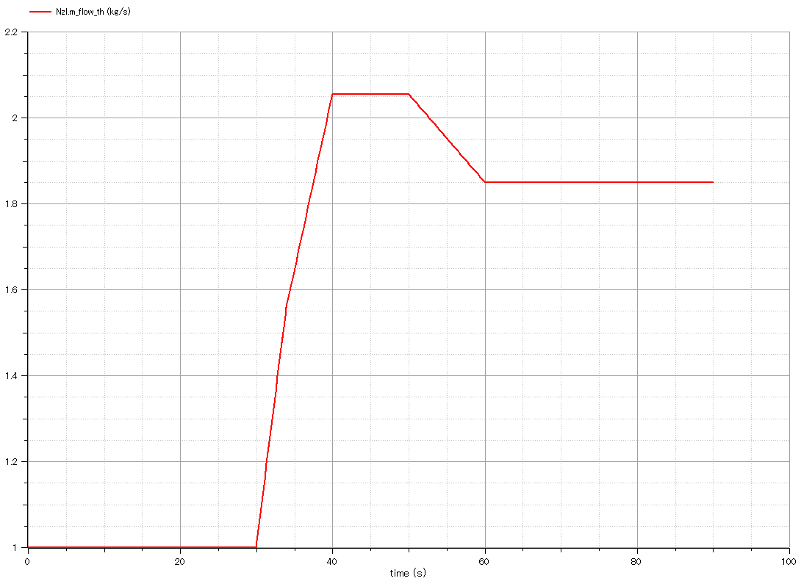
Output:
mass flow rate via nozzle.
It decreases as throat area multiplication factor drops.

Slide 10
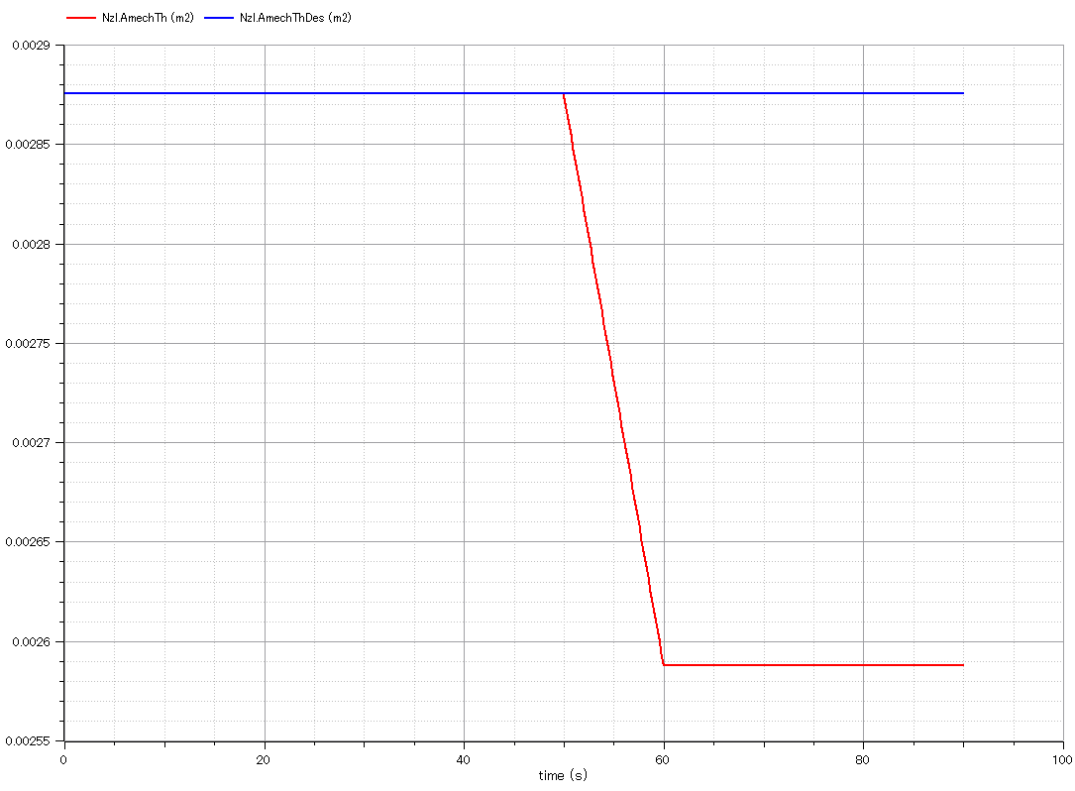
Output:
“des” marked throat mechanical cross sectional area.
It is kept constant while throat area multiplication factor is changed.
Output:
throat mechanical cross sectional area.
It decreases as throat area multiplication factor drops.

Slide 11
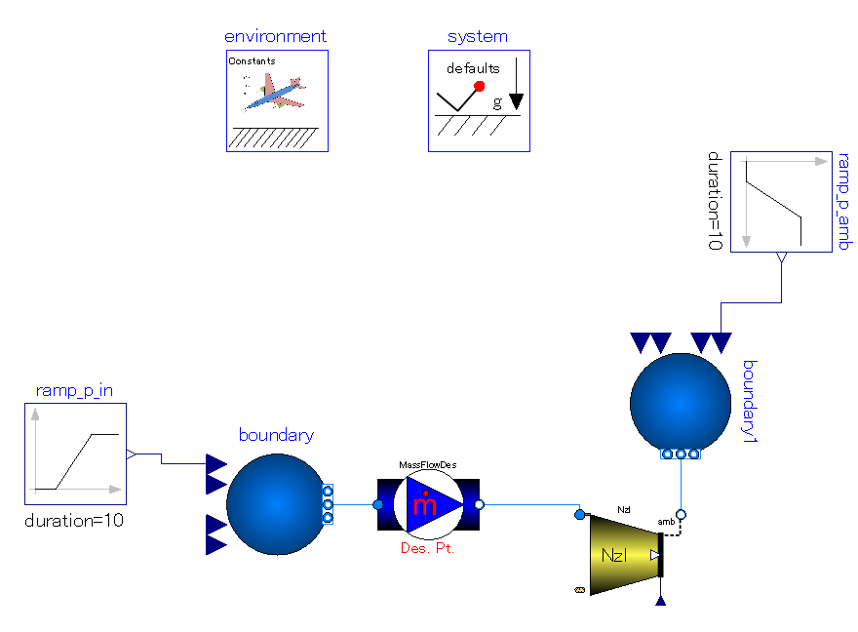
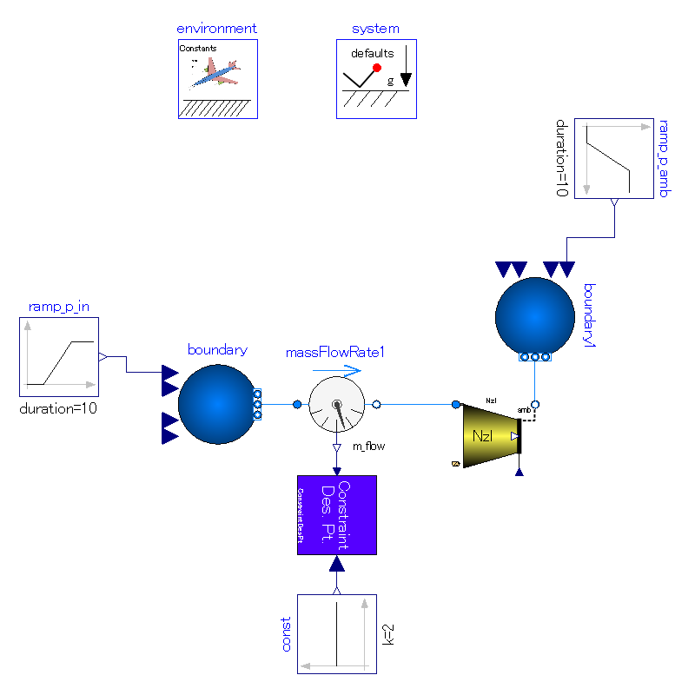
Components for design point constraint of mass flow rate is integrated into single component for easier handling.

Slide 12
This component defines the time when mass flow rate constraint is removed and mechanical cross sectional area of nozzle throat turns from output to input.
Change upstream pressure of nozzle after remove of mass flow rate constraint in order to check constraint become invalid and area is fixed.
Mass flow rate signal is constrained to the value input as signal.
Constraint is kept until the time which is defined by “environment” block.
Mechanical cross sectional area of throat is calculated variable when mass flow rate is constrained. “des” marked discrete variable stores that value.
After Mass flow rate constraint is removed, the value of mechanical cross sectional area is input and mass flow is calculated variable.

Slide 13
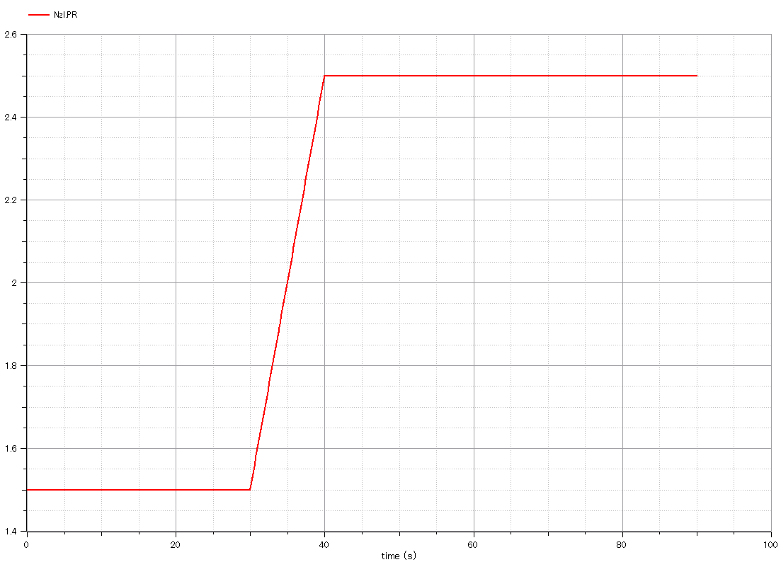
Input:
nozzle pressure ratio is increased

Slide 14
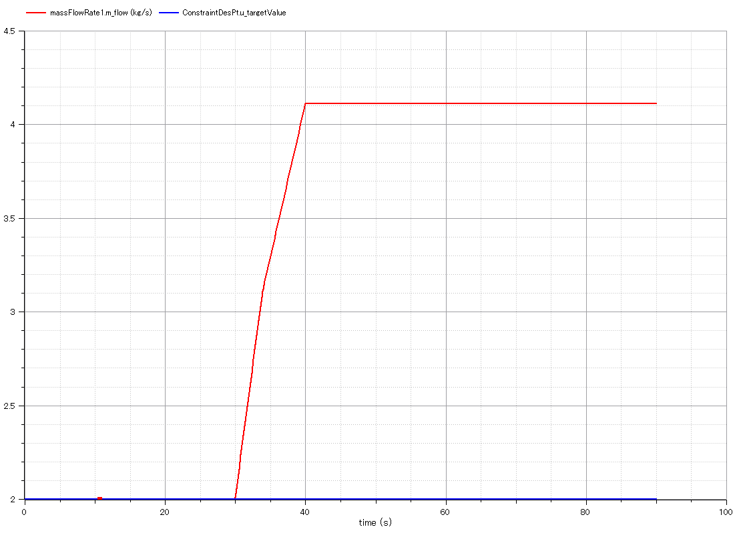
Output:
mass flow rate through nozzle.
It is increased as nozzle pressure ratio rises.
Output:
signal into constraint block which constrains mass flow rate.
The value is fixed to 2 throughout the simulation, but does not affect on mass flow rate after constraint period.

Slide 15
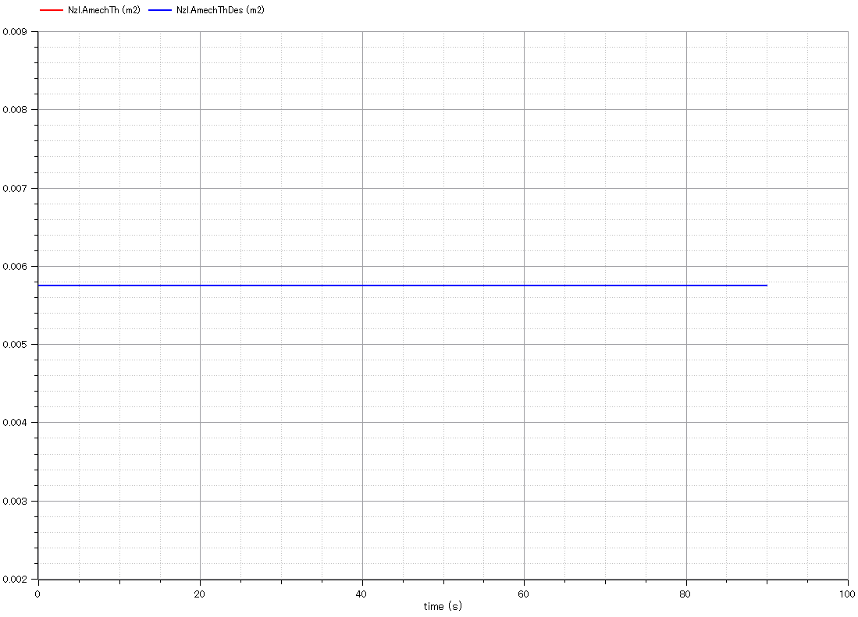
Output:
mechanical cross sectional area of nozzle throat.
It is calculated as output in period of mass flow constraint, and referred as input after constraint period.
Therefore, the value does not change when nozzle pressure ratio is increased.

Slide 16
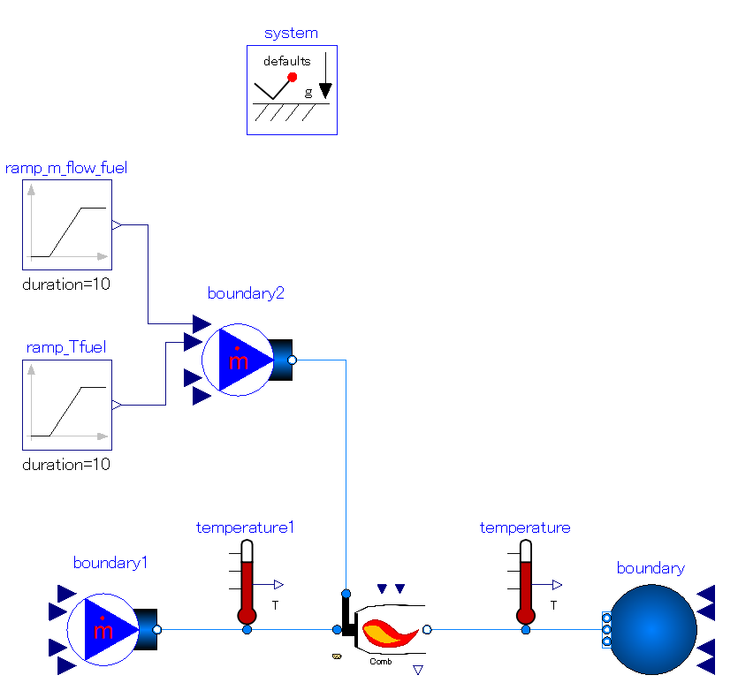
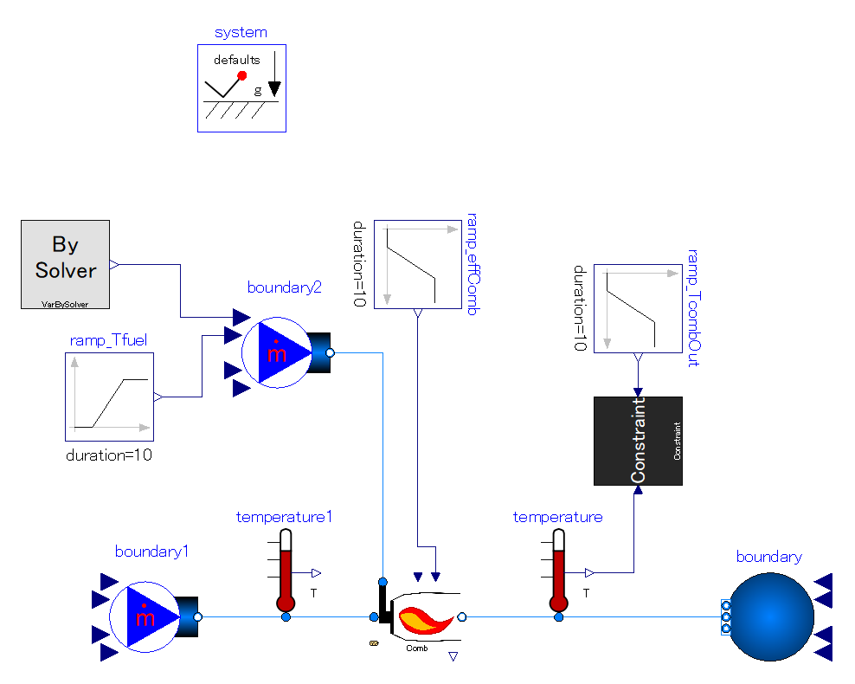

Slide 17
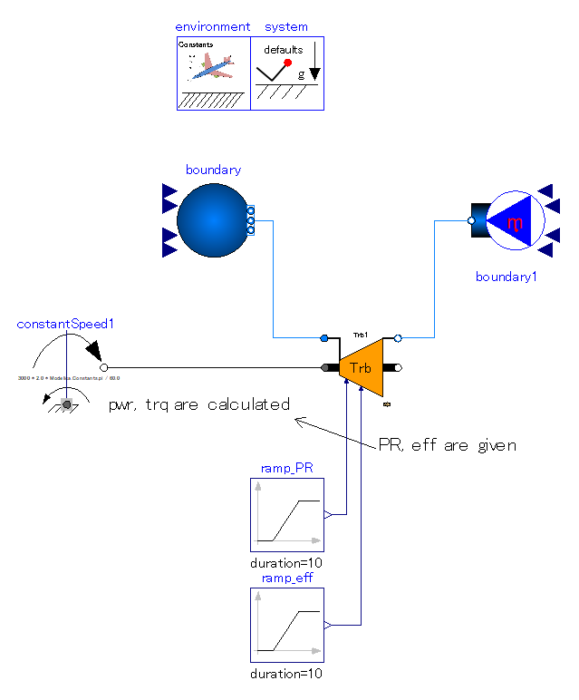
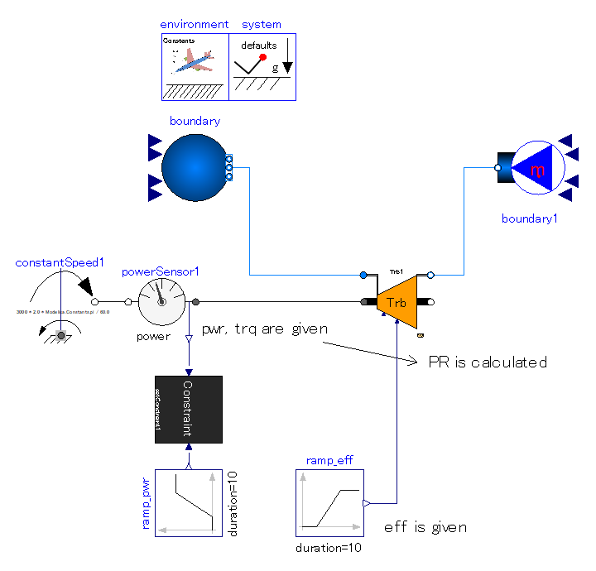

Slide 18
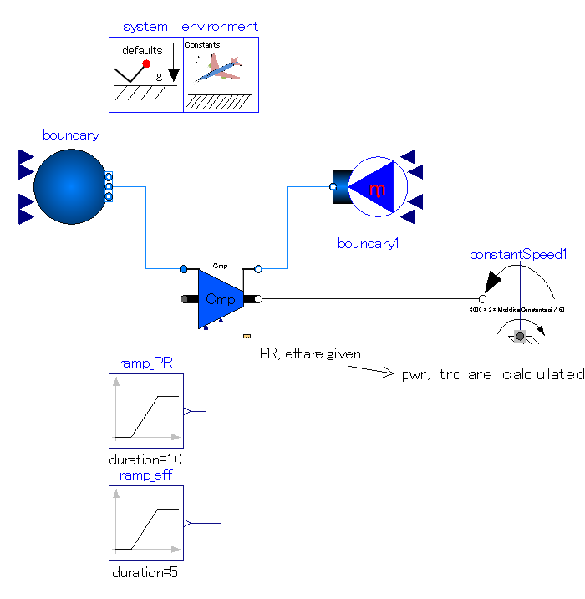
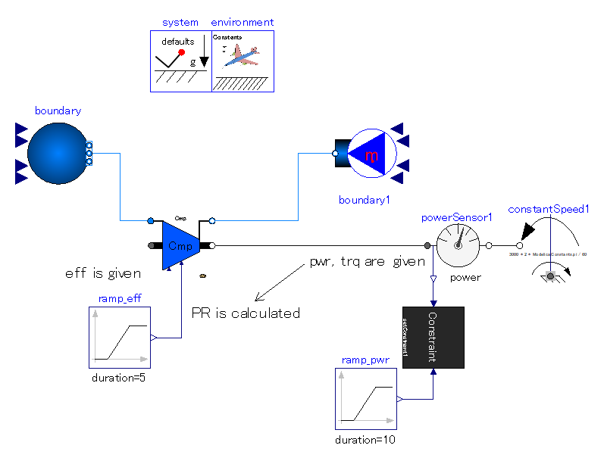

Slide 19
