Slide 1
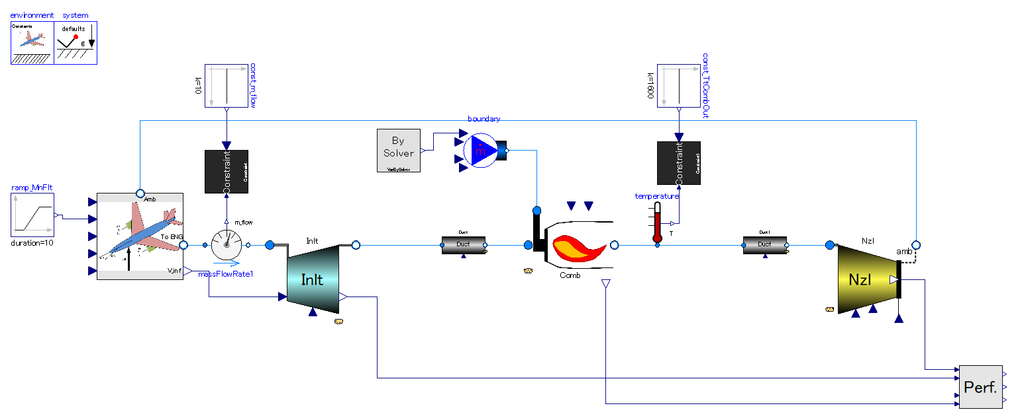
Ram pressurization.
Free stream velocity by flight gives compression to engine air.
Heat addition.
Heat (enthalpy) is given to flow. Essentially same as combustion chamber of other turbo-engines.
Principle of thrust generation is exactly same as that of turbojet.
Ducts.
There are only ducts before & after combustion chamber. They behave as flow resistance (pressure drop component)

Slide 2
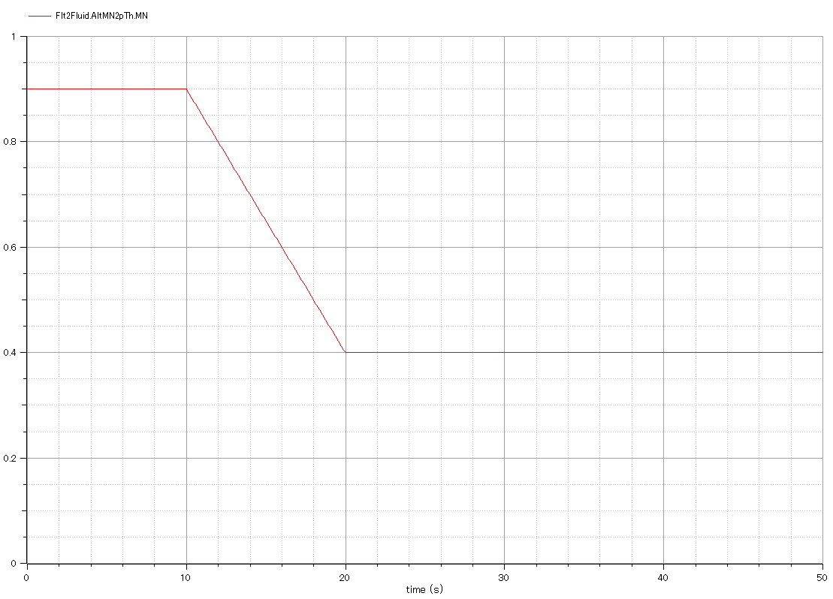
Input:
-. Flight Mach number, or mach number of free-stream outside of engine.

Slide 3
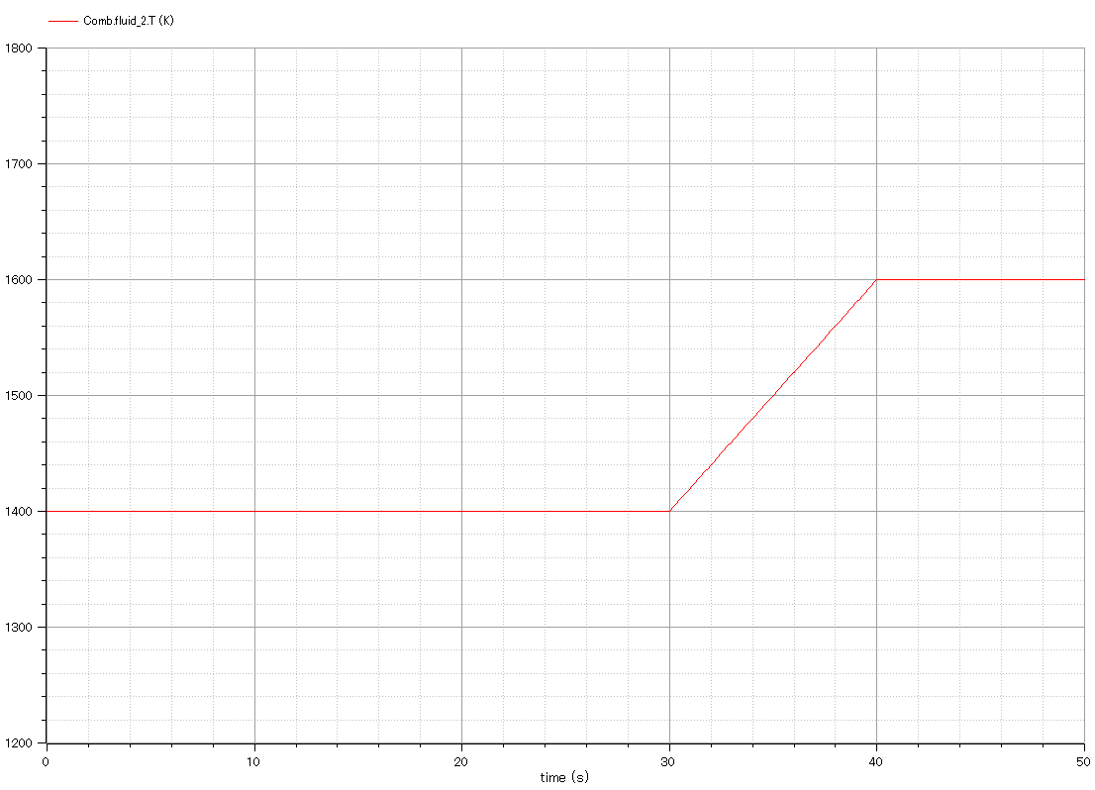
Input:
-. Temperature of combustion chamber outlet.

Slide 4
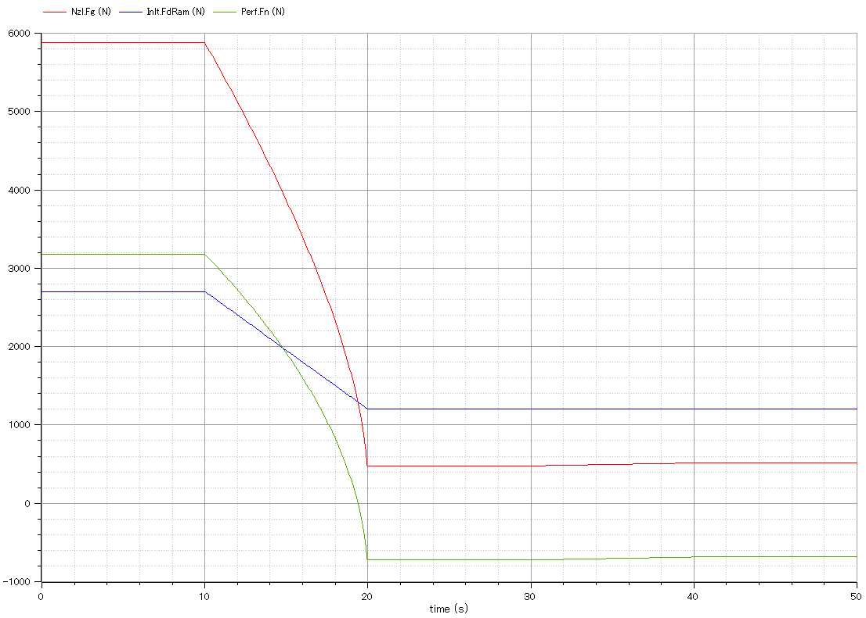
Output:
-. Gross thrust of exhaust nozzle.(red)
-. It gets smaller than ram drag as flight velocity decreases.
Output:
Ram drag.(blue)
Output:
-. Net thrust of engine.(green)
-. It gets negative as flight velocity decreases .

Slide 5
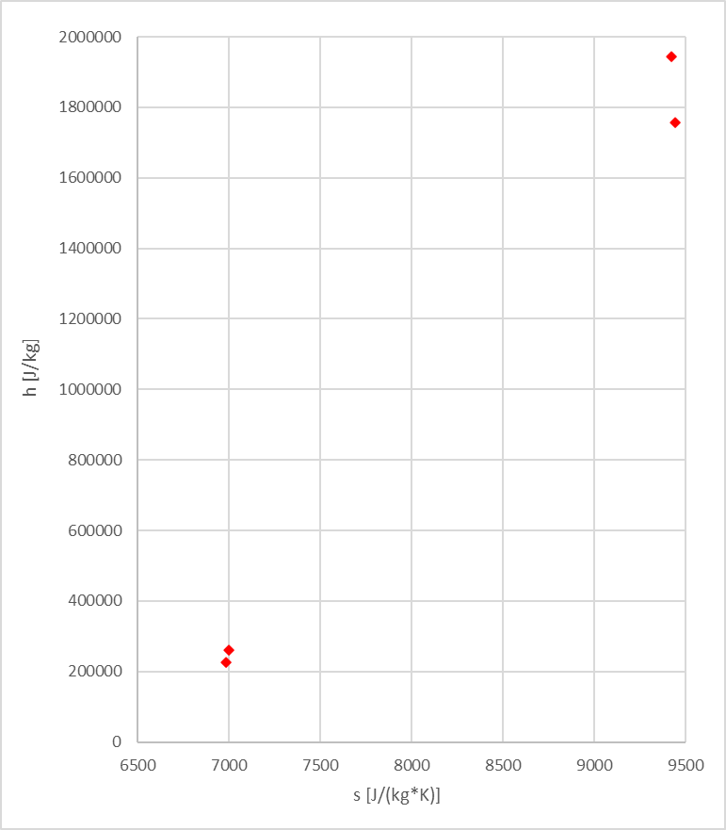
Adiabatic Expansion
Constant pressure heat addition
Constant pressure heat rejection
Adiabatic compression

Slide 6
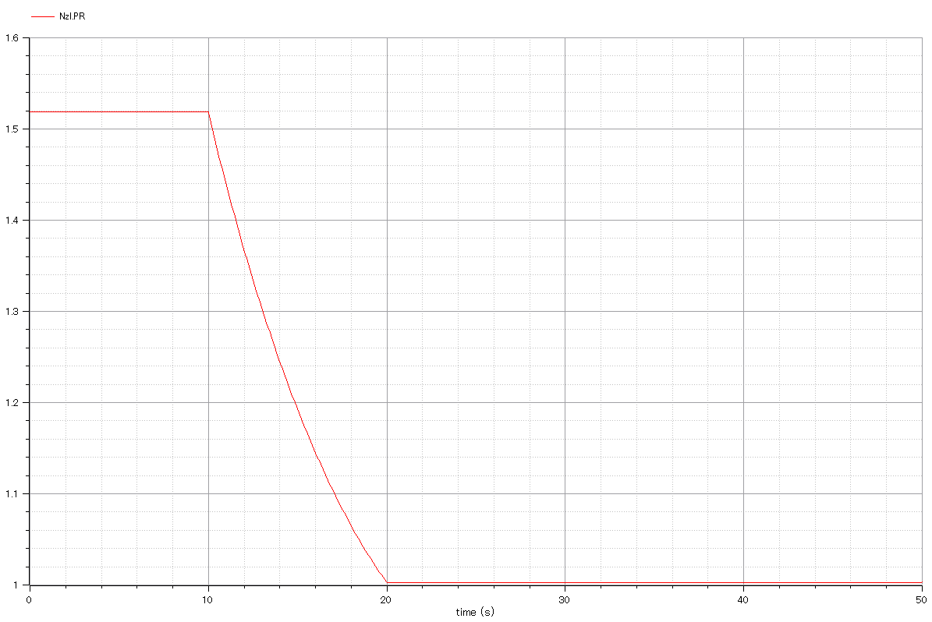
Output:
Nozzle pressure ratio

Slide 7
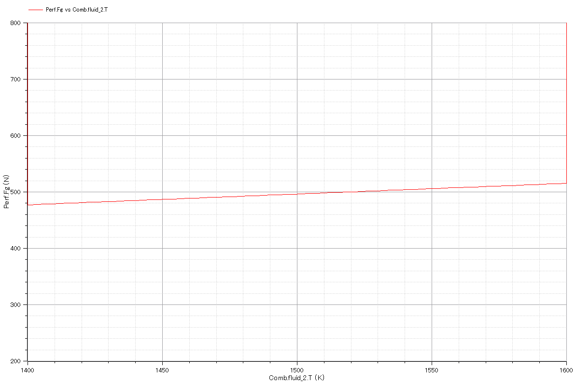
Output:
Nozzle gross thrust vs. combustor outlet temperature.

Slide 8
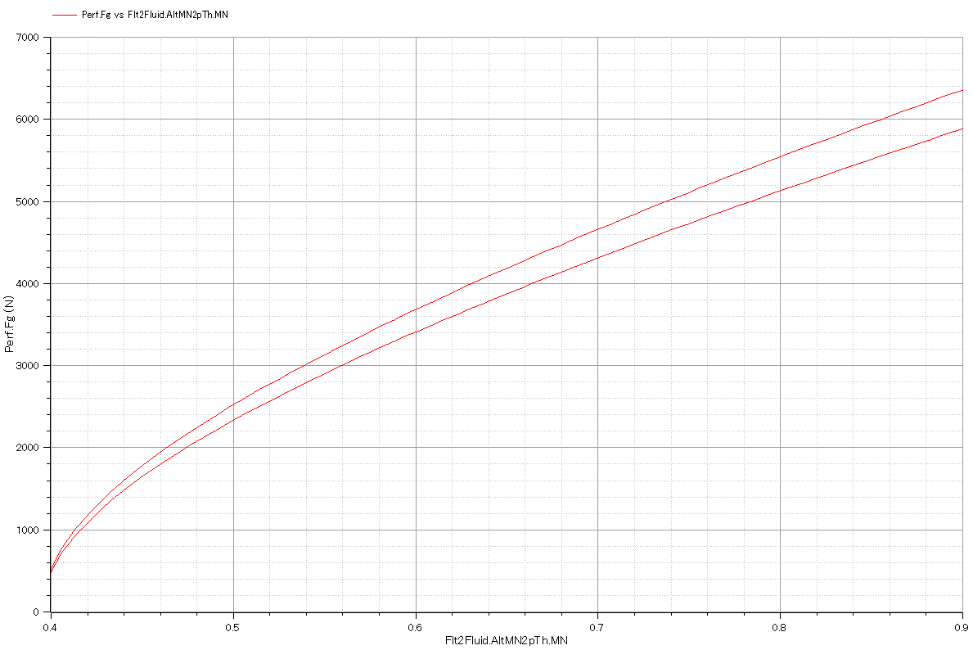
Output:
-. Nozzle gross thrust vs. flight Mach number.
-. There are 2 curves due to change in combustor outlet temperature in simulation.

Slide 9
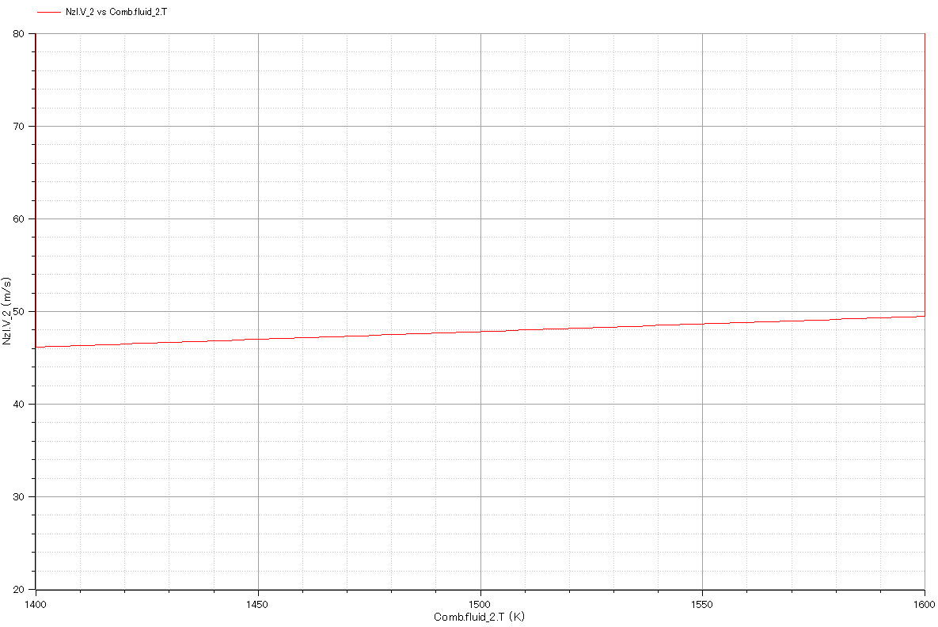
Output:
Full-Expanded exhaust gas velocity vs. combustor outlet temperature.

Slide 10
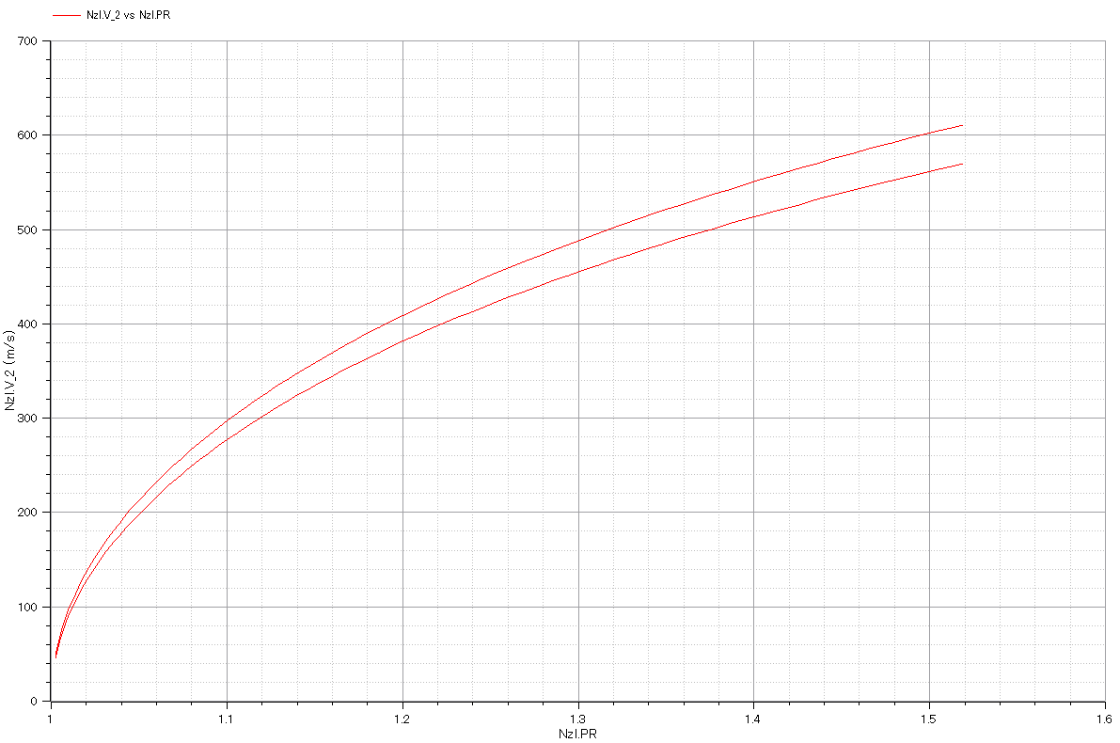
Output:
-. Full-expanded exhaust gas velocity vs. nozzle pressure ratio.
-. There are 2 curves due to change in combustor outlet temperature in simulation.

Slide 11
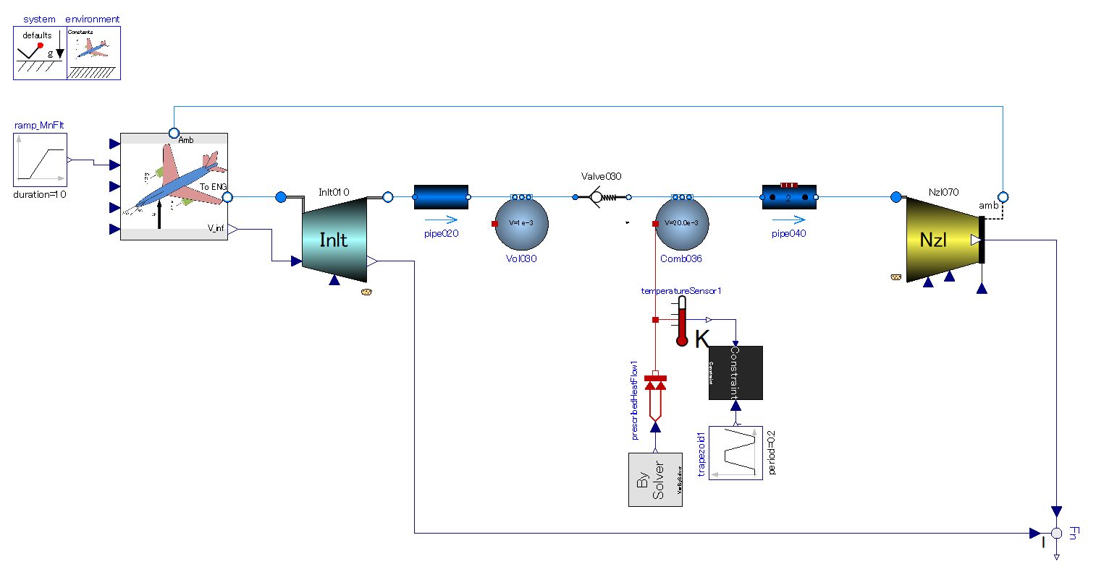
Flight velocity gives gas flow into engine.
This engine cannot start with zero-velocity.
Single direction flow valve.
-. Make gas stream intermittent for intermittent.
-. Prevent gas from flowing backward under combustion period.
Pipe (flow resistance) with volume effect.
-. Delay in mass flow.
No compression process in this thermodynamic cycle.
Heat addition.
-. Under constant volume
-. Intermittent combustion is necessary.

Slide 12
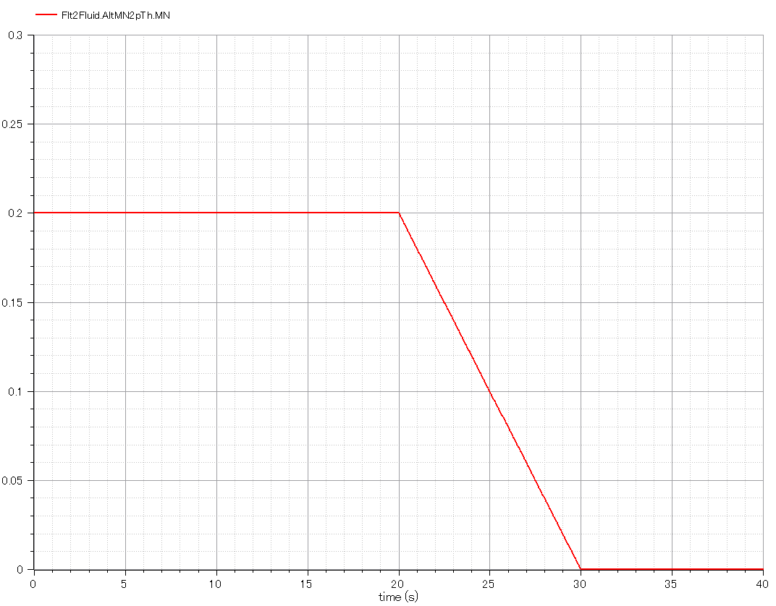
Input:
-. Flight Mach number, or mach number of free-stream outside of engine.
-. It must be greater than zero value at the beginning. The start device provides inlet air with velocity in the real world.

Slide 13
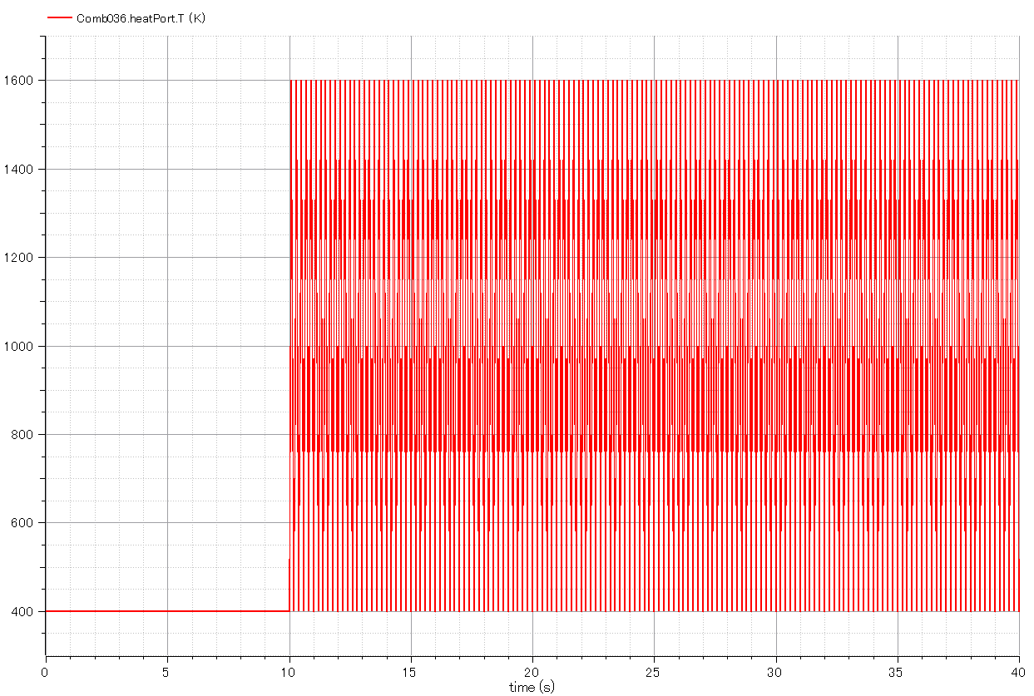
Input:
-. Temperature of combustion chamber.
-. Triangle wave in time domain simulating intermittent combustion.

Slide 14
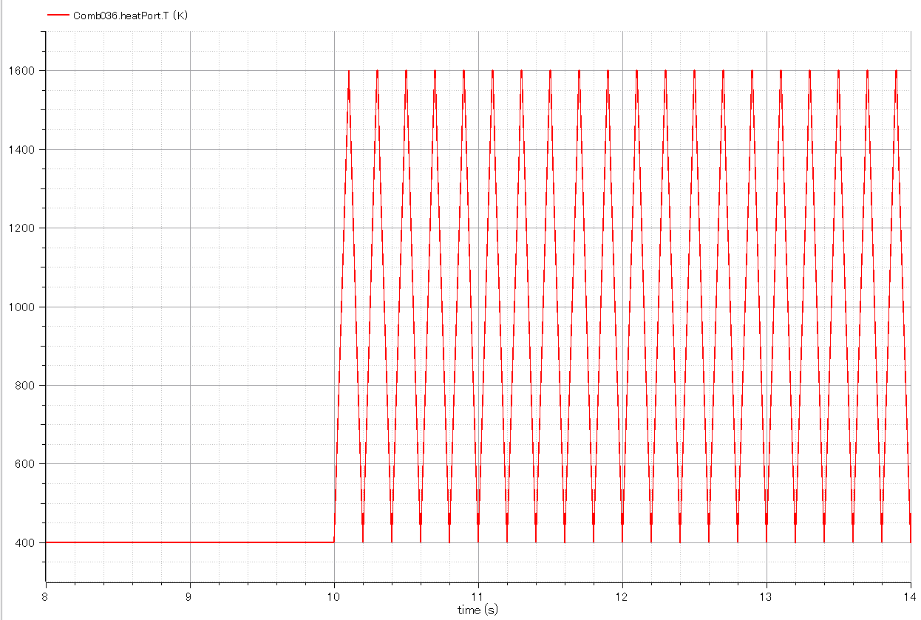
Input:
-. Temperature of combustion chamber. (Enlarged fig.)

Slide 15
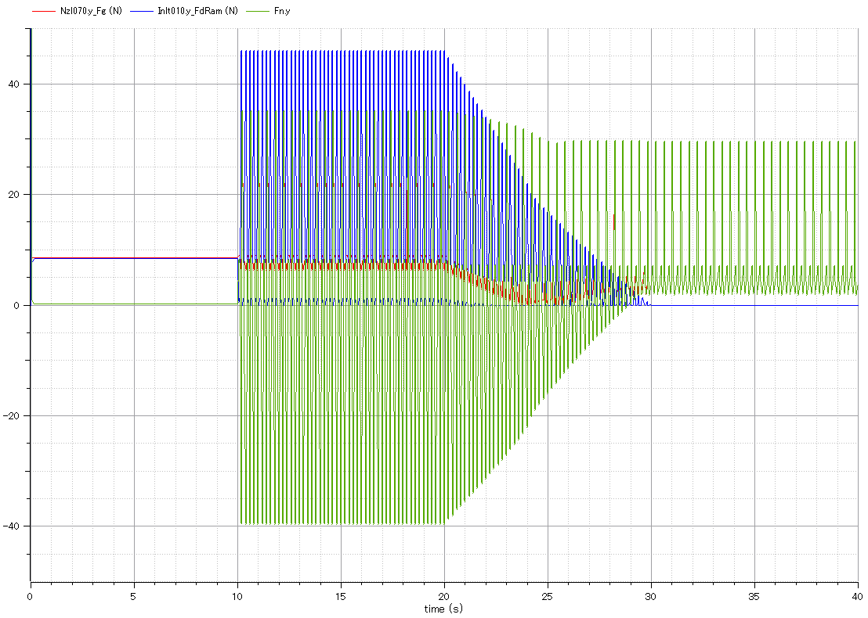
Output:
Ram drag.(blue)
Output:
-. Gross thrust of exhaust nozzle.(red)
-. Engine continues running after flight speed (inlet airspeed) gets zero.
Output:
Net thrust of engine.(green)

Slide 16
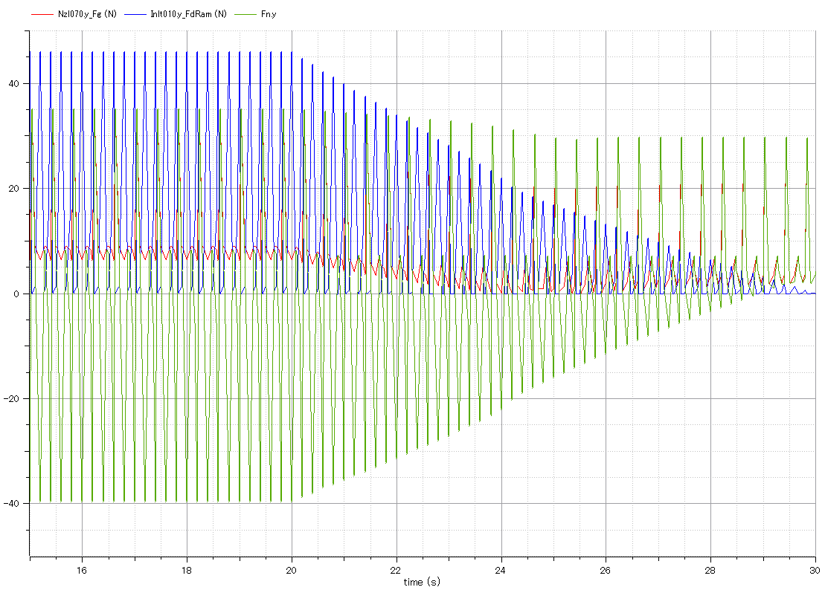
Output:
Ram drag.(blue)
Output:
Gross thrust of exhaust nozzle.(red)
Output:
Net thrust of engine.(green)

Slide 17
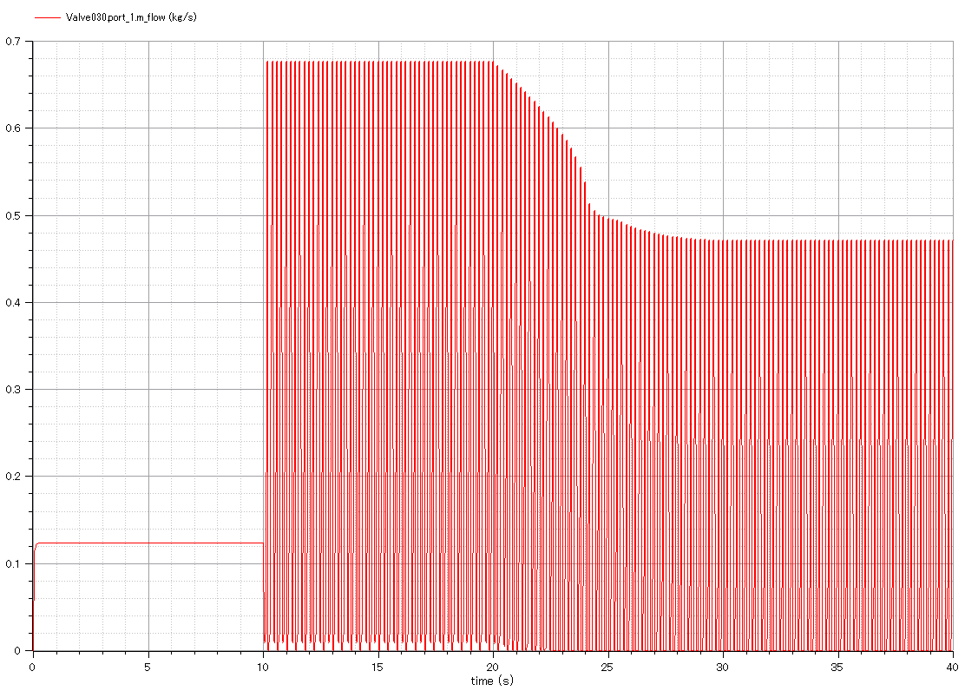
Output:
-. mass flow rate through engine.
-. Intermittent flow due to valve open/close.

Slide 18
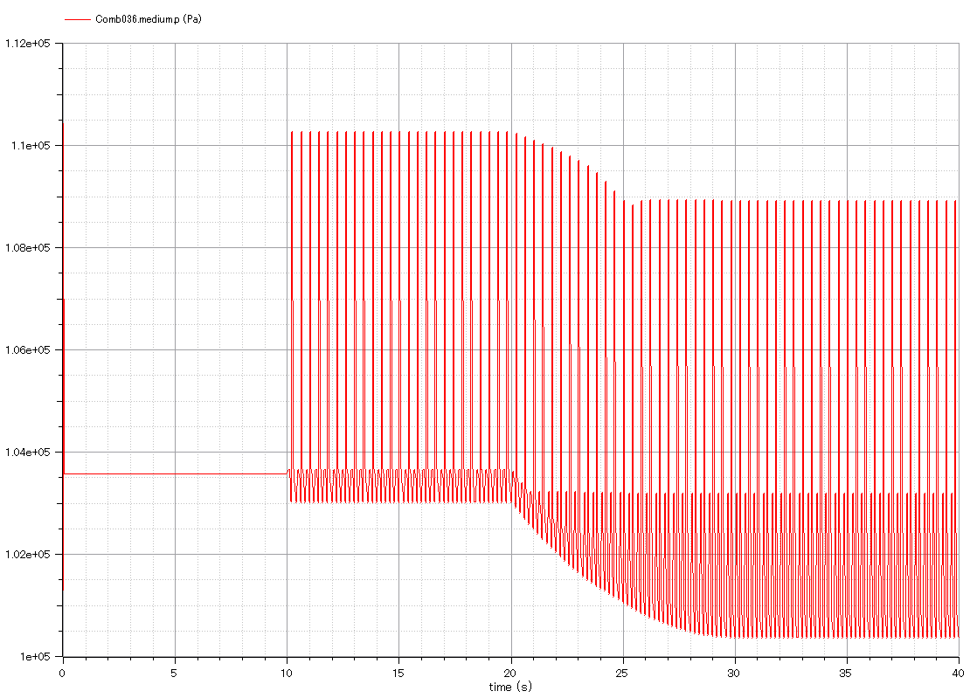
Output:
-. Pressure of combustion chamber.
-. Intermittent change.

