Slide 1
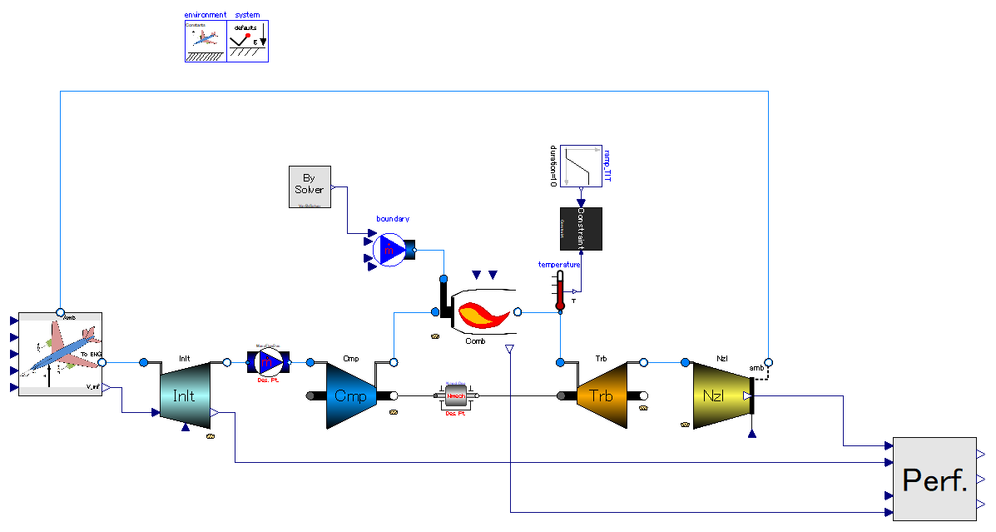
This component defines the time when simulation switches from design-point to off-design.
Mechanical cross sectional area of throat is calculated variable when mass flow rate is constrained. “des” marked discrete variable stores that value.
After Mass flow rate constraint is removed, the value of mechanical cross sectional area is input and mass flow is calculated variable.
Mass flow rate which engine takes in at design point is constrained (= sizing of fluid components).
Constraint is kept until the time which is defined by “environment” block.
Rotational speed of engine shaft at design point is constrained (= sizing of rotary machines).
Constraint is kept until the time which is defined by “environment” block.

Slide 2
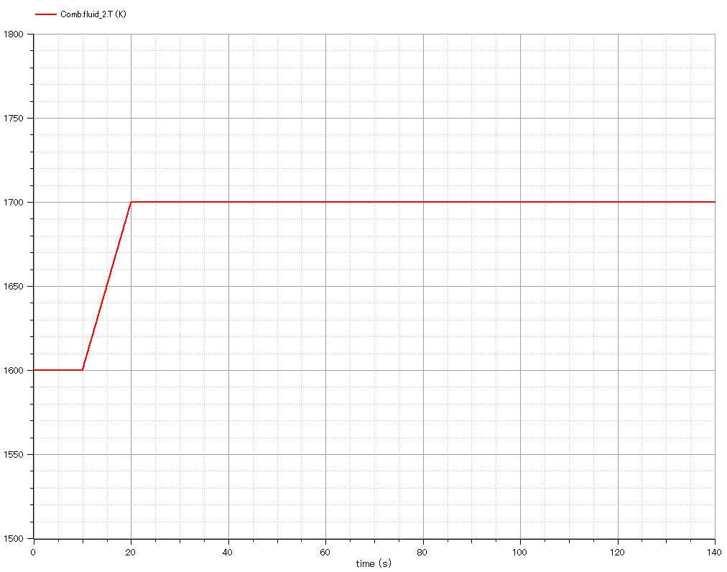
Input:
Combustor outlet temperature is constrained as input of engine rating.
It is increased in off-design simulation period.

Slide 3
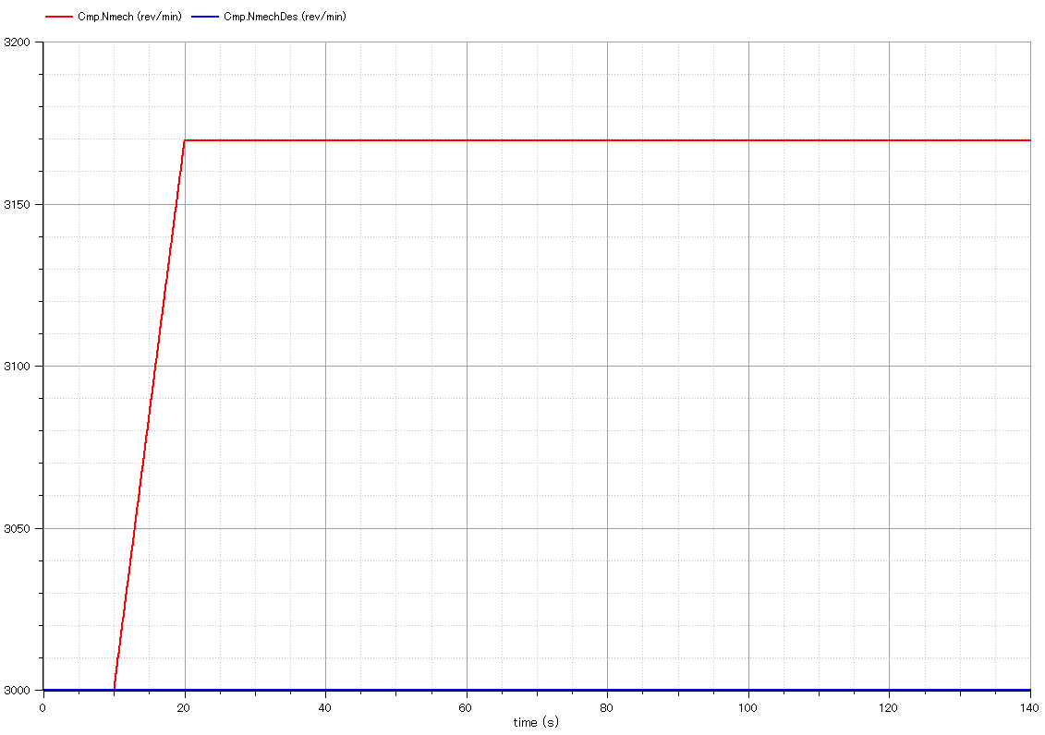
Output:
Mechanical rotational speed.
It is calculated as a result of input of combustor outlet temperature in off-design simulation period.
Output:
“des” marked mechanical rotational speed.
It is kept constant throughout simulation. Its value is defined in design-point calculation period.

Slide 4
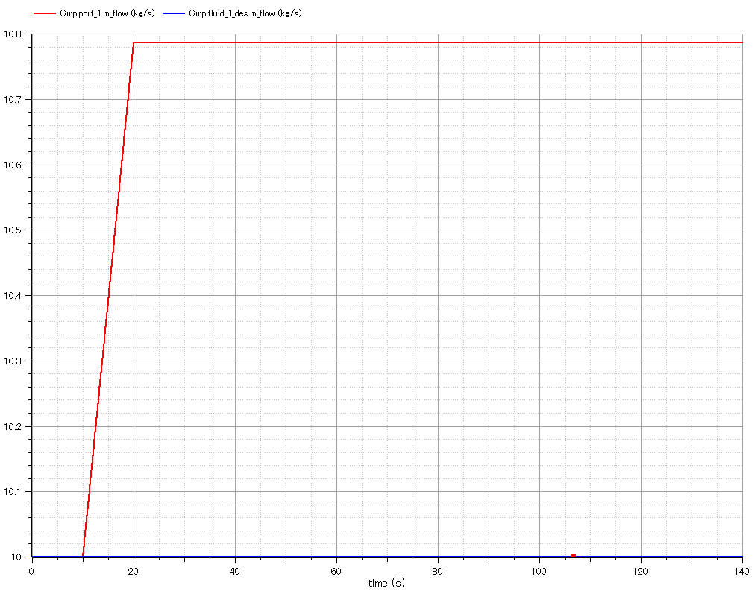
Output:
Mass flow rate which engine takes in.
It is calculated as a result of input of combustor outlet temperature in off-design simulation period.
Output:
“des” marked mass flow rate.
It is kept constant throughout simulation. Its value is defined in design-point calculation period.

Slide 5
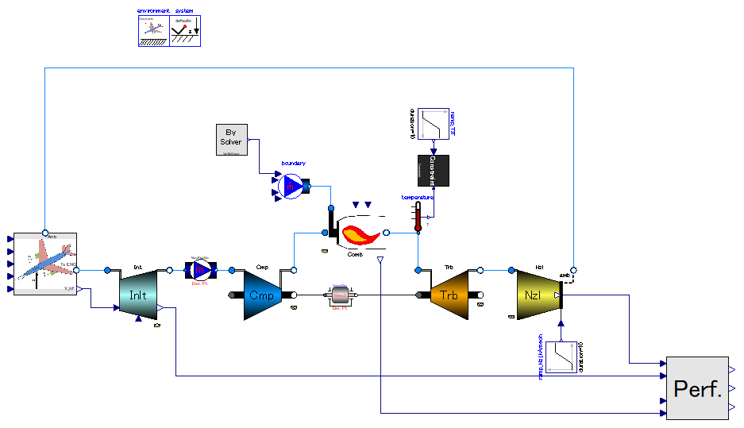
Actuate nozzle throat area size.
The area multiplication factor is changed from 1.0 to 0.9 gradually in this example.

Slide 6
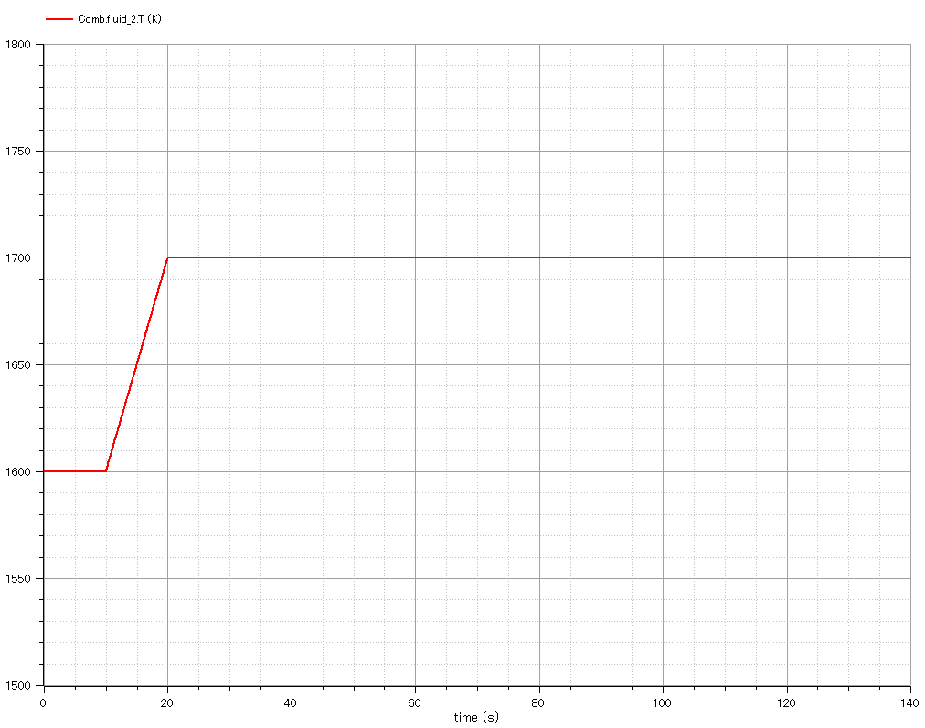
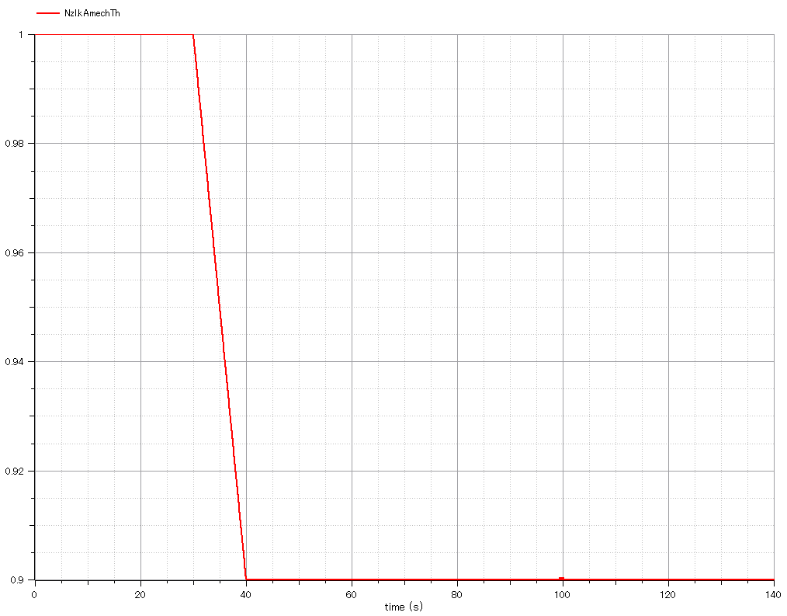
Input:
Combustor outlet temperature is constrained as input of engine rating.
It is increased in off-design simulation period. (10 [s] – 20 [s])
Input:
Multiplication factor of nozzle throat area.
It is decreased (closed) in off-design simulation period. (30 [s] – 40 [s])

Slide 7
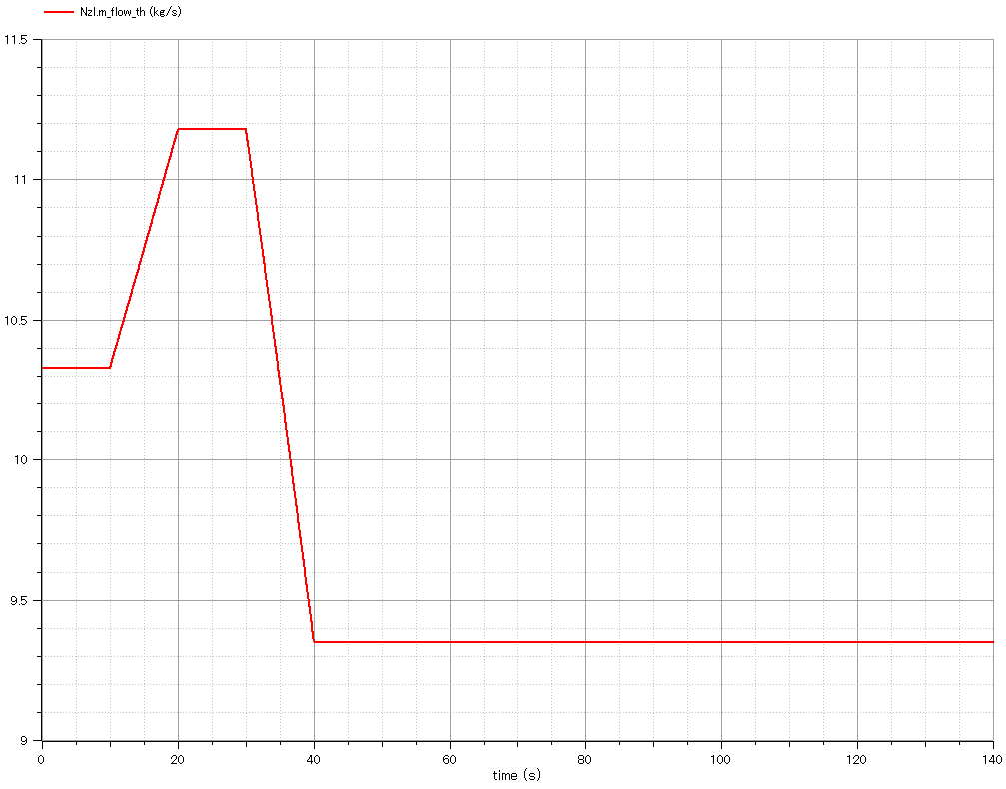
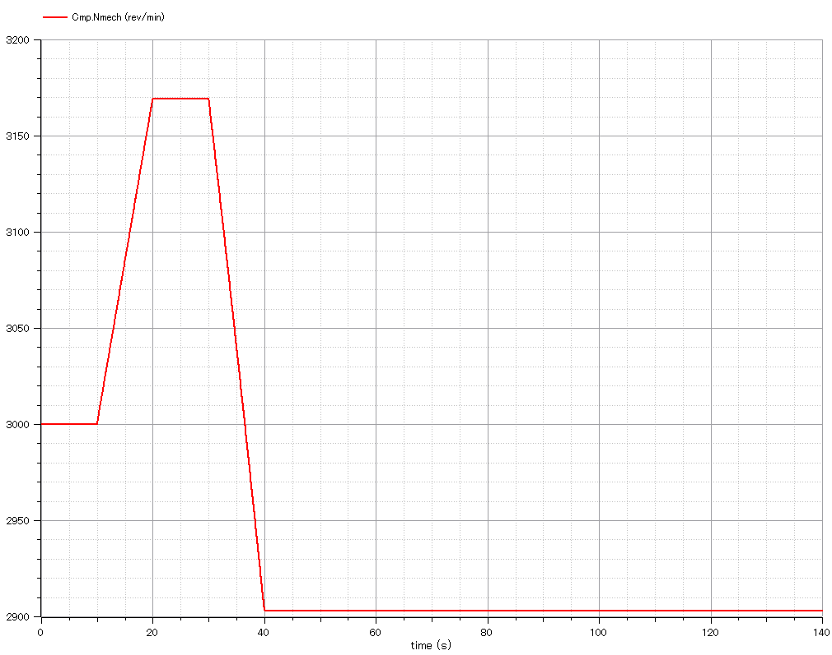
Output:
Mass flow rate through nozzle.
It is decreased as nozzle throat area closes.
Output:
Mechanical rotational speed of engine shaft.
It is decreased as nozzle throat closes in order to compensate for the decrease in mass flow rate capacity.

Slide 8
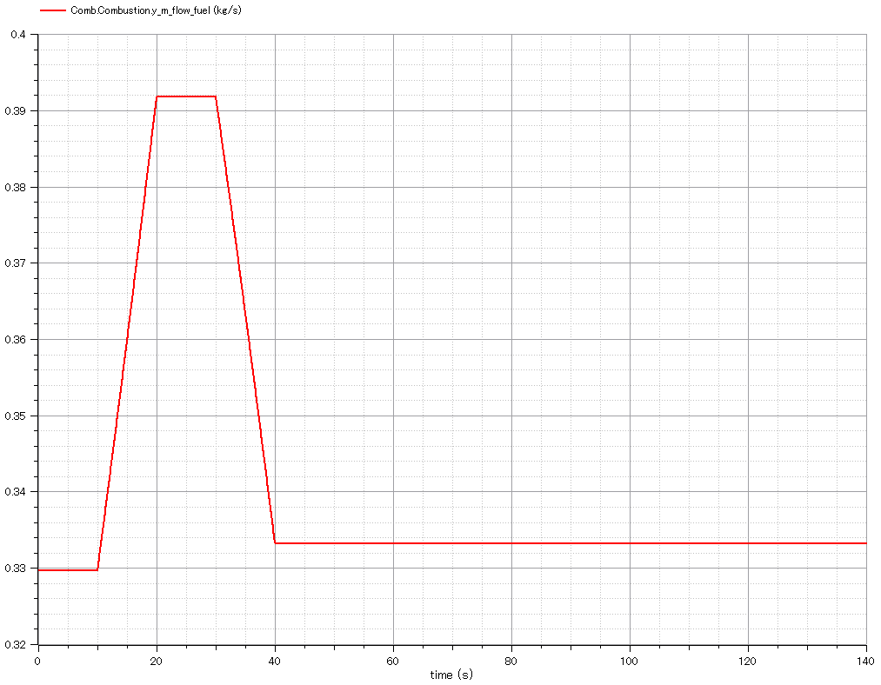
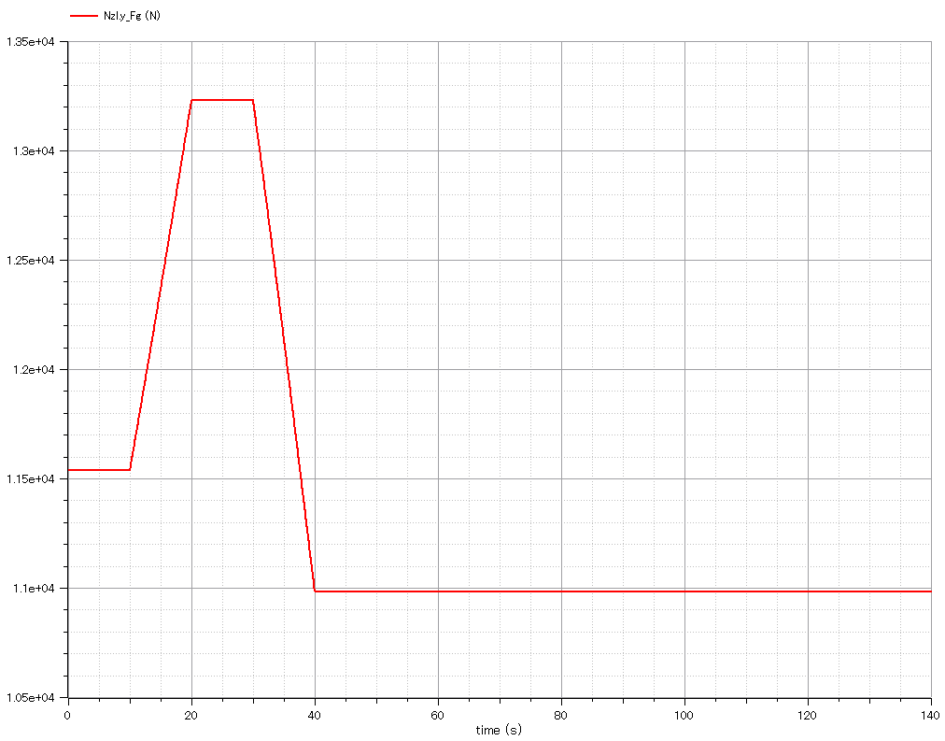
Output:
Mass flow rate of fuel.
It is decreased as nozzle throat closes because the mass flow of air through engine is decreased but combustor outlet temperature is kept.
Output:
Gross thrust of nozzle.
It is decreased as mass flow capacity of nozzle and engine speed decreases.

