Slide 1
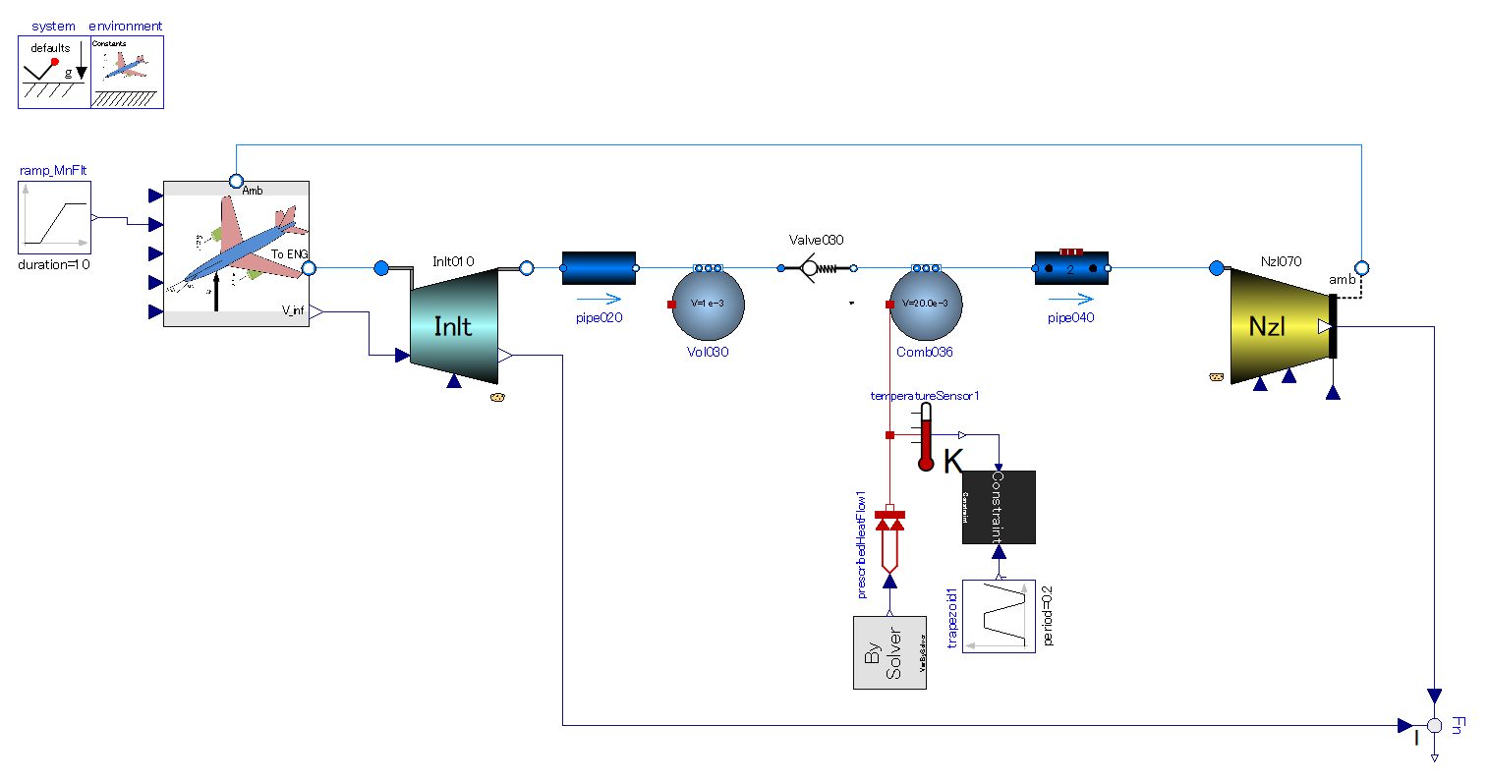
Flight velocity gives gas flow into engine.
This engine cannot start with zero-velocity.
Single direction flow valve.
-. Make gas stream intermittent for intermittent.
-. Prevent gas from flowing backward under combustion period.
Pipe (flow resistance) with volume effect.
-. Delay in mass flow.
No compression process in this thermodynamic cycle.
Heat addition.
-. Under constant volume
-. Intermittent combustion is necessary.

Slide 2
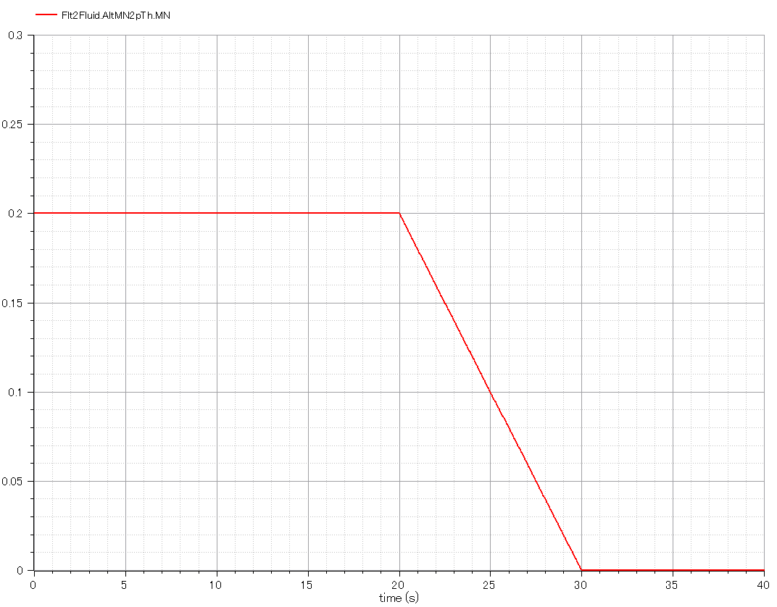
Input:
-. Flight Mach number, or mach number of free-stream outside of engine.
-. It must be greater than zero value at the beginning. The start device provides inlet air with velocity in the real world.

Slide 3
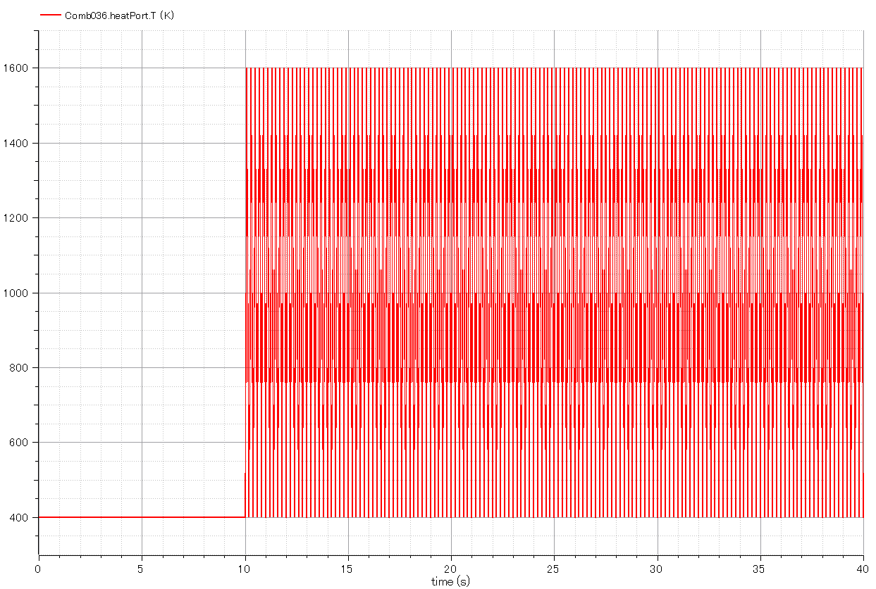
Input:
-. Temperature of combustion chamber.
-. Triangle wave in time domain simulating intermittent combustion.

Slide 4
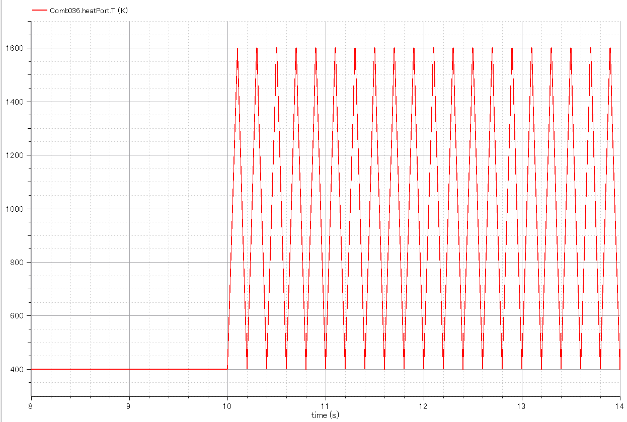
Input:
-. Temperature of combustion chamber. (Enlarged fig.)

Slide 5
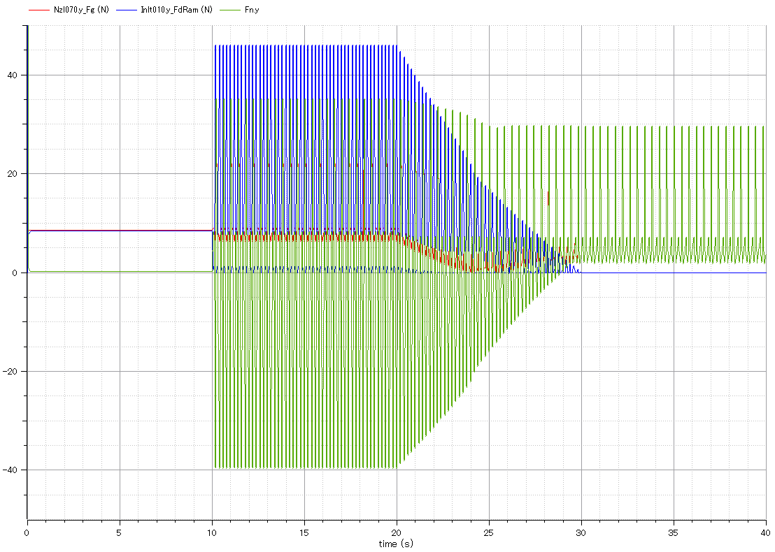
Output:
Ram drag.(blue)
Output:
-. Gross thrust of exhaust nozzle.(red)
-. Engine continues running after flight speed (inlet airspeed) gets zero.
Output:
Net thrust of engine.(green)

Slide 6
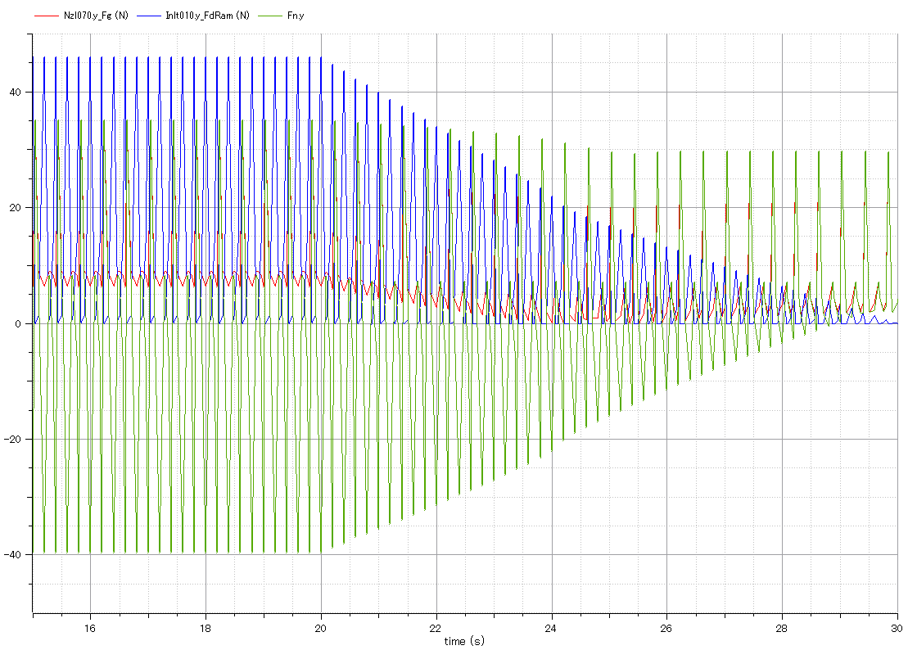
Output:
Ram drag.(blue)
Output:
Gross thrust of exhaust nozzle.(red)
Output:
Net thrust of engine.(green)

Slide 7
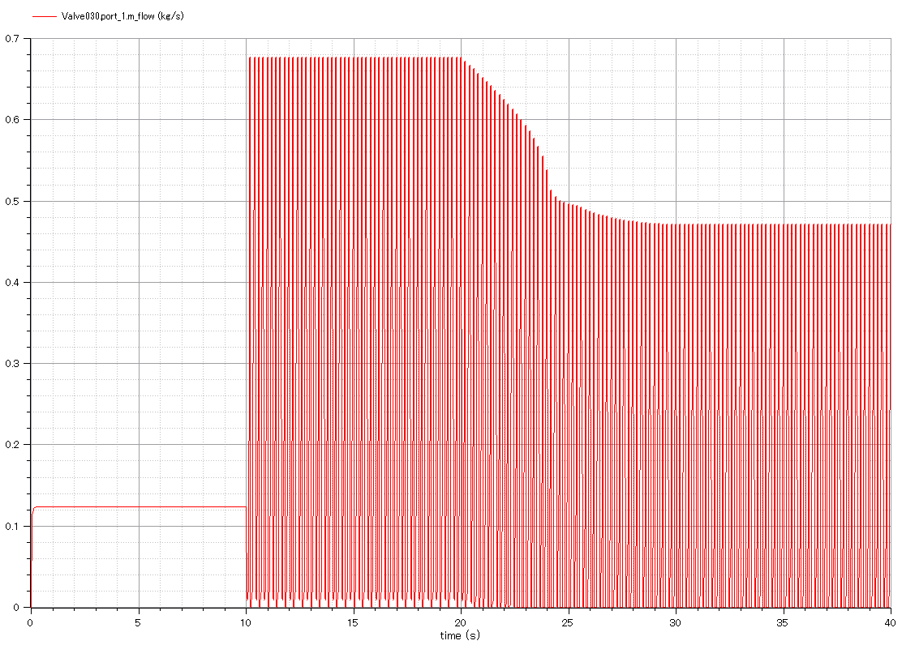
Output:
-. mass flow rate through engine.
-. Intermittent flow due to valve open/close.

Slide 8
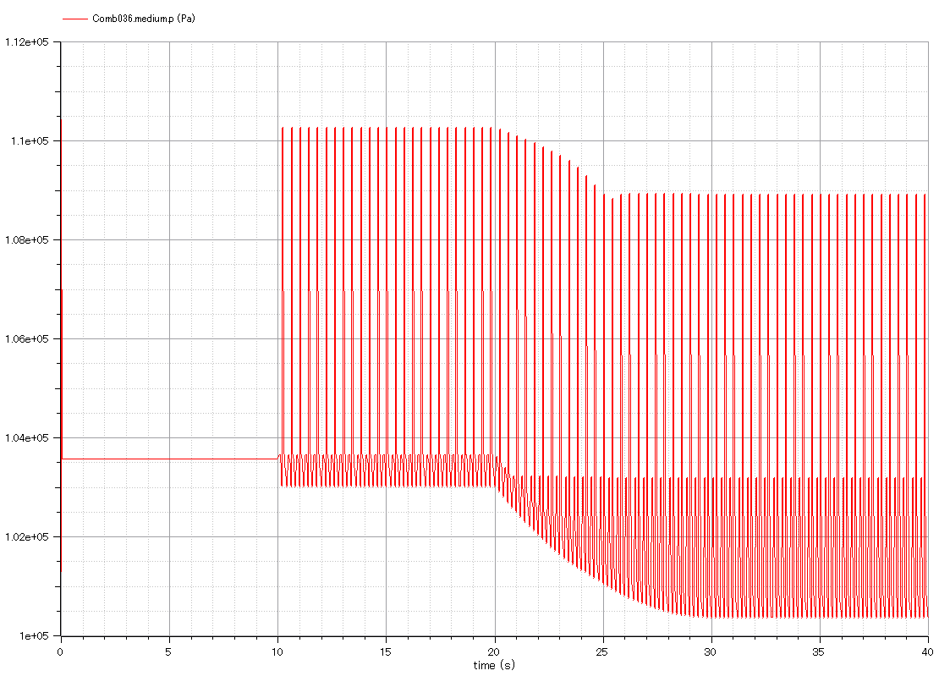
Output:
-. Pressure of combustion chamber.
-. Intermittent change.

Slide 9
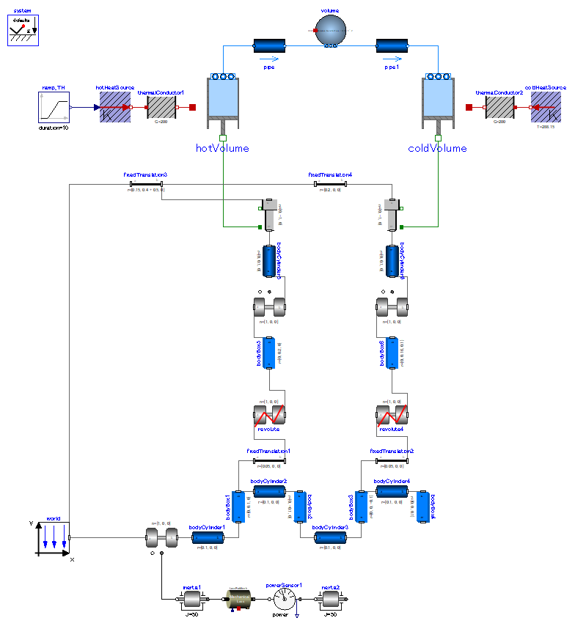
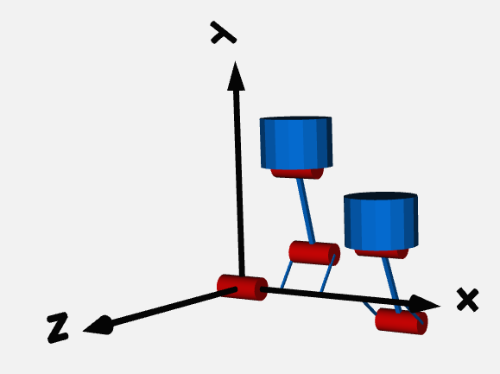
Operating fluid moves between hot and cold volume.
Define positions of cylinders.
Reject heat from cold volume. Constant volume heat rejection & constant temperature compression.
Add heat into hot volume. Constant volume heat addition & constant temperature expansion.
pistons.
Connecting rods.
Crank shaft.
90-deg phase difference between 2 rods.
Mechanical loss.
Fly wheel.

Slide 10
Animation window
pistons.
Connecting rods.
Crank shaft.
90-deg phase difference between 2 rods.

Slide 11
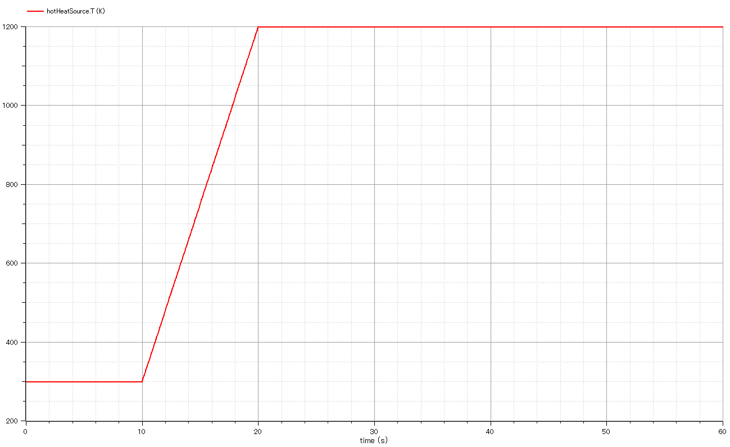
Input:
Temperature of hot heat source.

Slide 12
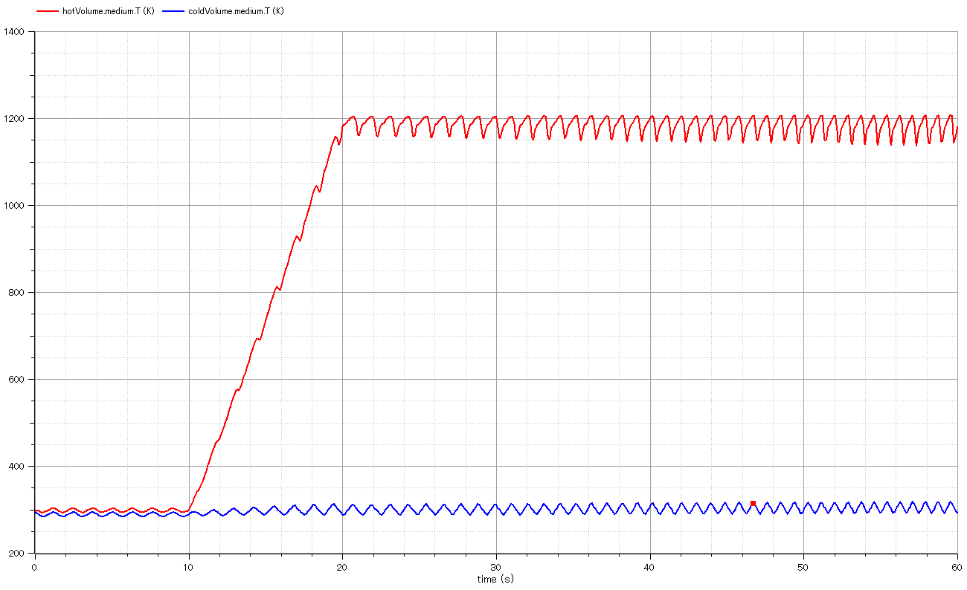
Output:
gas temperature in hot cylinder.
Output:
gas temperature in cold cylinder.

Slide 13
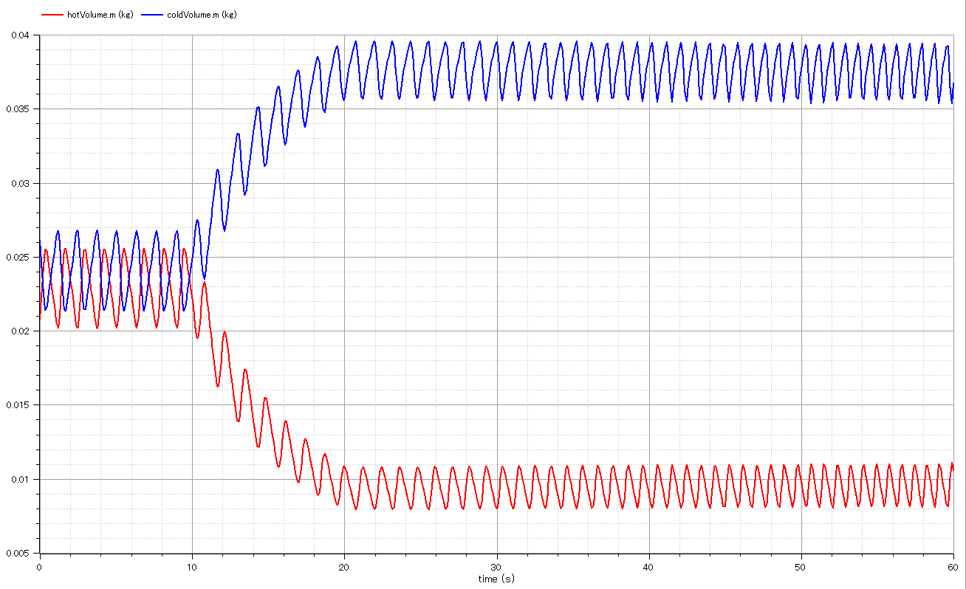
Output:
gas mass in cold cylinder.
Output:
gas mass in hot cylinder.

Slide 14
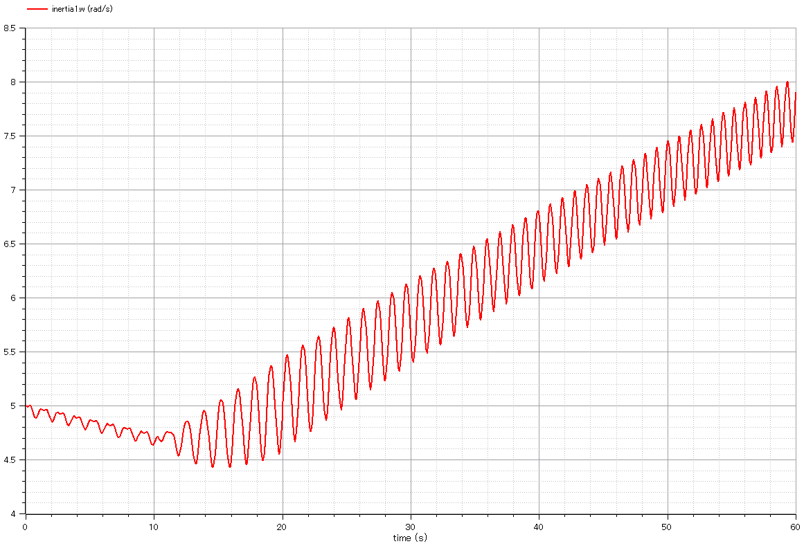
Output:
rotational speed of crank-shaft.
It accelerates as hot heat source temperature is increased. However, it oscillates.

Slide 15
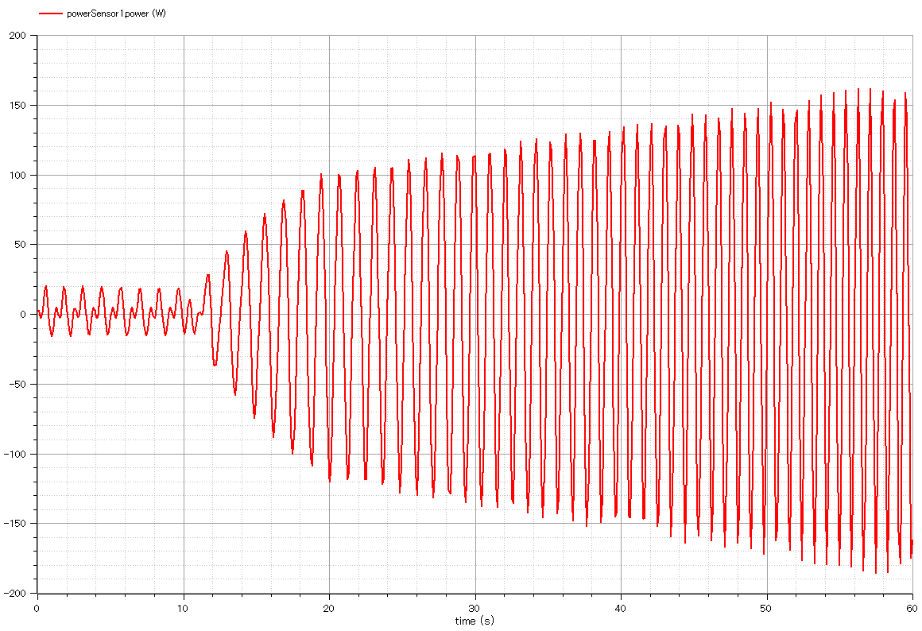
Output:
Power via crank shaft.

Slide 16
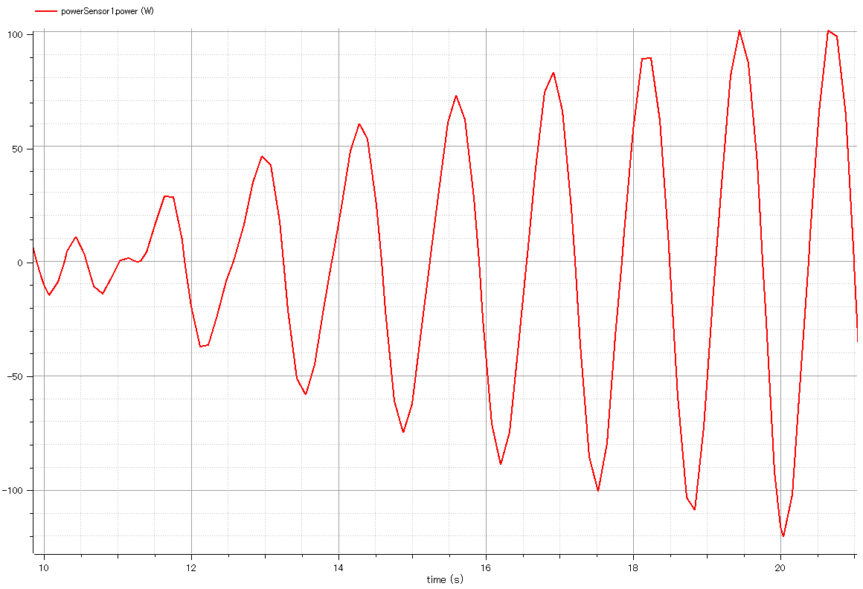
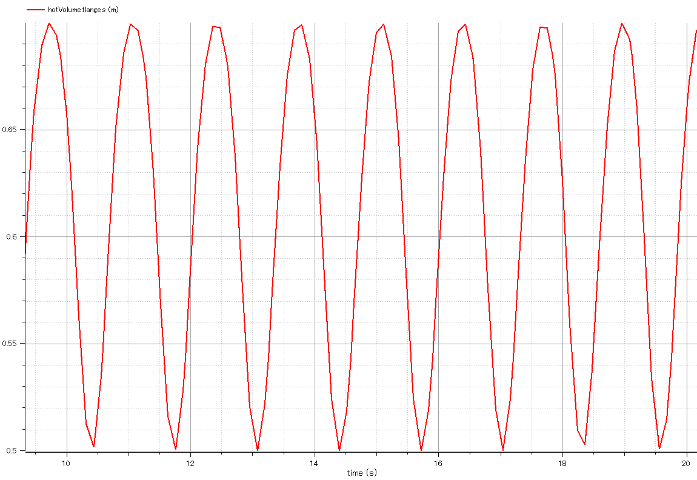

Slide 17
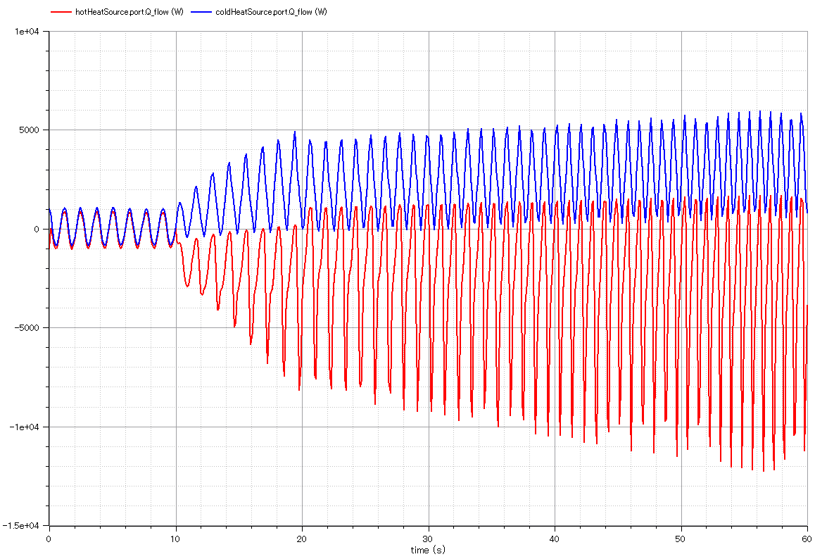
Output:
Heat flow out of cold volume.
Output:
Heat flow from hot heat source into hot volume.

