Slide 1
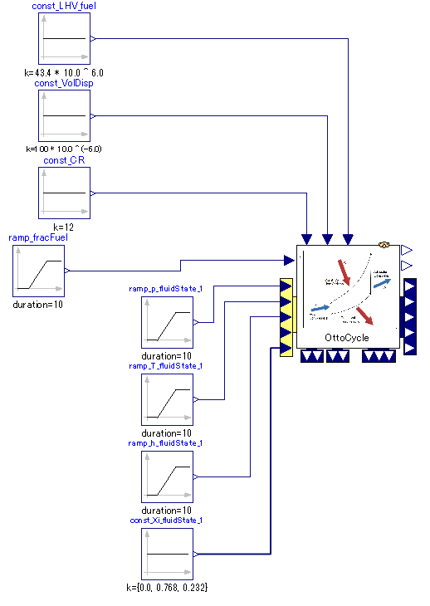

Slide 2
Input “parameters” of cycle via connector such as compression ratio.
Energy injected into working fluid is determined by fraction of fuel with respect to entire mass of cylinder.
Input fluid state of cycle beginning; fluid before compression.
Output fluid state of cycle end; fluid after power expansion.

