Slide 1
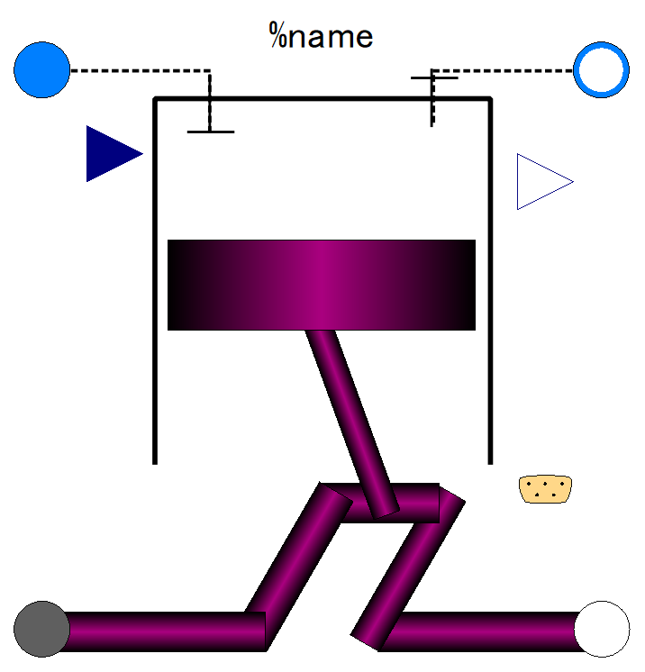

Slide 3
h
Q
Adiabatic Expansion
Const. Vol.
Heat Addition
W
W
Adiabatic Compression
Q
Const. Vol.
Heat Rejection
s

Slide 4
h
Q
Adiabatic Expansion
Const. Press.
Heat Addition
W
W
Adiabatic Compression
Const. Vol.
Heat Rejection
Q
s

Slide 6
Fn

Slide 7

AoA
MN
Alt
dm
Pt
Tt

Slide 8
dm
Pt
Tt
dm
Pt
Tt
MN
AoA
Alt

Slide 9
pStd
Tstd
g

Slide 13
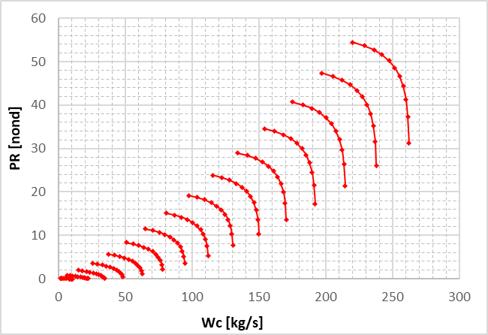
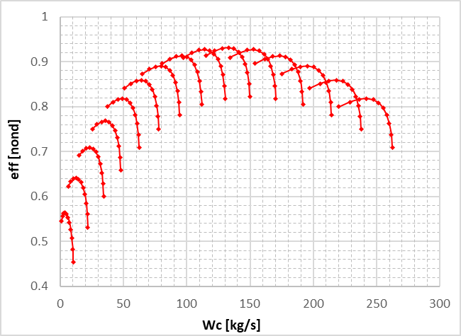

Slide 14
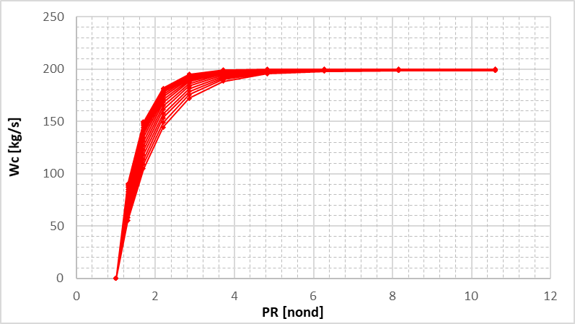
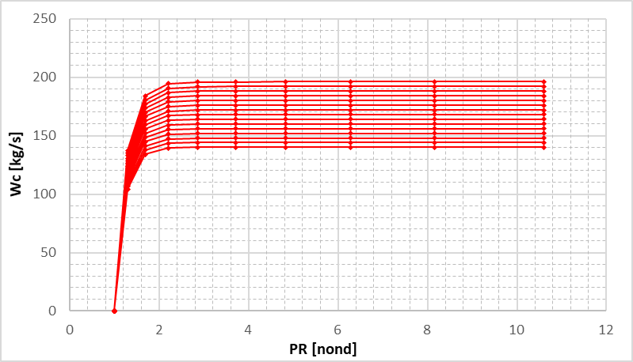
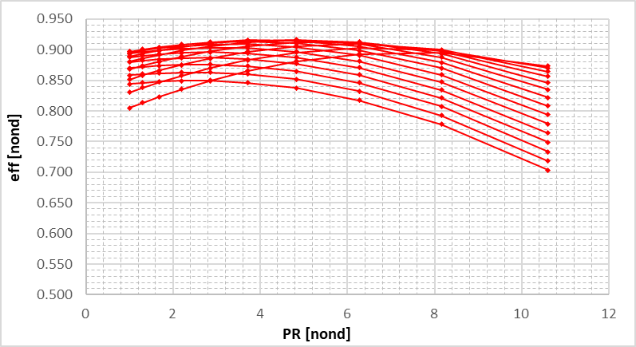
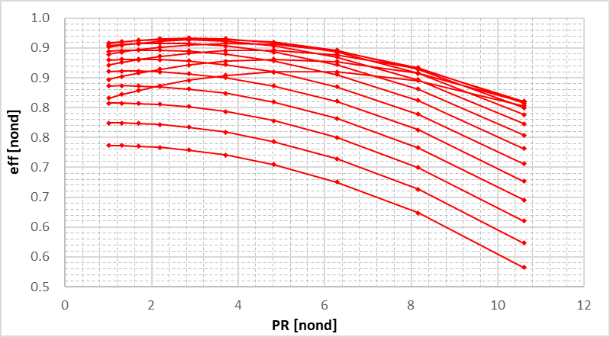

Slide 15
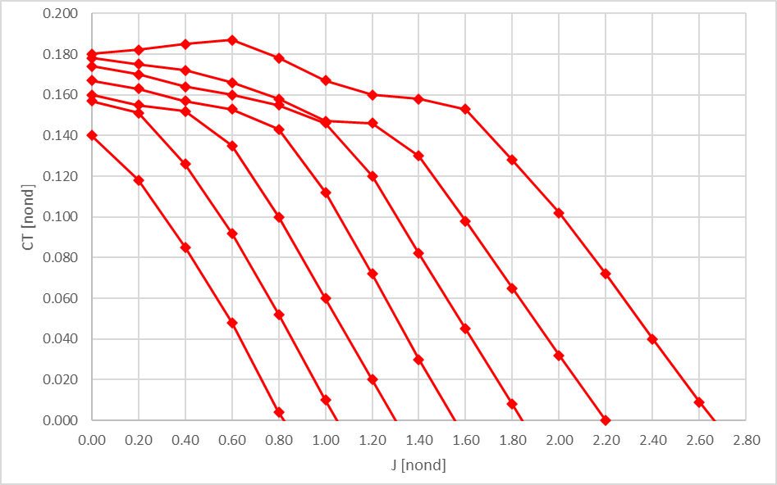
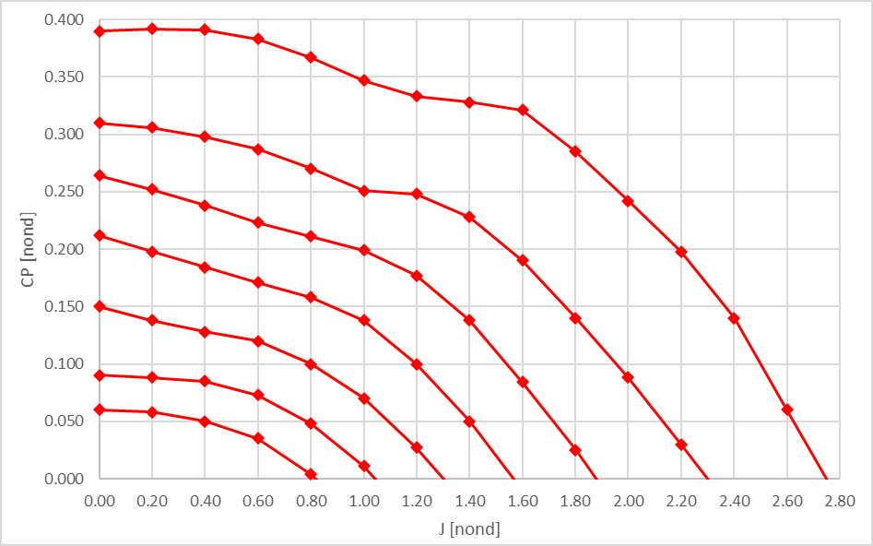

Slide 16
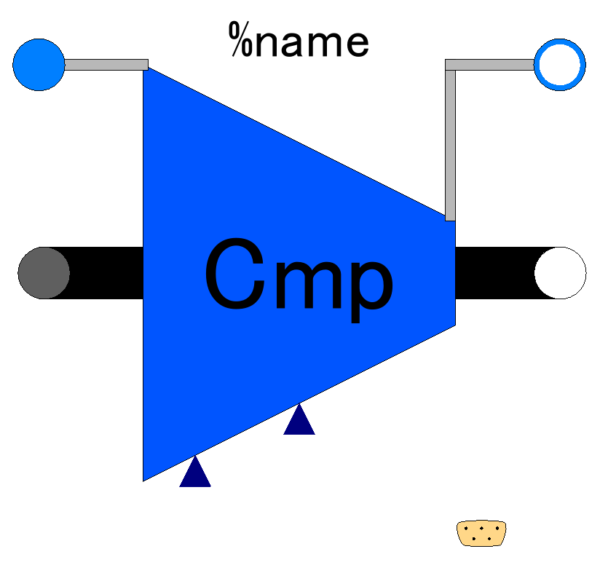

Slide 17
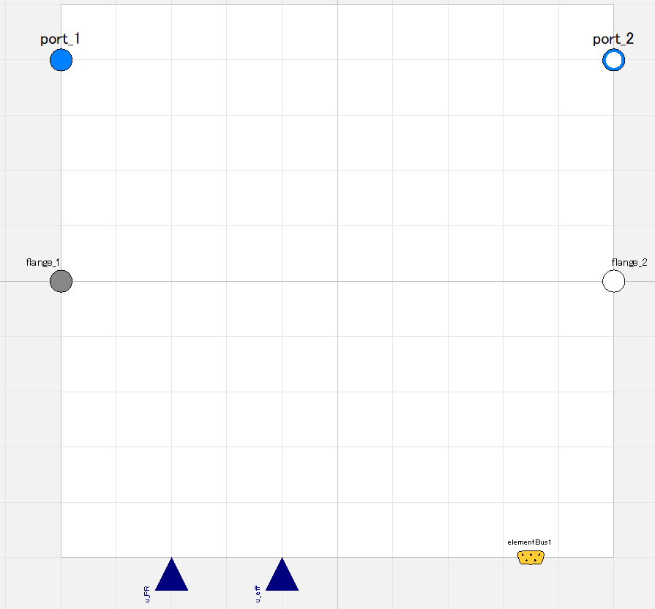

Slide 18
Fluid inlet port, input&output (use “connect” operator)
Fluid outlet port, input&output (use “connect” operator)
Flange (rotational mechanics port),
input&output (use “connect” operator)
Flange (rotational mechanics port),
input&output (use “connect” operator)
Pressure ratio;
input (use “connect” operator),
valid only when switchDetermine_PR==viaRealInput
Efficiency;
input (use “connect” operator),
valid only when switchDetermine_eff==viaRealInput
Expandable connector prepared for communication with internal variables which cannot be accessed by other ports,
input&output (use “connect” operator)

Slide 19
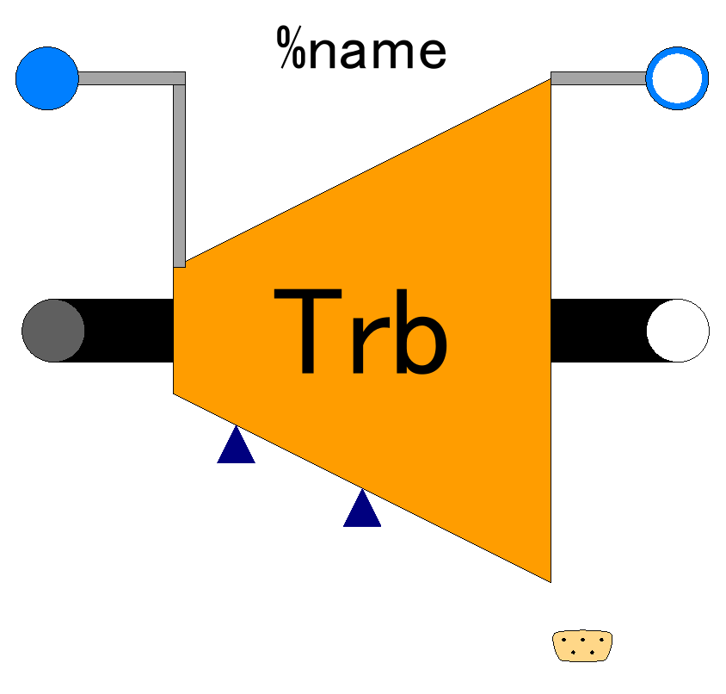

Slide 20
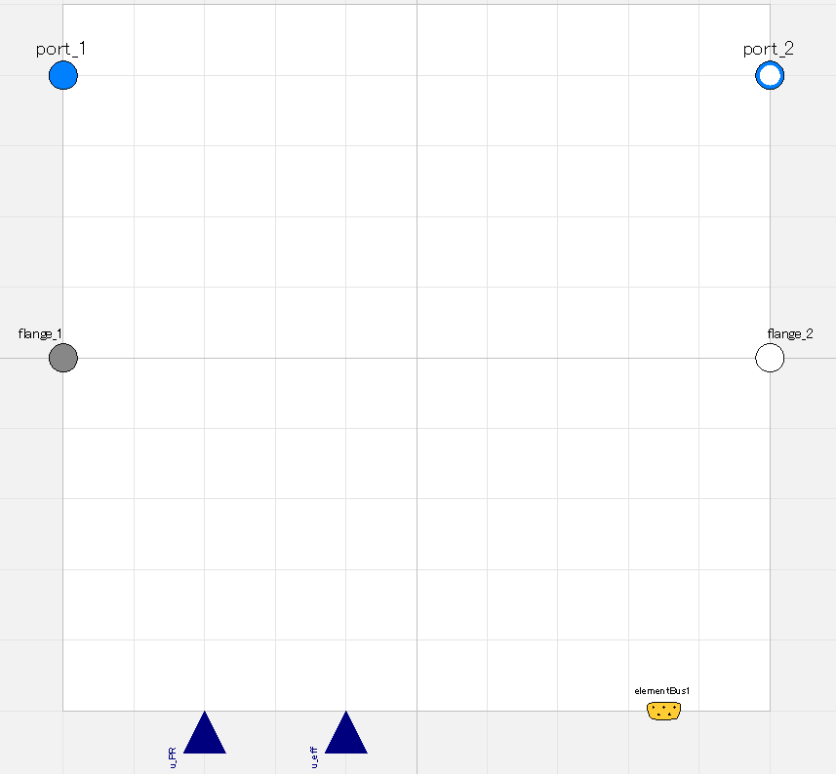

Slide 21
Fluid inlet port, input&output (use “connect” operator)
Fluid outlet port, input&output (use “connect” operator)
Flange (rotational mechanics port),
input&output (use “connect” operator)
Flange (rotational mechanics port),
input&output (use “connect” operator)
Pressure ratio;
input (use “connect” operator),
valid only when switchDetermine_PR==viaRealInput
Efficiency;
input (use “connect” operator),
valid only when switchDetermine_eff==viaRealInput
Expandable connector prepared for communication with internal variables which cannot be accessed by other ports,
input&output (use “connect” operator)

Slide 22
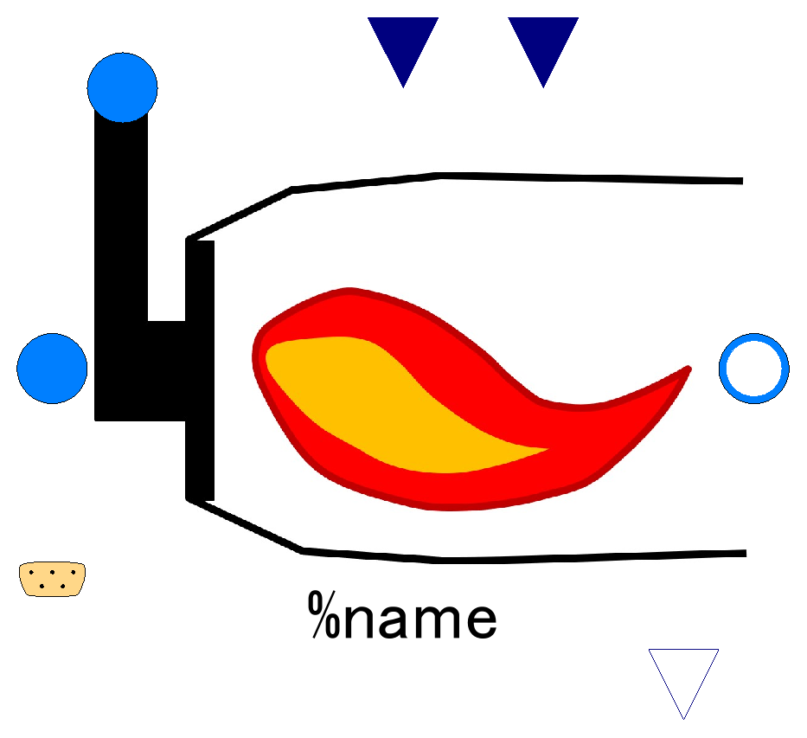

Slide 23
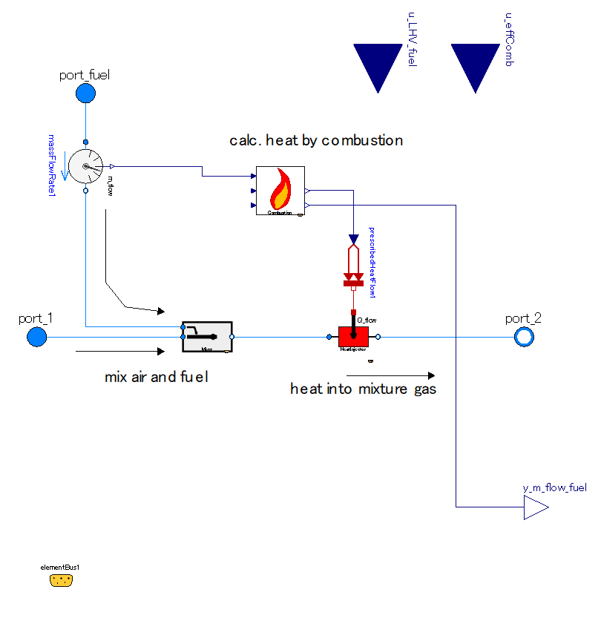

Slide 24
Lower Heating Value of Fuel;
input (use “connect” operator),
valid only when use_u_LHV_fuel==true
Efficiency of combustion;
input (use “connect” operator),
valid only when use_u_effComb==true
Fuel inlet port, input&output (use “connect” operator)
Fluid inlet port, input&output (use “connect” operator)
Fluid outlet port, input&output (use “connect” operator)
Fuel flow, output

Slide 25
