Slide 1
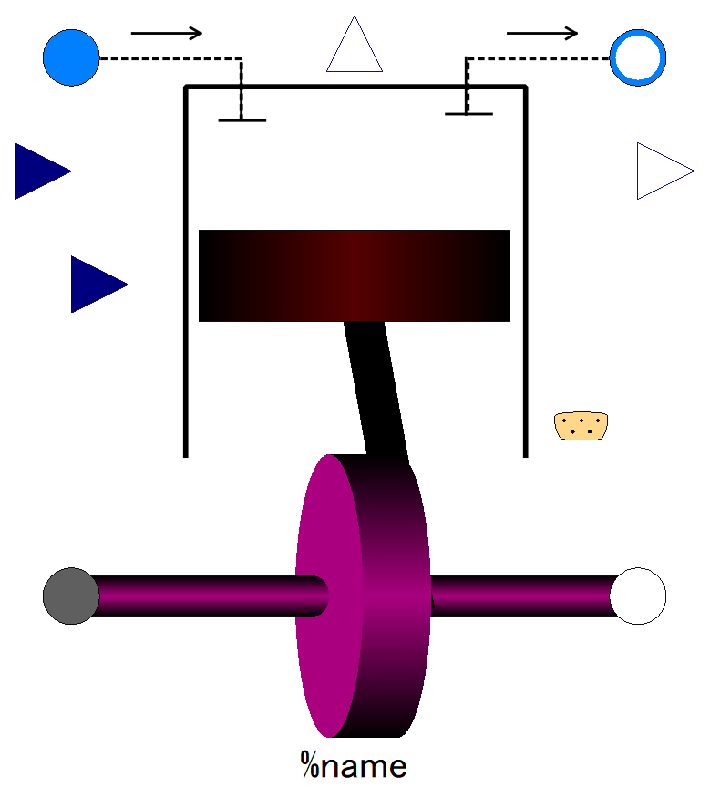

Slide 2
Output:
Pressure of fluid after compression (p2). This is to be used in fuel system modeling.
Everything rather than p2 output connector is same as pistonCylinder of Otto which was released earlier.

Slide 3
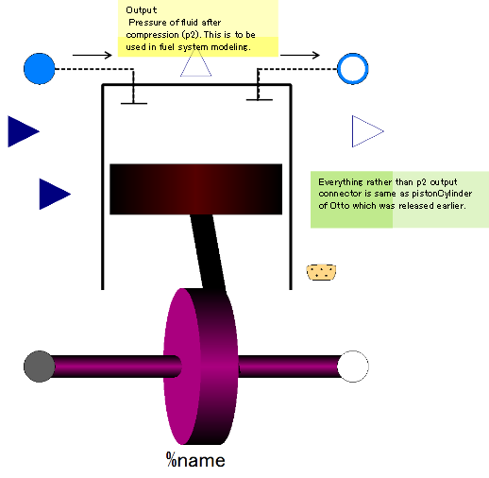

Slide 4
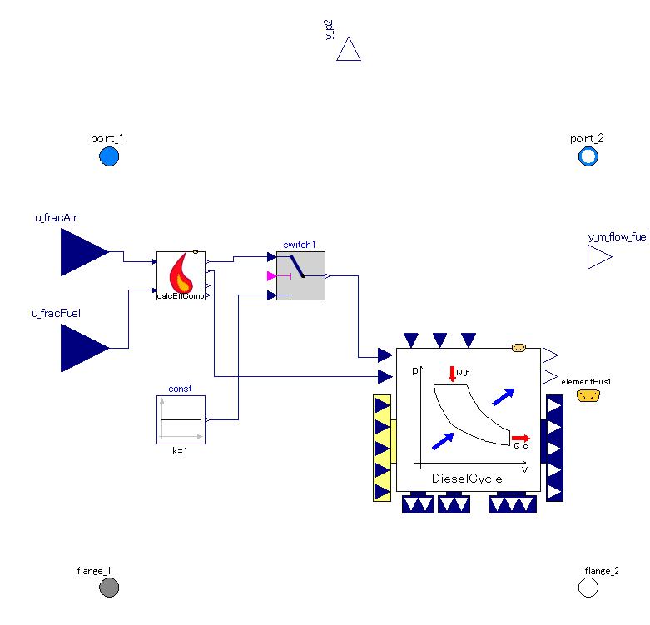

Slide 5
Include combustion efficiency curve model/not can be selected.
*The maximum temperature accomplished might be restricted by combustion efficiency.
Sub-component which executes diesel cycle calculation.

Slide 6
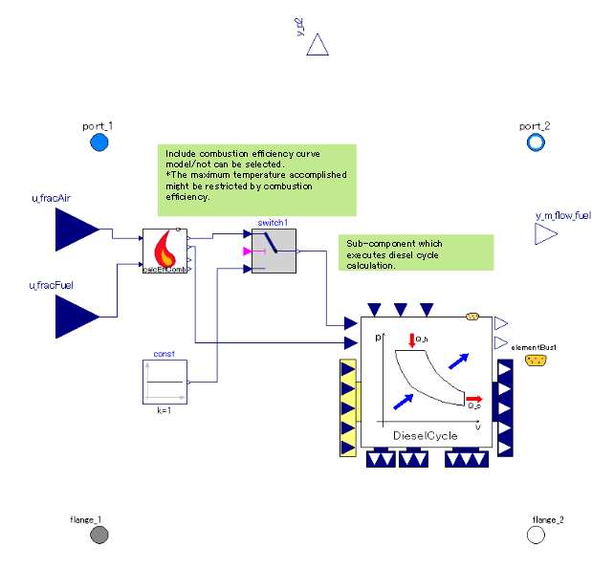

Slide 8
Inputs:
inlet fluid states, p and T.
Viscos friction. The friction torque is proportional to the shaft absolute angular velocity (shaft speed relative to fixed surrounding world) of shaft speed.
Shaft rotation gets steady at the angular speed at which the engine torque output is in equilibrium with friction torque.

