Slide 1
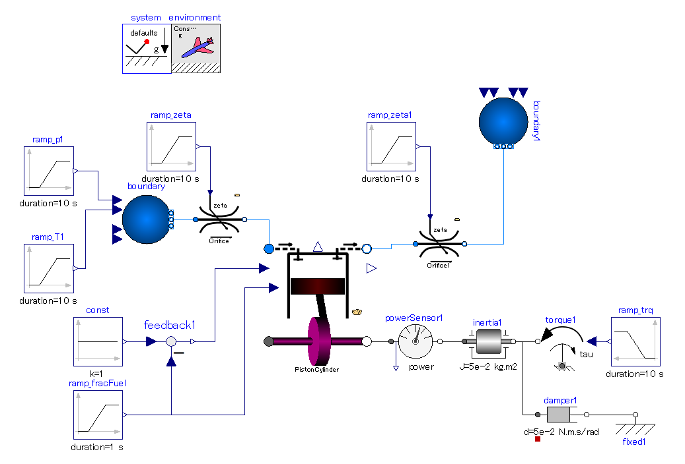

Slide 2
Inputs:
Pressure loss coefficient of orifice.
Controllable flow restriction.
The pressure loss coefficient can be manipulated by external real signal.
Inputs:
inlet fluid states, p and T.
Inputs:
Additional load can be applied.
Inputs:
the fraction of air and fuel in in-taken air fuel mixture.
Viscos friction. The friction torque is proportional to the shaft absolute angular velocity (shaft speed relative to fixed surrounding world) of shaft speed.
Shaft rotation gets steady at the angular speed at which the engine torque output is in equilibrium with friction torque.

