Slide 1
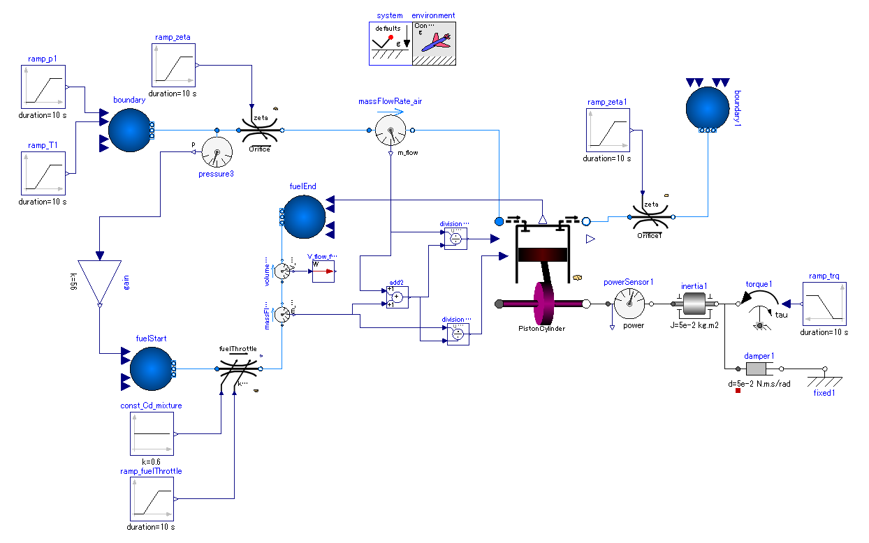

Slide 2
Inputs:
inlet fluid states, p and T.
Output the pressure after compression (p of state-2) for fuel supply system modeling purpose
Pressure at the exit of fuel supply line is cylinder pressure after compression in Diesel engine.
Inputs:
Additional load can be applied.
Provides pressure sufficient for supply of fuel (substitute of pump).
Figure out fractions of fuel and air by measuring mass flows of air fuel lines.
Viscos friction. The friction torque is proportional to the shaft absolute angular velocity (shaft speed relative to fixed surrounding world) of shaft speed.
Shaft rotation gets steady at the angular speed at which the engine torque output is in equilibrium with friction torque.
Simplified fuel supply system
Inputs:
Opening of fuel throttle valve.

