Slide 1

AoA
MN
Alt
dm
Pt
Tt

Slide 2
Fn

Slide 3
dm
Pt
Tt
dm
Pt
Tt
MN
AoA
Alt

Slide 4
pStd
Tstd
g

Slide 8
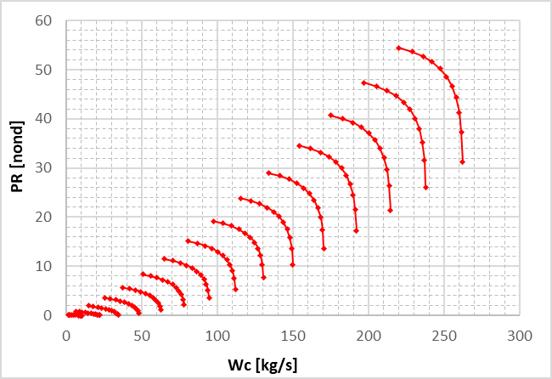
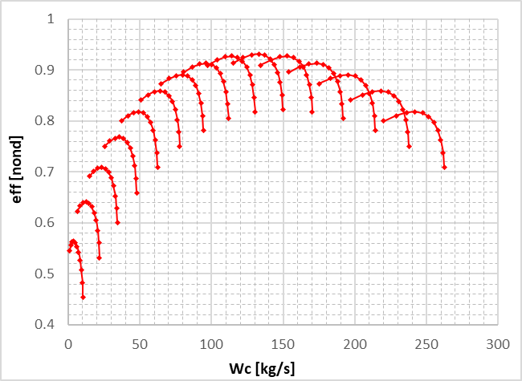

Slide 9
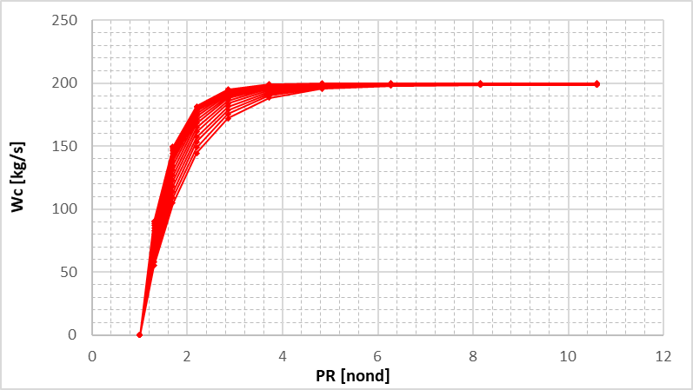
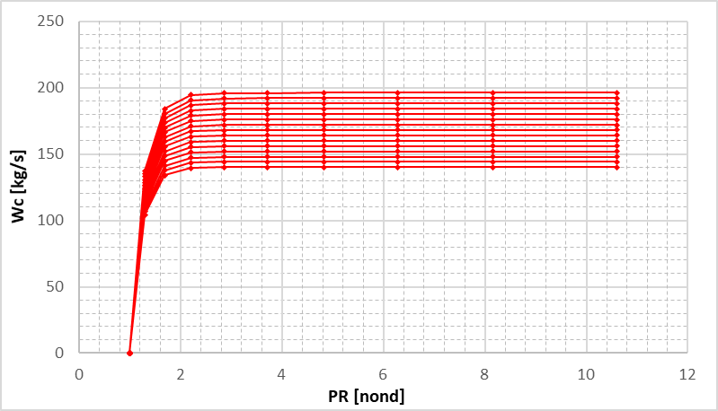
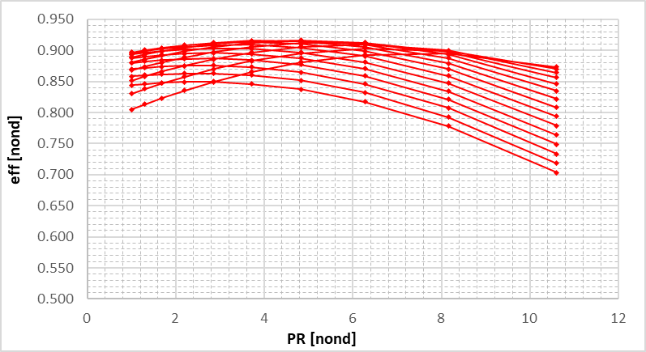
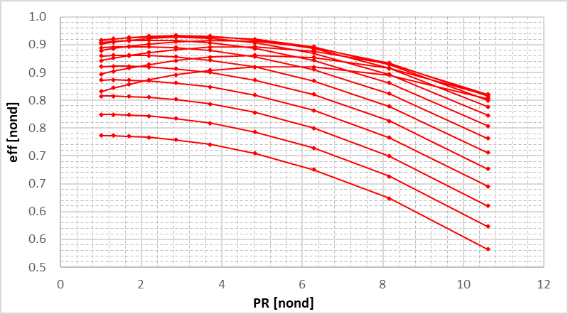

Slide 10
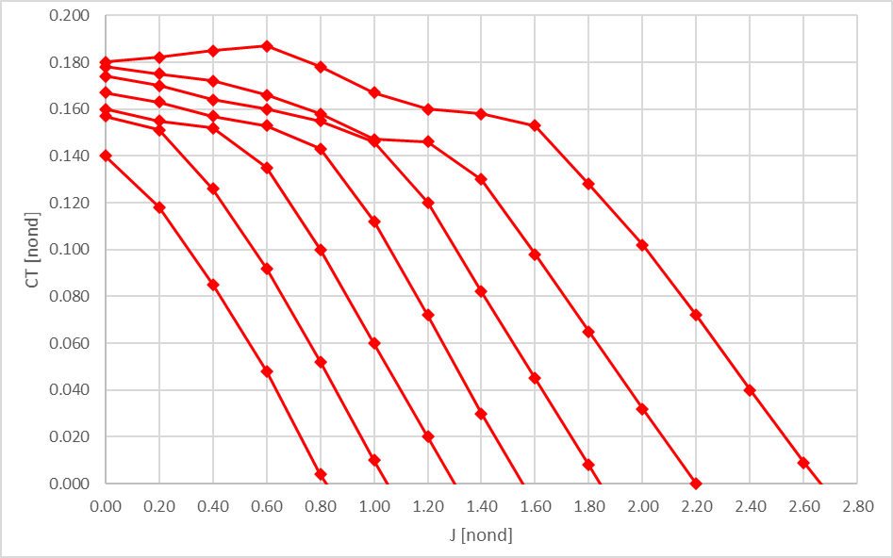
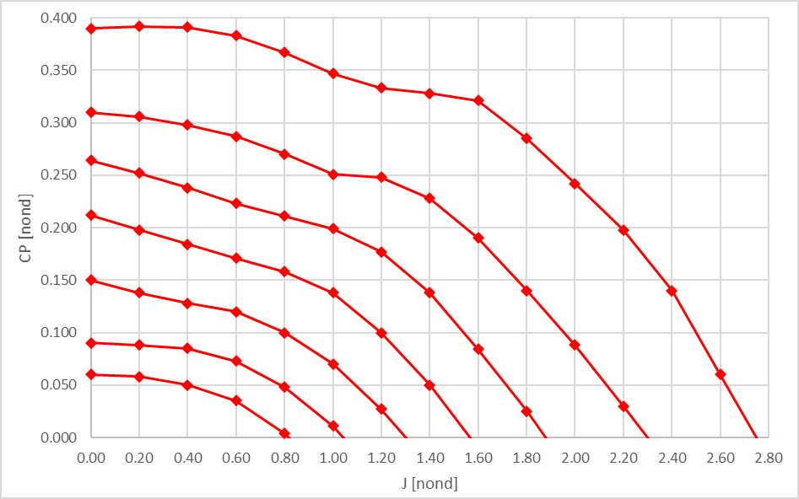

Slide 12
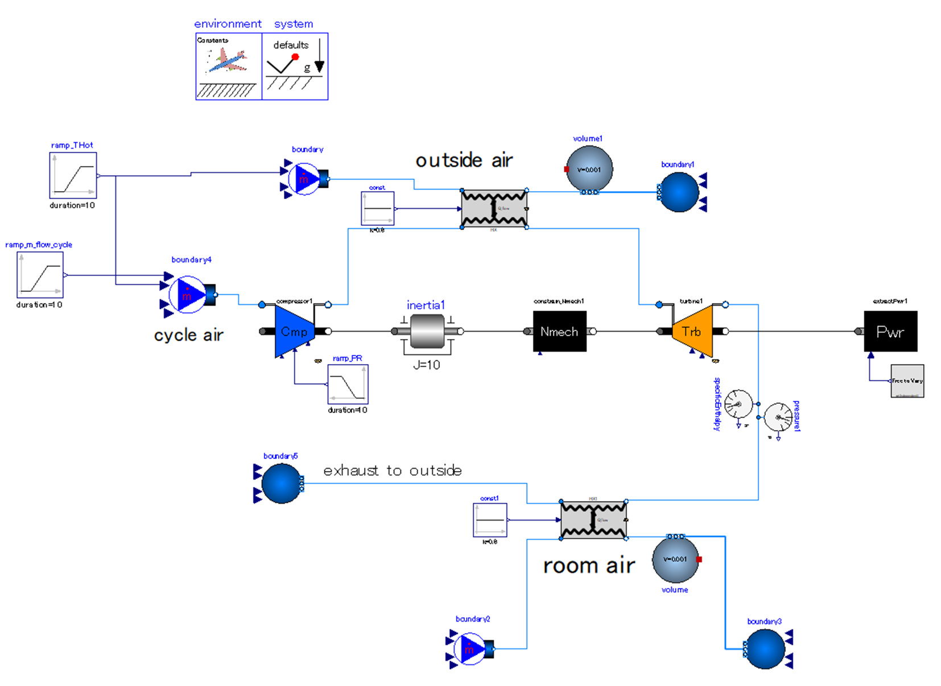
Release heat to outside air.
Expand cycle air to outside pressure. The work generated by expansion is used for driving compressor.
heat
Compress outside air.
Increase pressure ratio of compressor gradually.
heat
Set drive power the “as calculated” variable.
absorb heat from room air.

Slide 13
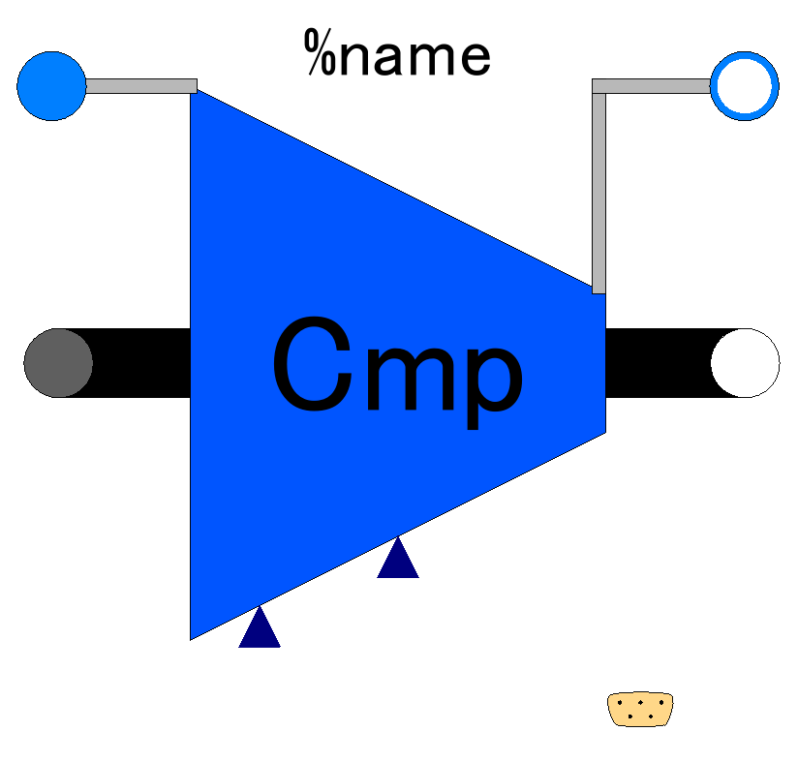

Slide 14
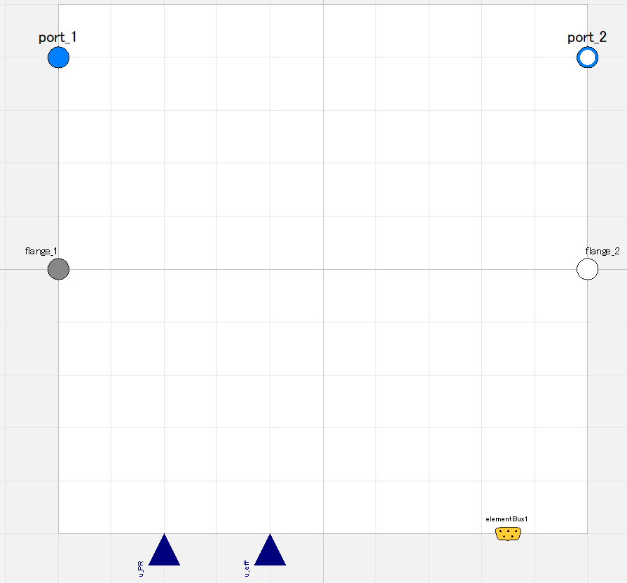

Slide 15
Fluid inlet port, input&output (use “connect” operator)
Fluid outlet port, input&output (use “connect” operator)
Flange (rotational mechanics port),
input&output (use “connect” operator)
Flange (rotational mechanics port),
input&output (use “connect” operator)
Pressure ratio;
input (use “connect” operator),
valid only when switchDetermine_PR==viaRealInput
Efficiency;
input (use “connect” operator),
valid only when switchDetermine_eff==viaRealInput
Expandable connector prepared for communication with internal variables which cannot be accessed by other ports,
input&output (use “connect” operator)

Slide 16
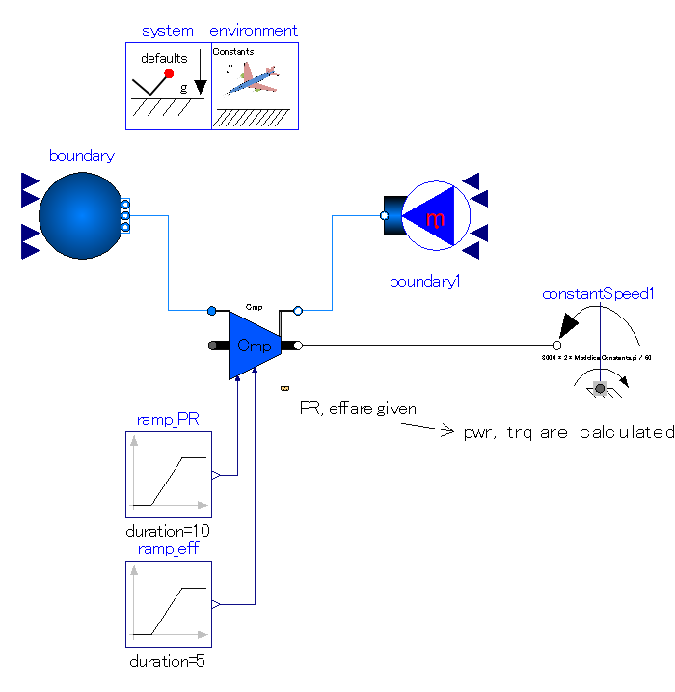
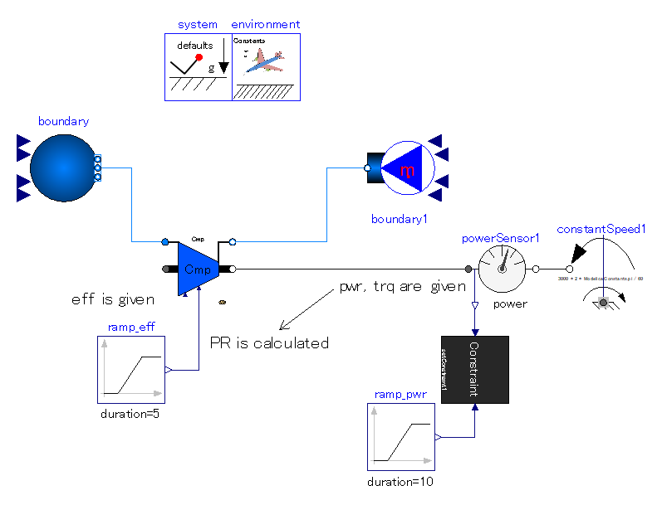

Slide 17
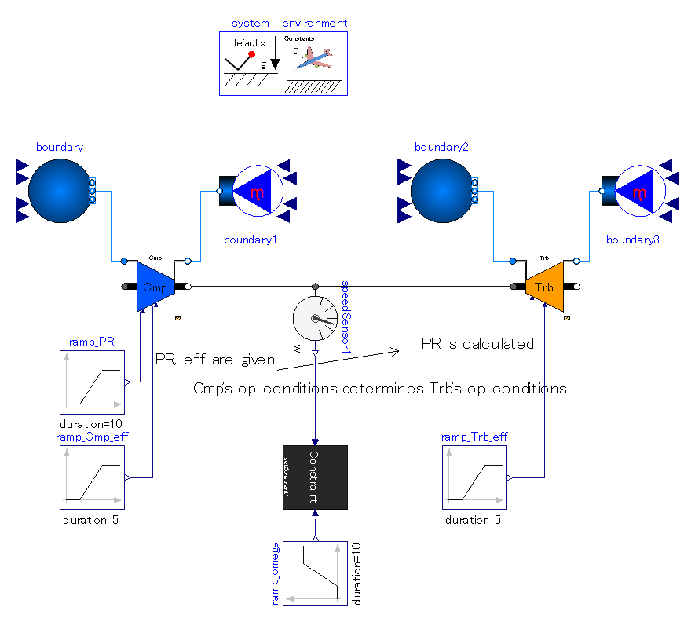
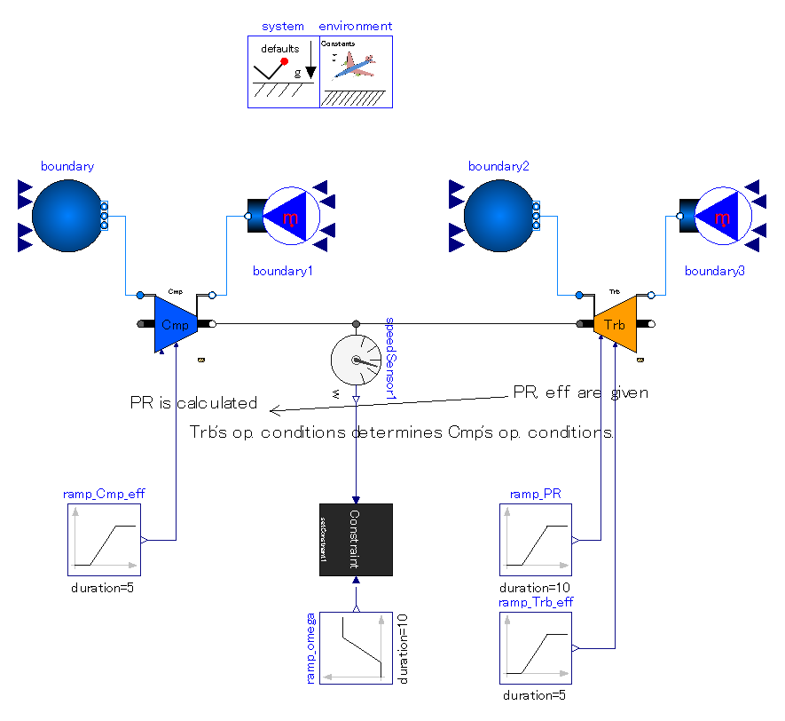

Slide 18
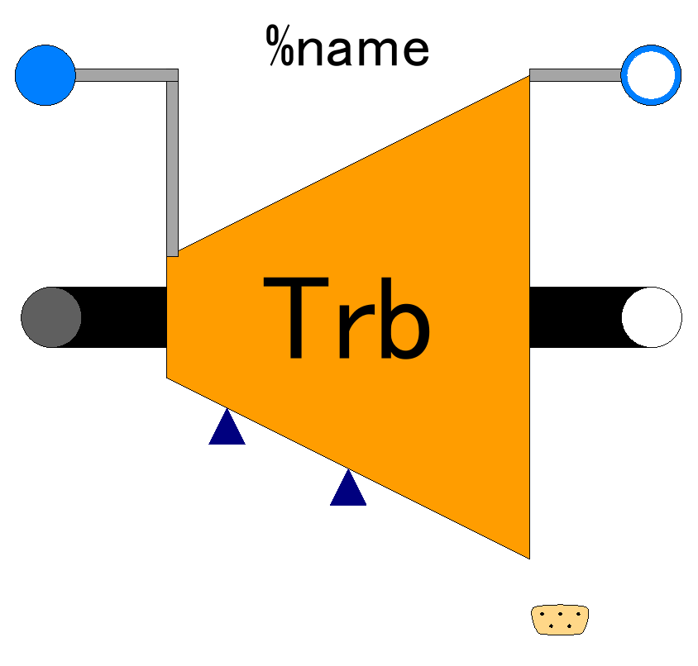

Slide 19
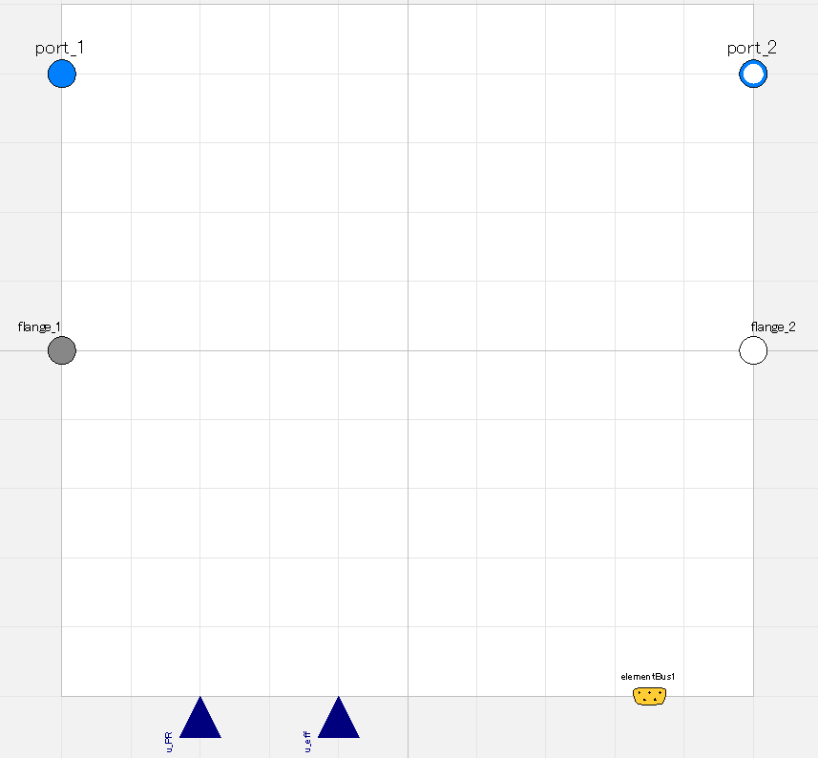

Slide 20
Fluid inlet port, input&output (use “connect” operator)
Fluid outlet port, input&output (use “connect” operator)
Flange (rotational mechanics port),
input&output (use “connect” operator)
Flange (rotational mechanics port),
input&output (use “connect” operator)
Pressure ratio;
input (use “connect” operator),
valid only when switchDetermine_PR==viaRealInput
Efficiency;
input (use “connect” operator),
valid only when switchDetermine_eff==viaRealInput
Expandable connector prepared for communication with internal variables which cannot be accessed by other ports,
input&output (use “connect” operator)

Slide 21
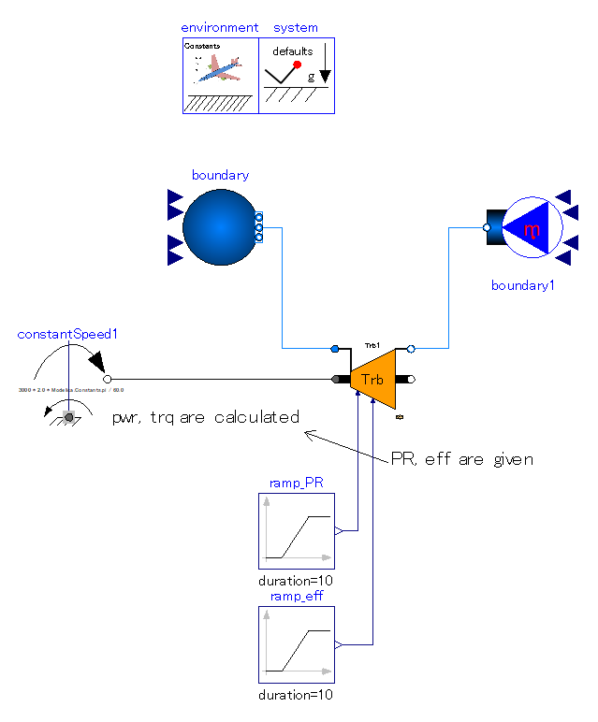
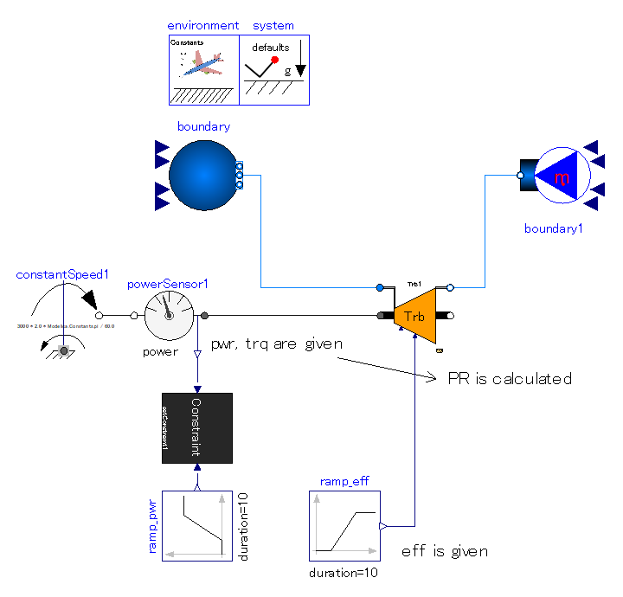

Slide 22
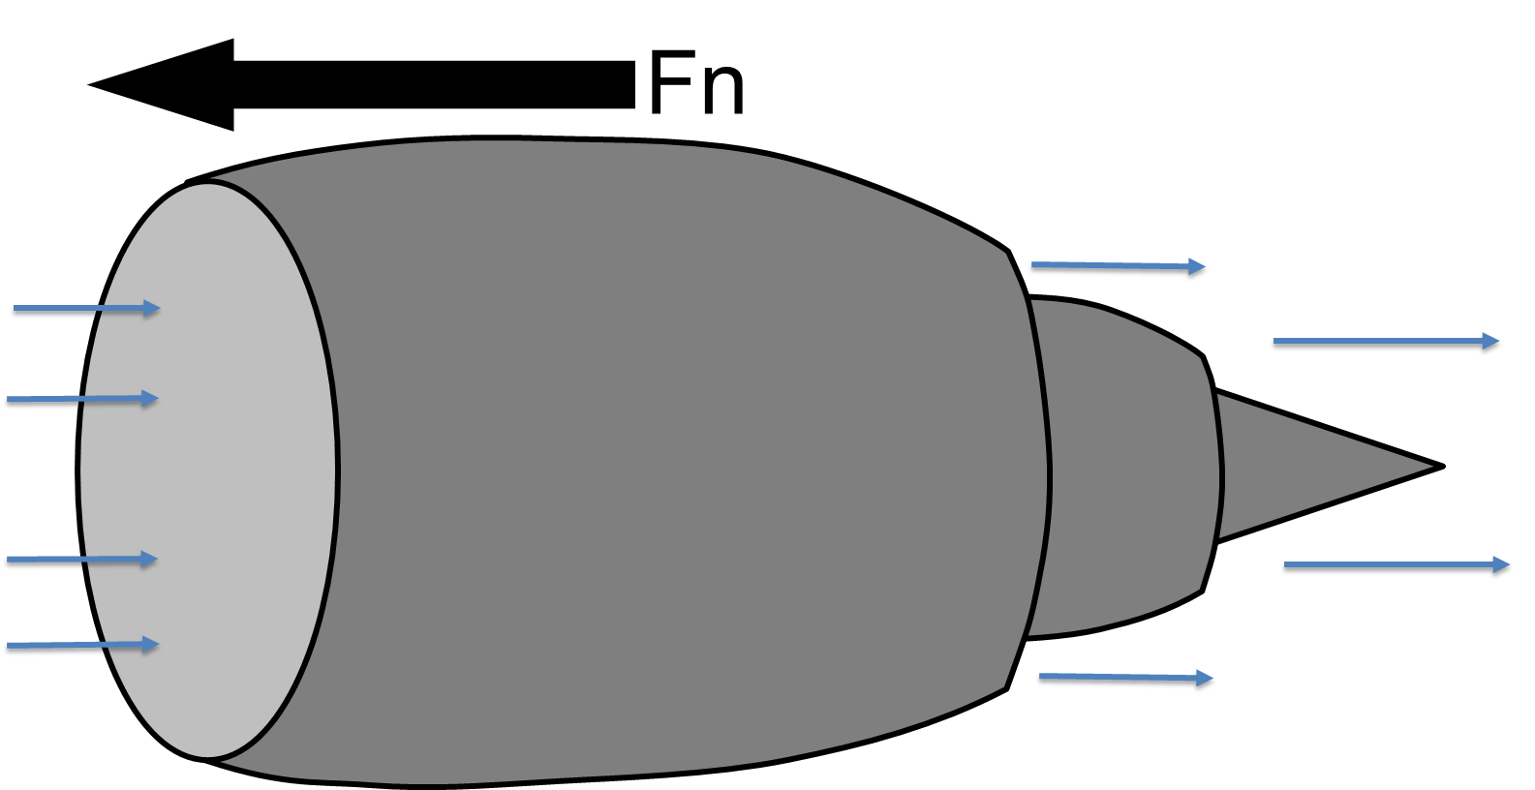
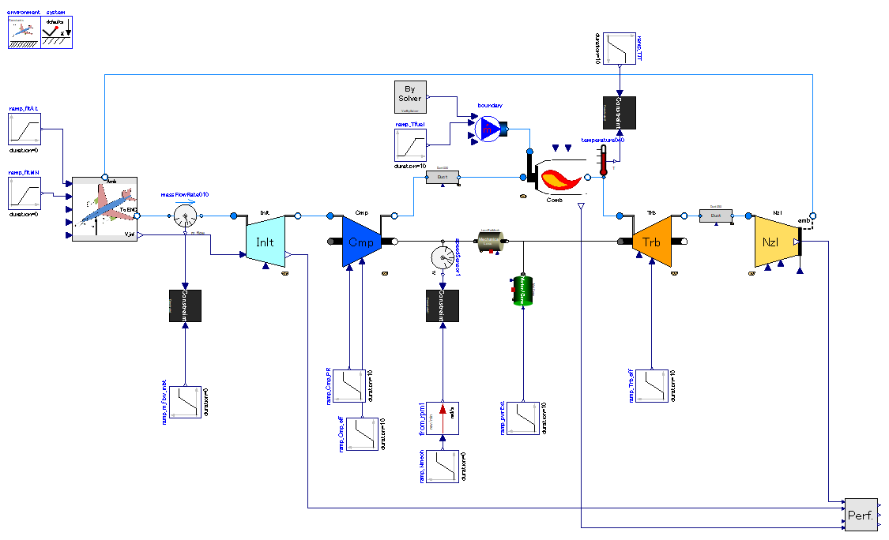
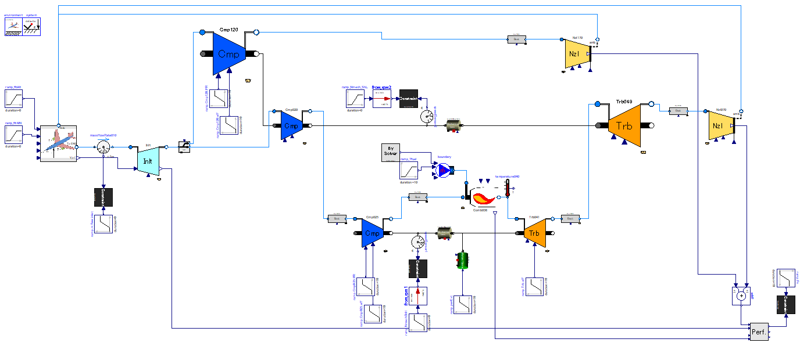
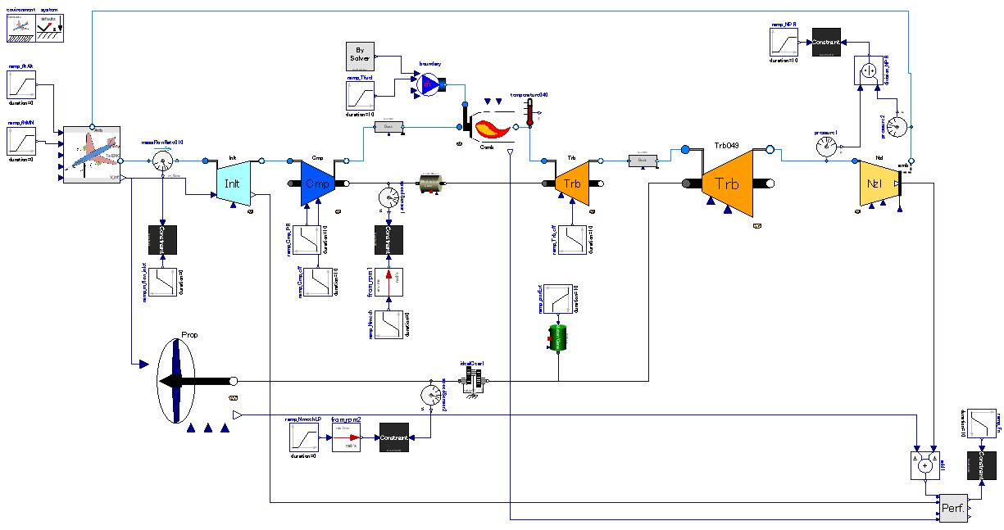
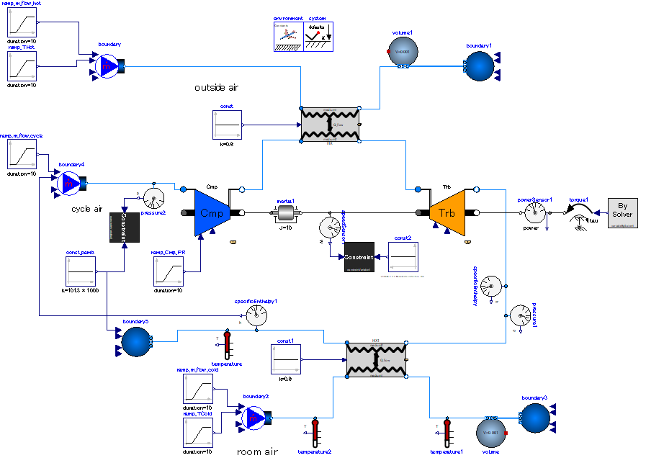

Slide 23
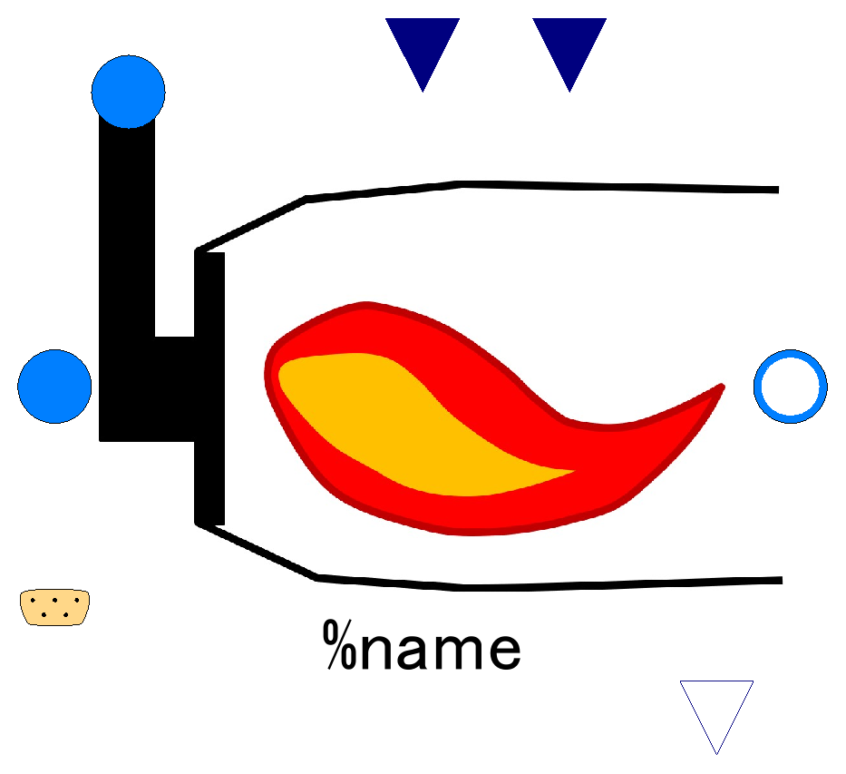

Slide 24
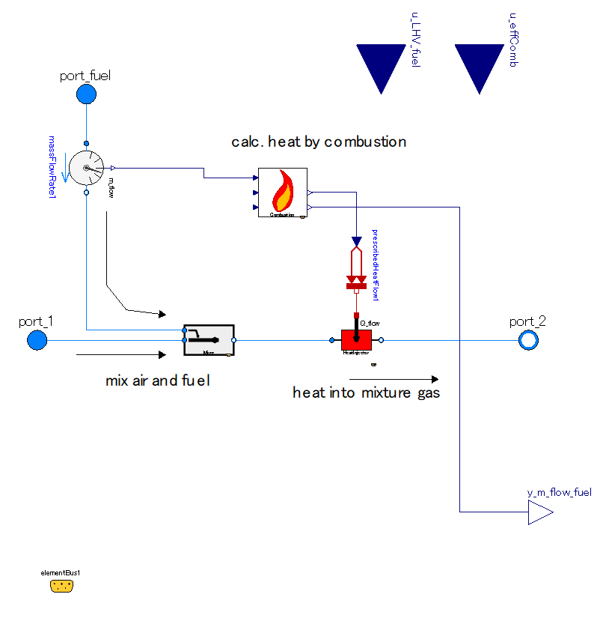

Slide 25
Lower Heating Value of Fuel;
input (use “connect” operator),
valid only when use_u_LHV_fuel==true
Efficiency of combustion;
input (use “connect” operator),
valid only when use_u_effComb==true
Fuel inlet port, input&output (use “connect” operator)
Fluid inlet port, input&output (use “connect” operator)
Fluid outlet port, input&output (use “connect” operator)
Fuel flow, output

Slide 26
