Slide 1
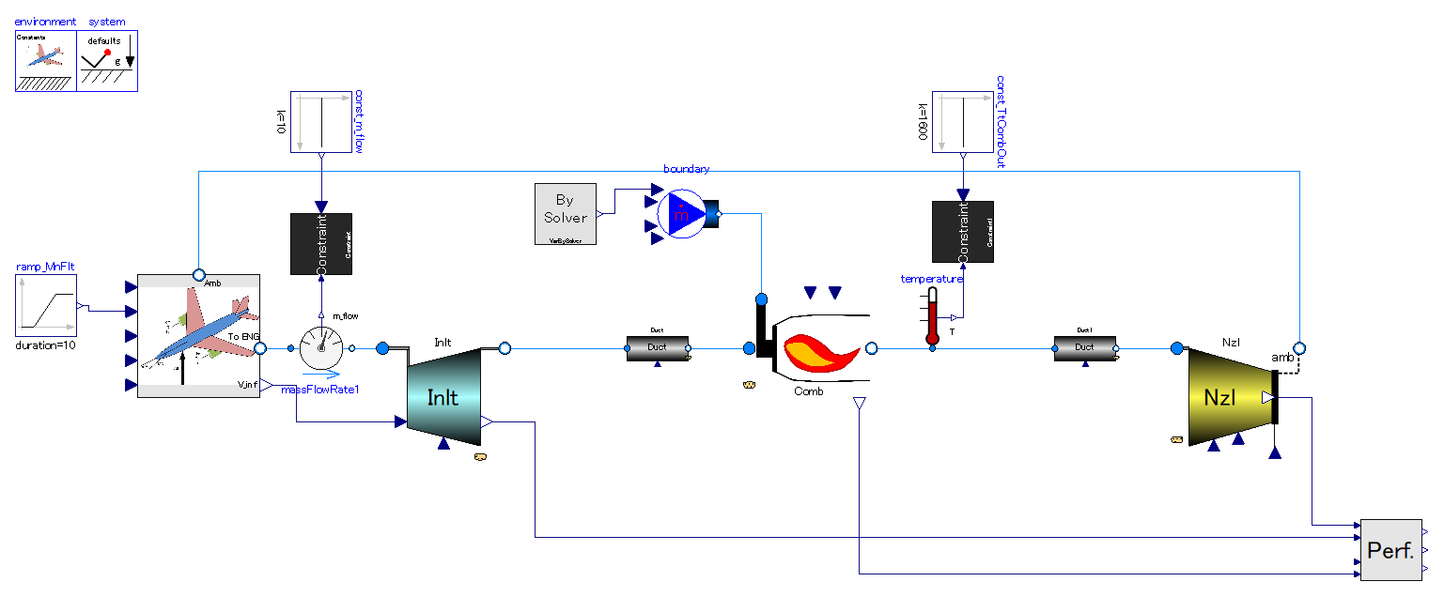
Ram pressurization.
Free stream velocity by flight gives compression to engine air.
Heat addition.
Heat (enthalpy) is given to flow. Essentially same as combustion chamber of other turbo-engines.
Principle of thrust generation is exactly same as that of turbojet.
Ducts.
There are only ducts before & after combustion chamber. They behave as flow resistance (pressure drop component)

Slide 2
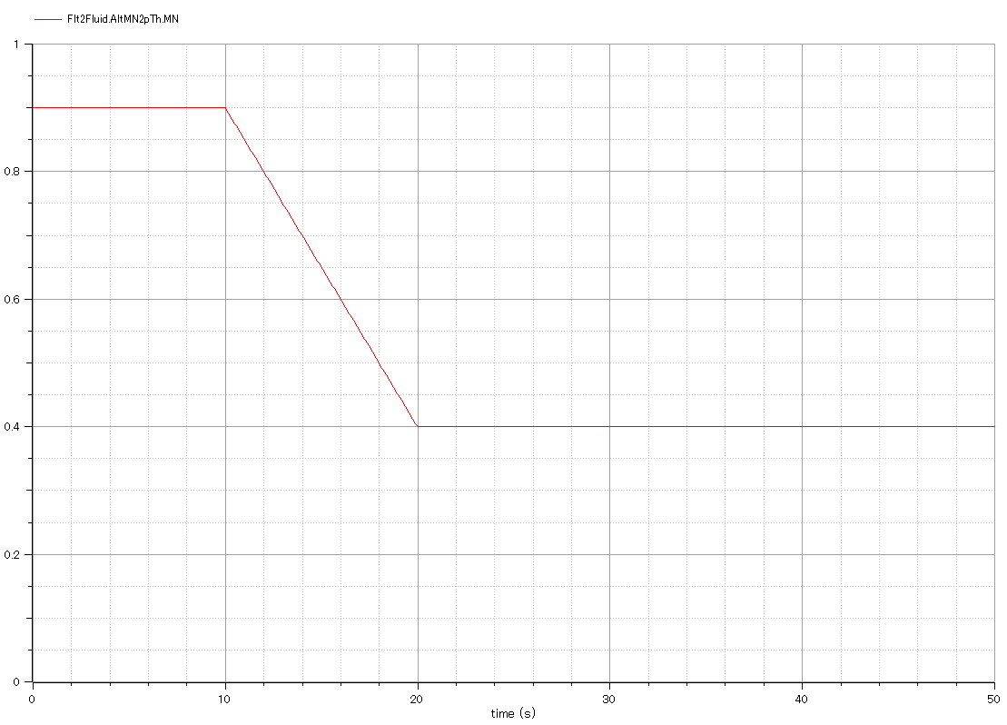
Input:
-. Flight Mach number, or mach number of free-stream outside of engine.

Slide 3
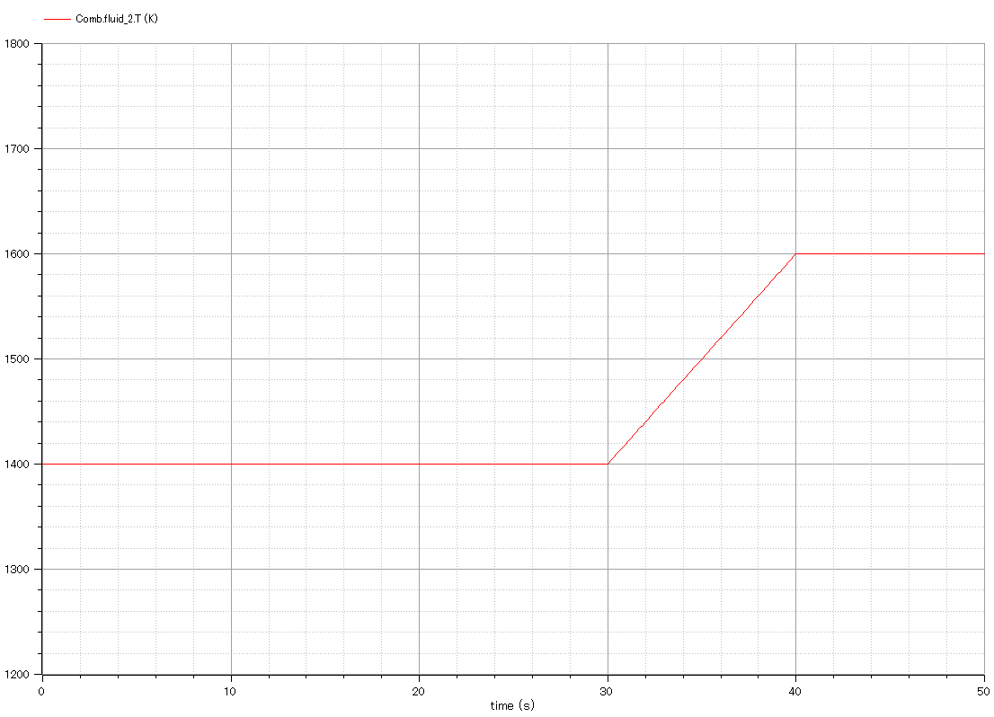
Input:
-. Temperature of combustion chamber outlet.

Slide 4
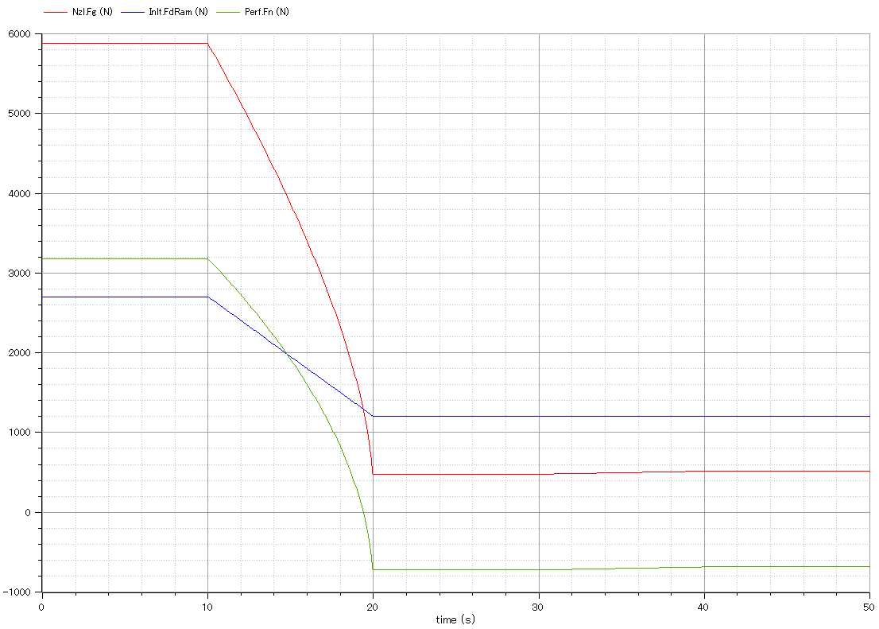
Output:
-. Gross thrust of exhaust nozzle.(red)
-. It gets smaller than ram drag as flight velocity decreases.
Output:
Ram drag.(blue)
Output:
-. Net thrust of engine.(green)
-. It gets negative as flight velocity decreases .

Slide 5
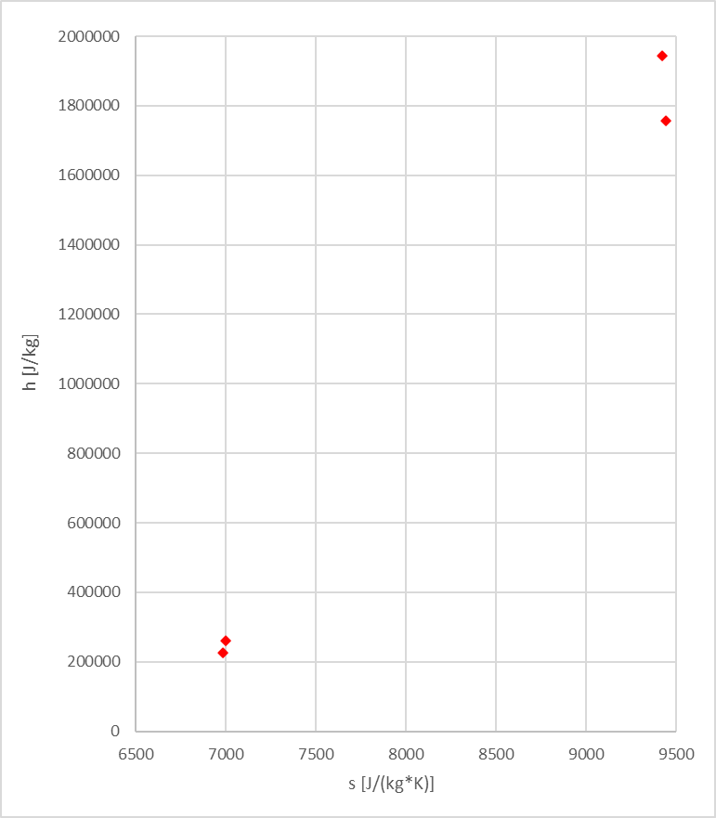
Adiabatic Expansion
Constant pressure heat addition
Constant pressure heat rejection
Adiabatic compression

Slide 6
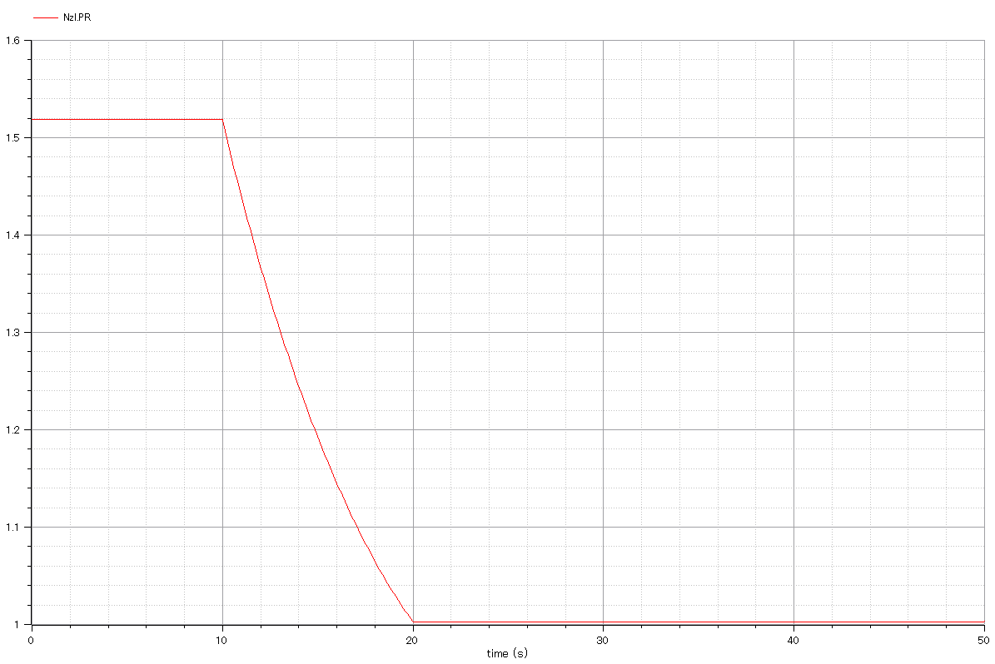
Output:
Nozzle pressure ratio

Slide 7
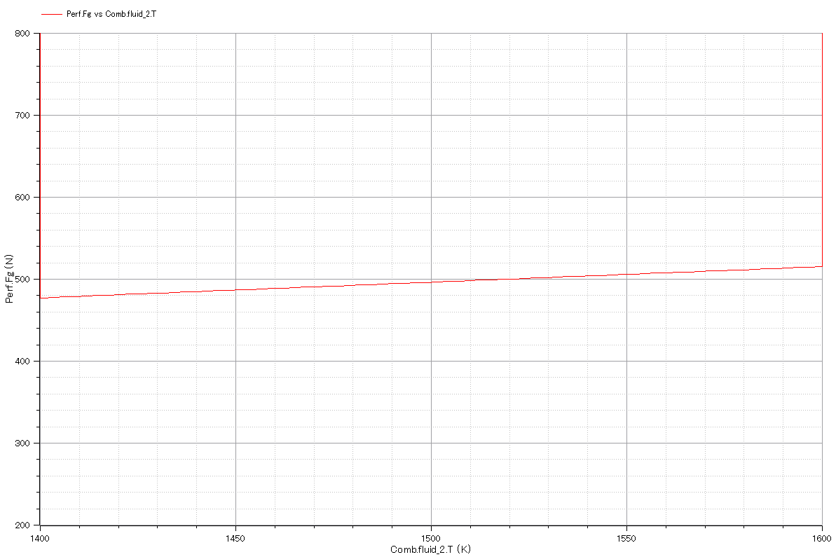
Output:
Nozzle gross thrust vs. combustor outlet temperature.

Slide 8
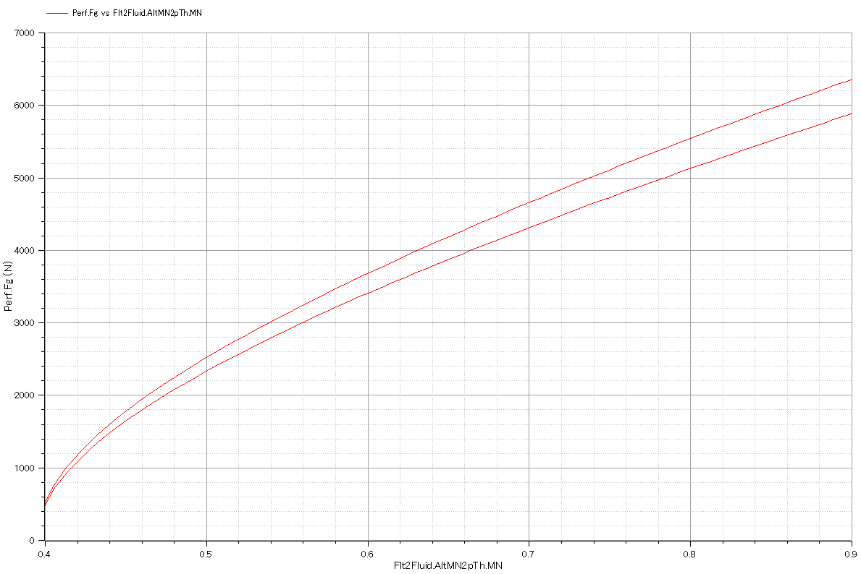
Output:
-. Nozzle gross thrust vs. flight Mach number.
-. There are 2 curves due to change in combustor outlet temperature in simulation.

Slide 9
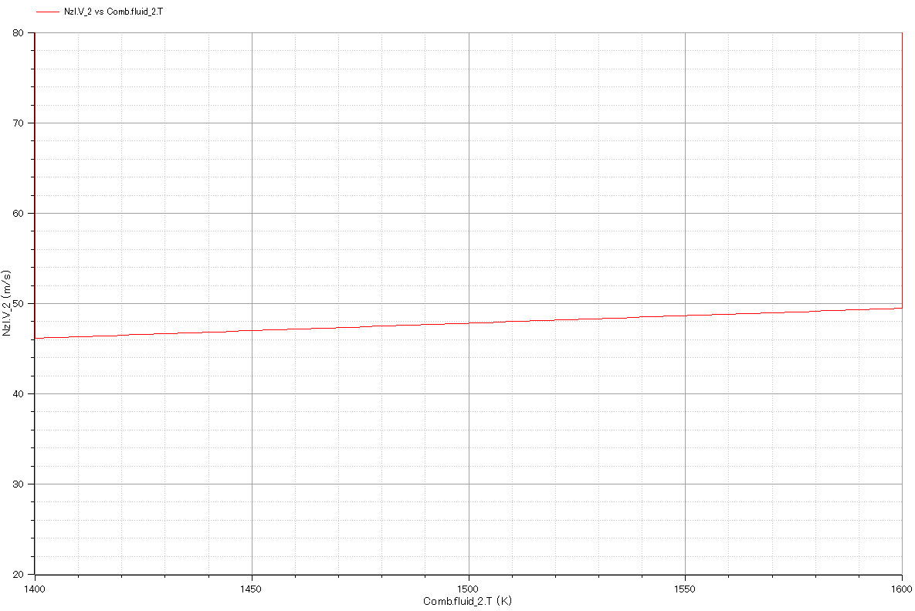
Output:
Full-Expanded exhaust gas velocity vs. combustor outlet temperature.

Slide 10
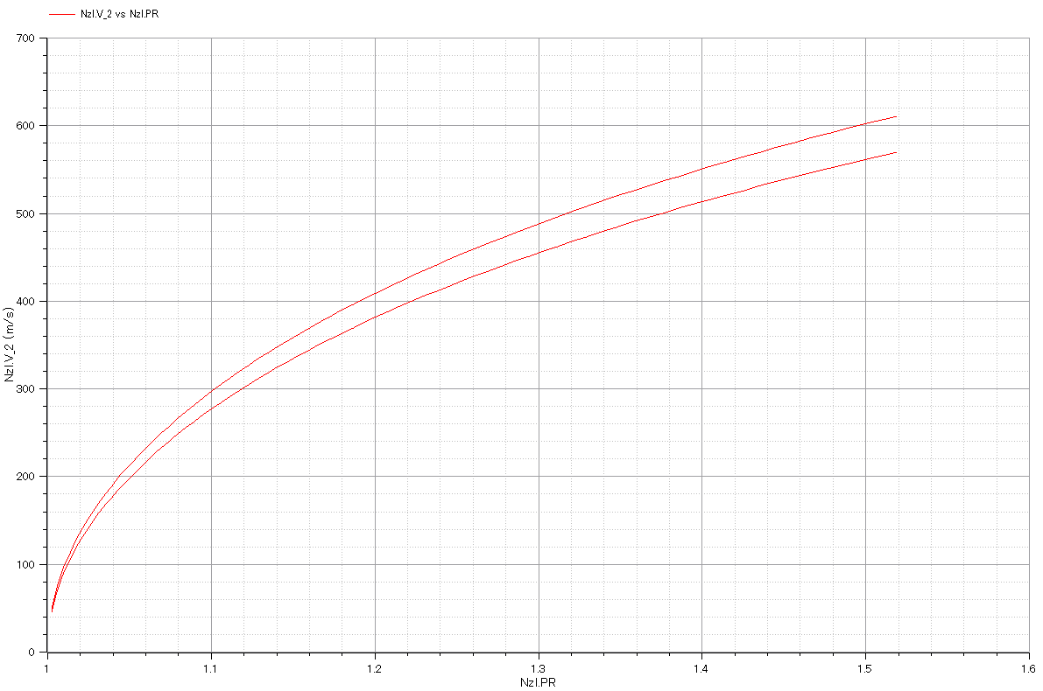
Output:
-. Full-expanded exhaust gas velocity vs. nozzle pressure ratio.
-. There are 2 curves due to change in combustor outlet temperature in simulation.

Slide 11
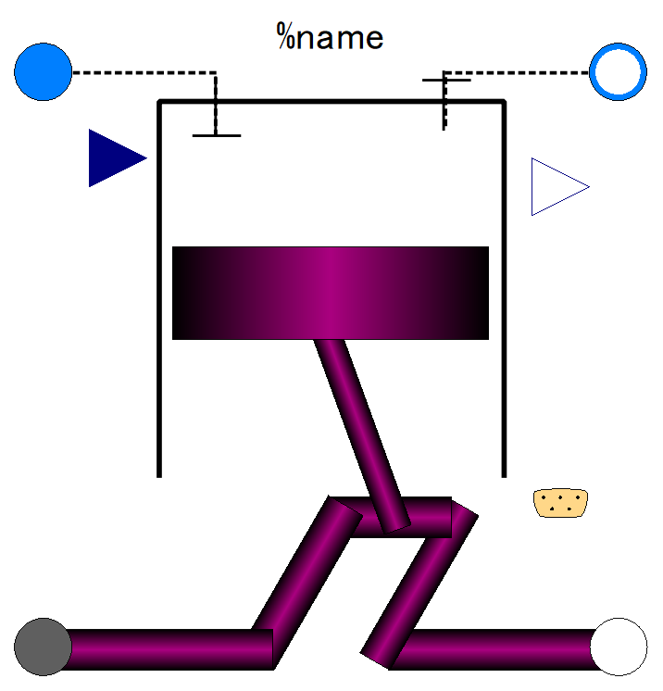

Slide 13
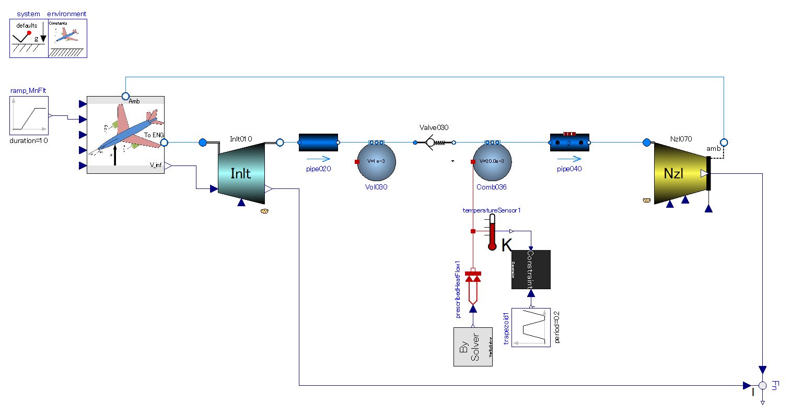
Flight velocity gives gas flow into engine.
This engine cannot start with zero-velocity.
Single direction flow valve.
-. Make gas stream intermittent for intermittent.
-. Prevent gas from flowing backward under combustion period.
Pipe (flow resistance) with volume effect.
-. Delay in mass flow.
No compression process in this thermodynamic cycle.
Heat addition.
-. Under constant volume
-. Intermittent combustion is necessary.

Slide 14
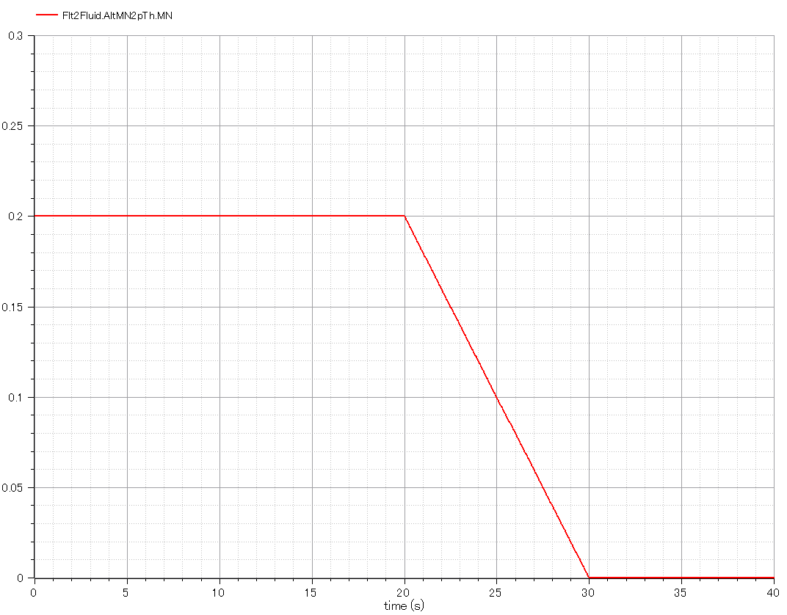
Input:
-. Flight Mach number, or mach number of free-stream outside of engine.
-. It must be greater than zero value at the beginning. The start device provides inlet air with velocity in the real world.

Slide 15
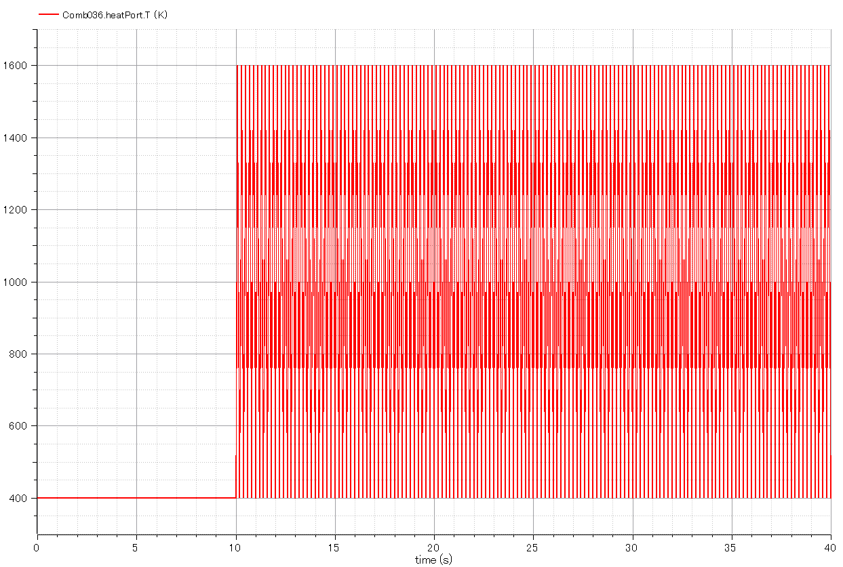
Input:
-. Temperature of combustion chamber.
-. Triangle wave in time domain simulating intermittent combustion.

Slide 16
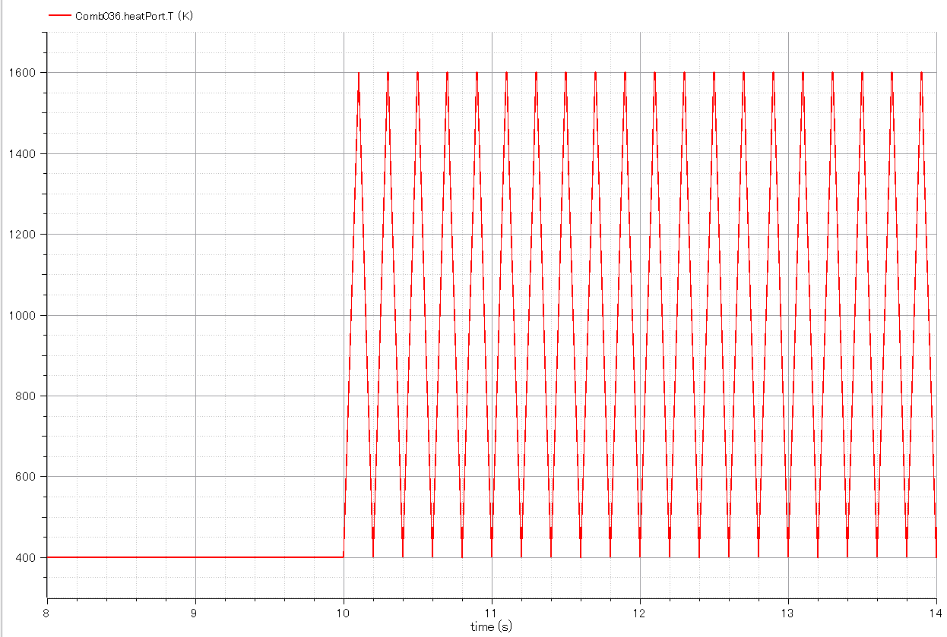
Input:
-. Temperature of combustion chamber. (Enlarged fig.)

Slide 17
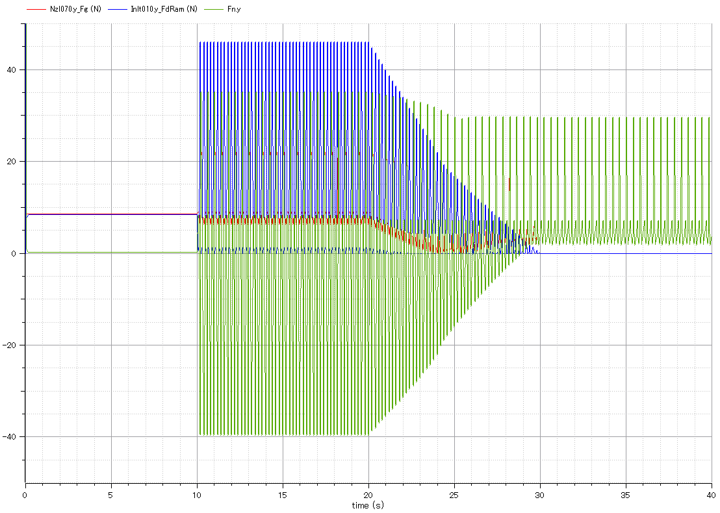
Output:
Ram drag.(blue)
Output:
-. Gross thrust of exhaust nozzle.(red)
-. Engine continues running after flight speed (inlet airspeed) gets zero.
Output:
Net thrust of engine.(green)

Slide 18
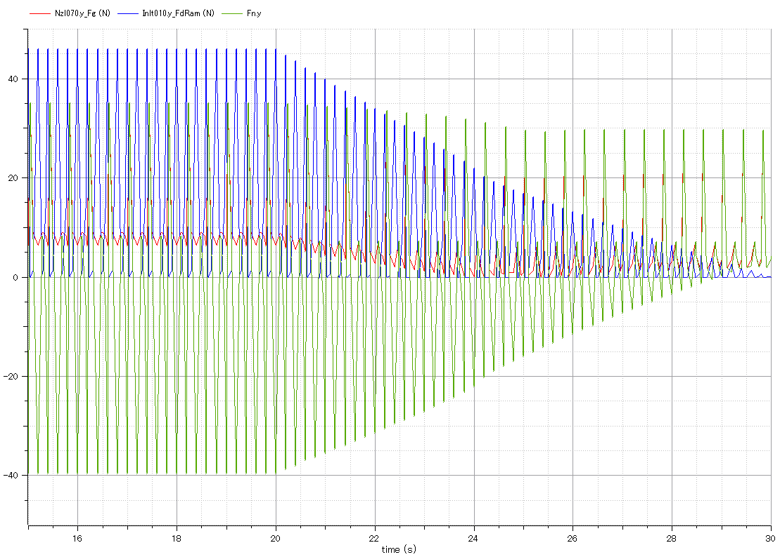
Output:
Ram drag.(blue)
Output:
Gross thrust of exhaust nozzle.(red)
Output:
Net thrust of engine.(green)

Slide 19
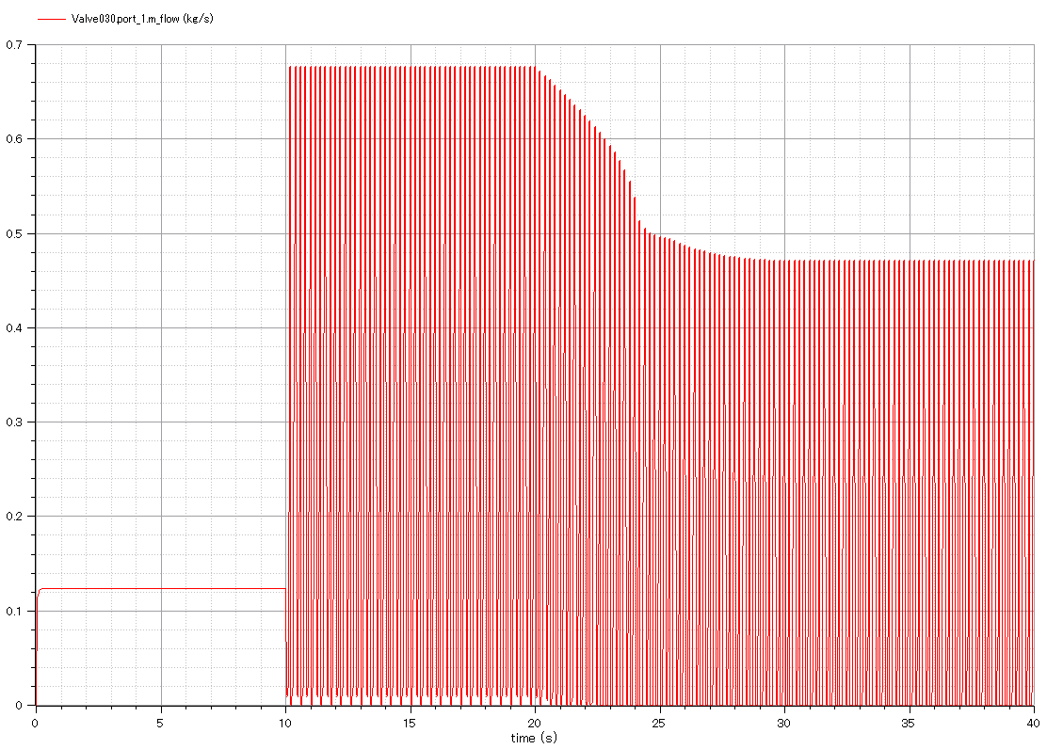
Output:
-. mass flow rate through engine.
-. Intermittent flow due to valve open/close.

Slide 20
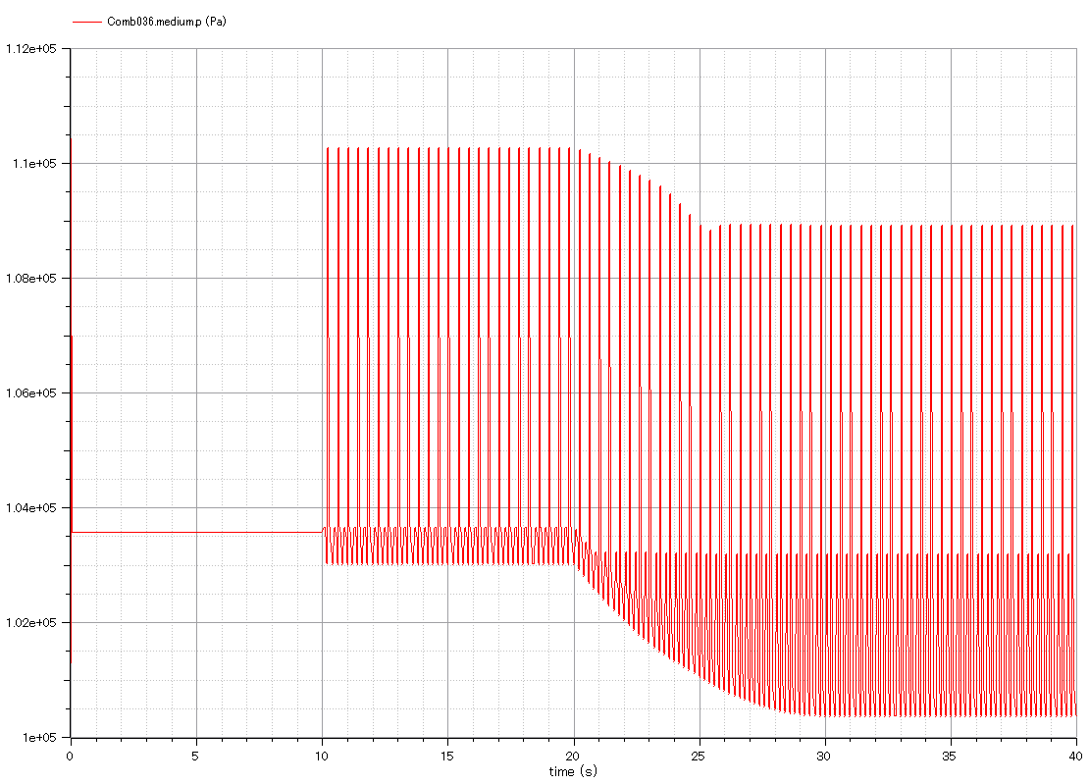
Output:
-. Pressure of combustion chamber.
-. Intermittent change.

Slide 21
h
Q
Adiabatic Expansion
Const. Vol.
Heat Addition
W
W
Adiabatic Compression
Q
Const. Vol.
Heat Rejection
s

Slide 23

AoA
MN
Alt
dm
Pt
Tt

Slide 24
Fn

Slide 25
dm
Pt
Tt
dm
Pt
Tt
MN
AoA
Alt

Slide 26
pStd
Tstd
g

Slide 30
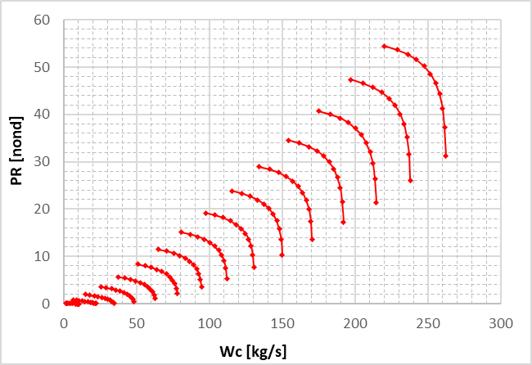
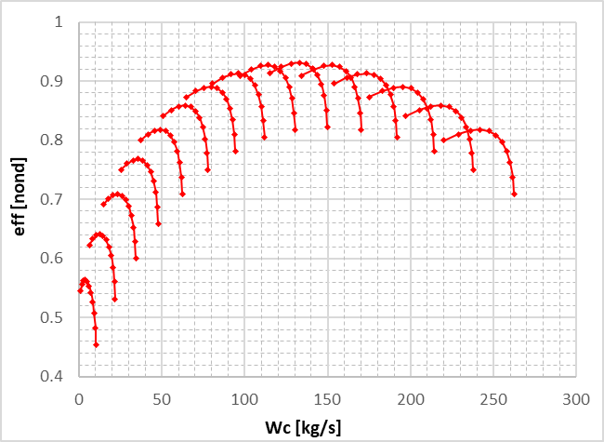

Slide 31
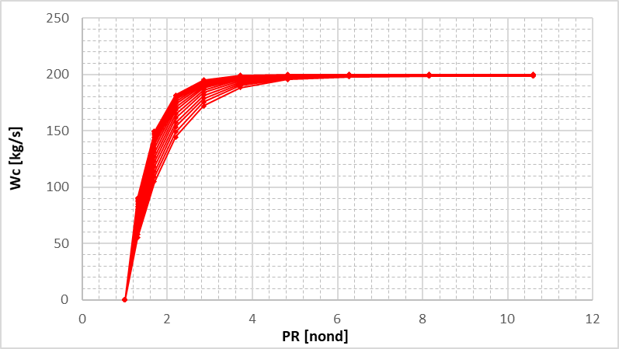
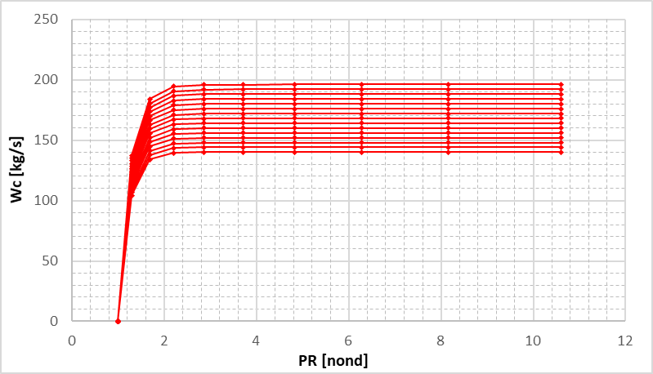
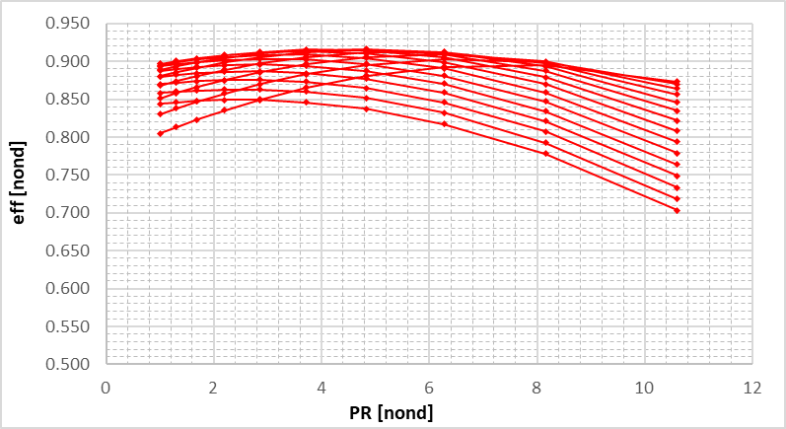
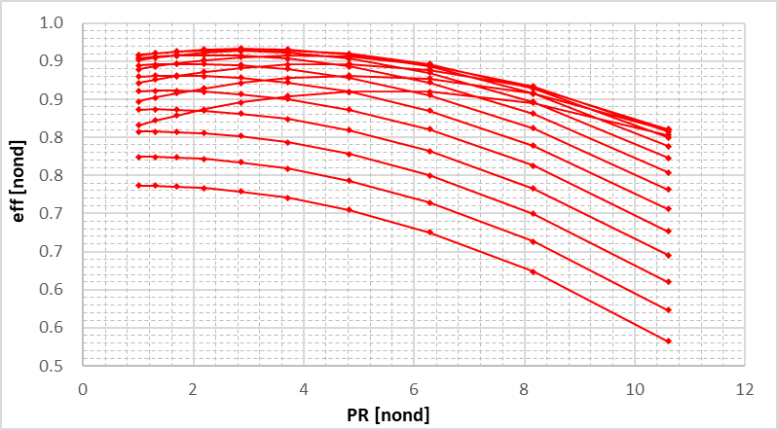

Slide 32
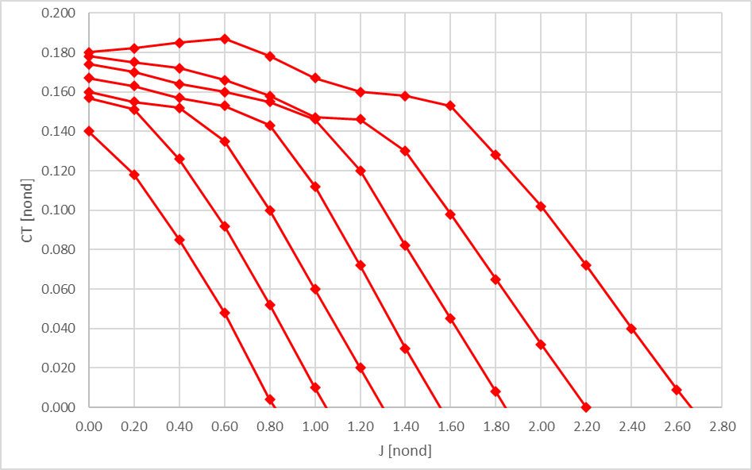
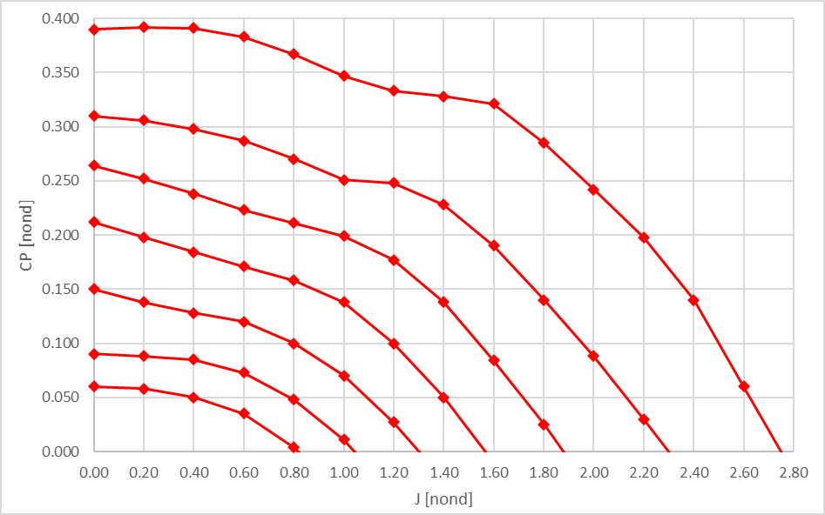

Slide 34
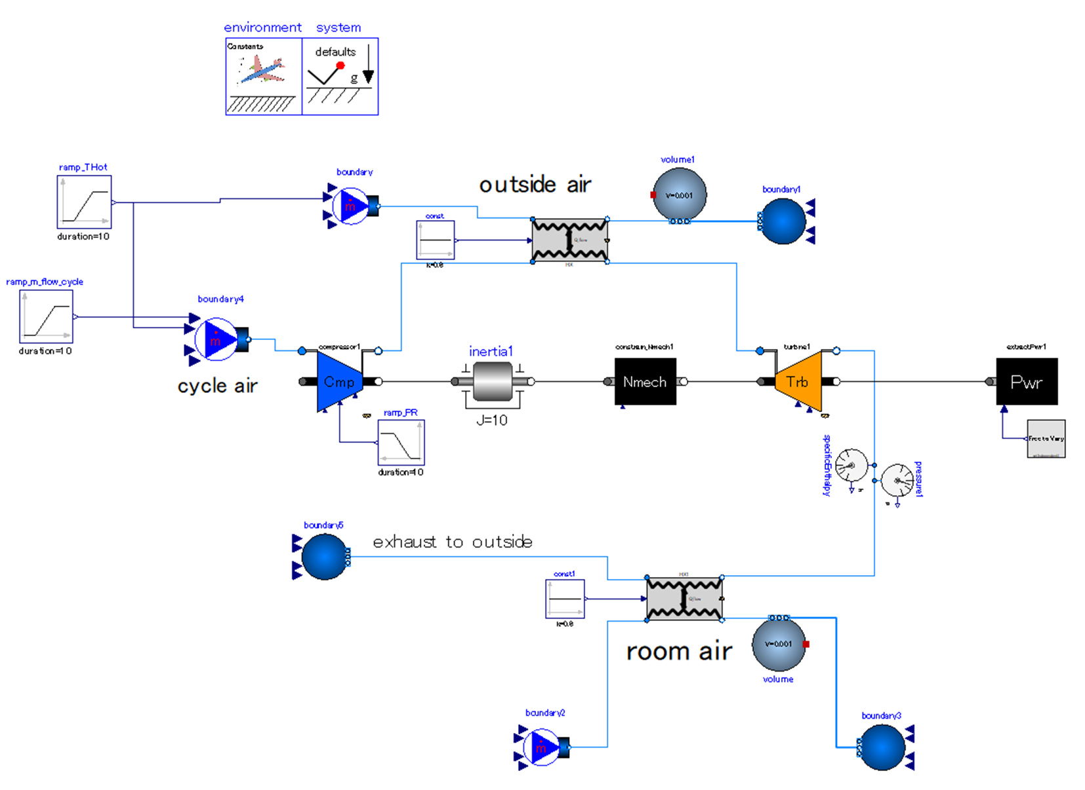
Release heat to outside air.
Expand cycle air to outside pressure. The work generated by expansion is used for driving compressor.
heat
Compress outside air.
Increase pressure ratio of compressor gradually.
heat
Set drive power the “as calculated” variable.
absorb heat from room air.

Slide 35
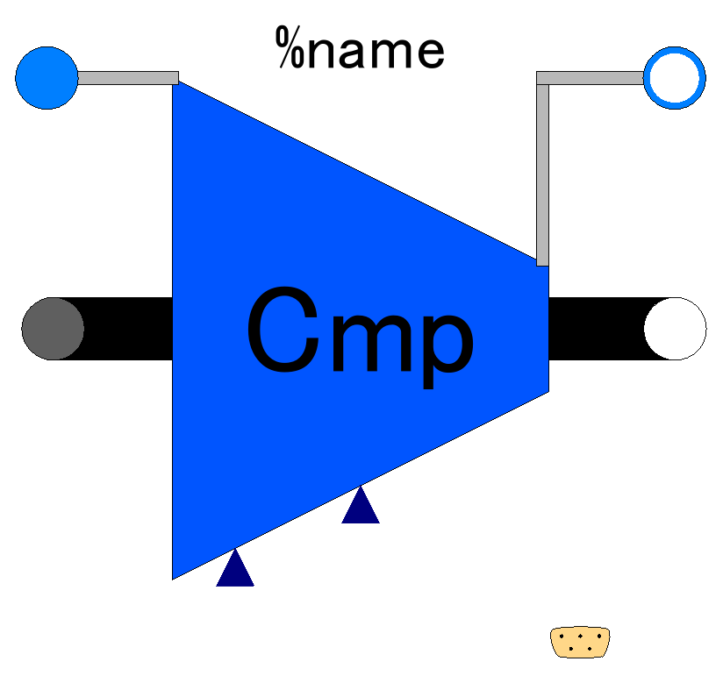

Slide 36
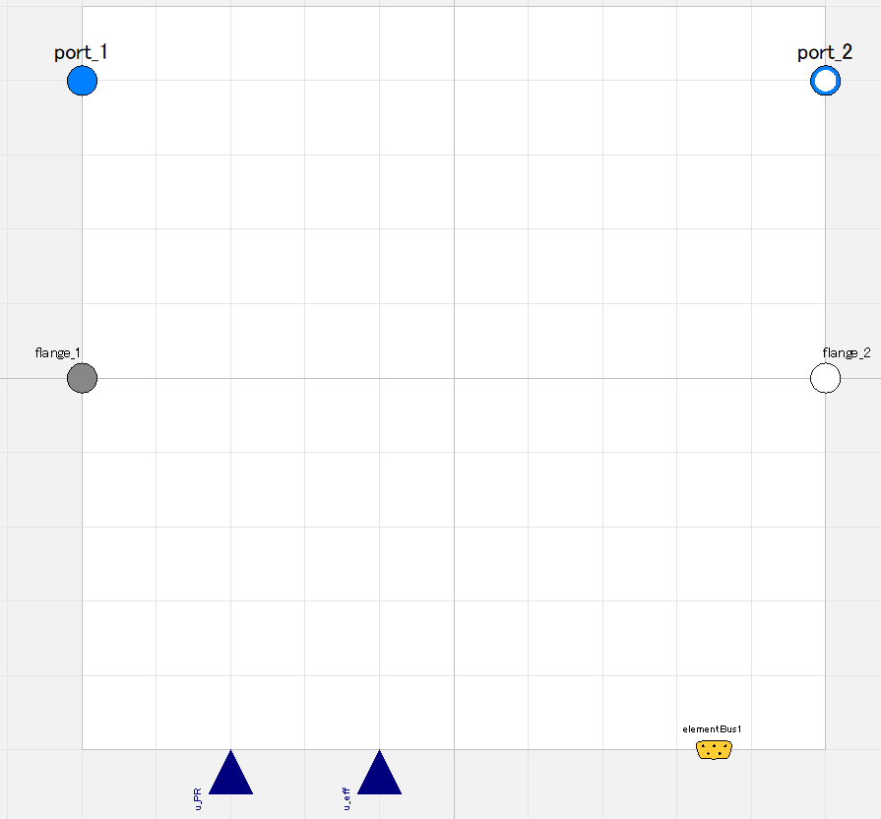

Slide 37
Fluid inlet port, input&output (use “connect” operator)
Fluid outlet port, input&output (use “connect” operator)
Flange (rotational mechanics port),
input&output (use “connect” operator)
Flange (rotational mechanics port),
input&output (use “connect” operator)
Pressure ratio;
input (use “connect” operator),
valid only when switchDetermine_PR==viaRealInput
Efficiency;
input (use “connect” operator),
valid only when switchDetermine_eff==viaRealInput
Expandable connector prepared for communication with internal variables which cannot be accessed by other ports,
input&output (use “connect” operator)

Slide 38
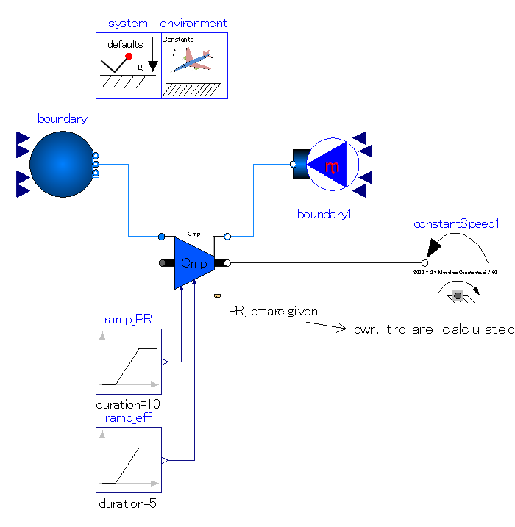
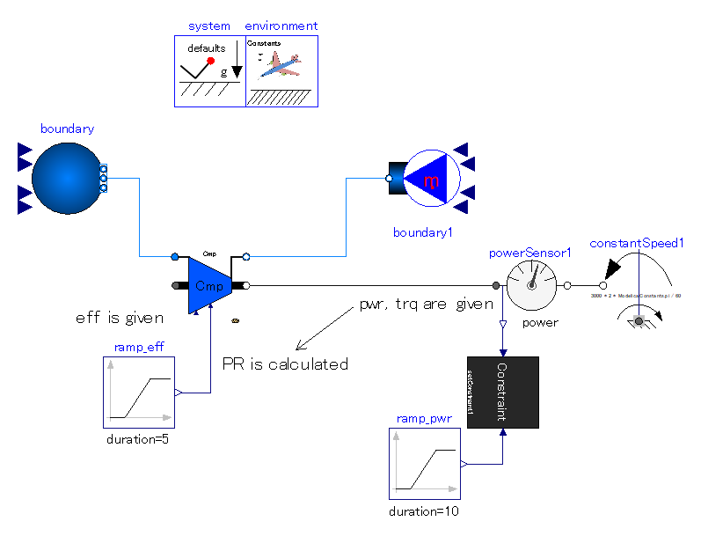

Slide 39
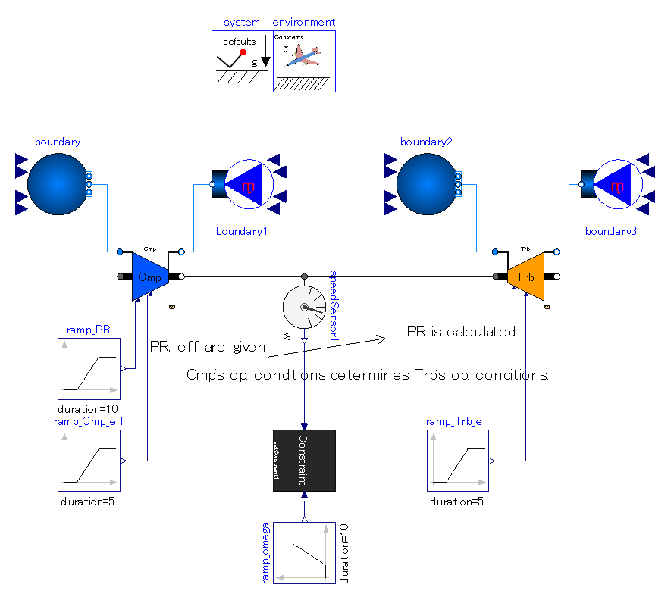
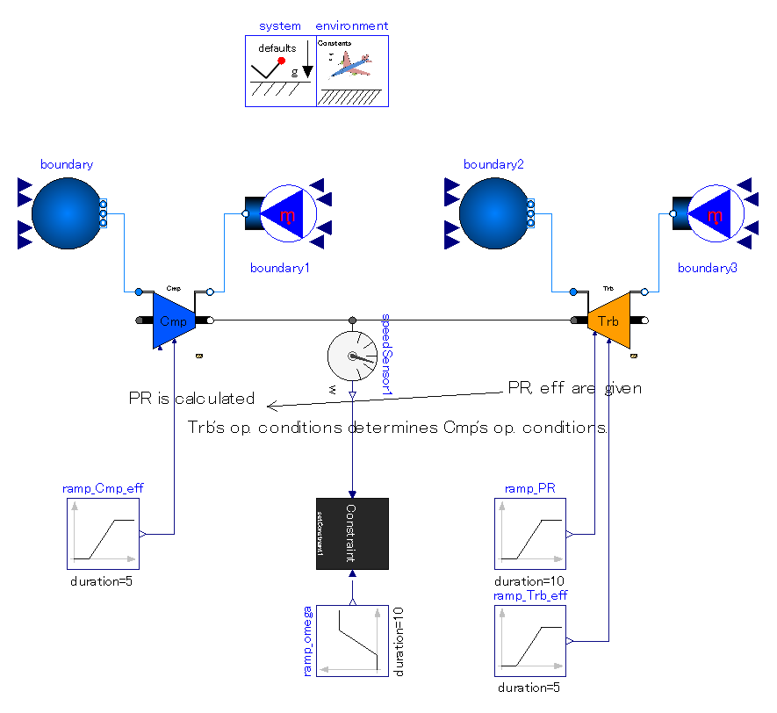

Slide 40
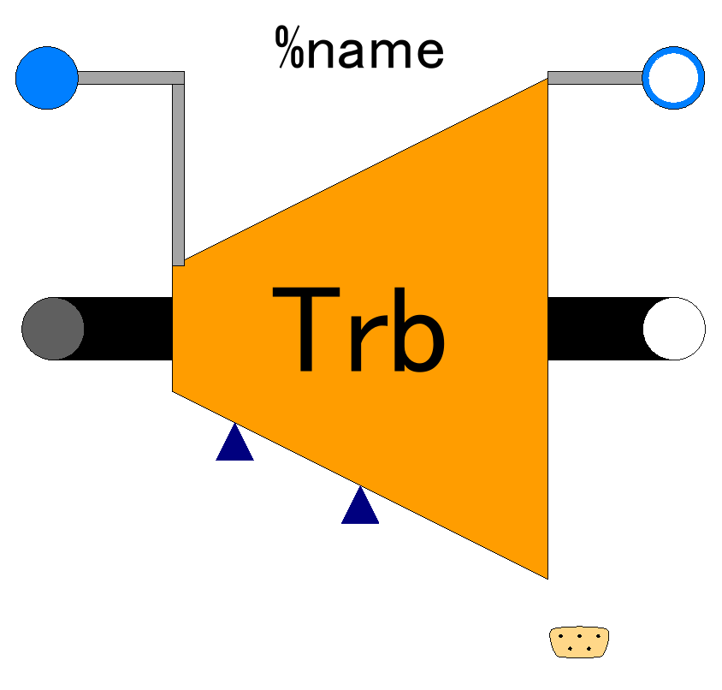

Slide 41
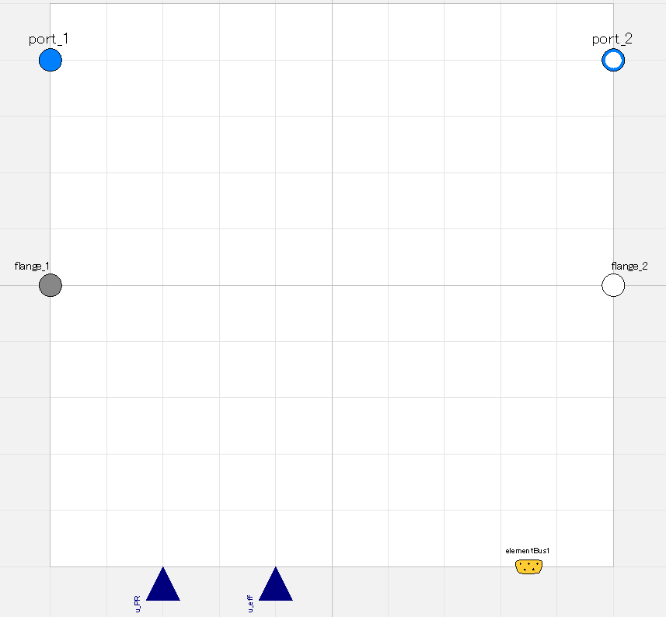

Slide 42
Fluid inlet port, input&output (use “connect” operator)
Fluid outlet port, input&output (use “connect” operator)
Flange (rotational mechanics port),
input&output (use “connect” operator)
Flange (rotational mechanics port),
input&output (use “connect” operator)
Pressure ratio;
input (use “connect” operator),
valid only when switchDetermine_PR==viaRealInput
Efficiency;
input (use “connect” operator),
valid only when switchDetermine_eff==viaRealInput
Expandable connector prepared for communication with internal variables which cannot be accessed by other ports,
input&output (use “connect” operator)

Slide 43
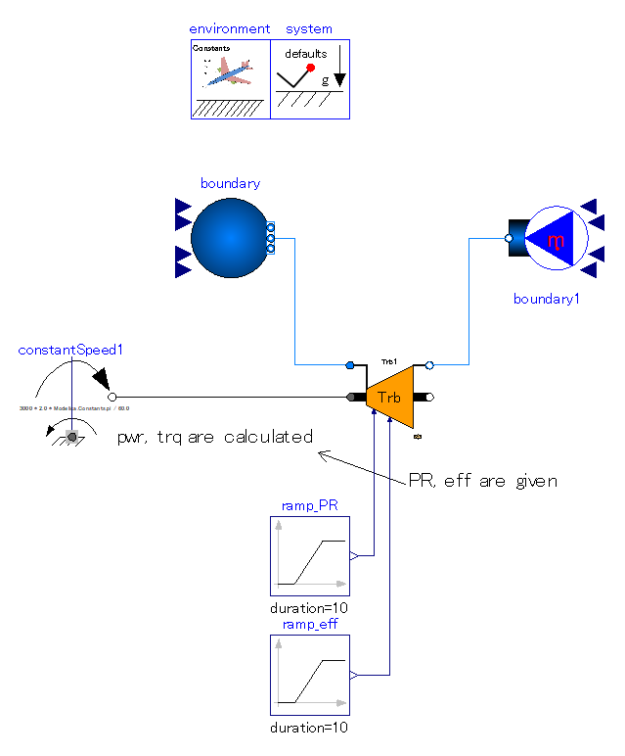
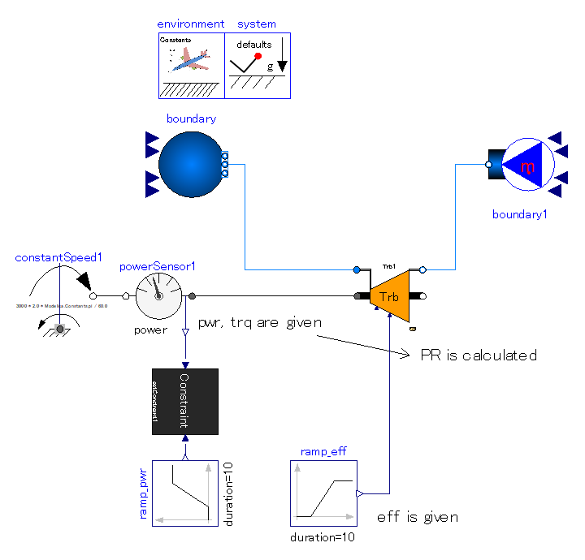

Slide 44
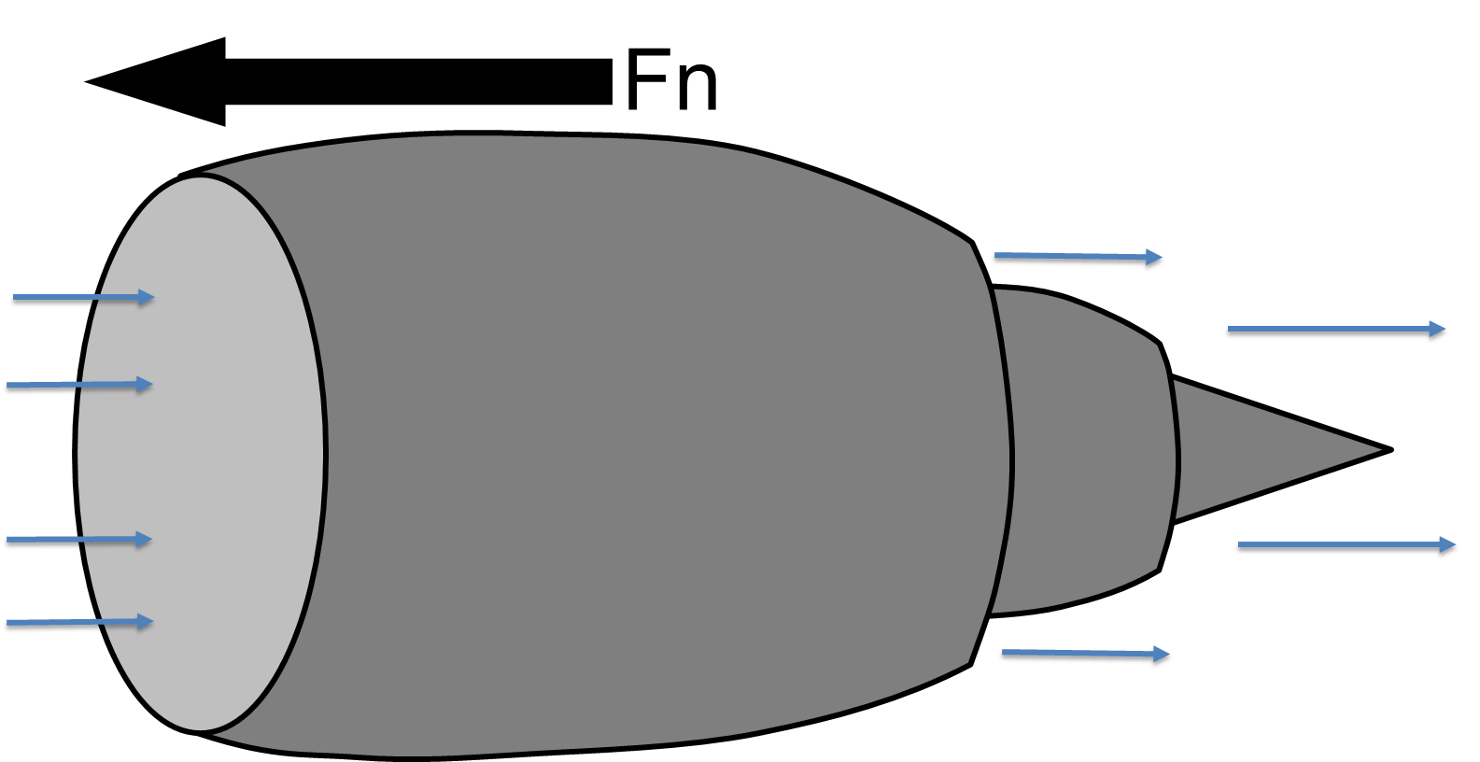
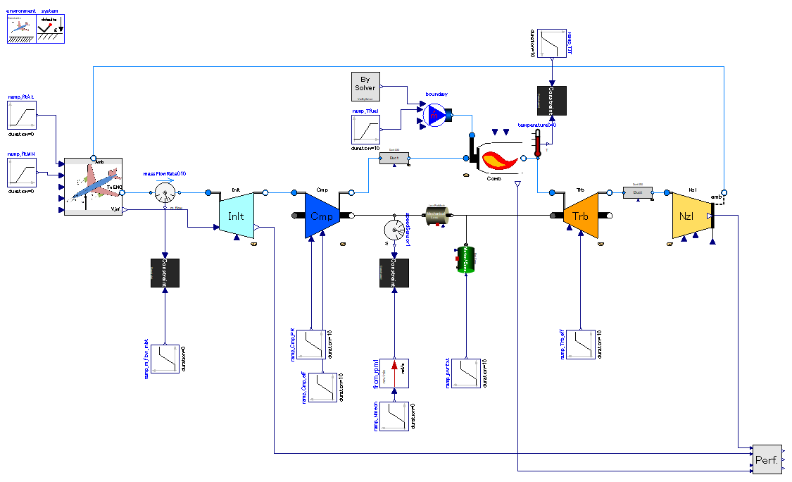
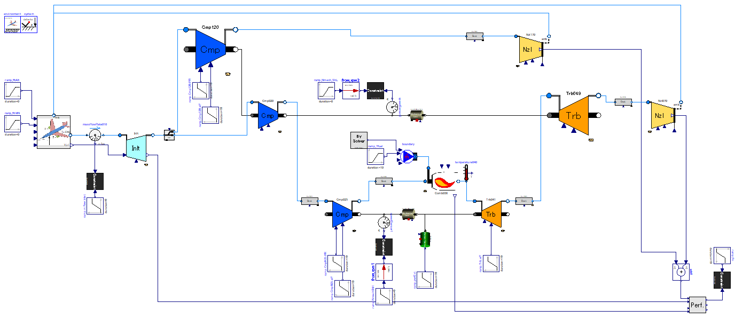
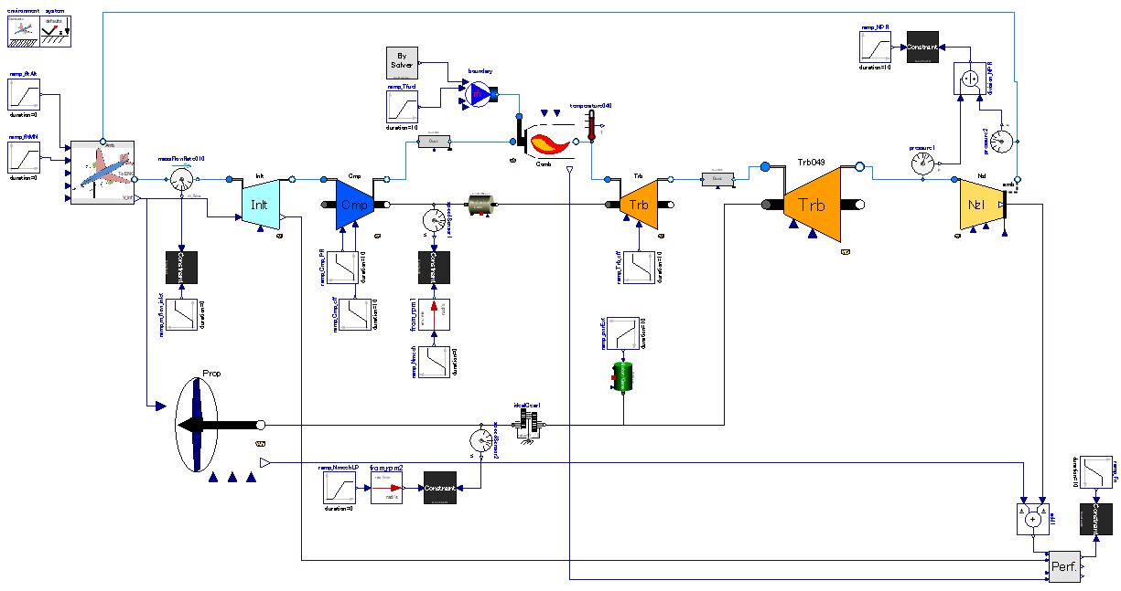
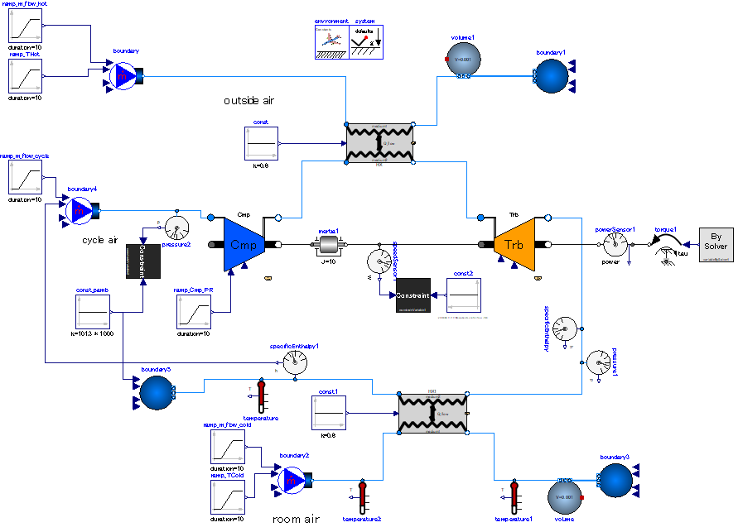

Slide 45
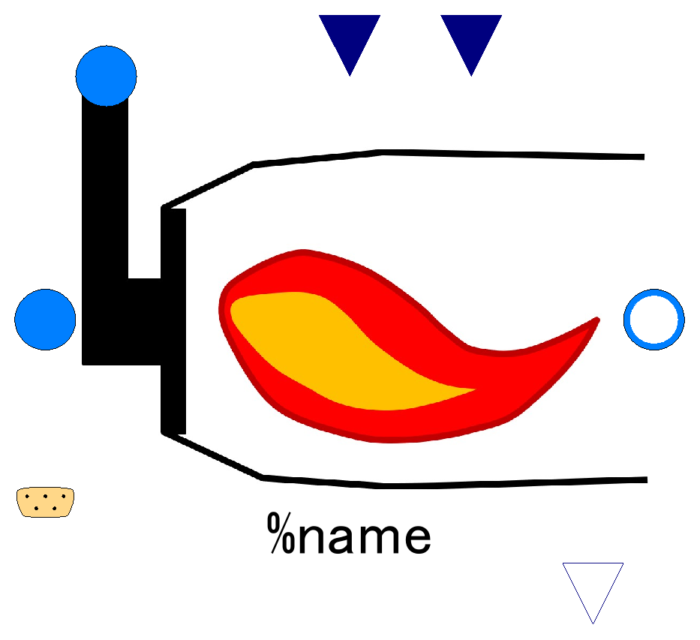

Slide 46
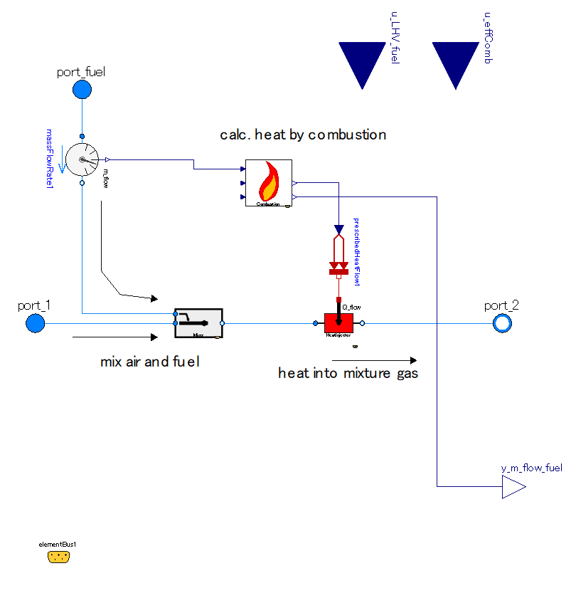

Slide 47
Lower Heating Value of Fuel;
input (use “connect” operator),
valid only when use_u_LHV_fuel==true
Efficiency of combustion;
input (use “connect” operator),
valid only when use_u_effComb==true
Fuel inlet port, input&output (use “connect” operator)
Fluid inlet port, input&output (use “connect” operator)
Fluid outlet port, input&output (use “connect” operator)
Fuel flow, output

Slide 48
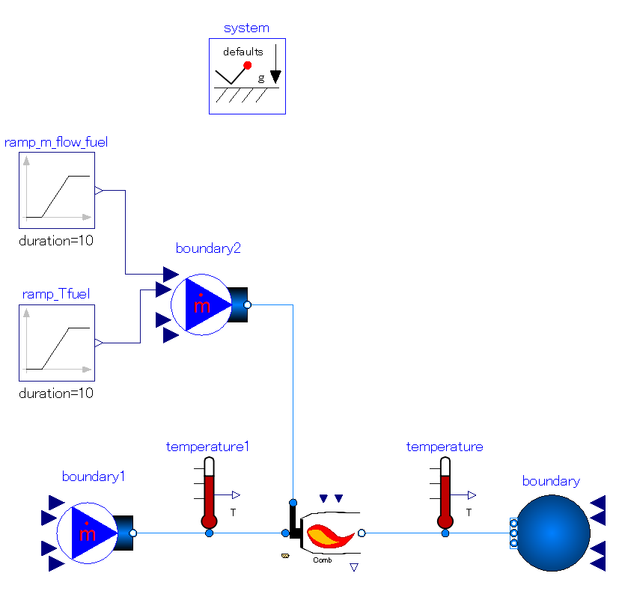
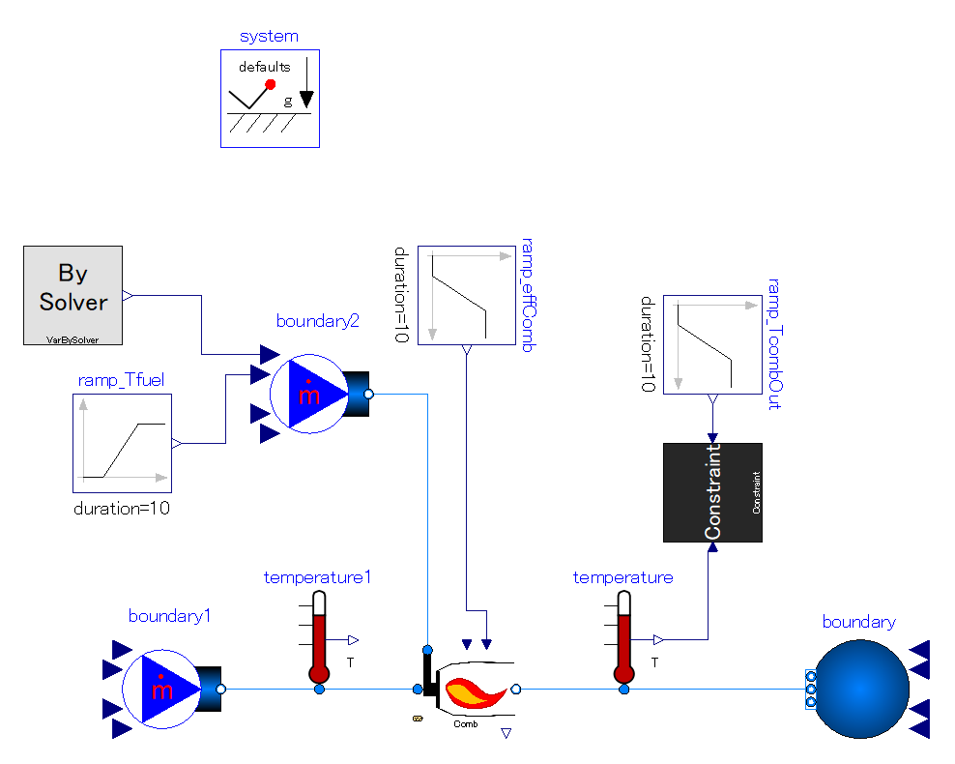

Slide 49
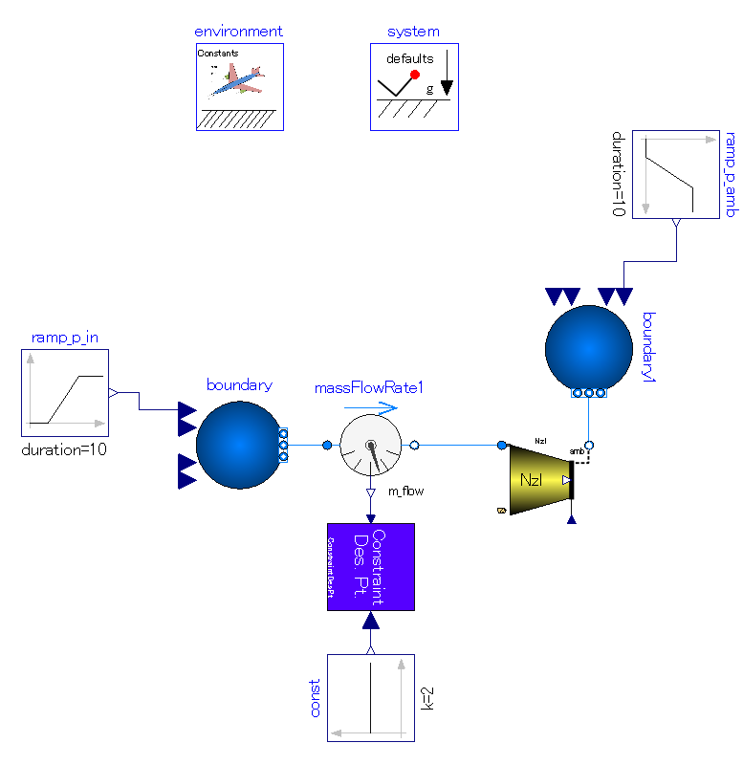
This component defines the time when mass flow rate constraint is removed and mechanical cross sectional area of nozzle throat turns from output to input.
Change upstream pressure of nozzle after remove of mass flow rate constraint in order to check constraint become invalid and area is fixed.
Mass flow rate signal is constrained to the value input as signal.
Constraint is kept until the time which is defined by “environment” block.
Mechanical cross sectional area of throat is calculated variable when mass flow rate is constrained. “des” marked discrete variable stores that value.
After Mass flow rate constraint is removed, the value of mechanical cross sectional area is input and mass flow is calculated variable.

Slide 50
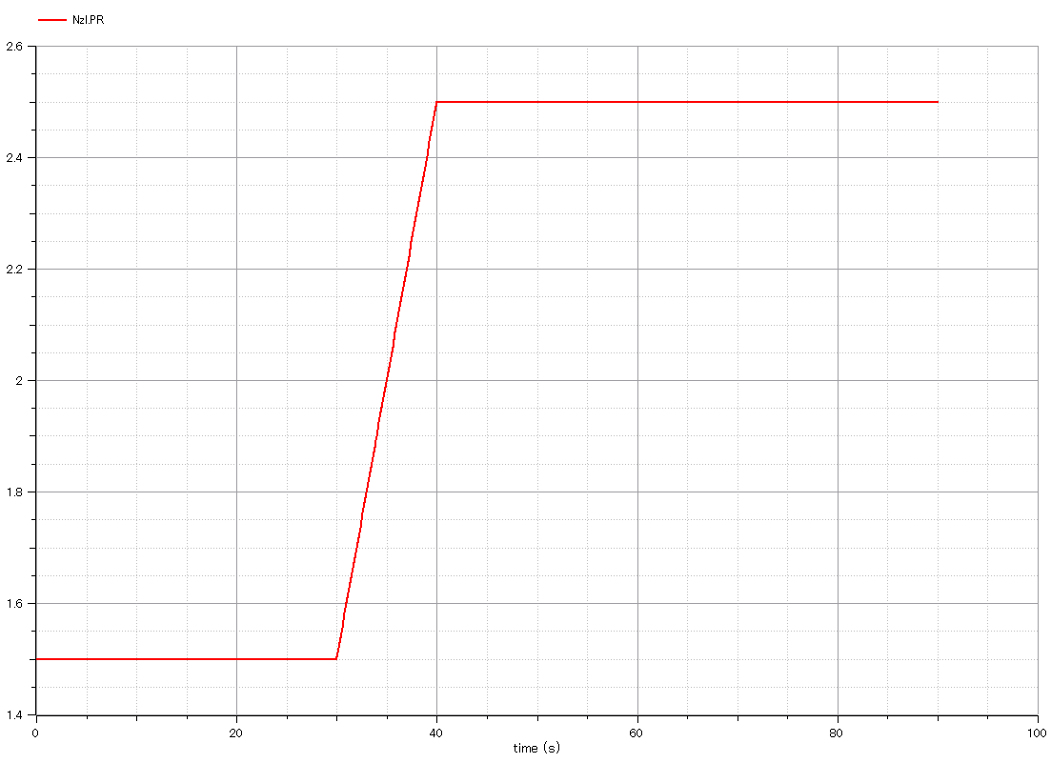
Input:
nozzle pressure ratio is increased

Slide 51
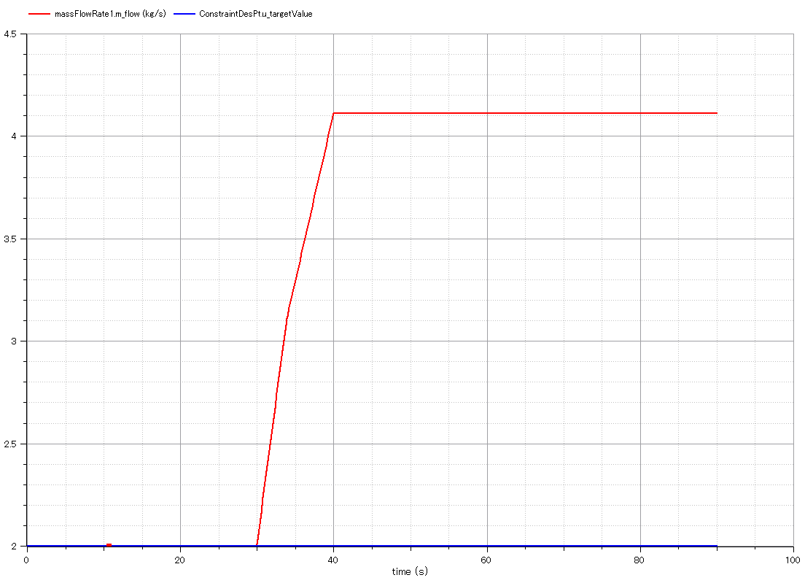
Output:
mass flow rate through nozzle.
It is increased as nozzle pressure ratio rises.
Output:
signal into constraint block which constrains mass flow rate.
The value is fixed to 2 throughout the simulation, but does not affect on mass flow rate after constraint period.

Slide 52

Output:
mechanical cross sectional area of nozzle throat.
It is calculated as output in period of mass flow constraint, and referred as input after constraint period.
Therefore, the value does not change when nozzle pressure ratio is increased.

Slide 53

Components for design point constraint of mass flow rate is integrated into single component for easier handling.

Slide 54

Nozzle throat mechanical cross sectional area is “actuatable” by multiplication factor after constraint period.
The area multiplication factor is changed from 1.0 to 0.9 gradually in this example.

Slide 55

Input:
nozzle pressure ratio is increased

Slide 56

Output:
mass flow rate via nozzle.
It decreases as throat area multiplication factor drops.

Slide 57

Output:
“des” marked throat mechanical cross sectional area.
It is kept constant while throat area multiplication factor is changed.
Output:
throat mechanical cross sectional area.
It decreases as throat area multiplication factor drops.

Slide 58

This component defines the time when simulation switches from design-point to off-design.
Mechanical cross sectional area of throat is calculated variable when mass flow rate is constrained. “des” marked discrete variable stores that value.
After Mass flow rate constraint is removed, the value of mechanical cross sectional area is input and mass flow is calculated variable.
Mass flow rate which engine takes in at design point is constrained (= sizing of fluid components).
Constraint is kept until the time which is defined by “environment” block.
Rotational speed of engine shaft at design point is constrained (= sizing of rotary machines).
Constraint is kept until the time which is defined by “environment” block.

Slide 59

Input:
Combustor outlet temperature is constrained as input of engine rating.
It is increased in off-design simulation period.

Slide 60

Output:
Mechanical rotational speed.
It is calculated as a result of input of combustor outlet temperature in off-design simulation period.
Output:
“des” marked mechanical rotational speed.
It is kept constant throughout simulation. Its value is defined in design-point calculation period.

Slide 61

Output:
Mass flow rate which engine takes in.
It is calculated as a result of input of combustor outlet temperature in off-design simulation period.
Output:
“des” marked mass flow rate.
It is kept constant throughout simulation. Its value is defined in design-point calculation period.

Slide 62

Actuate nozzle throat area size.
The area multiplication factor is changed from 1.0 to 0.9 gradually in this example.

Slide 63


Input:
Combustor outlet temperature is constrained as input of engine rating.
It is increased in off-design simulation period. (10 [s] – 20 [s])
Input:
Multiplication factor of nozzle throat area.
It is decreased (closed) in off-design simulation period. (30 [s] – 40 [s])

Slide 64


Output:
Mass flow rate through nozzle.
It is decreased as nozzle throat area closes.
Output:
Mechanical rotational speed of engine shaft.
It is decreased as nozzle throat closes in order to compensate for the decrease in mass flow rate capacity.

Slide 65


Output:
Mass flow rate of fuel.
It is decreased as nozzle throat closes because the mass flow of air through engine is decreased but combustor outlet temperature is kept.
Output:
Gross thrust of nozzle.
It is decreased as mass flow capacity of nozzle and engine speed decreases.

Slide 66


Operating fluid moves between hot and cold volume.
Define positions of cylinders.
Reject heat from cold volume. Constant volume heat rejection & constant temperature compression.
Add heat into hot volume. Constant volume heat addition & constant temperature expansion.
pistons.
Connecting rods.
Crank shaft.
90-deg phase difference between 2 rods.
Mechanical loss.
Fly wheel.

Slide 67
Animation window
pistons.
Connecting rods.
Crank shaft.
90-deg phase difference between 2 rods.

Slide 68

Input:
Temperature of hot heat source.

Slide 69

Output:
gas temperature in hot cylinder.
Output:
gas temperature in cold cylinder.

Slide 70

Output:
gas mass in cold cylinder.
Output:
gas mass in hot cylinder.

Slide 71

Output:
rotational speed of crank-shaft.
It accelerates as hot heat source temperature is increased. However, it oscillates.

Slide 72

Output:
Power via crank shaft.

Slide 73



Slide 74

Output:
Heat flow out of cold volume.
Output:
Heat flow from hot heat source into hot volume.

Slide 75


