Slide 1
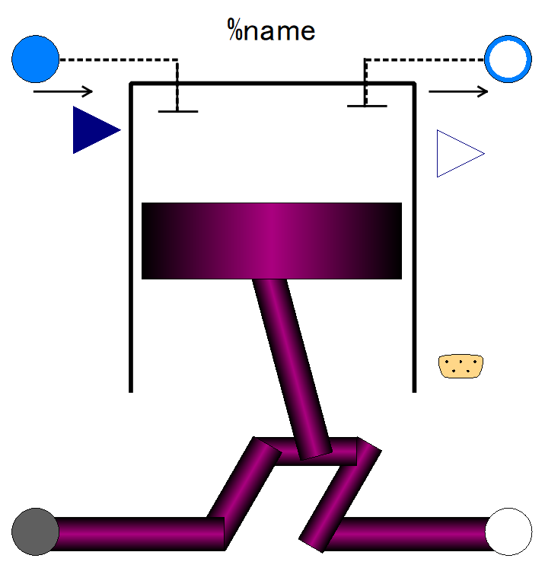

Slide 2
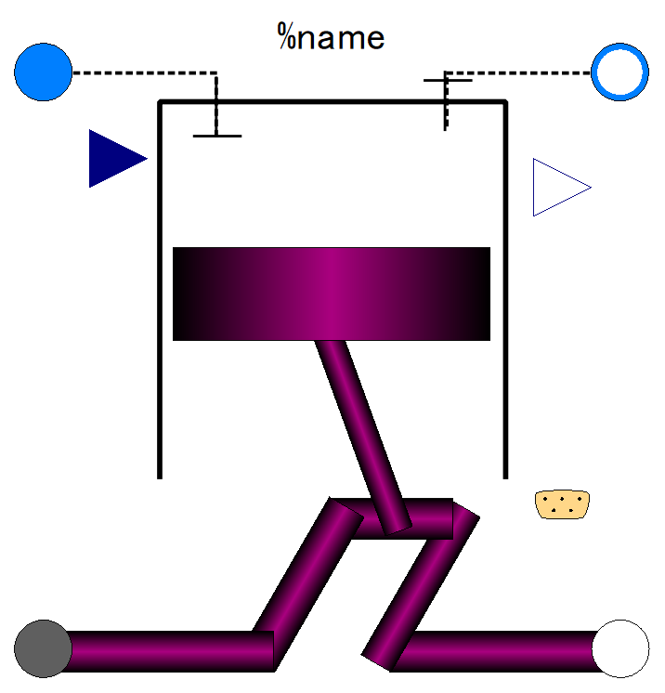
Fluid inlet port, input&output (use “connect” operator)
Fluid outlet port, input&output (use “connect” operator)
Fuel flow rate, output
Fuel fraction in in-taken gas;
input (use “connect” operator),
Expandable connector prepared for communication with internal variables which cannot be accessed by other ports,
input&output (use “connect” operator)
Flange (rotational mechanics port),
input&output (use “connect” operator)
Flange (rotational mechanics port),
input&output (use “connect” operator)

Slide 3
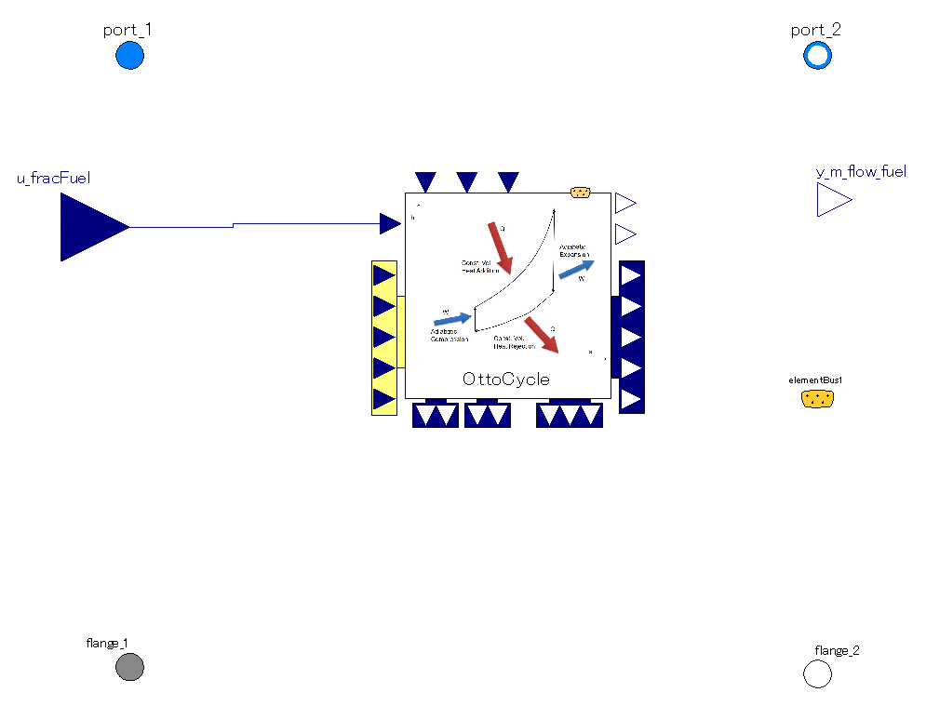
The mass flow rate through the piston is averaged over 2 rotations (=1 cycle).
Thus mass flow rate is steady as long as flange rotation is so.
Pressure and spec. enthalpy of port_1 are referred as fluid state before compression stroke in cycle calculation
Pressure and spec. enthalpy of fluid state after expansion stroke are referred as those of port_2.
It calculates power output, mass of fuel consumed in one Otto cycle and fluid state after expansion stroke.
The power output of Otto cycle is averaged over 2 rotations (=1 cycle).
Thus, torque out is steady as long as flange rotation is so.

Slide 4
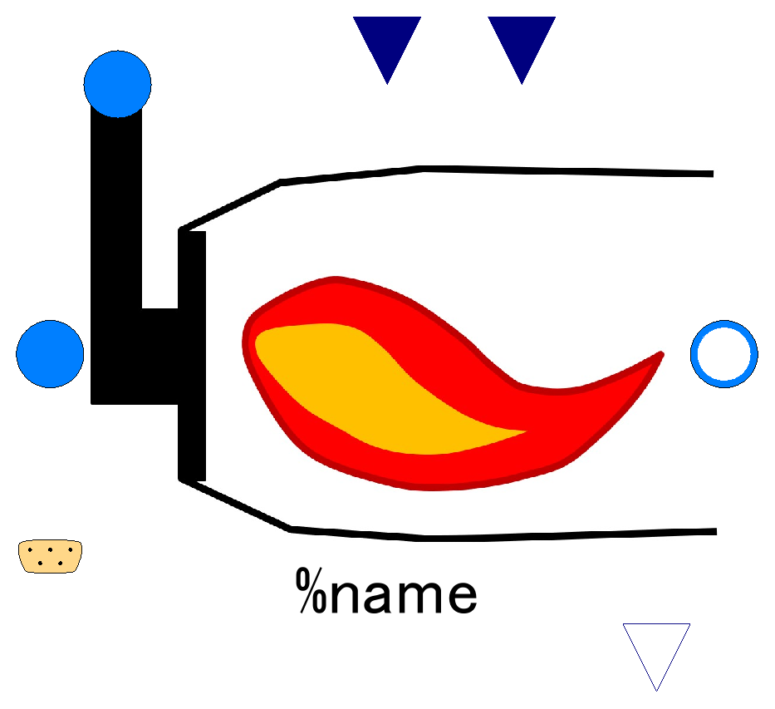

Slide 5
Lower Heating Value of Fuel;
input (use “connect” operator),
valid only when use_u_LHV_fuel==true
Efficiency of combustion;
input (use “connect” operator),
valid only when use_u_effComb==true
Fuel inlet port, input&output (use “connect” operator)
Fluid inlet port, input&output (use “connect” operator)
Fluid outlet port, input&output (use “connect” operator)
Fuel flow, output

Slide 6
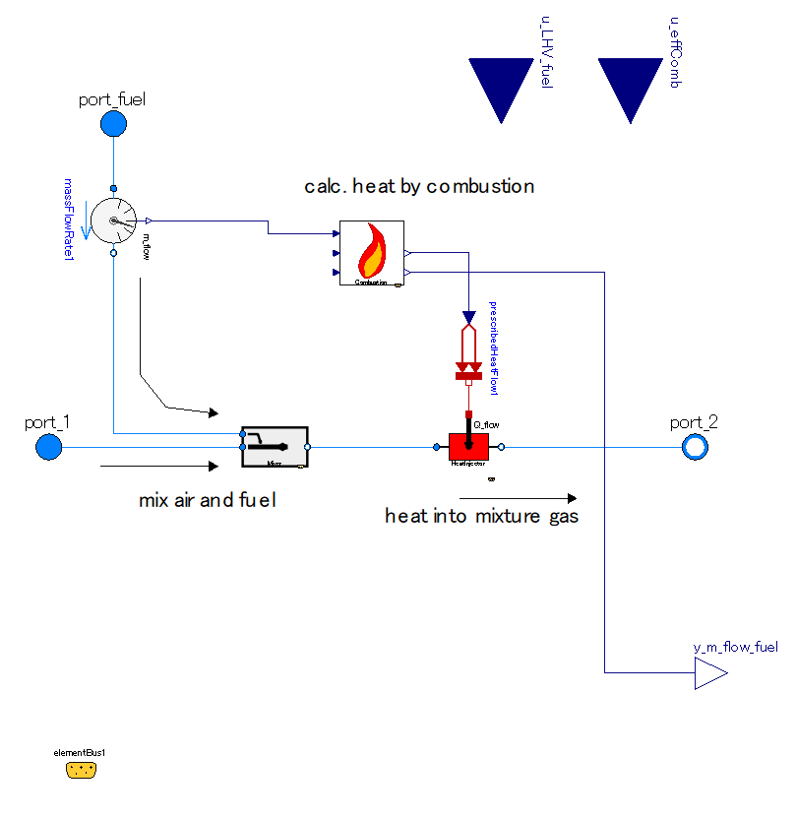

Slide 7
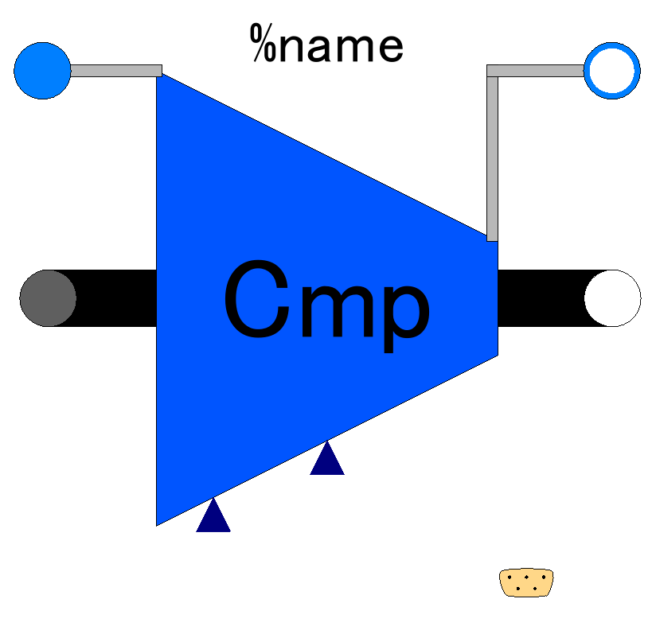

Slide 8
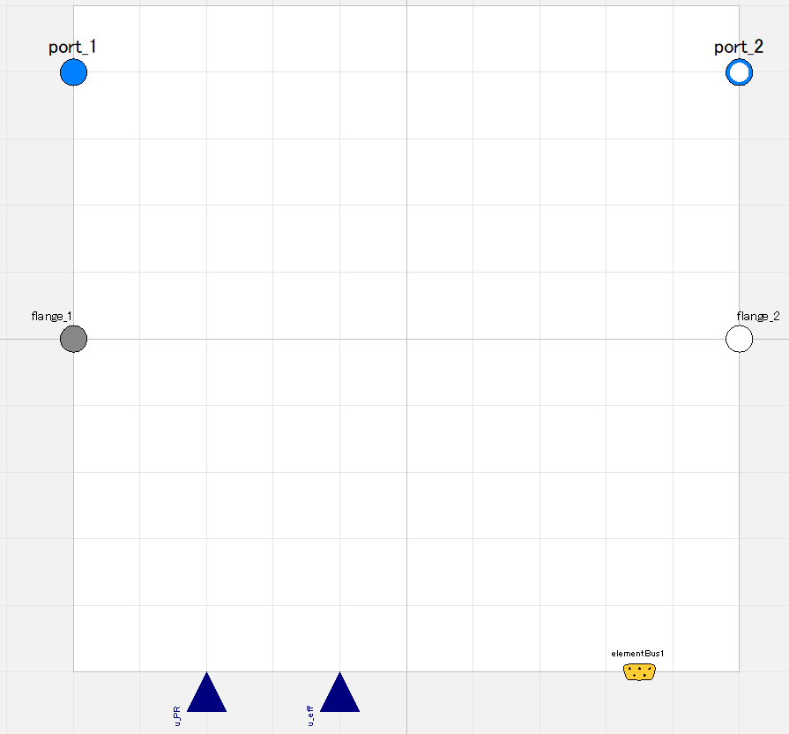

Slide 9
Fluid inlet port, input&output (use “connect” operator)
Fluid outlet port, input&output (use “connect” operator)
Flange (rotational mechanics port),
input&output (use “connect” operator)
Flange (rotational mechanics port),
input&output (use “connect” operator)
Pressure ratio;
input (use “connect” operator),
valid only when switchDetermine_PR==viaRealInput
Efficiency;
input (use “connect” operator),
valid only when switchDetermine_eff==viaRealInput
Expandable connector prepared for communication with internal variables which cannot be accessed by other ports,
input&output (use “connect” operator)

Slide 10
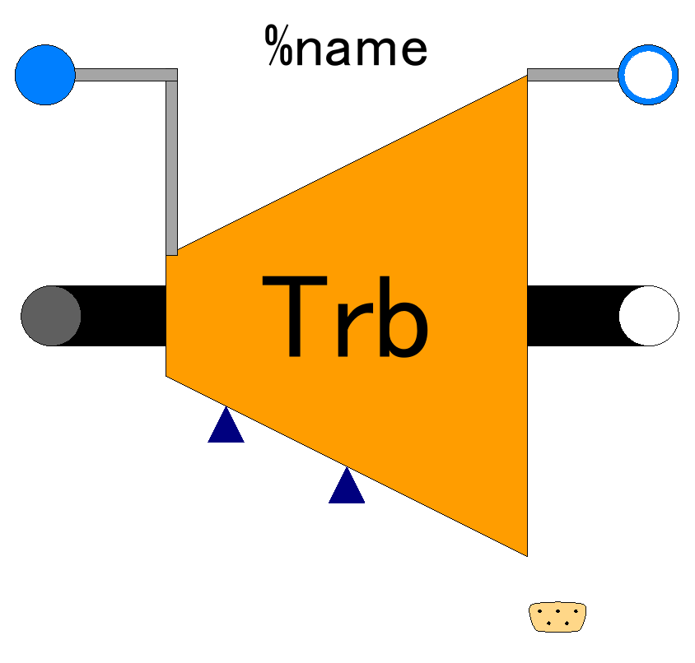

Slide 11
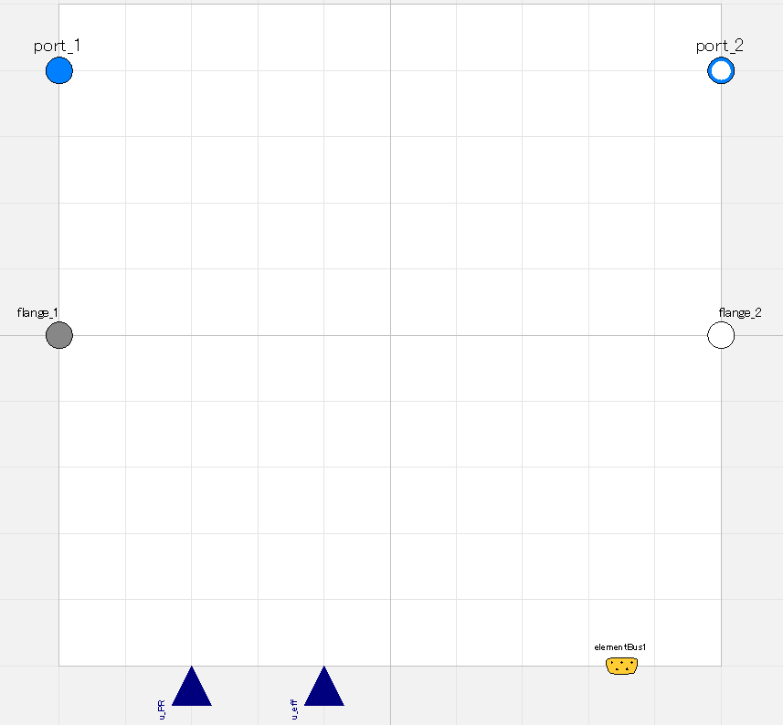

Slide 12
Fluid inlet port, input&output (use “connect” operator)
Fluid outlet port, input&output (use “connect” operator)
Flange (rotational mechanics port),
input&output (use “connect” operator)
Flange (rotational mechanics port),
input&output (use “connect” operator)
Pressure ratio;
input (use “connect” operator),
valid only when switchDetermine_PR==viaRealInput
Efficiency;
input (use “connect” operator),
valid only when switchDetermine_eff==viaRealInput
Expandable connector prepared for communication with internal variables which cannot be accessed by other ports,
input&output (use “connect” operator)

