Slide 1
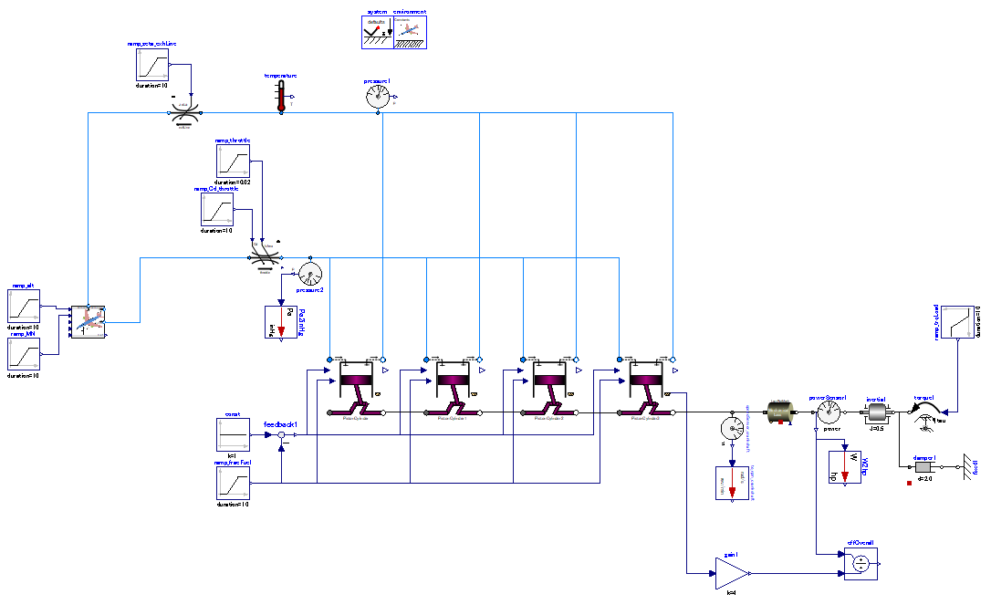

Slide 2
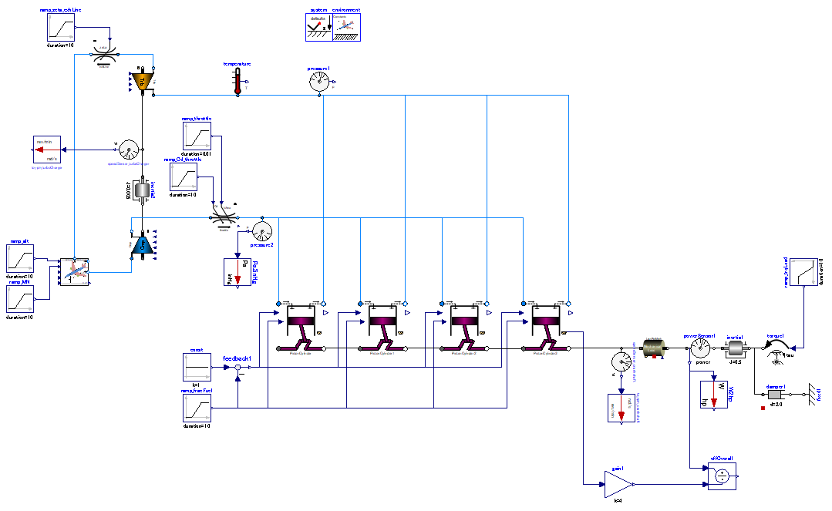

Slide 3
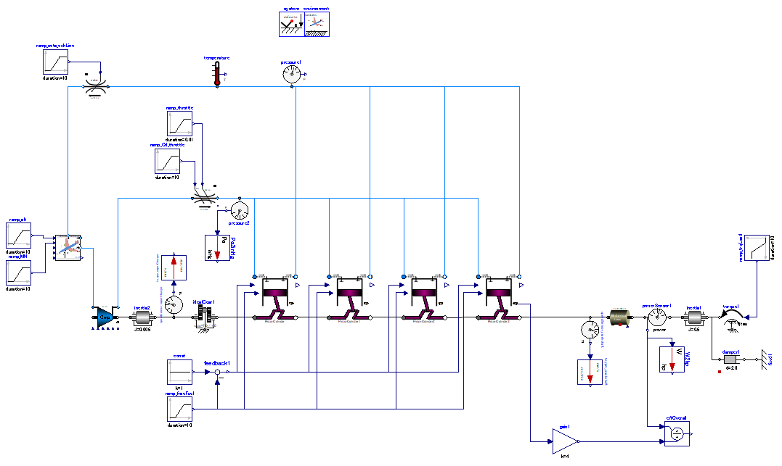

Slide 4
engine power output
load
Acceleration gear.
crankshaft speed
<< compressor speed
Torque load which is proportional to angular speed is applied to crankshaft.
→ power output ∝ engine speed.

