Slide 1
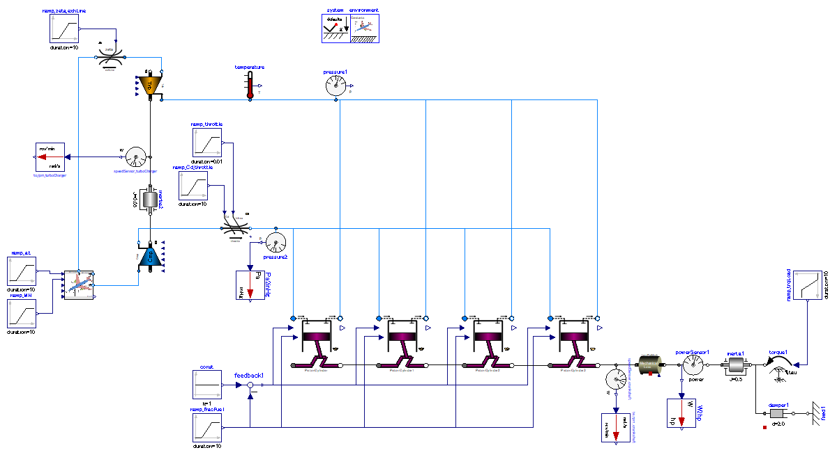

Slide 2
Set inertia 1/10 of that of piston&cylinder; large value to exaggarate the turb-lag intentionally.
engine power output
load
Torque load which is proportional to angular speed is applied to crankshaft.
→ power output ∝ engine speed.

Slide 3
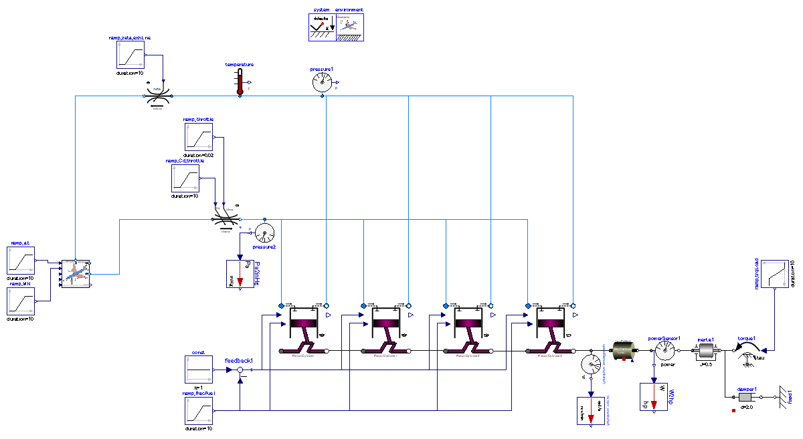

Slide 4
engine power output
load
Torque load which is proportional to angular speed is applied to crankshaft.
→ power output ∝ engine speed.

Slide 5
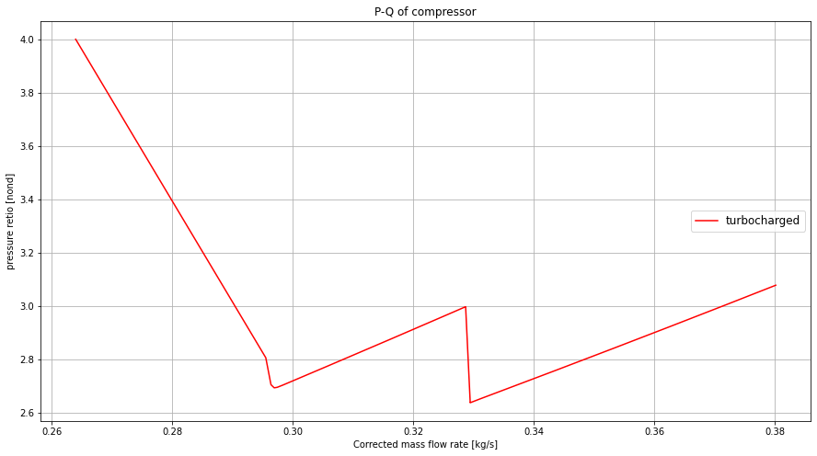
Response to sudden acceleration (throttle opening)
Op. line toward steady state.
Time< 50 [s]
Op. line at initialization and right after.
Acceleration and toward steady state
50 < time <100 [s]

Slide 6
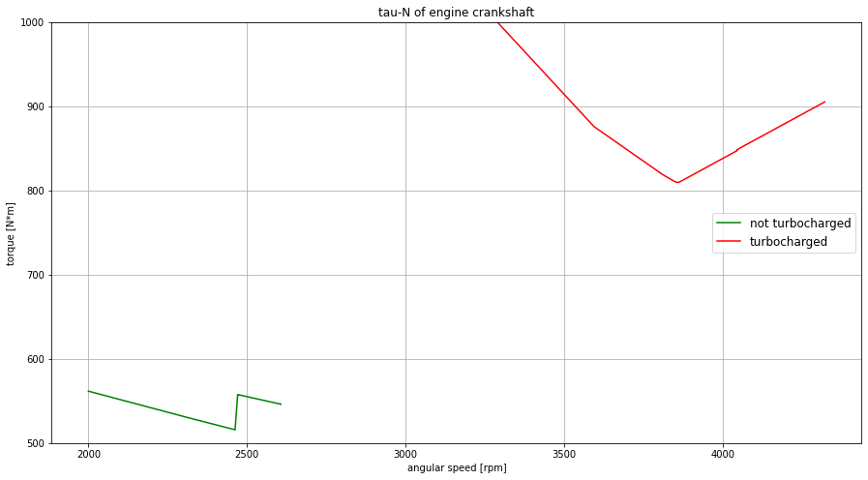
Acceleration and toward steady state
50 < time <100 [s]
Response to sudden acceleration (throttle opening)
Response to sudden acceleration (throttle opening)
Acceleration and toward steady state
50 < time <100 [s]

Slide 7
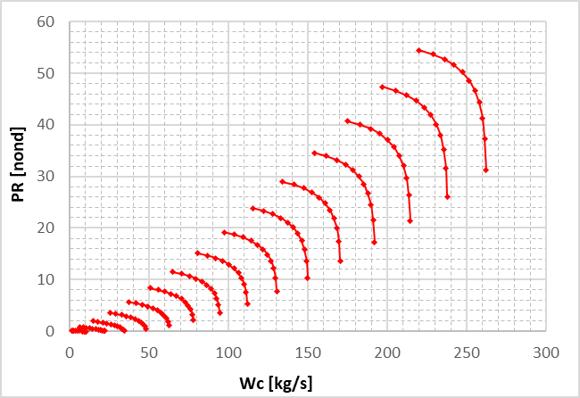
圧縮機
エンジンスロットルの開度
＝圧縮機下流の流路絞り
急加速操作
下流の絞りが減り、より多くの流量が流れるようになる。
絞りを開く前の作動点
回転数はまだ上昇していない。
等回転線
等回転線上を、作動点が流量が増えるように移動
一時的に圧力比低下
絞りを開いた直後の作動点

