Slide 1
h
Q
Adiabatic Expansion
Const. Vol.
Heat Addition
W
W
Adiabatic Compression
Q
Const. Vol.
Heat Rejection
s

Slide 2
h
Q
Adiabatic Expansion
Const. Vol.
Heat Addition
W
W
Adiabatic Compression
Q
Const. Vol.
Heat Rejection
s

Slide 3
Fn

Slide 4

AoA
MN
Alt
dm
Pt
Tt

Slide 5
dm
Pt
Tt
dm
Pt
Tt
MN
AoA
Alt

Slide 6
pStd
Tstd
g

Slide 10
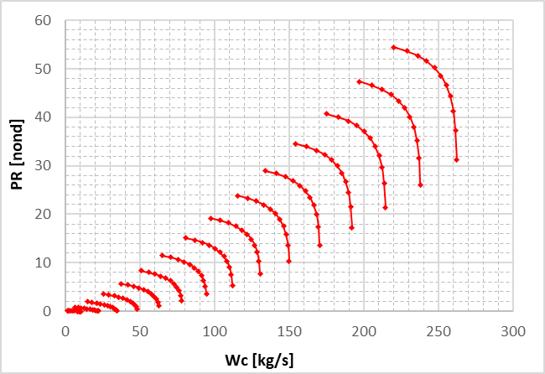
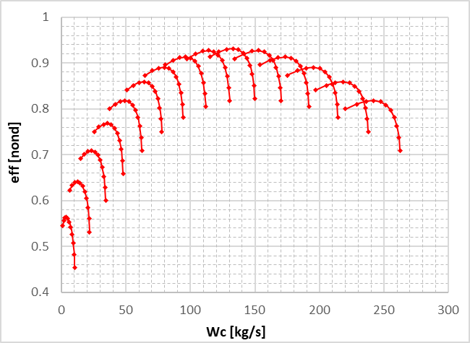

Slide 11
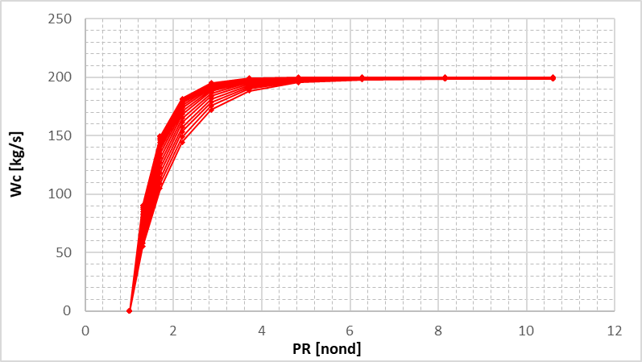
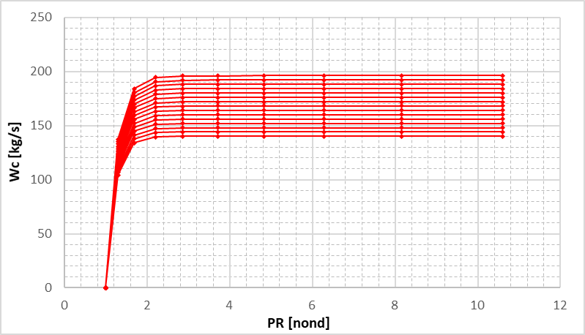
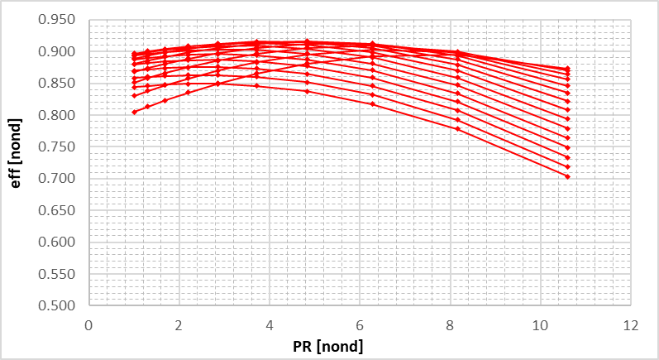
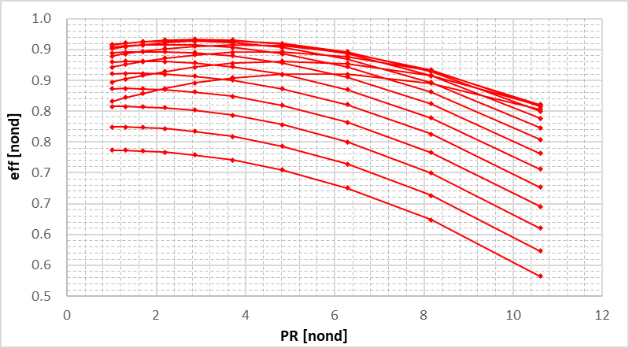

Slide 12
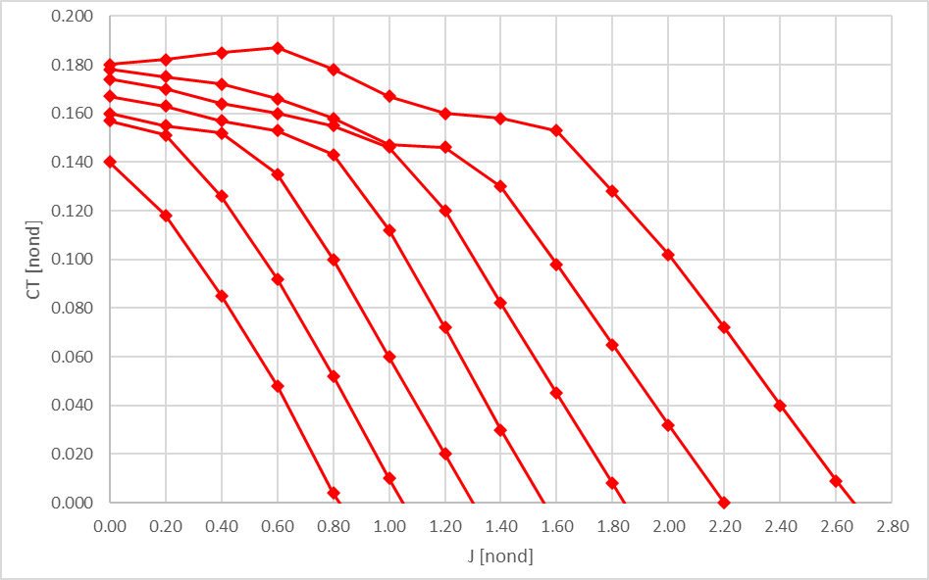
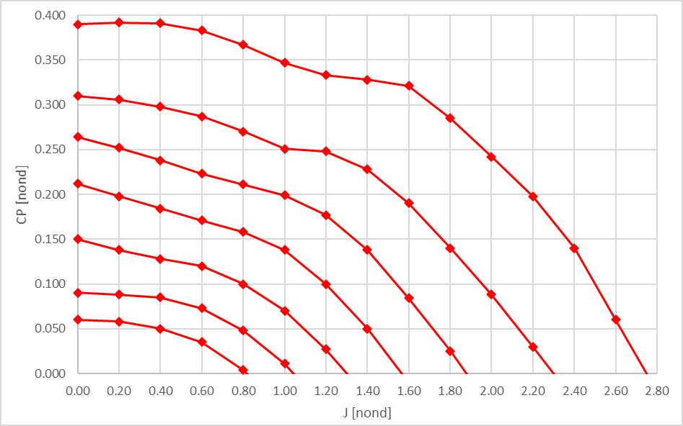

Slide 13
