Slide 1
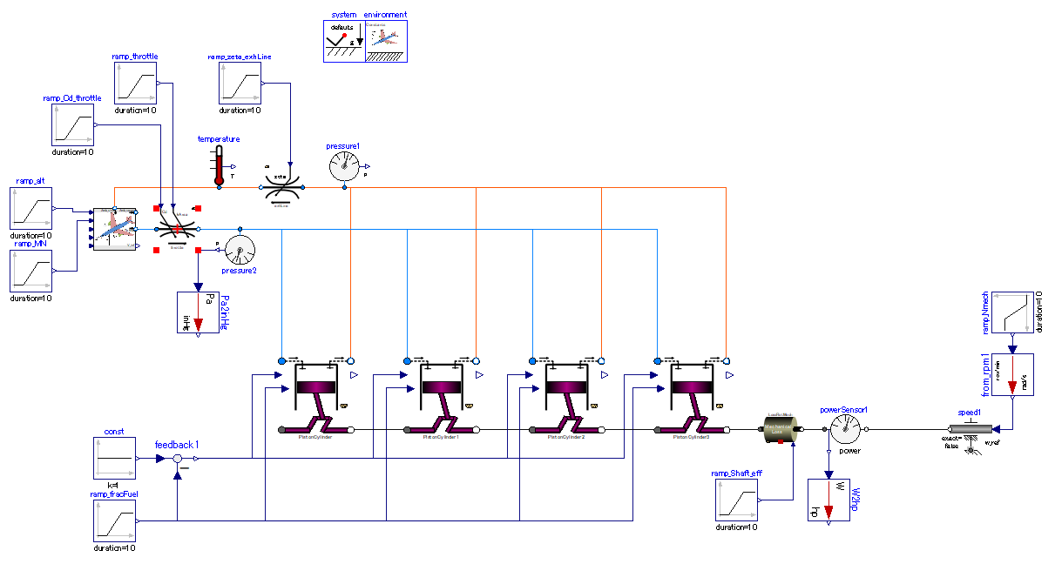

Slide 2
Input: Discharge coefficient and opening of throttle.
Exhaust line pressure loss
Input: flight altitude and speed (Mach number).
Input: shaft rotation speed.
Throttle valve.
Simulated by variable area&Cd orifice
Convert intake manifold pressure to [inHg].
Input: the fraction of air and fuel in in-taken air fuel mixture.
4 piston-cylinders in series.
Convert available shaft power output into [hp].
Input: Shaft transmission efficiency. = manipulate loss.

