Slide 1

AoA
MN
Alt
dm
Pt
Tt

Slide 2
Fn

Slide 3
dm
Pt
Tt
dm
Pt
Tt
MN
AoA
Alt

Slide 4
pStd
Tstd
g

Slide 8
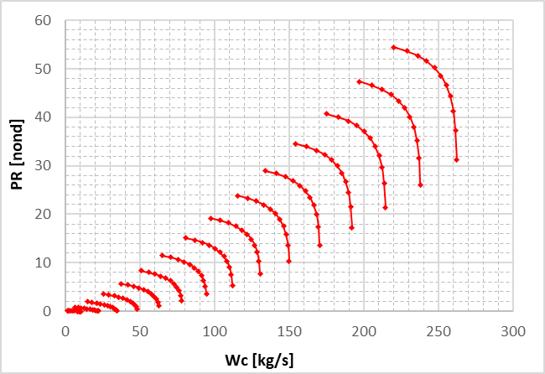
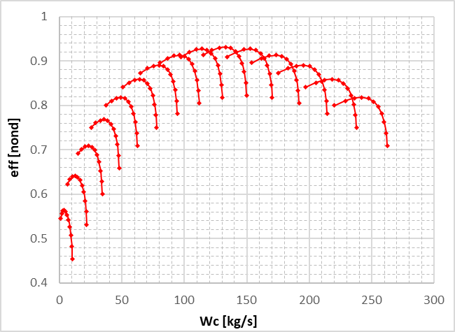

Slide 9
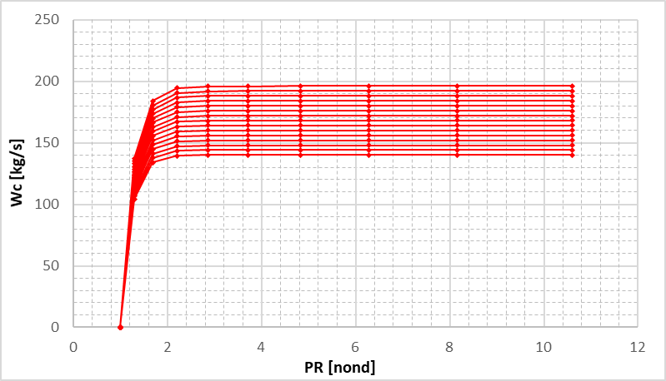
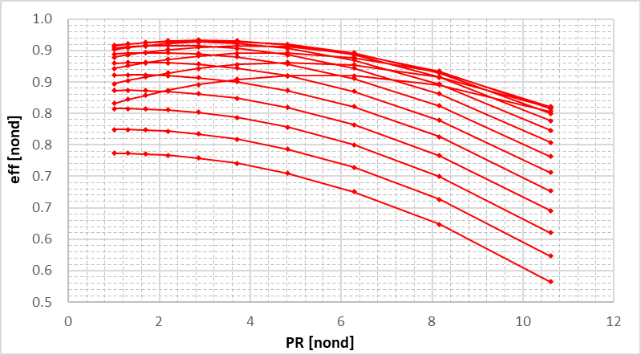

Slide 11
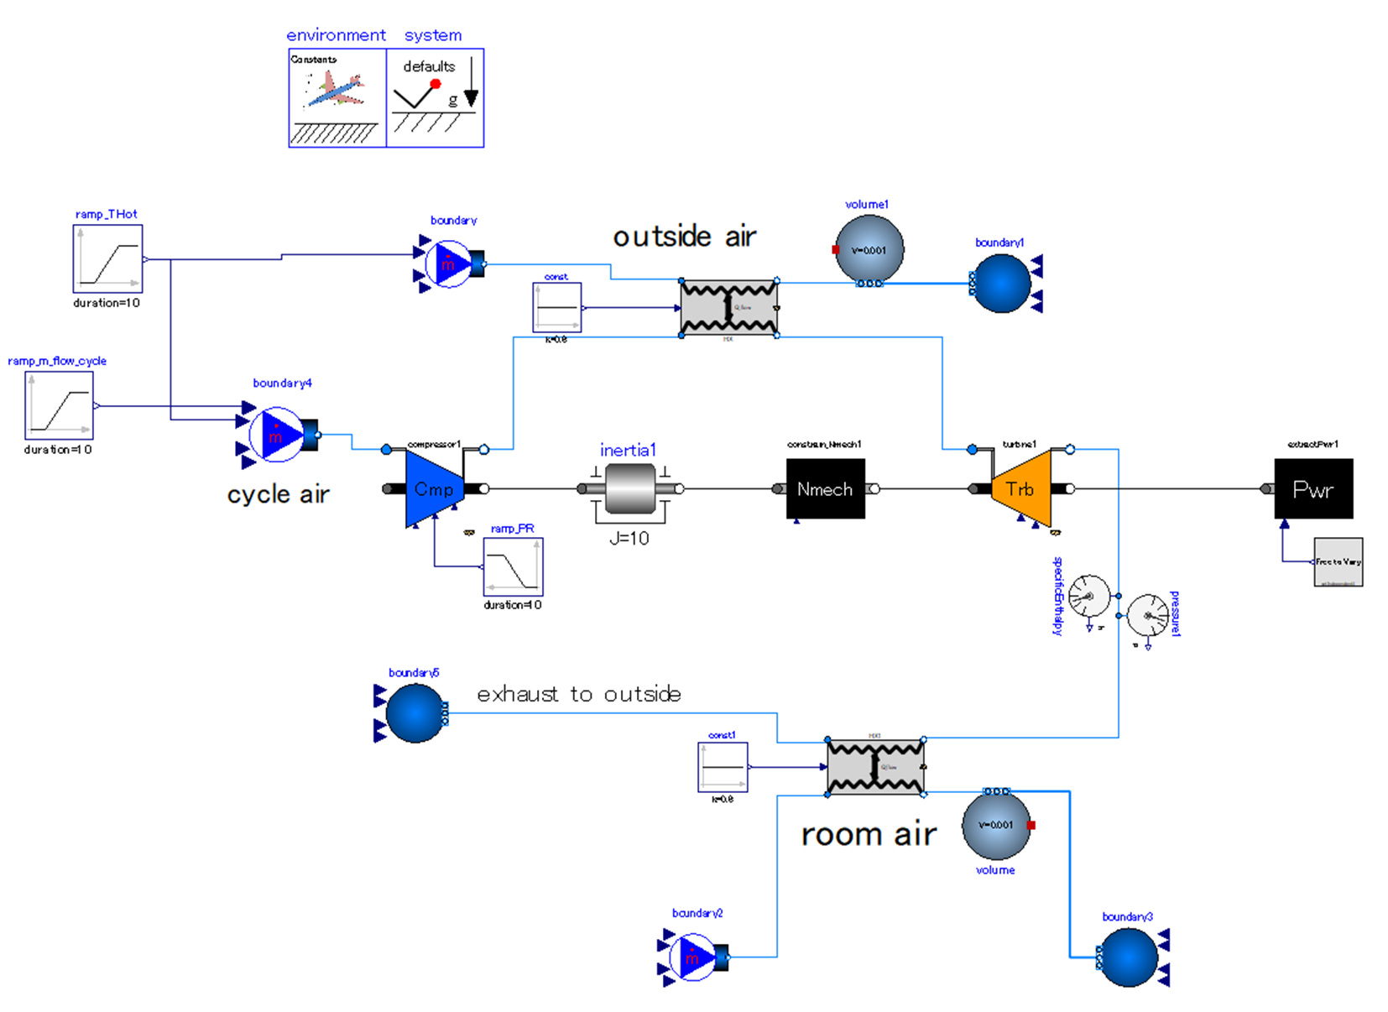
Release heat to outside air.
Expand cycle air to outside pressure. The work generated by expansion is used for driving compressor.
heat
Compress outside air.
Increase pressure ratio of compressor gradually.
heat
Set drive power the “as calculated” variable.
absorb heat from room air.

Slide 12
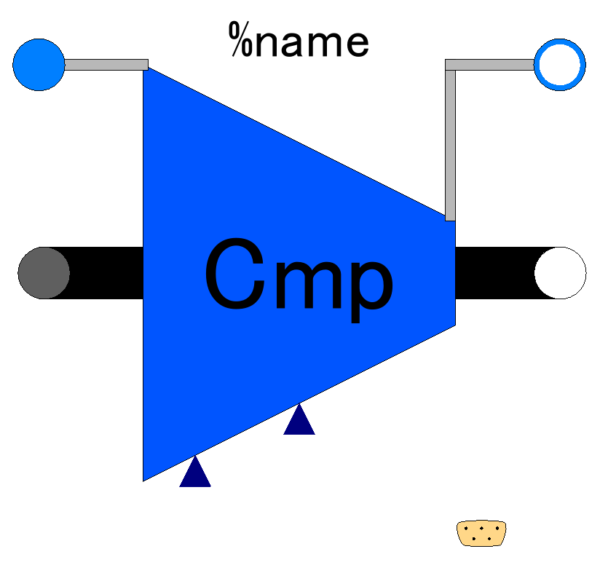

Slide 13
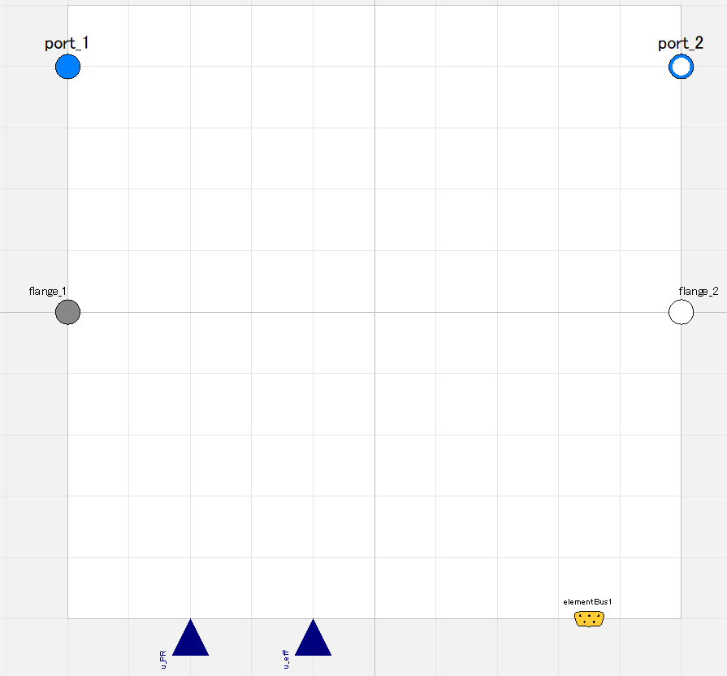

Slide 14
Fluid inlet port, input&output (use “connect” operator)
Fluid outlet port, input&output (use “connect” operator)
Flange (rotational mechanics port),
input&output (use “connect” operator)
Flange (rotational mechanics port),
input&output (use “connect” operator)
Pressure ratio;
input (use “connect” operator),
valid only when switchDetermine_PR==viaRealInput
Efficiency;
input (use “connect” operator),
valid only when switchDetermine_eff==viaRealInput
Expandable connector prepared for communication with internal variables which cannot be accessed by other ports,
input&output (use “connect” operator)

Slide 15
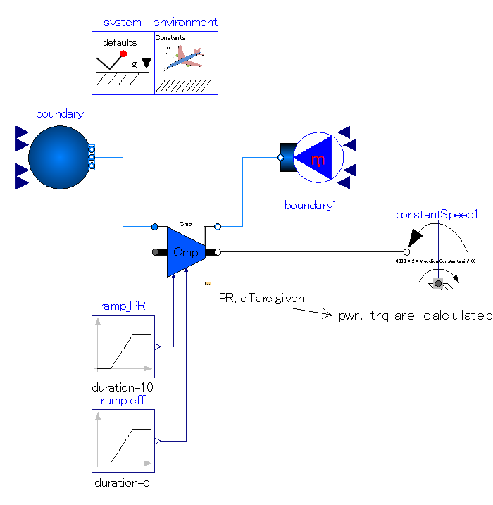
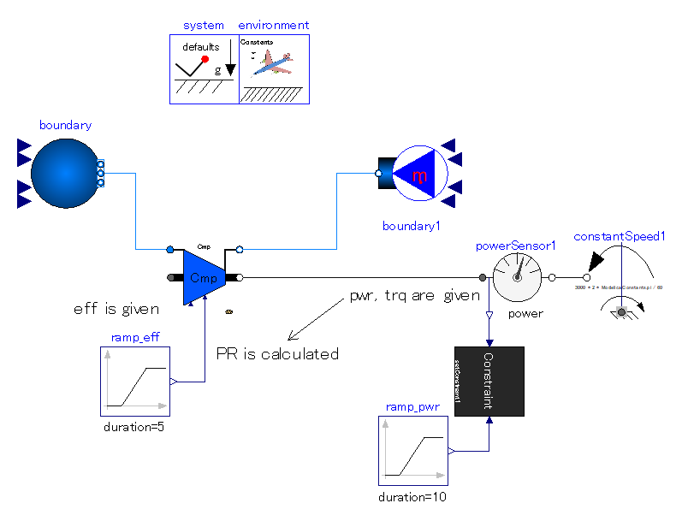

Slide 16
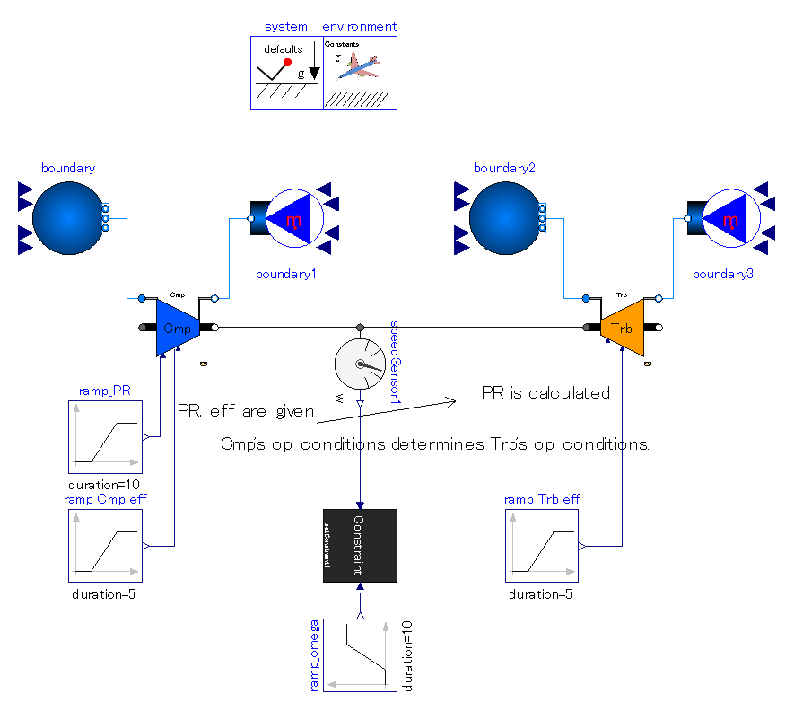
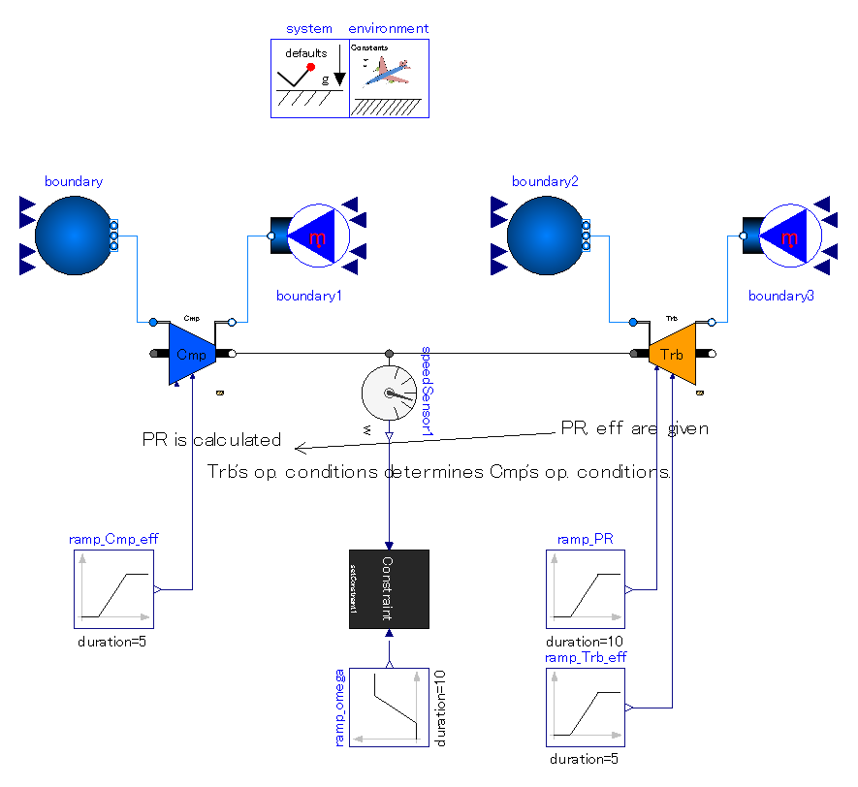

Slide 17
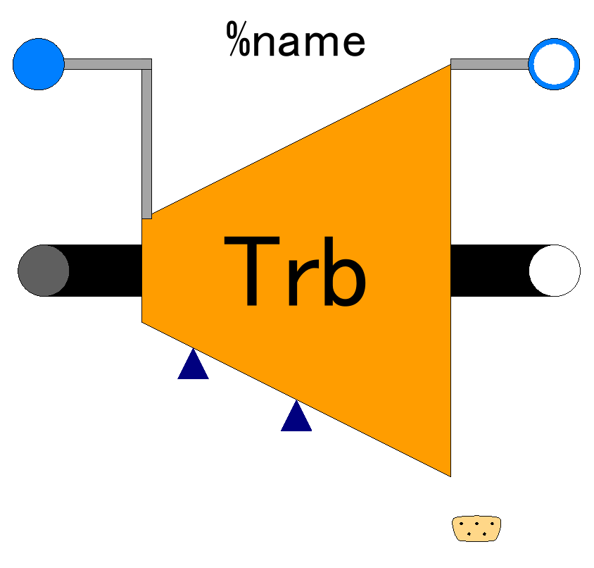

Slide 18
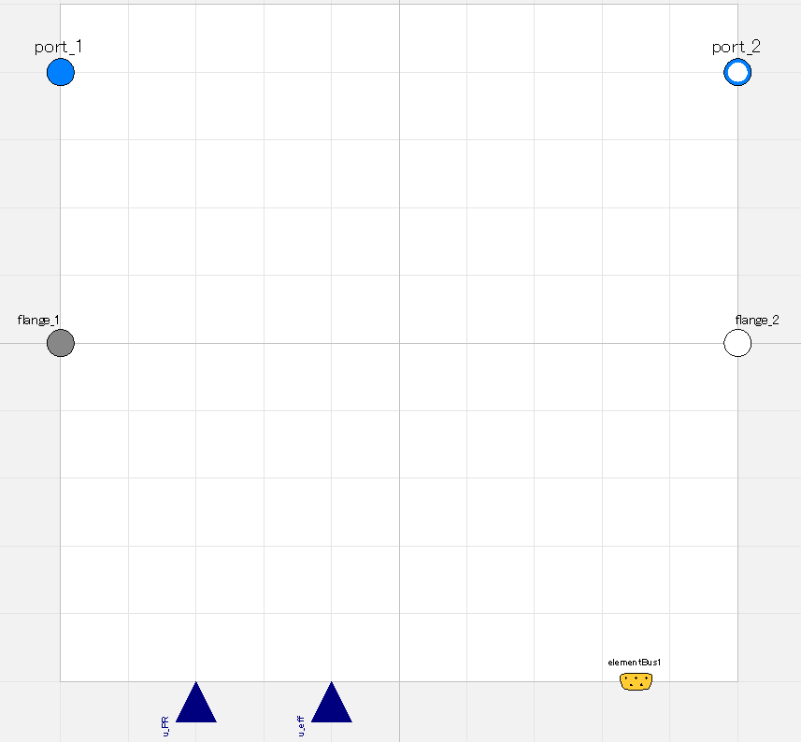

Slide 19
Fluid inlet port, input&output (use “connect” operator)
Fluid outlet port, input&output (use “connect” operator)
Flange (rotational mechanics port),
input&output (use “connect” operator)
Flange (rotational mechanics port),
input&output (use “connect” operator)
Pressure ratio;
input (use “connect” operator),
valid only when switchDetermine_PR==viaRealInput
Efficiency;
input (use “connect” operator),
valid only when switchDetermine_eff==viaRealInput
Expandable connector prepared for communication with internal variables which cannot be accessed by other ports,
input&output (use “connect” operator)

Slide 20
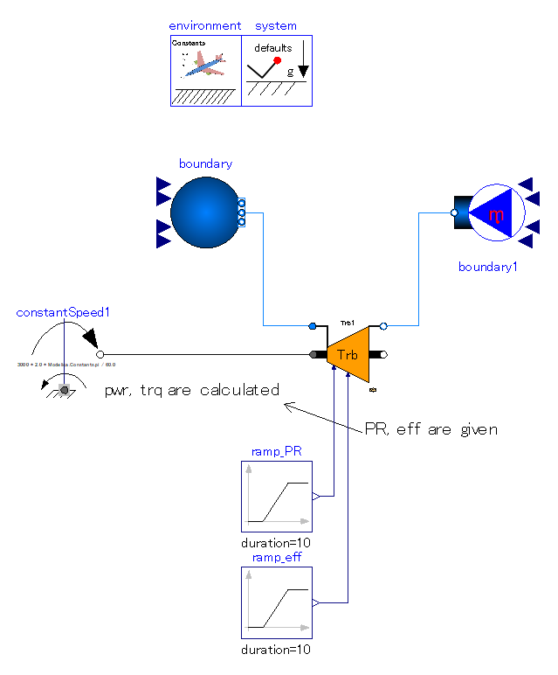
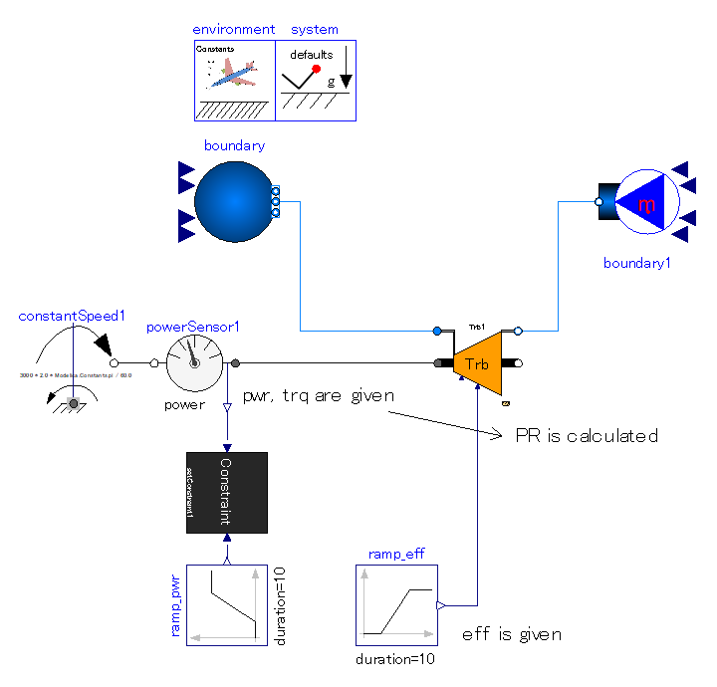

Slide 21
