Slide 1
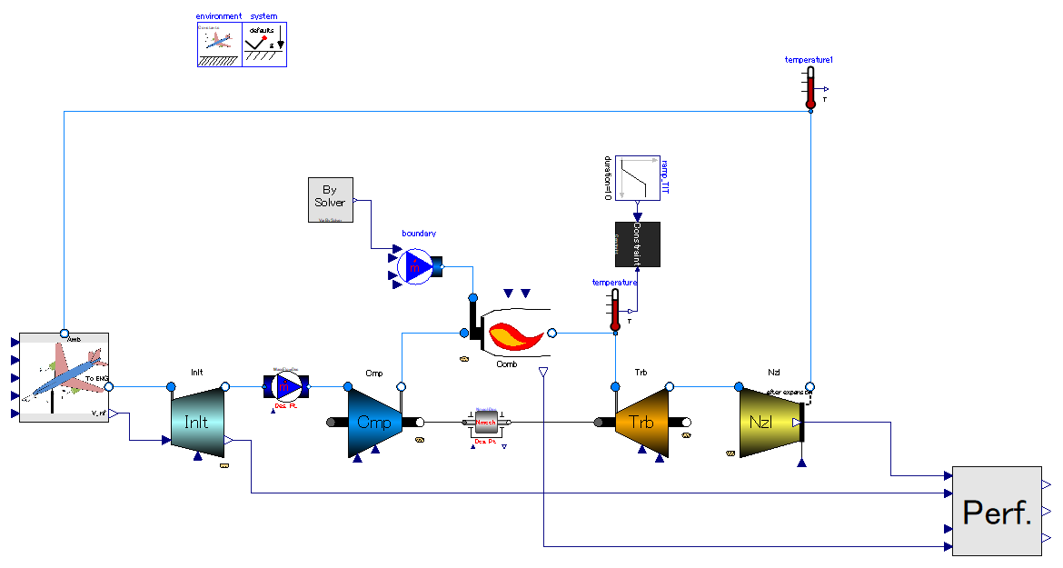

Slide 2
[Design point calc.]
[Off-design calc.]
[Cause (Input)]
-. mass flow rate: given from upstream of system.
-. inlet fluid states (p, T)
-. outlet pressure
[Result (Output)]
-. throat area -> stored into “calculated parameter”
This component defines the time when off-design commences.
[Design point calc.]
Constrain mechanical rotational speed of engine in design point calculation.
[Off design calc.]
Do nothing.
[Cause (Input)]
-. throat area.
-. inlet fluid states (p, T)
-. outlet pressure
[Result (Output)]
-. mass flow rate
[Design point calc.]
Constrain mass flow rate of engine in design point calculation.
[Off design calc.]
Do nothing.
[Design point calc.]
[Off-design calc.]
[Design point calc.]
[Off-design calc.]
[Cause (Input)]
-. Power out via shaft.
-. Adiabatic efficiency.
-. Mass flow rate.
-. Inlet fluid states (p, T)
-. Outlet pressure.
[Result (Output)]
-. Characteristics table scalers. (= size of component)
[Cause (Input)]
-. Pressure ratio.
-. Adiabatic efficiency.
-. Mass flow rate.
-. Inlet fluid states (p, T)
-. Mechanical rotational speed.
[Result (Output)]
-. Characteristics table scalers. (= size of component)
[Cause (Input)]
-. Inlet fluid states (p, T)
[Result (Output)]
-. Pressure ratio.
-. Adiabatic efficiency.
-. Mass flow rate (corrected mass flow).
-. Mechanical rotational speed
-. Power out via shaft
[Cause (Input)]
-. Inlet fluid states (p, T)
-. Power in via shaft.
[Result (Output)]
-. Pressure ratio.
-. Adiabatic efficiency.
-. Mass flow rate (corrected mass flow).
-. Mechanical rotational speed

Slide 3
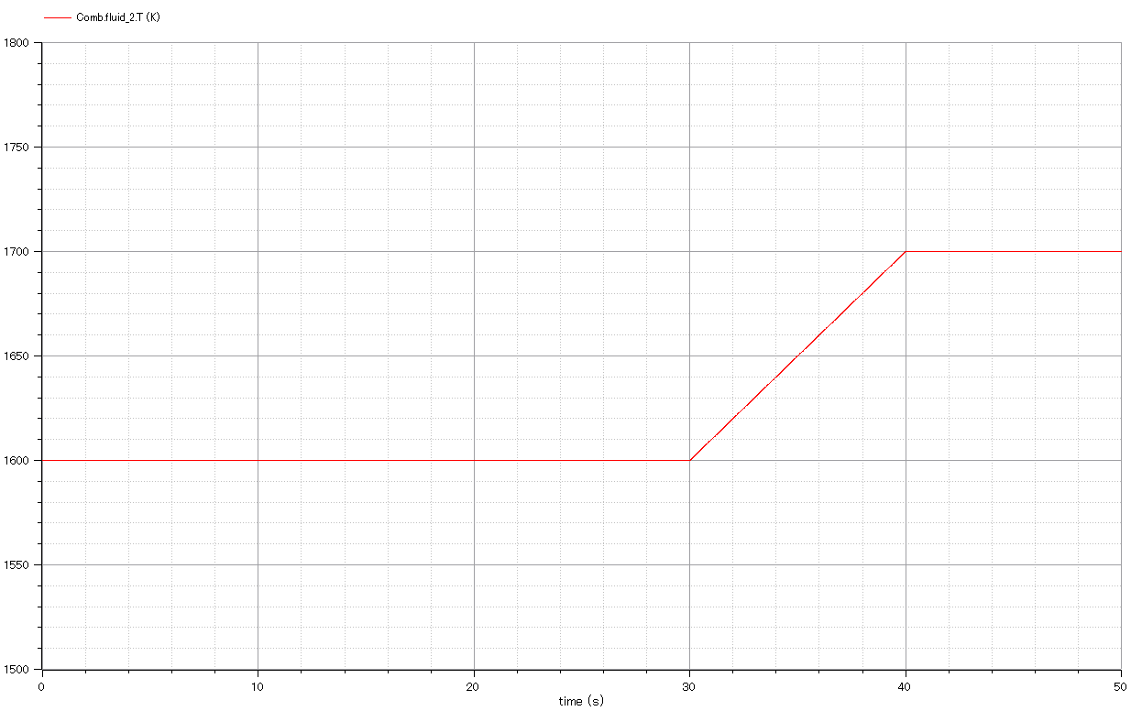

Slide 4
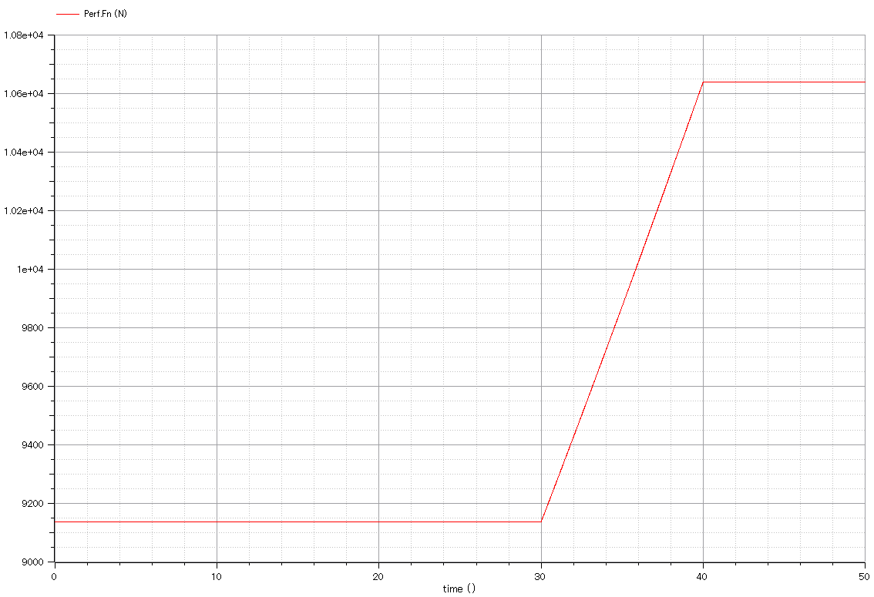

Slide 5
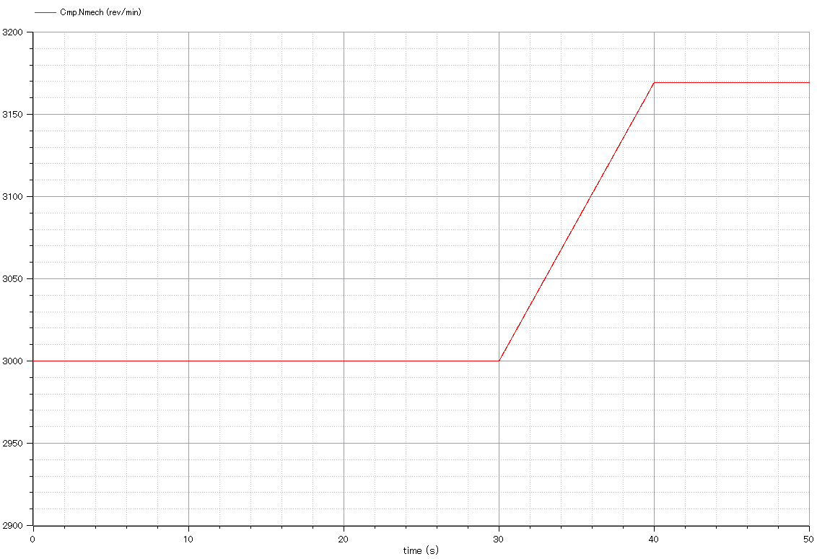

Slide 6
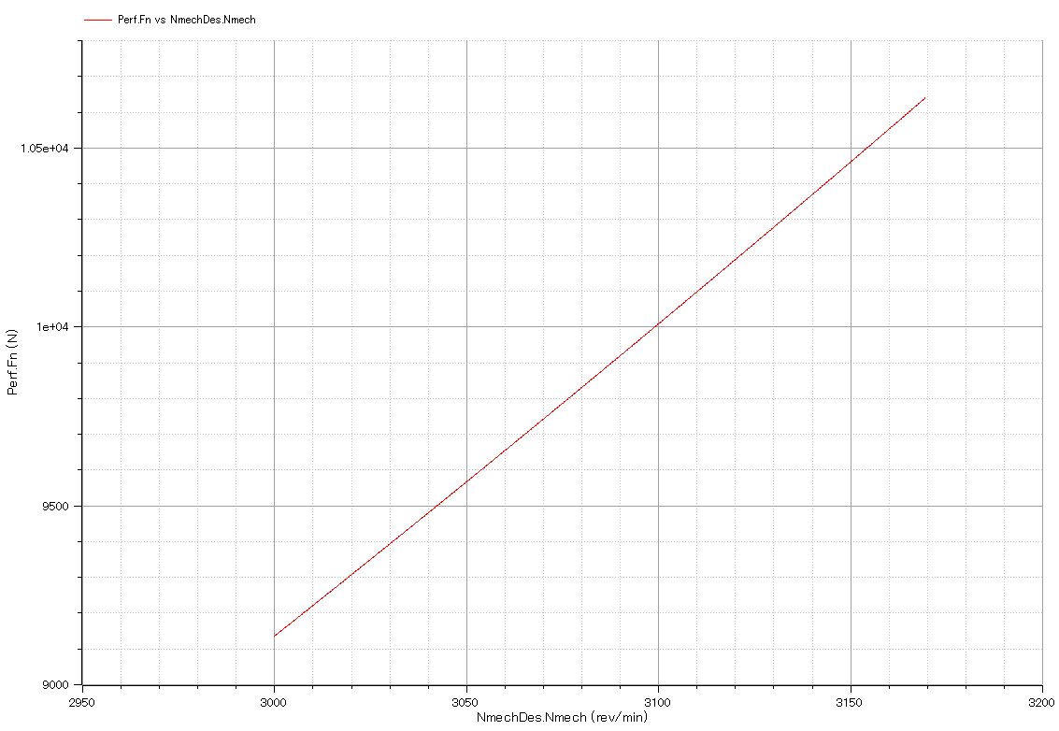

Slide 7
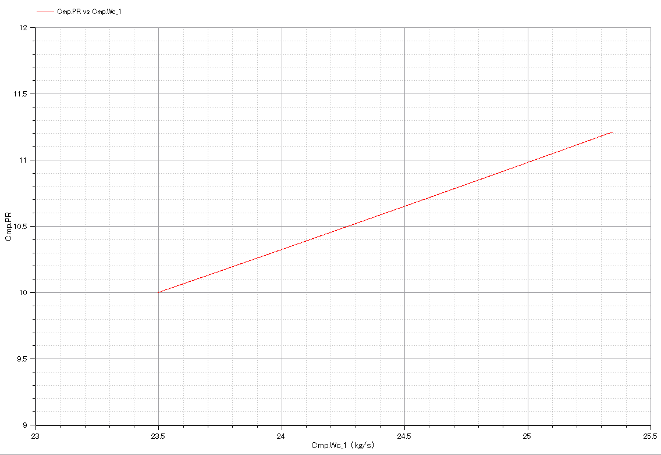

Slide 8
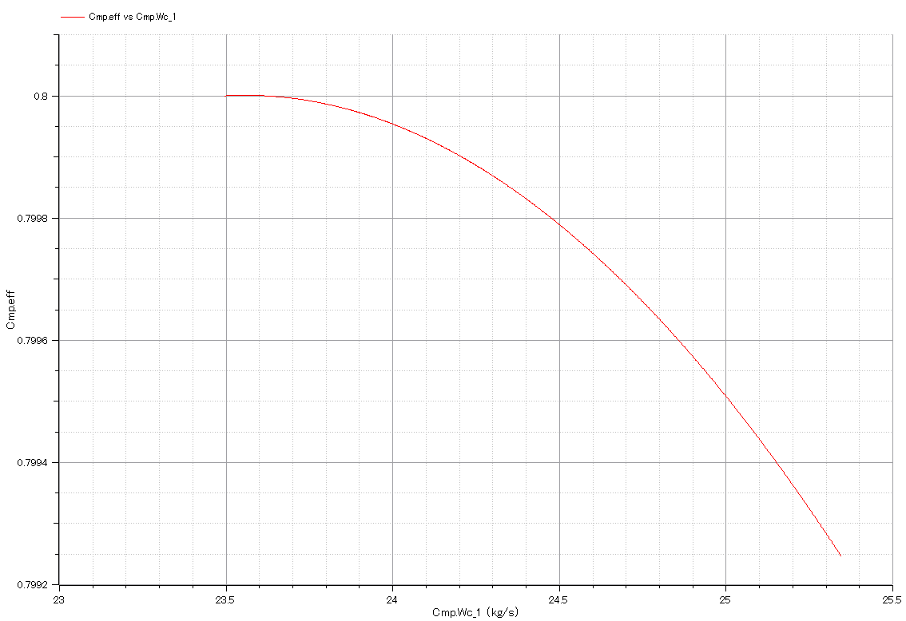

Slide 9
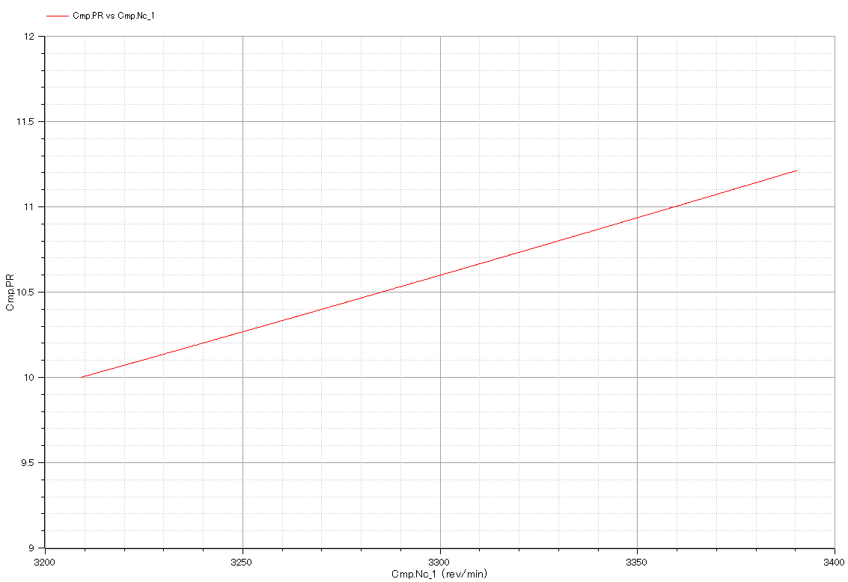

Slide 10
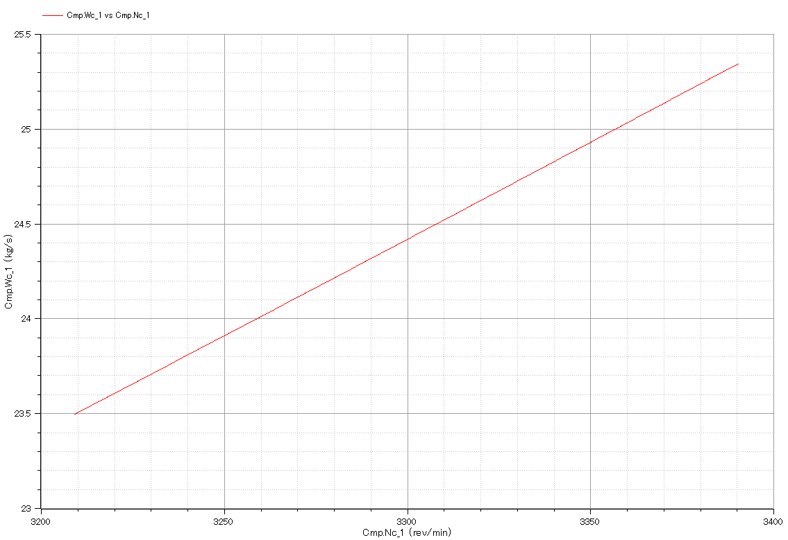

Slide 11
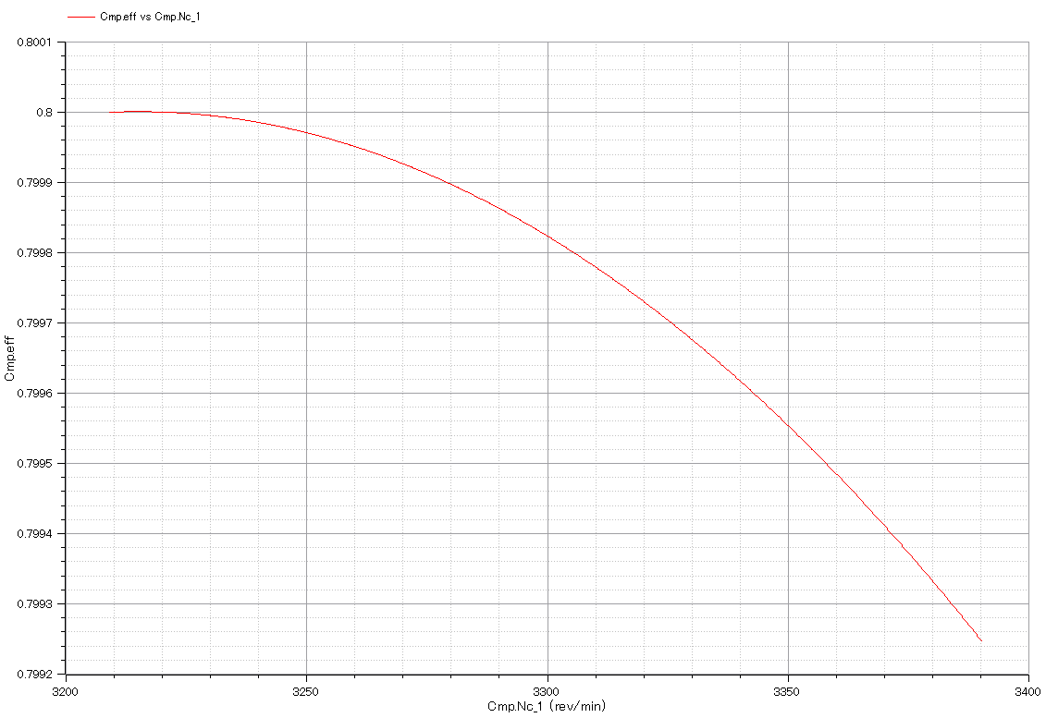

Slide 12
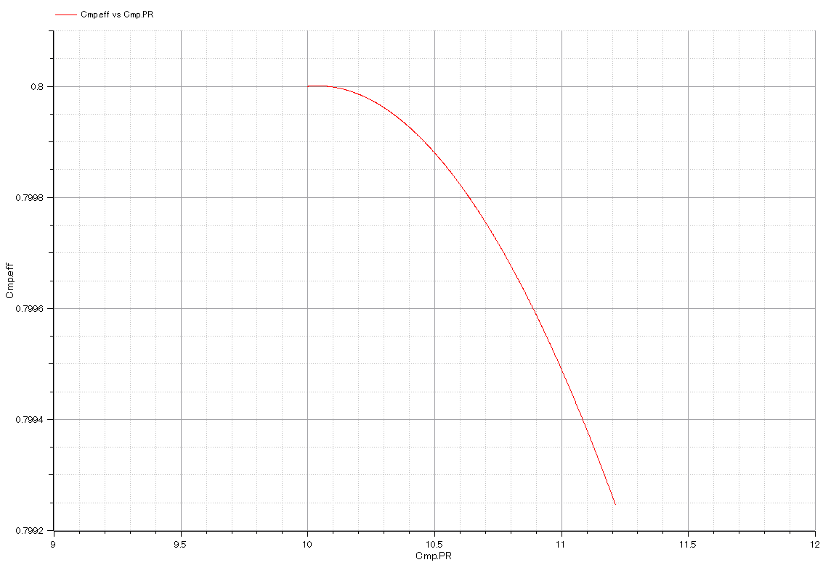

Slide 13
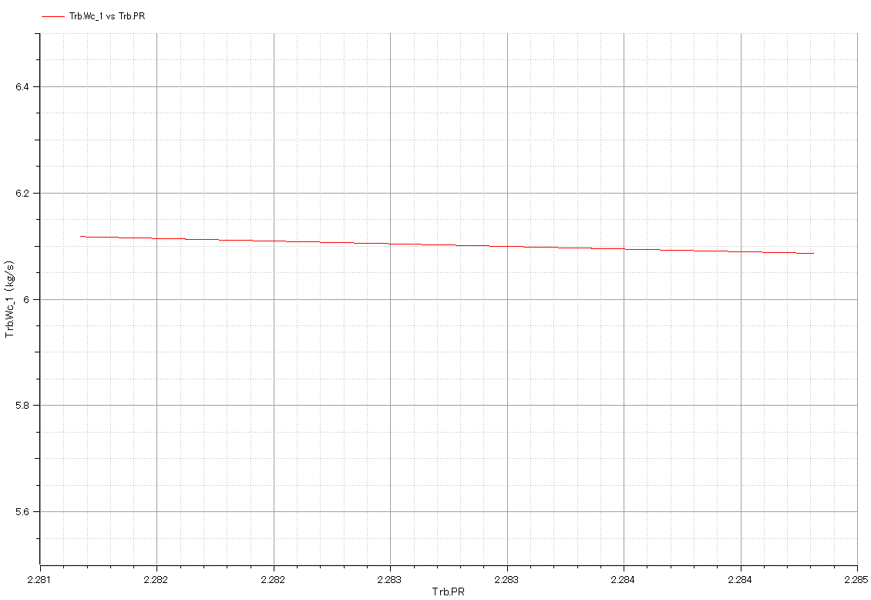

Slide 14
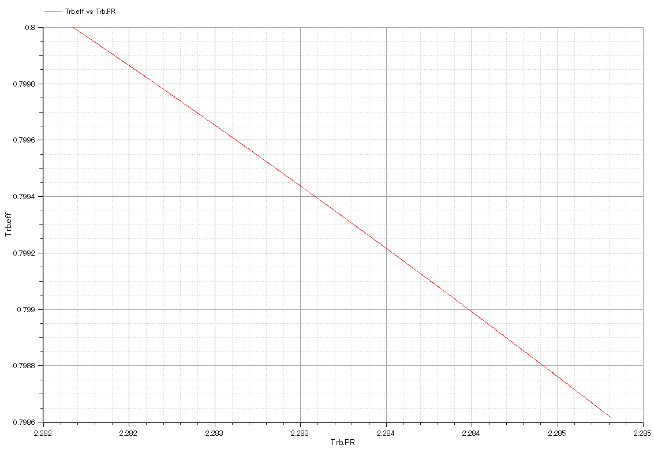

Slide 15
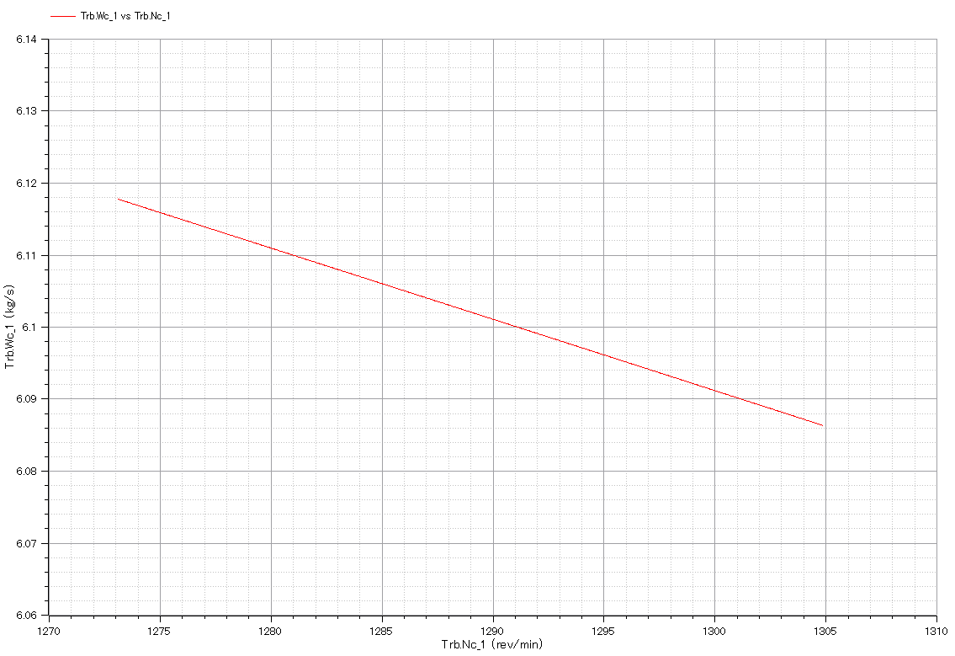

Slide 16
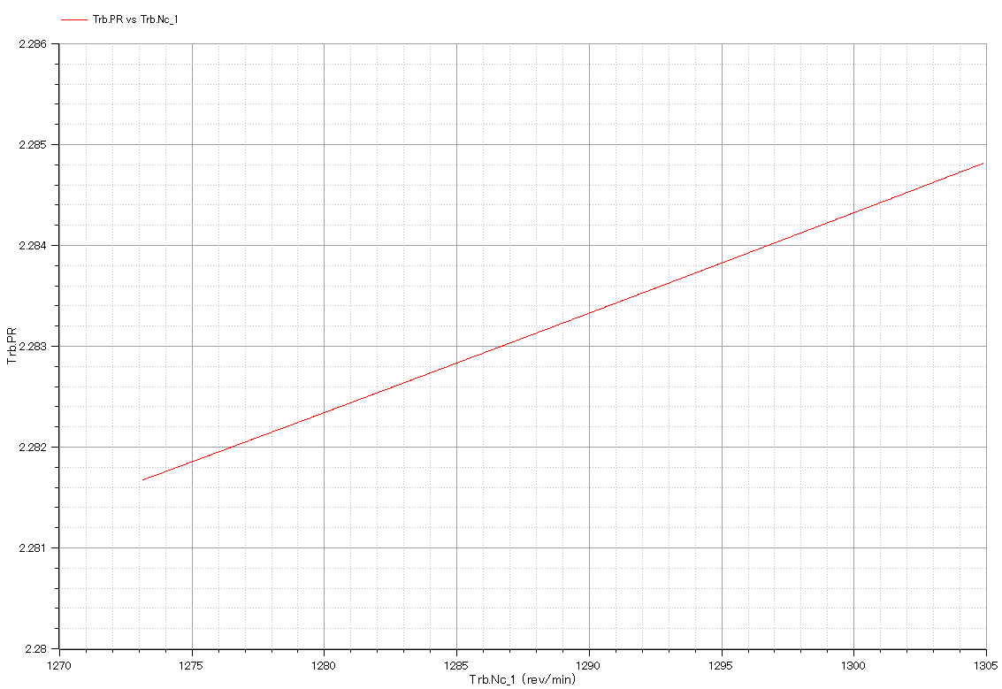

Slide 17
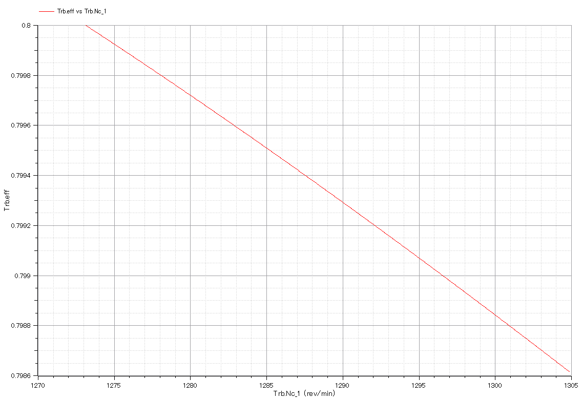

Slide 18
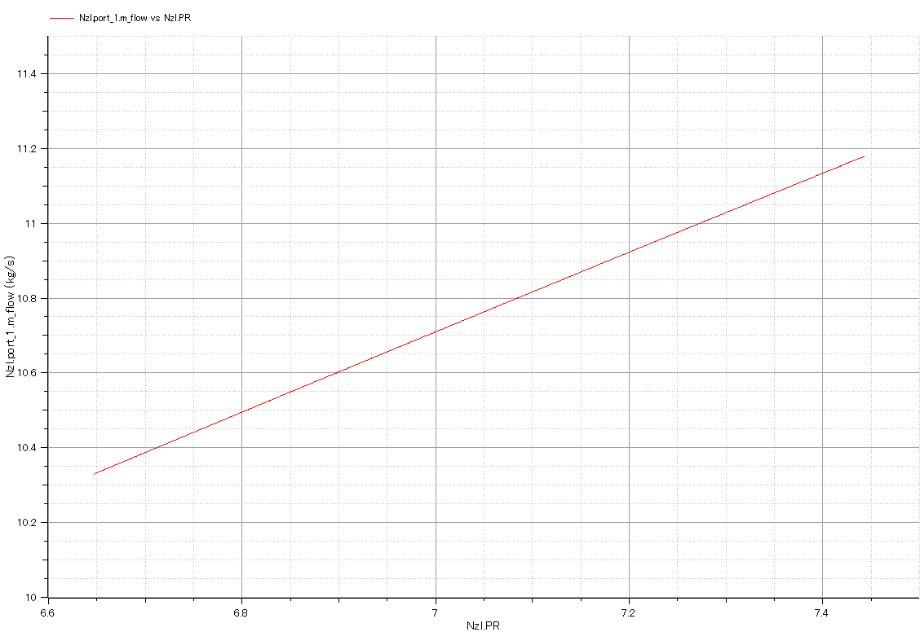

Slide 19
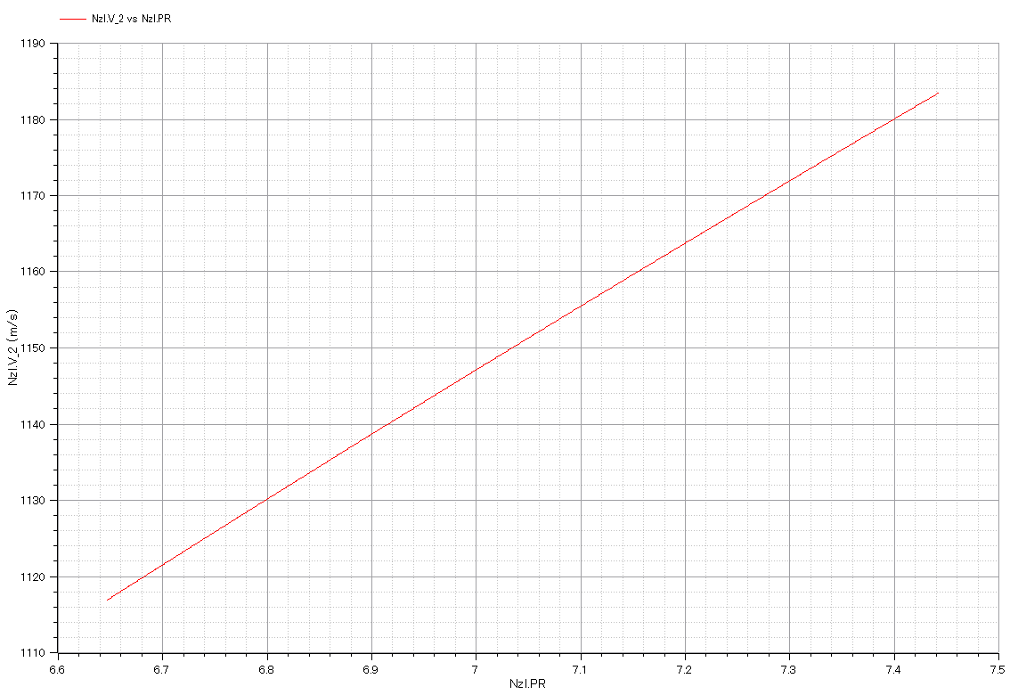

Slide 21
Input:

Slide 22
Output:
Output:

