Slide 1
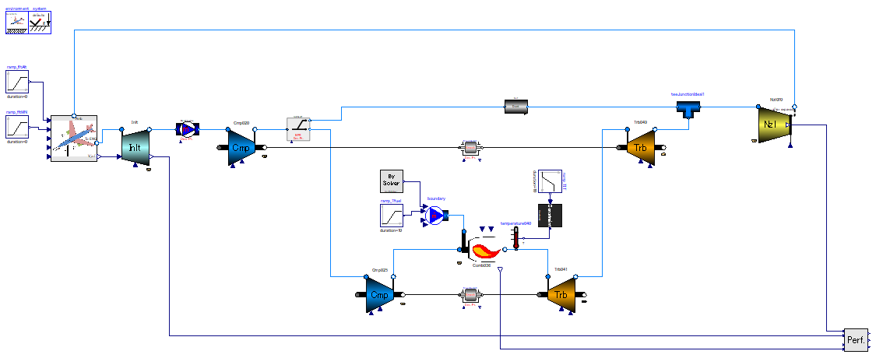

Slide 2
[Design point calc.]
[Off-design calc.]
[Cause (Input)]
-. mass flow rate: given from upstream of system.
-. inlet fluid states (p, T)
-. Pressure drop.
[Result (Output)]
-. Pressure loss coefficient; relationship between dp and W (≒size of passage)
[Design point calc.]
Constrain mechanical rotational speed of engine in design point calculation.
[Off design calc.]
Do nothing.
*Define each axis separately.
[Cause (Input)]
-. Pressure Loss coefficient.
-. inlet fluid states (p, T)
-. outlet pressure
[Result (Output)]
-. mass flow rate
[Design point calc.]
Constrain ratio of mass flow into 2 flow passages.
[Off design calc.]
Do nothing.
[Design point calc.]
Constrain mass flow rate of entire engine in design point calculation.
[Off design calc.]
Do nothing.
Core and bypass flows converges, and exhaust flow out via single nozzle.

Slide 3
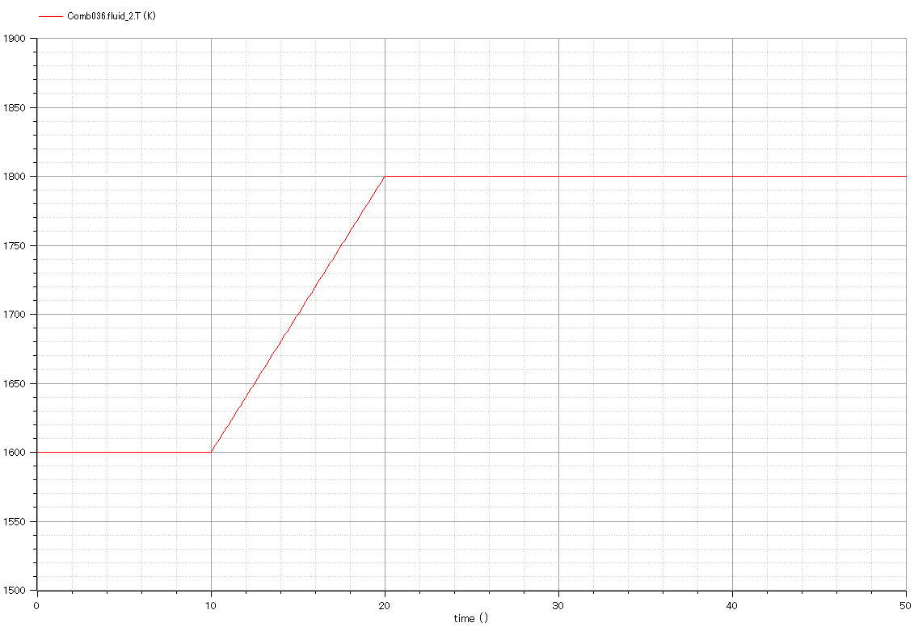

Slide 4
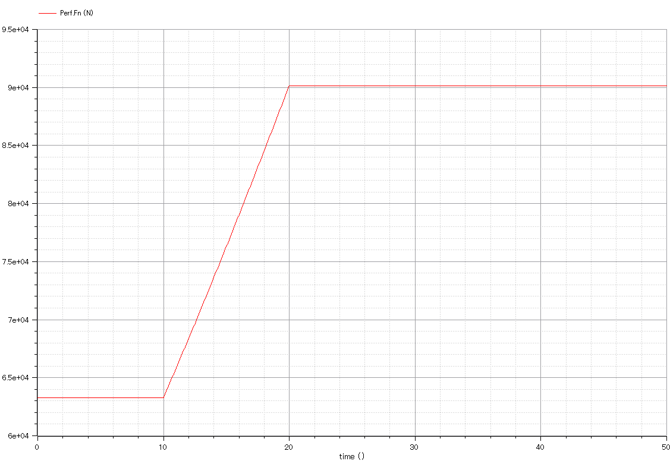

Slide 5
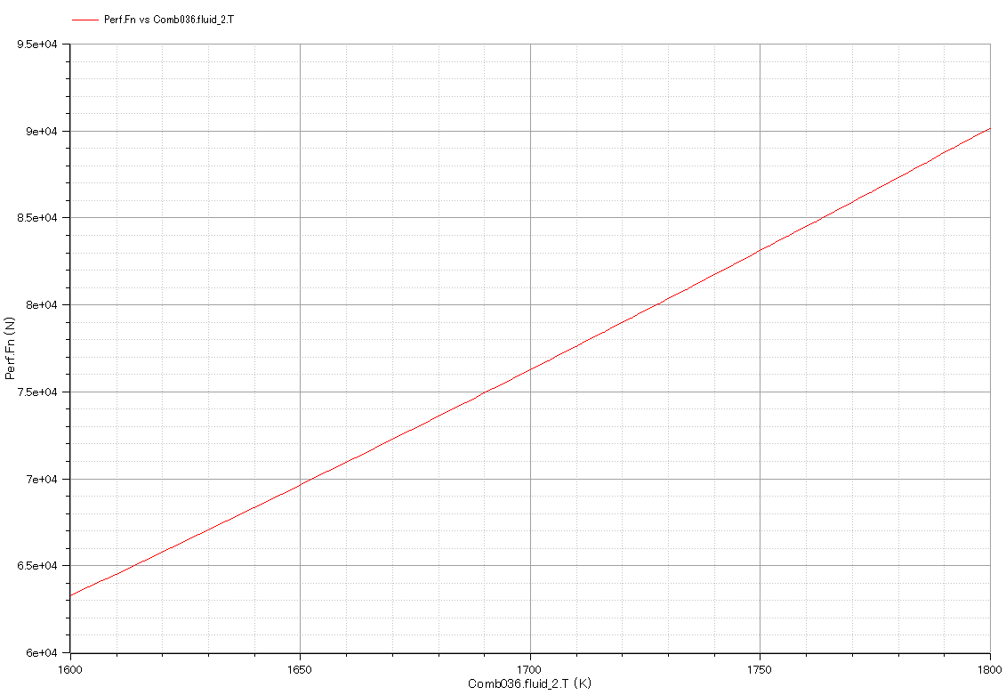

Slide 6
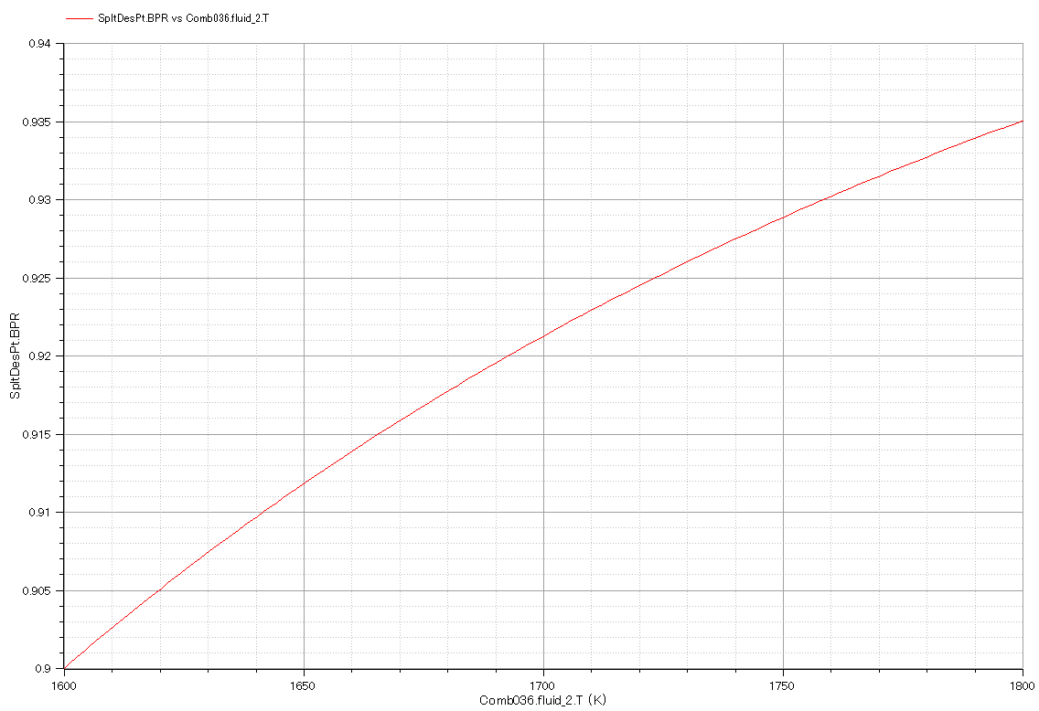

Slide 7
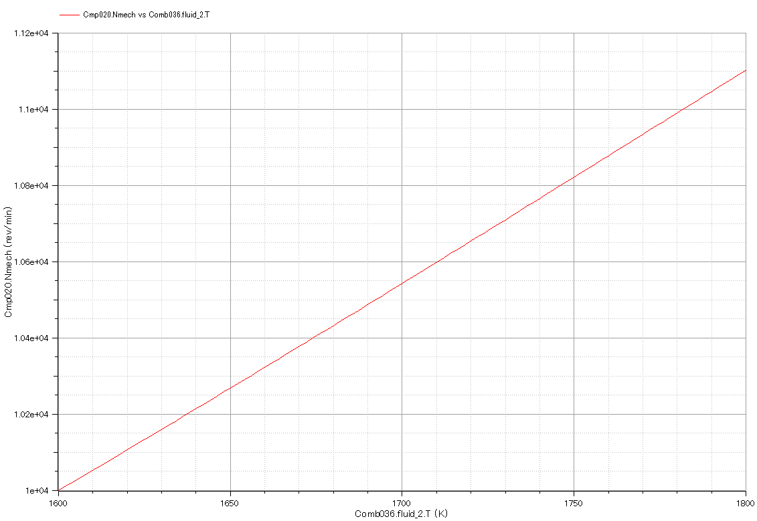

Slide 8
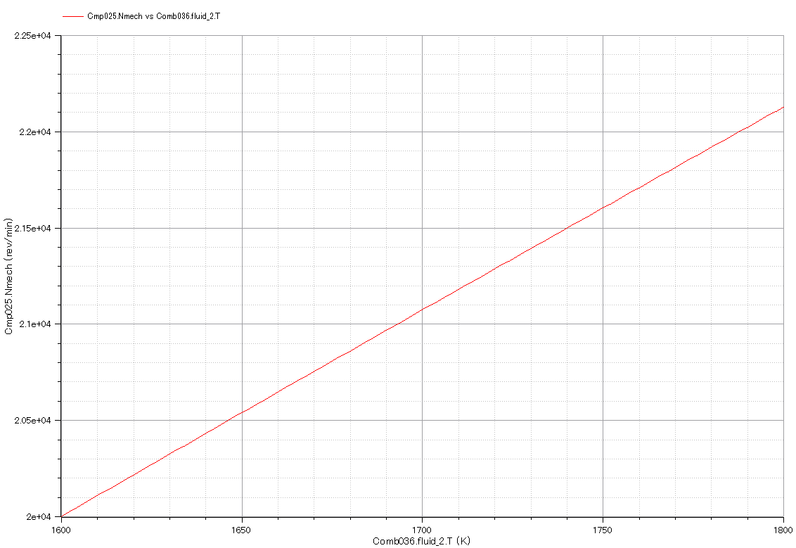

Slide 9
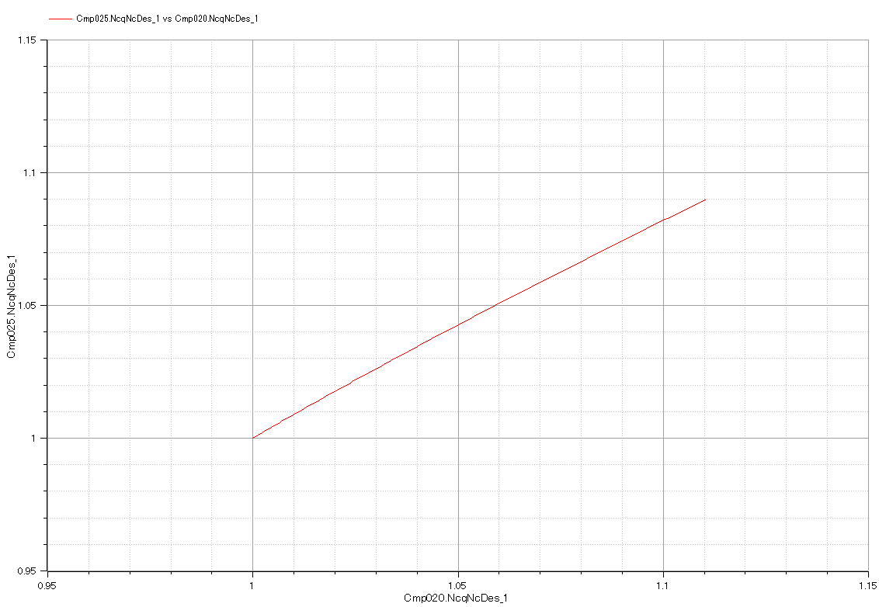

Slide 10
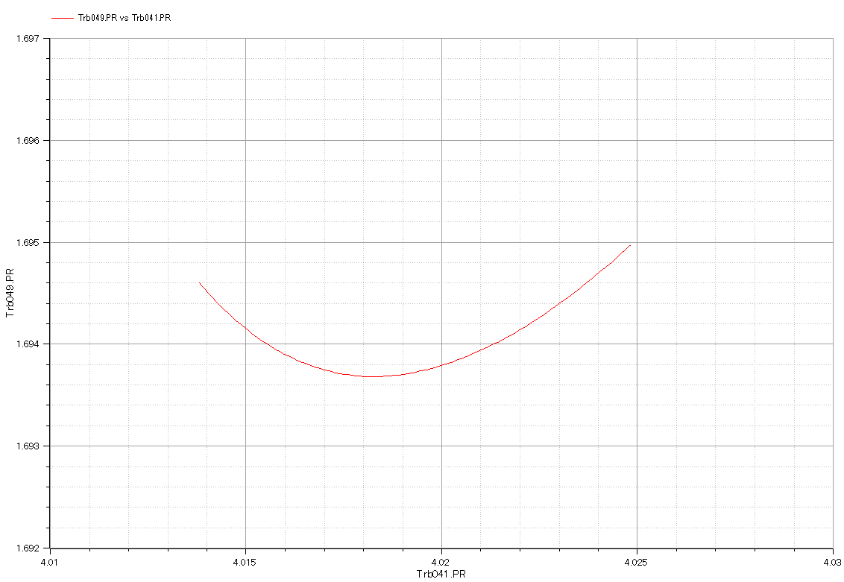

Slide 11
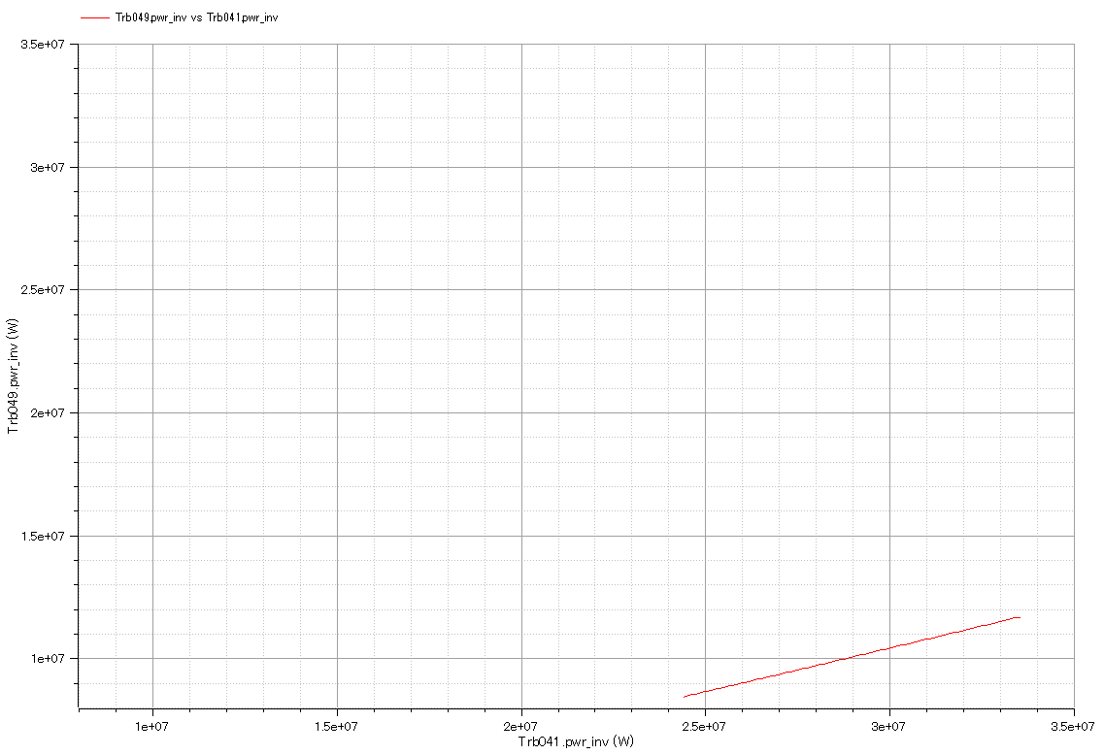

Slide 12
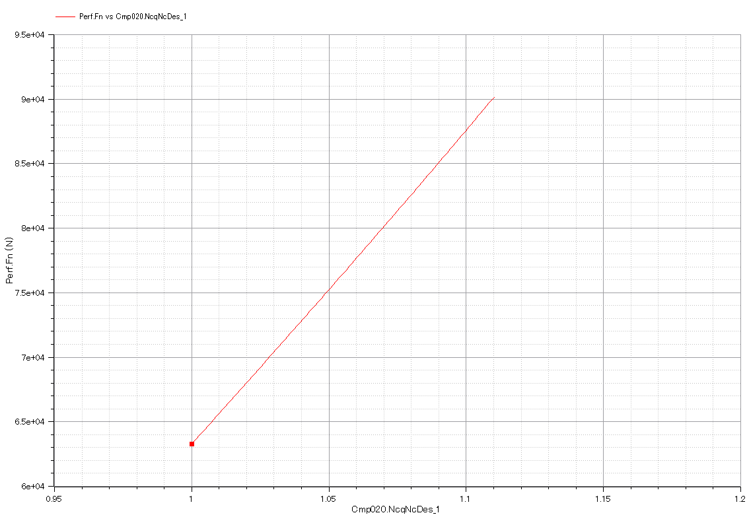

Slide 13
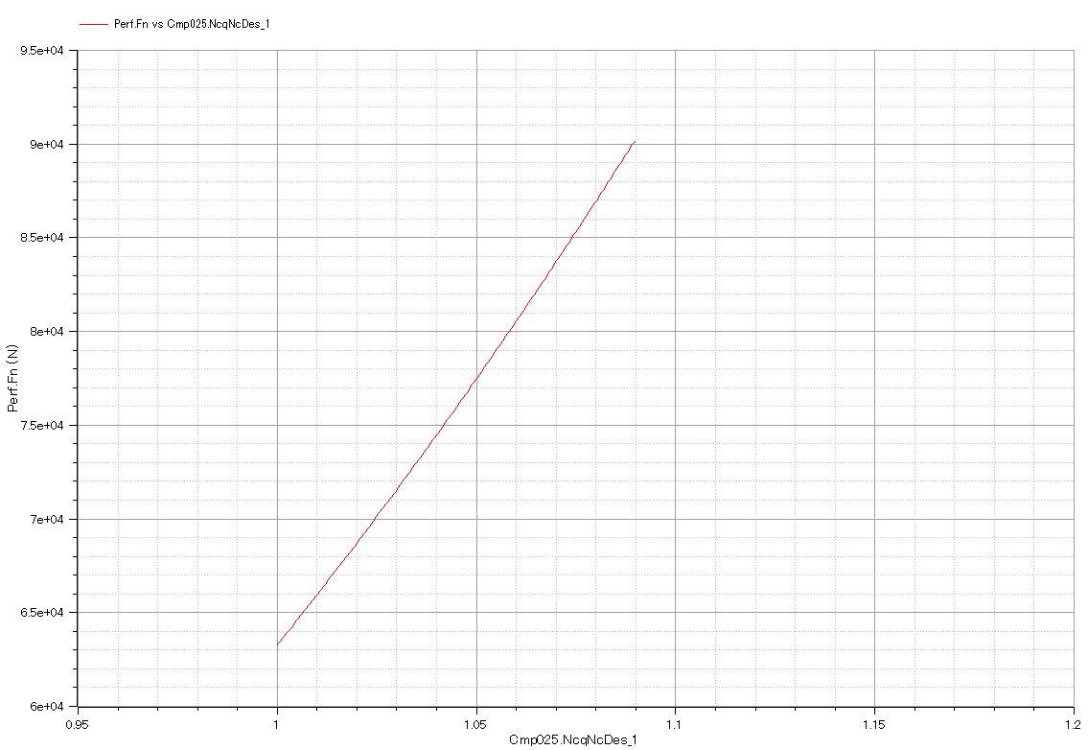

Slide 17
Input:

Slide 18
Output:
Output:

