Slide 1
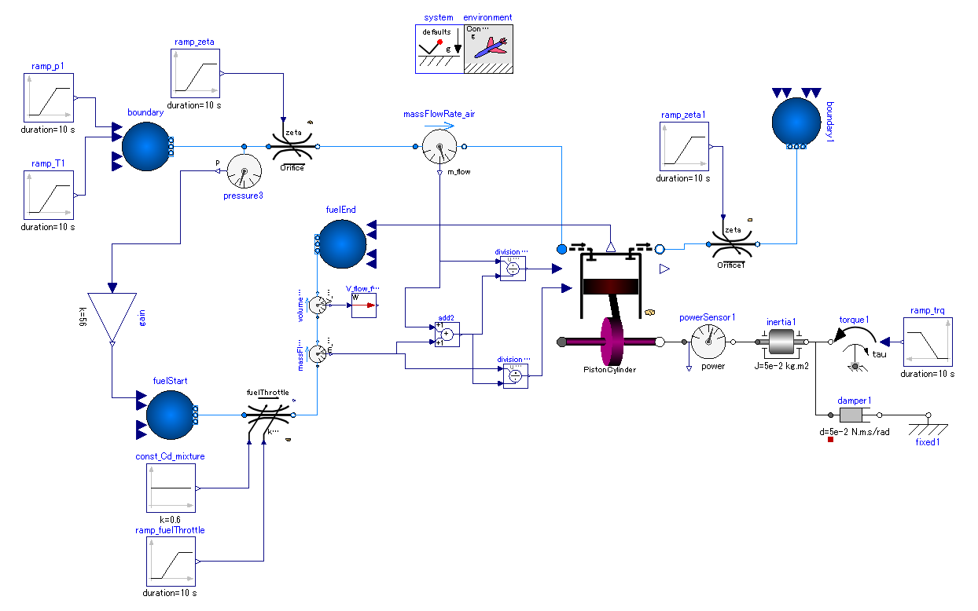

Slide 2
Controllable flow restriction.
The pressure loss coefficient can be manipulated by external real signal.
Inputs

