Slide 1
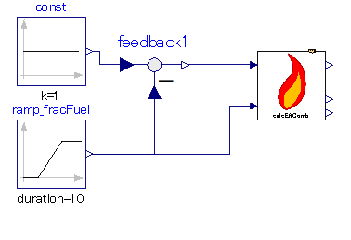

Slide 2
Combustion efficiency is calculated
Input: mass fraction of fuel and air.

