Slide 1
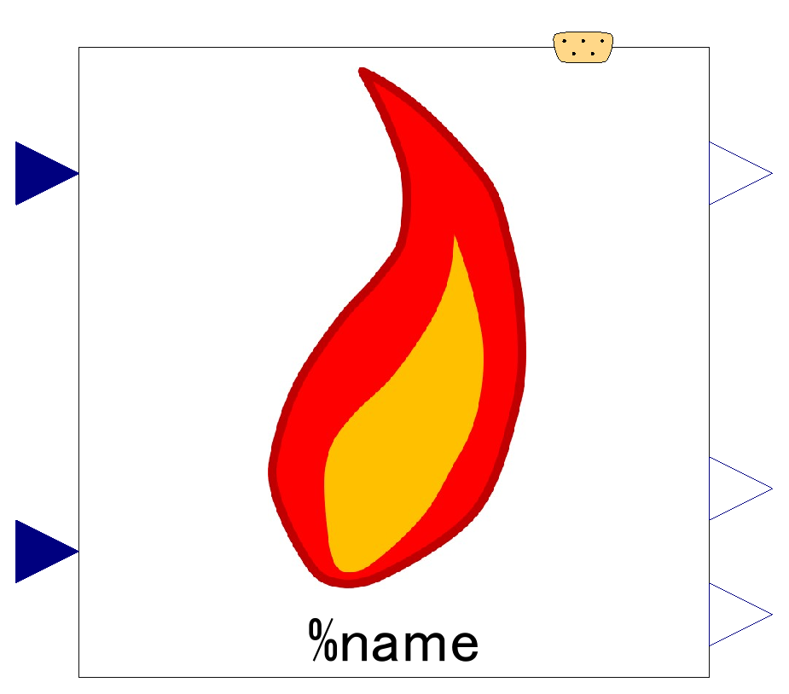

Slide 2
Expandable connector prepared for communication with internal variables which cannot be accessed by other connectors,
input&output (use “connect” operator)
Mass fraction of air; input
Combustion efficiency; output
Air-fuel ratio; output
Mass fraction of fuel; input
Equivalence air-fuel ratio; output

Slide 3

No internal component.
This component is made of internal variables and equations/algorithms

