Slide 1
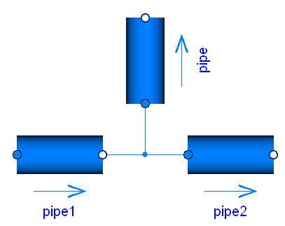




Overview and Rationale for
Modelica Stream Connectors
January 27, 2009
Revisions:
May 25, 2008 | by Martin Otter (DLR). First version. Presented at 57th Modelica Design Meeting
June 9, 2008 | by Martin Otter (DLR): Considerably improved version. Presented at EUROSYSLIB WP5.3 meeting
June 11, 2008 | by Martin Otter (DLR): Newly structured and considerably improved (after EUROSYSLIB meeting)
Jan. 27, 2009 | by Francesco Casella (Politecnico di Milano): Updated with changes in the final Modelica_Fluid release 1.0

Slide 2
Contents
Part A Overview
1. Stream Variables and Stream Operators
2. Modeling with Streams
Part B Rationale
3. Basic Problems of Fluid Connectors
4. Stream Connection Semantics
5. Reliable Handling of Ideal Mixing
6. Open Issues
7. Status
8. History and Contributors
Overview and Rationale for Stream Connectors - Page <number>

Slide 3
Part A Overview
At the 57th Modelica design meeting (May 25-28, 2008) a new fundamental type of connector variables "stream" was introduced for the next
Modelica Language Specification Version 3.1, because the two standard types of port variables used in all component oriented modeling systems
potential/flow, across/through, effort/flow variables
are not sufficient to model flow of matter in a reliable way.
Modelica_Fluid 1.0 is based on this new concept.
These slides give an introduction in to this new connector type and provide a rationale why it is introduced and the benefits of the concept.
Overview and Rationale for Stream Connectors - Page <number>

Slide 4
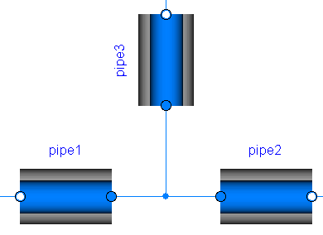
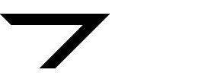
1. Stream Variables and Stream Operators
Purpose
Reliable handling of convective mass and energy transport in
thermo-fluid systems with bi-directional flow of matter.
Relevant boundary conditions and balance equations are fulfilled in a connection point.
(convective) transport of matter
mass and energy balance fulfilled
in the idealized connection point
Overview and Rationale for Stream Connectors - Page <number>

Slide 5
Examples of an interface for fluid components
p | absolute pressure | potential variable
m_flow | mass flow rate | flow variable (describes transport of matter)
h | specific enthalpy | stream variable (quantity transported with matter)
X_{i} | mass fraction | stream variable (quantity transported with matter)
{
A stream variable h_{i} of a connector i is associated with
a flow variable m_flow ("0 = Σ m_flow_{i}") and
a stream balance equation ("0 = Σ m_flow_{i}*<upstream value of h_{i}>")
Overview and Rationale for Stream Connectors - Page <number>

Slide 6
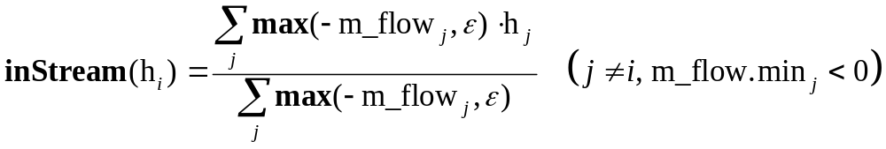
Reliable handling of bi-directional flow:
 | value of stream variable h_{i} in connector i
h_{i} | if flow from component to connection point (m_flow_{i} ≤ 0)
inStream(h_{i}) | if flow from connection point to component (m_flow_{i} > 0
actualStream(h_{i}) | for both flow directions (= if m_flow_{i} > 0 then instream(h_{i}) else h_{i}) only to be used when absolutely necessary(!)
inStream(h₂)
h₂
h₃
inStream(h₃)
h₁
inStream(h₁)
(mixing value for m_flow_{i} > 0)
Overview and Rationale for Stream Connectors - Page <number>

Slide 7
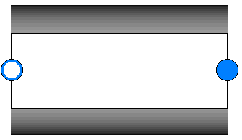
Example of a volume – pressure drop network
volume
pressure drop
pressure drop
volume
h₁
inStream(h₂)
h₃
inStream(h₄)
h₅
inStream(h₆)
inStream(h₁)
h₂
inStream(h₃)
h₄
inStream(h₅)
h₆
inStream(h1) = h2 = inStream(h3) = h4 = inStream(h5) = h6
inStream(h6) = h5 = inStream(h4) = h3 = inStream(h2) = h1
Energy balance in volume 1:
der(U₁) = m_flow₁*actualStream(h₁)
= m_flow₁*(if m_flow₁ > 0 then inStream(h₁) else h₁)
= m_flow₁*(if m_flow₁ > 0 then h₆ else h₁)
Overview and Rationale for Stream Connectors - Page <number>

Slide 8
2. Modeling with Streams
Connector definition:
connector FluidPort
SI = Modelica.SIunits;
SI.AbsolutePressure p "Pressure in connection";
flow SI.MassFlowRate m_flow "Mass flow rate";
stream SI.SpecificEnthalpy h_outflow "h if m_flow <= 0";
stream SI.MassFraction X_outflow[nX] "X if m_flow <= 0";
end FluidPort;
If a connector has one or more stream variables, exactly one (scalar) flow
variable must be present which is the flow associated with all stream variables.
Modeling with stream variables is very simple (see following examples)!
For notational convenience, the equations for the mass fractions X
are not shown in the following examples.
Overview and Rationale for Stream Connectors - Page <number>

Slide 9

Example: Mixing Volume
model MixingVolume "Volume that mixes two flows"
replaceable package Medium = Modelica.Media.Interfaces.PartialMedium;
FluidPort port_a, port_b;
parameter Modelica.SIunits.Volume V "Volume of device";
Modelica.SIunits.Mass m "Mass in device";
Modelica.SIunits.Energy U "Inner energy in device";
Medium.BaseProperties medium(preferredMediumStates=true);
equation
// Definition of port variables
port_a.p = medium.p;
port_b.p = medium.p;
port_a.h_outflow = medium.h;
port_b.h_outflow = medium.h;
// Mass and energy balance
m = V*medium.d;
U = m*medium.u;
der(m) = port_a.m_flow + port_b.m_flow;
der(U) = port_a.m_flow*actualStream(port_a.h_outflow) +
port_b.m_flow*actualStream(port_b.h_outflow);
end MixingVolume;
Overview and Rationale for Stream Connectors - Page <number>

Slide 10
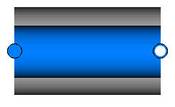
Example: Isenthalpic fluid transport
model IsenthalpicFlow "No energy storage/losses, e.g. pressure drop, valve, ..."
replaceable package Medium=Modelica.Media.Interfaces.PartialMedium;
FluidPort port_a, port_b:
Medium.ThermodynamicState port_a_state_inflow "State at port_a if inflowing";
Medium.ThermodynamicState port_b_state_inflow "State at port_b if inflowing";
equation
// Medium states for inflowing fluid
port_a_state_inflow = Medium.setState_phX(port_a.p,
inStream(port_a.h_outflow));
port_b_state_inflow = Medium.setState_phX(port_b.p,
inStream(port_b.h_outflow));
// Mass balance
0 = port_a.m_flow + port_b.m_flow;
// Instantaneous propagation of enthalpy flow between the ports with
// isenthalpic state transformation (no storage and no loss of energy)
port_a.h_outflow = inStream(port_b.h_outflow);
port_b.h_outflow = inStream(port_a.h_outflow);
// (Regularized) Momentum balance
port_a.m_flow = f(port_a.p, port_b.p,
Medium.density(port_a_state_inflow),
Medium.density(port_b_state_inflow));
end IsenthalpicFlow;
Overview and Rationale for Stream Connectors - Page <number>

Slide 11
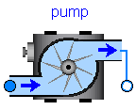
Example: Isentropic fluid transport
model IsenthalpicFlow "No energy storage, e.g. pump, heat losses, ..."
replaceable package Medium = Modelica.Media.Interfaces.PartialMedium;
FluidPort port_a, port_b:
Medium.ThermodynamicState port_a_state_inflow "State at port_a if inflowing";
Medium.ThermodynamicState port_b_state_inflow "State at port_b if inflowing";
Modelica.SIunit.Power P_ext "Energy flow via other connectors"
equation
// Medium states for inflowing fluid
port_a_state_inflow = Medium.setState_phX(port_a.p, inStream(port_a.h_outflow));
port_b_state_inflow = Medium.setState_phX(port_b.p, inStream(port_b.h_outflow));
// Mass balance
0 = port_a.m_flow + port_b.m_flow;
// Instantaneous propagation of enthalpy flow between the ports with
// isentropic state transformation
port_a.h_outflow = Medium.isentropicEnthalpy(port_a.p,inStream(port_b.h_outflow));
port_b.h_outflow = Medium.isentropicEnthalpy(port_b.p,inStream(port_a.h_outflow));
// Energy balanced to compute energy flow exchanged with other ports
0 = P_ext + port_a.m_flow*actualStream(port_a.h_outflow)
+ port_b.m_flow*actualStream(port_b.h_outflow);
// (Regularized) Momentum balance
port_a.m_flow = f(port_a.p, port_b.p, Medium.density(port_a_state_inflow),
Medium.density(port_b_state_inflow));
end IsenthalpicFlow;
Overview and Rationale for Stream Connectors - Page <number>

Slide 12

Example: Temperature sensor
model TemperatureSensor "Ideal temperature sensor"
replaceable package Medium = Modelica.Media.Interfaces.PartialMedium;
FluidPort port(m_flow(min=0)); // No flow out of sensor ever
Modelica.Blocks.Interfaces.RealOutput T "Upstream temperature";
equation
T = Medium.temperature(Medium.setState_phX(port.p, inStream(port.h_outflow));
port.m_flow = 0;
port.h_outflow = Medium.specificEnthalpy(Medium.setState_pTX(
Medium.reference_p, Medium.reference_T));
// This value will never be used, since m_flow(min=0),
// but it will show up in the plot window.
end TemperatureSensor;
Setting "m_flow.min=0" is very important, in order that the temperature sensor has
no influence on the stream that it measures, if all mass flow rates are zero; since then
"max(-port.m_flow,ε) = 0" in the inStream(..)-operators of the connected ports!!!
Overview and Rationale for Stream Connectors - Page <number>

Slide 13
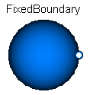
Example: Infinite Reservoir
model FixedBoundary_pT "Infinite reservoir with fixed pressure and temperature"
replaceable package Medium = Modelica.Media.Interfaces.PartialMedium;
FluidPort port;
parameter Medium.AbsolutePressure p "Boundary pressure";
parameter Medium.Temperature T "Boundary temperature";
equation
port.p = p;
port.h_outflow = Medium.specificEnthalpy(Medium.setState_pTX(p, T));
end FixedBoundary_pT;
Overview and Rationale for Stream Connectors - Page <number>

Slide 14
Part B Rationale
The following slides
provide a rationale, why reliable bi-directional flow modeling
requires a third type of connector variable (streams),
discusses details of the connection semantics of streams,
shows why stream connectors lead to reliable models.
Overview and Rationale for Stream Connectors - Page <number>

Slide 15
3. Basic Problems of Fluid Connectors
Desired connector for bi-directional flow of matter. The intensive quantities
transported with the matter (like h) have the newly introduced "stream" prefix:
connector FluidPort
import SI = Modelica.SIunits;
SI.AbsolutePressure p "Pressure in connection point";
flow SI.MassFlowRate m_flow "Mass flow rate";
stream SI.SpecificEnthalpy h "Specific enthalpy";
end FluidPort;
Observation
This is the most simplest connector description form for the desired class of models
(independently how the connected components are described, e.g. lumped,
discretized PDE, PDE, ...). It is very unlikely that a "simpler" connector exists.
Goal
Define connection semantic of stream variables, so that the balance equations
for stream variables in an infinitesimal small connection point are fulfilled and
the equations can be solved reliably.
Overview and Rationale for Stream Connectors - Page <number>

Slide 16
Central Question: What is the meaning of a stream variable, such as "h"?
Balance equations of stream variables for 3 connected components
(independently how the components are described, e.g. lumped, PDE, ...)
m2.h
m1.m_flow
m1.h
m3.h
h_mix
(1) 0 = m1.m_flow*(if m1.m_flow > 0 then h_mix else m1.h) +
m2.m_flow*(if m2.m_flow > 0 then h_mix else m2.h) +
m3.m_flow*(if m3.m_flow > 0 then h_mix else m3.h)
(2) 0 = m1.m_flow + m2.m_flow + m3.m_flow
From the balance equations, it seems natural that the stream variables are one
of the occurring variables, e.g., h_mix or m1.h
Overview and Rationale for Stream Connectors - Page <number>

Slide 17
but: then, the result will be of the form:
h_mix = if m1.m_flow > 0 then ... else ...
m1.h = if m1.m_flow > 0 then ... else ...
e.g. for 2 connected components:
h_mix = if m1.m_flow > 0 then m2.h else m1.h
this means that m1,h, m2.h, h_mix etc. are computed by equations
that contain if-clauses which depend on the mass flow rate.
If algebraic systems of equations occur (due to initialization, or ideal mixing,
or pressure drop components directly connected together etc.), then these equation systems, inevitably, have unknowns that depend on the unknown mass flow direction, i.e., nasty non-linear equation systems occur that are difficult to solve (since Boolean unknowns as iteration variables)!!!
Overview and Rationale for Stream Connectors - Page <number>

Slide 18
The issue appears even in the most simple case of
MixingVolume – PressureDrop – MixingVolume
connection, if the mass flow rate in the pressure drop does not only depend on pressure, but also on density as a function of the medium state:
mixing volume
mixing volume
h1,p1
pressure drop
h2,p1
h3,p4
h4,p4
m_flow
h2 = if m_flow > 0 then h4 else h1
h3 = h2; // !!!!!
d2 = f1(p1,h2) // density
d3 = f1(p4,h3)
m_flow = f2(p1, p4, d2, d3)
Note: Even for the most simplest case (volume – pressure drop – volume), a nasty non-linear equation system appears, since m_flow = f2(..., m_flow > 0);
Can sometimes be fixed by replacing "m_flow > 0" with "p4 - p1 > 0"
Overview and Rationale for Stream Connectors - Page <number>

Slide 19
Additionally, every pressure drop component is not differentiable
at m_flow = 0. If non-linear equation systems occur, then this system is
not differentiable at a critical point, and then every non-linear solver has difficulties.
mixing volume
mixing volume
h1,p1
pressure drop
h2,p1
h3,p4
h4,p4
m_flow
h2 = if m_flow > 0 then h4 else h1
h3 = h2; // !!!!!
d2 = f1(p1,h2) // density
d3 = f1(p4,h3)
m_flow = f2(p1, p4, d2, d3)
Major problem:
Independently of the flow direction: h3 = h2
m_flow > 0: m_flow = f2(..., d2(p1,h4), d3(p4,h4));
m_flow < 0: m_flow = f2(..., d2(p1,h1), d3(p4,h1));
However (see next slides): f2(..) must be a function of d2(p1,h1), d3(p1,h4) !!!
Overview and Rationale for Stream Connectors - Page <number>

Slide 20
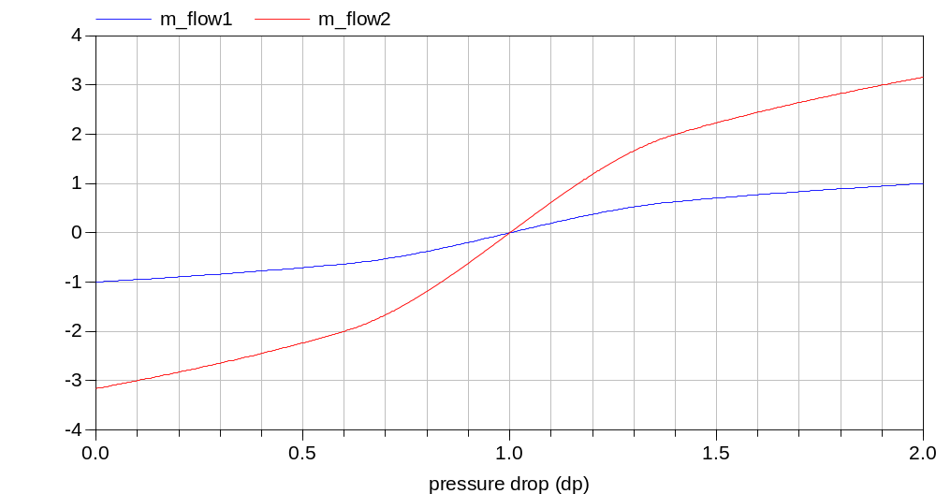
When m_flow > 0, dp > 0: The "blue" curve (m_flow1) is computed.
When m_flow < 0, dp < 0: The "red" curve (m_flow2) is computed.
When m_flow changes from positive to negative, the interpolation jumps from curve "blue" to "red". This means, that m_flow is not differentiable at m_flow = 0.
If m_flow appears in a non-linear equation system, this is not good, because the
pre-requisite of a non-linear solver is not fulfilled in the critical point at m_flow = 0!!!!
d(p1,h4)
d(p1,h1)
Overview and Rationale for Stream Connectors - Page <number>

Slide 21
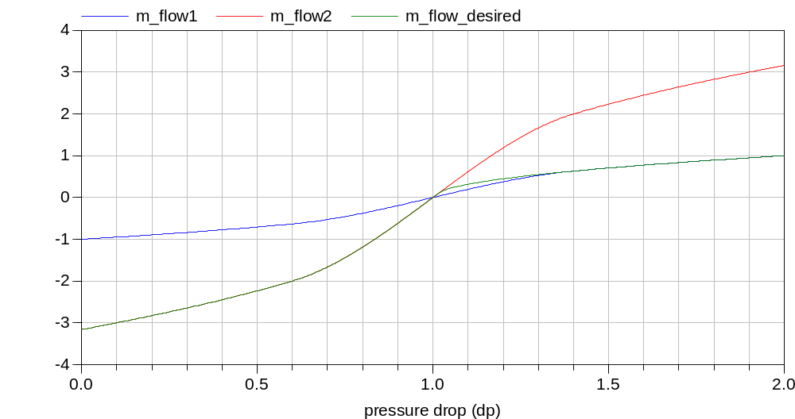
Correct treatment: m_flow = f2(..) is a function of d2(p1,h1), d3(p1,h4) !!!
d(p1,h4)
d(p1,h1)
In order that the correct f2(..) function is used ("green" curve),
the "density" of the "actual" flow (m_flow > 0) and
the "density" of the "reversed flow" (m_flow < 0) are needed
at the same time instant. Only then, regularization around m_flow = 0
is possible, leading to a smooth characteristic.
Overview and Rationale for Stream Connectors - Page <number>

Slide 22
Summary:
It is impossible to arrive at reliable, bi-directional flow models, if the actual
intensive quantities (like h_mix, h1, h2, ...) are used in the connector equations.
mixing volume
mixing volume
h1,p1
pressure drop
h2,p1
h3,p4
h4,p4
m_flow
Note, the only way to avoid the identified problems is to not compute
h_mix, m1.h, etc. Instead:
d2_outflow = f1(p1,h4) // flow from h4 to h1
d3_outflow = f1(p4,h1) // flow from h1 to h4
m_flow = f2(p1, p4, d2_outflow, d3_outflow)
Overview and Rationale for Stream Connectors - Page <number>

Slide 23
4. Stream Connection Semantics
Central idea:
compute value for "outflow" and
inquire value for "inflow" with operator "inStream(..)"
port_a.h_outflow
inStream(port_a.h_outflow)
port_a.h_outflow
port_b.h_outflow
instream(port_a.h_outflow
inStream(port_b.h_outflow)
Overview and Rationale for Stream Connectors - Page <number>

Slide 24
Basic connector definition
connector FluidPort
SI = Modelica.SIunits;
SI.AbsolutePressure p "Pressure in connection point";
flow SI.MassFlowRate m_flow "Mass flow rate";
stream SI.SpecificEnthalpy h_outflow "h close to port if m_flow < 0";
end FluidPort;
connect(pipe1.port_a, pipe2.port_b);
connect(pipe1.port_a, pipe3.port_b);
pipe1.port_a.p = pipe2.port_a.p
pipe1.port_a.p = pipe3.port_a.p
0 = pipe1.port_a.m_flow +
pipe2.port_a.m_flow +
pipe3.port_a.m_flow
pipe3.port_a.m_flow
pipe1.port_a.m_flow
pipe2.port_a.m_flow
No connection equations are
generated for stream variables (!)
pipe1.port_a.h_outflow
Overview and Rationale for Stream Connectors - Page <number>

Slide 25
balance equations
model : m1,m2,m3;
connector: c;
flow : m_flow
stream : h_outflow
(1) 0 = m1.c.m_flow*(if m1.c.m_flow > 0 then h_mix else m1.c.h_outflow) +
m2.c.m_flow*(if m2.c.m_flow > 0 then h_mix else m2.c.h_outflow) +
m3.c.m_flow*(if m3.c.m_flow > 0 then h_mix else m3.c.h_outflow)
(2) 0 = m1.c.m_flow + m2.c.m_flow + m3.c.m_flow
(1) 0 = max(m1.c.m_flow,0)*h_mix - max(-m1.c.m_flow,0)*m1.c.h_outflow +
max(m2.c.m_flow,0)*h_mix – max(-m2.c.m_flow,0)*m2.c.h_outflow +
max(m3.c.m_flow,0)*h_mix – max(-m3.c.m_flow,0)*m3.c.h_outflow
(2) 0 = max( m1.c.m_flow,0) + max( m2.c.m_flow,0) + max(m3.c.m_flow,0)
- max(-m1.c.m_flow,0) – max(-m2.c.m_flow,0) – max(m3.c.m_flow,0)
(3) h_mix = (max(-m1.c.m_flow,0)*m1.c.h_outflow +
max(-m2.c.m_flow,0)*m2.c.h_outflow +
max(-m3.c.m_flow,0)*m3.c.h_outflow) /
(max(m1.c.m_flow,0) +
max(m2.c.m_flow,0) +
max(m3.c.m_flow,0))
m3
m1
c.h_outflow
m2
mass balance
h_mix
(h for ideal mixing)
(4) h_mix = (max(-m1.c.m_flow,0)*m1.c.h_outflow +
max(-m2.c.m_flow,0)*m2.c.h_outflow +
max(-m3.c.m_flow,0)*m3.c.h_outflow) /
(max(-m1.c.m_flow,0) +
max(-m2.c.m_flow,0) +
max(-m3.c.m_flow,0))
Overview and Rationale for Stream Connectors - Page <number>

Slide 26
(4) h_mix = (max(-m1.c.m_flow,0)*m1.c.h_outflow +
max(-m2.c.m_flow,0)*m2.c.h_outflow +
max(-m3.c.m_flow,0)*m3.c.h_outflow) /
(max(-m1.c.m_flow,0) +
max(-m2.c.m_flow,0) +
max(-m3.c.m_flow,0))
Definition:
inStream(m1.c.h_outflow) = h_mix for m1.c.m_flow > 0
Reason:
This definition prepares for the changing flow direction at m1.c.m_flow = 0:
If only m1.c.m_flow is changing the flow direction, then
h_mix is discontinuous at m1.c.m_flow = 0.
However,
h_mix for m1.c.m_flow > 0 is continuous at m1.c.m_flow = 0
since m1.c.h_outflow does not appear in the equation, because for
inflowing flow, this variable does not influence the mixing and
the same formula is used also for the reversed direction!!!
Overview and Rationale for Stream Connectors - Page <number>

Slide 27
(4) h_mix = (max(-m1.c.m_flow,0)*m1.c.h_outflow +
max(-m2.c.m_flow,0)*m2.c.h_outflow +
max(-m3.c.m_flow,0)*m3.c.h_outflow) /
(max(-m1.c.m_flow,0) +
max(-m2.c.m_flow,0) +
max(-m3.c.m_flow,0))
Definition:
inStream(m1.c.h_outflow) = h_mix for m1.c.m_flow > 0
(5) inStream(m1.c.h_outflow) = (max(-m2.c.m_flow,0)*m2.c.h_outflow +
max(-m3.c.m_flow,0)*m3.c.h_outflow) /
(max(-m2.c.m_flow,0) + max(-m3.c.m_flow, 0))
≈ (max(-m2.c.m_flow,ε)*m2.c.h_outflow +
max(-m3.c.m_flow,ε)*m3.c.h_outflow) /
(max(-m2.c.m_flow,ε) + max(-m3.c.m_flow,ε))
For 2 connections:
(6) inStream(m1.c.h_outflow) = (max(-m2.c.m_flow,0)*m2.c.h_outflow /
max(-m2.c.m_flow,0)
= m2.c.h_outflow
For 3 connections with m3.c.m_flow.min=0 (One-Port Sensor):
(7) inStream(m1.c.h_outflow) = m2.c.h_outflow
(8) inSteram(m3.c.h_outflow) = (max(-m1.c.m_flow,0)*m1.c.h_outflow +
max(-m2.c.m_flow,0)*m2.c.h_outflow) /
(max(-m1.c.m_flow,0) + max(-m2.c.m_flow, 0))
Overview and Rationale for Stream Connectors - Page <number>

Slide 28
If all mass flow rates are zero, the stream balance equation is identically
fulfilled, independently of the values of h_mix, and mi.c.h_outflow.
Therefore, there are an infinite number of solutions.
The basic idea is to approximate the "max(..)" function to avoid this case:
(5) inStream(m1.c.h_outflow) = (max(-m2.c.m_flow,0)*m2.c.h_outflow +
max(-m3.c.m_flow,0)*m3.c.h_outflow) /
(max(-m2.c.m_flow,0) + max(-m3.c.m_flow, 0))
≈ (max(-m2.c.m_flow,ε)*m2.c.h_outflow +
max(-m3.c.m_flow,ε)*m3.c.h_outflow) /
(max(-m2.c.m_flow,ε) + max(-m3.c.m_flow,ε))
Then a unique solution of this equation always exists.
If all mass flow rates are identically to zero, the result is the mean value of
the involved specific enthalpies:
(6) inStream(m1.c.h_outflow) ≈ (max(-m2.c.m_flow,ε)*m2.c.h_outflow +
max(-m3.c.m_flow,ε)*m3.c.h_outflow) /
(max(-m2.c.m_flow,ε) + max(-m3.c.m_flow,ε))
= (ε*m2.c.h_outflow + ε*m3.c.h_outflow) / (ε + ε)
= (m2.c.h_outflow + m3.c.h_outflow) / 2
Overview and Rationale for Stream Connectors - Page <number>

Slide 29

The actual regularization is a bit more involved, in order that
an approximation is only used, if all mass flow rates are small,
the characteristic is continuous and differentiable
(max(.., ε) is continuous but not differentiable)
// Actual regularization for small mass flow rates
// Determine denominator s for exact computation
s := sum( max(-mj.c.m_flow,0) )
// Define a "small number" eps (nominal(v) is the nominal value of v)
eps := relativeTolerance*min(nominal(mj.c.m_flow))
// Define a smooth curve, such that alpha(s>=eps)=1 and alpha(s<=0)=0
// (using a polynomial of 3rd order)
alpha := smooth(1, if s > eps then 1 else
if s > 0 then (s/eps)^2*(3-2*(s/eps)) else 0);
// Define function positiveMax(v) as a linear combination of max(v,0)
// and of eps along alpha
positiveMax(-mj.c.m_flow) := alpha*max(-mj.c.m_flow,0) + (1-alpha)*eps;
// Use "positiveMax(..)" instead of "max(.., eps)" in the
// inStream(..) definition!
Overview and Rationale for Stream Connectors - Page <number>

Slide 30
5. Reliable Handling of Ideal Mixing
reference problem
"DryAirNasa" (ideal gas with f(p,T)) and
"FlueGasSixComponents" (mixture of ideal gases with 6 substances)
Detailed pipe friction correlations for the laminar and turbulent flow regimes
Ideal mixing point (no volume) in the connection point.
All the details are described in a report from M. Sielemann and M. Otter.
Only the major results are presented on the following slides.
Overview and Rationale for Stream Connectors - Page <number>

Slide 31
(Note: with a volume in the connection point there would be 2+6=8 state variables, i.e., an implicit DAE solver
would have 8 iteration variables).
Number of iteration variables for "FlueGasSixComponents"
(mixture of ideal gases with 6 substances)
22 | Modelica_Fluid (previous version; non-smooth iteration variables; no sim.)
6 | ThermoPower (non-smooth iteration variables)
3 | Modelica_Fluid (new version with "stream"; smooth iteration variables)
Overview and Rationale for Stream Connectors - Page <number>

Slide 32
Basic (previous) form of "pressure drop" component:
replaceable package Medium = Modelica.Media.Interfaces.PartialMedium;
Medium.BaseProperties medium_a_inflow;
Medium.BaseProperties medium_b_inflow;
equation
medium_a_inflow.p = port_a.p;
medium_b_inflow.p = port_b.p;
medium_a_inflow.h = inStream(port_a.h_outflow);
medium_b_inflow.h = inStream(port_b.h_outflow);
port_a.h_inflow = medium_a_inflow.h;
port_b.h_inflow = medium_b_inflow.h;
port_a_d_inflow = medium_a_inflow_d;
port_b_d_inflow = medium_b_inflow_d;;
If medium is not f(p.h), a non-linear equation system appears, in order to compute
medium_a_inflow.h from medium_a_inflow.T (and from the pressure).
For an ideal mixing point (or any other non-linear equation system), a tool will
therefore select T as iteration variable.
Overview and Rationale for Stream Connectors - Page <number>

Slide 33
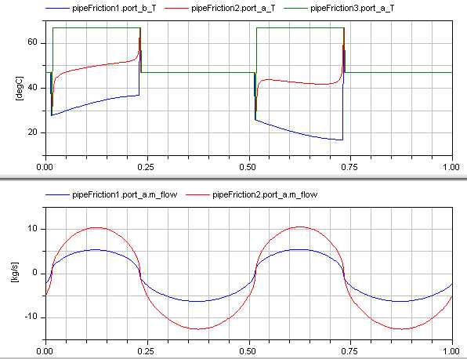
Severe disadvantage: Temperature is discontinuous and therefore the
iteration variable is discontinuous!!!
T as iteration variable
(discontinuous)
-> at m_flow = 0, jump
in iteration variable;
every non-linear solver
has difficulties with this.
m_flow as
iteration variable
(continuous)
Overview and Rationale for Stream Connectors - Page <number>

Slide 34
New form of "pressure drop" component:
replaceable package Medium = Modelica.Media.Interfaces.PartialMedium;
equation
port_a.h_outflow = inStream(port_b.h_outflow);
port_b.h_outflow = inStream(port_a.h_outflow);
port_a_state_inflow = Medium.setState_phX(
port_a.p, inStream(port_a.h_outflow),...);
port_b_state_inflow = Medium.setState_phX(
port_b.p, inStream(port_b.h_outflow),...);
port_a_inflow = Medium.density(port_a_state_inflow);
port_b_inflow = Medium.density(port_b_state_inflow);
If medium is not f(p.h), no (explicit) non-linear equation system appears, since the
medium state is computed from the known port properties.
However, the function "setState_phX" solves internally a non-linear equation system
(with Brents algorithm; a fast and very reliable algorithm to solve one non-linear
algebraic equation in one unknown).
Overview and Rationale for Stream Connectors - Page <number>

Slide 35
A tool can now compute all variables in a point with N connections from
N-1 mass flow rates and 1 pressure
in an explicit forward sequence and therefore selects these variables
as iteration variables (and these variables are always continuous):
The N-th mass flow rate is computed from the mass balance
The port-specific mixing enthalpies (h_mix(m_flow_i = 0)) can be computed, since they depend only on known variables
(enthalpies in the volumes and the mass flow rates).
The medium states can be computed via Medium.setState_phX(..),
since p,h,X are known now.
All medium properties can be computed from the medium state, especially the density.
Via the momentum balance, the mass flow rates can be computed
(= residue equations).
Analysis does also hold for initialization: With this approach, initialization will
work much better, since mass flow rates are selected as iteration variables.
A default start value of zero for mass flow rates is often sufficient for the solver.
Overview and Rationale for Stream Connectors - Page <number>

Slide 36
Summary
If the "streams" concept is used, and the pressure drop components are implemented as sketched in the previous slide, then an ideal mixing point with N connections gives rise to a non-linear system of algebraic equations
(if N > 2 and no min-attributes are set) that has the following properties:
The number of iteration variables is N (independent of the medium, and how many substances are in the medium).
The iteration variables are continuous everywhere
(since as iteration variables, N-1 mass flow rates and one pressure is used).
The iteration variables are in most cases differentiable
(due to the definition of stream-variables and of the inStream(..) operator).
The iteration variables are not differentiable, if all mass flow rates in an ideal mixing point become zero at the same time instant.
If this is not the case, they are differentiable.
Default start values of zero for the mass flow rates and for the pressure drop in the pressure drop components, are good guess values for the
iteration variables (independent of the medium).
It can therefore be expected that a solution of the equation system is easy
to compute by every reasonable non-linear equation solver.
Overview and Rationale for Stream Connectors - Page <number>

Slide 37
6. Open Issues
For a regular network of the usual "Volume – Pressure Drop – Volume"
structure a non-linear algebraic equation in one unknown is present for every connector of a pressure drop component, if the medium states are
not p,h,X. It seems possible to remove all these equation systems by clever symbolic analysis. This issue is not critical, because these scalar implicit equations can be solved reliably. The only issue is to enhance efficiency.
If components from discretized PDEs are connected together, there are two options with respect to the mathematical structure.
One option is to split the momentum balance between two components in two parts, leading to two half-momentum-balances on either side of the connection. This results in one non-linear algebraic equation in one unknown (the pressure) for every connection point, which can be numerically troublesome, expecially at initialization.
The other option is to split the mass and energy balances in two parts, leading to two half-mass-balances on either side of the connection. This results in a high-index problem. If the tool can handle the index reduction, the resulting equations can be solved reliably
Both options are available in the DistributedPipe model of Modelica_Fluid
Overview and Rationale for Stream Connectors - Page <number>

Slide 38
7. Status
Detailed specification text for Modelica 3.1 available
(Positive) voting for the specification text for inclusion in Modelica 3.1
Fully functional implementation in Dymola available (version 7.1 and later)
Work going on to implement the concept in OpenModelica and MathModelica
Final release of Modelica_Fluid library v.1.0 changed to new connector design
Detailed tests with sandbox libraries by Rüdiger Franke and Michael Sielemann
All examples of Modelica_Fluid simulate without problems
Initialization parameters removed from all pressure drop coefficients
(no longer needed, since m_flow used as iteration variable; default of m_flow.start = 0 is a good guess value; a better one can be provided via a parameter)
Plan: Tests in EUROSYSLIB with larger and realistic benchmarks.
Overview and Rationale for Stream Connectors - Page <number>

Slide 39
The tool requirements for "stream" support is very modest:
No special symbolic transformation algorithms needed!
Connection semantic is trivial:
Generate no connection equation for stream variables
The inStream(..) operator requires to analyze all corresponding stream-variables in a connection set (e.g. with respect to "min(..)" attributes).
A tool could decide to only support 1:1 connections in the beginning.
The inStream(..) operator is then trivial to implement.
Inside/outside connections (= hierarchical connections) complicate issues a bit (similarly to flow-variables), but nothing serious
Overview and Rationale for Stream Connectors - Page <number>

Slide 40
8. History and Contributors
2002:ThermoPower connectors by Francesco Casella
(this is the basis of the stream connector concept)
2002: First version of Modelica_Fluid that is refined until 2008.
Many basic concepts are from Hilding Elmqvist.
It was never possible to make the library reliable.
Jan. 2008: upstream(..) operator by Hilding Elmqvist
(triggered the further development)
Jan. 2008: new formulation of "ideal mixing" from Francesco Casella
(this is the basis of the inStream(..) operator)
March 2008: proposal of "stream" connectors by Rüdiger Franke
April 2008: refined proposal by Rüdiger Franke & Martin Otter,
prototype in Dymola by Sven Erik Mattsson,
improved definition of inside/outside connector by Hans Olsson,
test of the concept by Rüdiger Franke and Michael Sielemann,
reformulation to improve the numerics by M. Sielemann and M. Otter,
transformation of Modelica_Fluid to streams by M. Otter
May 2008: final proposal developed by Modelica fluid group at the
57th design meeting and (positive) vote for inclusion in Modelica 3.1.
Jan 2009: Modelica_Fluid 1.0 released, based on stream connectors
Overview and Rationale for Stream Connectors - Page <number>

