Slide 1
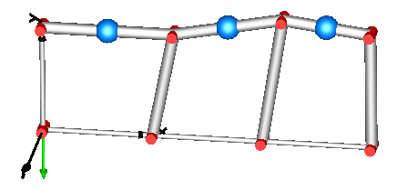
Figure used in:
Modelica.Mechanics.MultiBody.Examples.Loops.PlanarLoops_analytic
rv
r1b
r2b
r3b
rh
rh
rh

