Slide 1
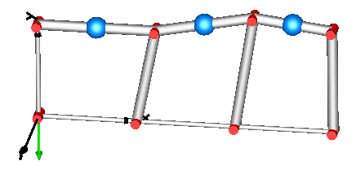
rv
r1b
r2b
r3b
rh
rh
rh

