Slide 1
A Library for Synchronous Control Systems in Modelica
Martin Otter Bernhard Thiele Hilding Elmqvist
DLR Dassault Systèmes
Institute of System Dynamics and Control
Presented at the Modelica’2012 Conference Munich, Sept. 3-5, 2012 This slide set has be updated to the changes of the library performed after the conference.

Slide 2
Content
Introduction
Clocks
Sample and Hold
Sub- and Super-sampling
Discretizing Continuous Blocks
Modelica_DeviceDrivers library
Conclusions

Slide 3
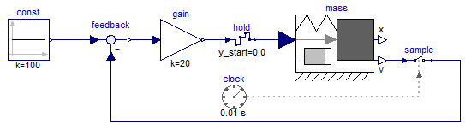
Introduction
Synchronous language elements of Modelica 3.3 are “low level”:
Modelica_Synchronous library developed to access language elements in a convenient way graphically:
// speed sensor
vd = sample(v, Clock(0.01));
// P controller for speed
u = K*(vref-vd);
// force actuator
f = hold(u);

Slide 4
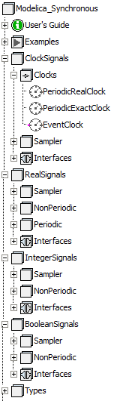
Blocks to generate clock signals
Blocks operating on clock signals (e.g. sub-sampling a clock signal)
Blocks operating on clocked signals of type Real (e.g. sub-sampling a Real signal, PI block, FIR filter)
Blocks operating on clocked signals of type Integer
Blocks operating on clocked signals of type Boolean

Slide 5


Clocks
New base data type: Clock
Variables associated to a clock have only a value at the clock tick.
r(t_{i})
c(t_{i}): Clock
r(t_{i}): Variable associated to c
c(t_{i})
t₀
t₁
t₂
t₃
time t
Similar to Real, Integer, Boolean, introduced input/output Clock connectors:
connector ClockInput = input Clock;
connector ClockOutput = output Clock;

Slide 6
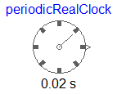
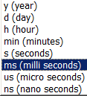
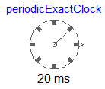

Blocks that generate clock signals
Generates a periodic clock with a Real period
parameter Modelica.SIunits.Time period;
ClockOutput y;
equation
y = Clock(period);
Generates a periodic clock as an integer multiple of a resolution (defined by an enumeration).
Code for 20 ms period:
y = superSample(Clock(20), 1000);
Clock with period 20 s
super-sample clock with 1000
period = 20 / 1000 = 20 ms
Generates an event clock: The clock ticks whenever the continuous-time Boolean input changes from false to true.
y = Clock(u);

Slide 7
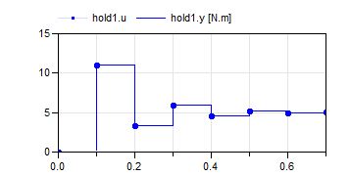
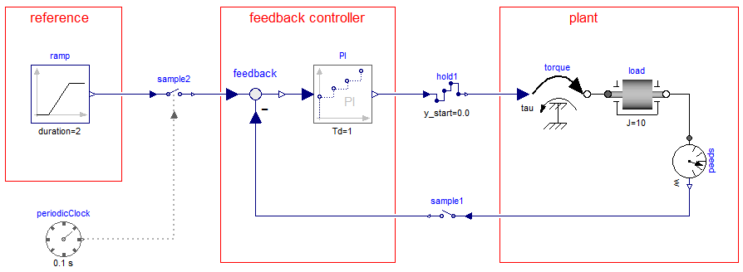
Sample and Hold
Holds a clocked signal and generates a continuous-time signal. Before the first clock tick, the continuous-time output y is set to parameter y_start; y = hold(u);
Discrete-time PI controller
Samples a continuous-time signal and generates a clocked signal.
Purely algebraic block from Modelica.Blocks.Math
y = sample(u, clock);
y = sample(u);

Slide 8
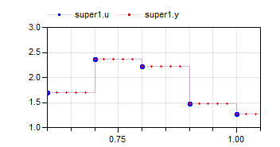
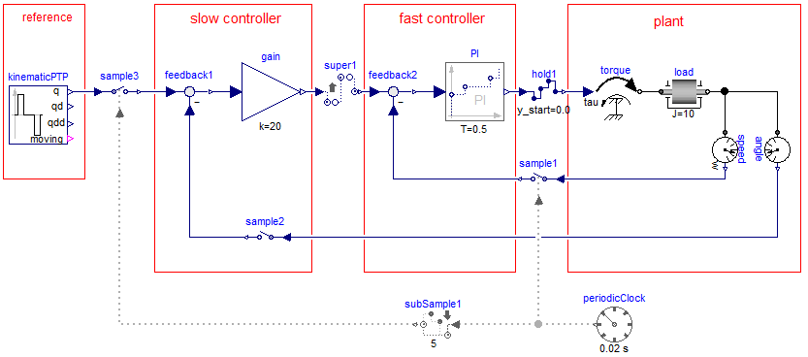
Sub- and Super-Sampling
Defines that the output signal is an integer factor faster as the input signal, using a “hold” semantics for the signal. By default, this factor is inferred. It can also be defined explicitly.
y = superSample(u);

Slide 9
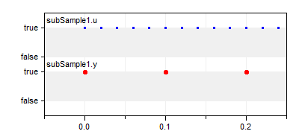
Defines that the output signal is an integer factor slower as the input signal, picking every n-th value of the input.
y = subSample(u,factor);

Slide 10
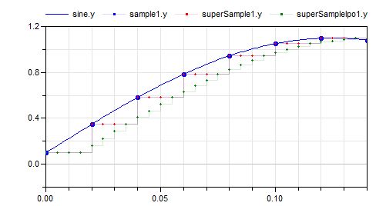
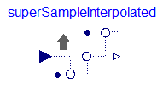
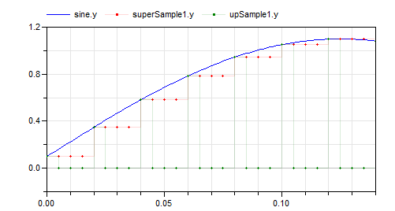
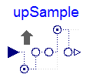
Several other blocks to change the clock of a signal, such as

Slide 11
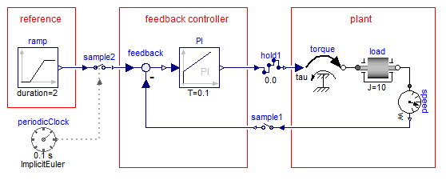
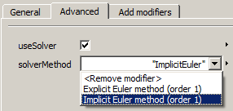
Discretizing Continuous Blocks
A clocked partition can consists of differential equations, provided an integrator is associated to the corresponding clock (the differential equations are solved at one clock tick with this integrator).
Continuous-time PI controller

Slide 12
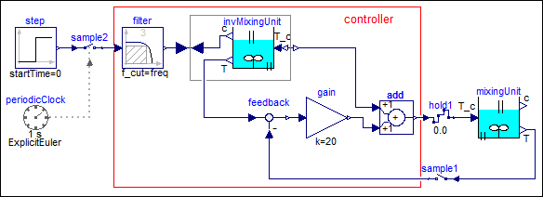
Especially, inverse, continuous-time models can be discretized (this is not possible with Modelica 3.2):
clocked controller
inverse plant model (input T_c becomes output output c becomes input)

Slide 13
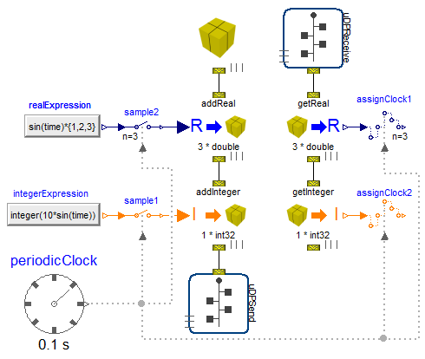
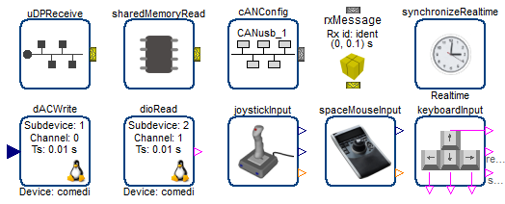
Modelica_DeviceDrivers library
New, free library by DLR that interfaces hardware drivers.
Cross platform (Windows and Linux)
Realtime synchronization, UDP, joystick, keyboard, etc.
Basic functionality provided with Modelica functions.
Convenience blocks based either on Modelica_Synchronous library or on Modelica 3.1 when-clauses.
Generic packaging system, e.g. to pack 8 Booleans on 1 Integer.
Currently supported for UDP, shared memory, and (prototypical) CAN bus

Slide 14
Conclusions (1)
Modelica_Synchronous library
Main purpose: Encapsulating the Modelica 3.3 synchronous language elements with an easy to use graphical user interface (the code of most blocks is very simple!!) Makes definition of sampled-data systems much simpler and safer.
Should work with every Modelica tool that supports Modelica 3.3.
Shall be included in the Modelica Standard Library after an evaluation period.
Available for MA members on internal svn server. Released version is stored publicly on MA web.

Slide 15
Conclusions (2)
Modelica_DeviceDrivers library
Main purpose: Access device drivers on Windows and Linux PCs from a Modelica block.
Should work with every Modelica tool that supports external Modelica functions (with C-code included in include annotation) synchronous elements of Modelica 3.3 (for Modelica 3.3 conveníence blocks).
Shall be included in the Modelica Standard Library after an evaluation period.
Available for MA members on internal svn server. Released version is stored publicly on MA web.

